Slide 1

Augustas Bastys
When Microservices Don't Make Sense
Lessons From Consolidating 10 Microservices Into 2 Monoliths + 1 Microservice

Slide 2


Slide 3
The Core Message
Use Technology Where It Solves Real Problems

Slide 4









Why Choose Microservices?
Independent Teams
Independent Deployments
Independent Scaling
Each team owns a set of services and can develop them independently.
Deploy individual components rapidly without the need of a full system deployment.
Scale specific high-traffic services precisely according to compute and resource demand.

Slide 5
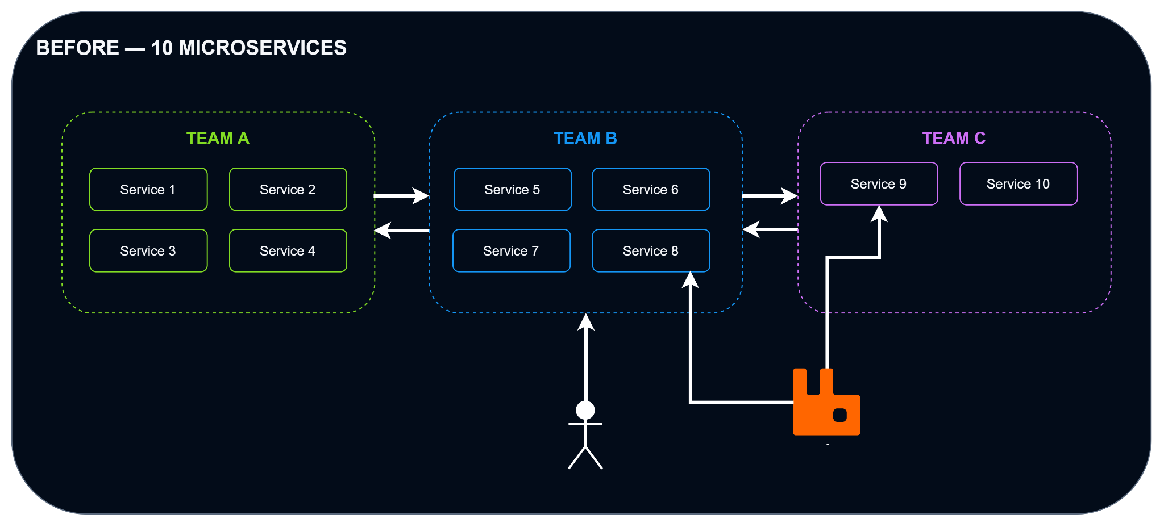
Our Architecture Journey

Slide 6
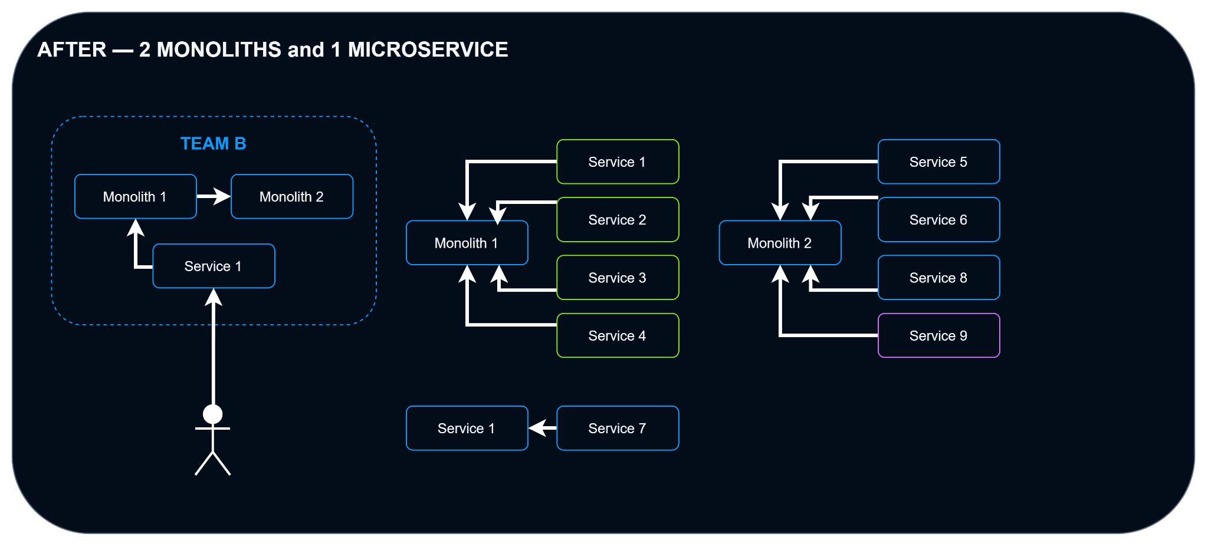
Our Architecture Journey

Slide 7
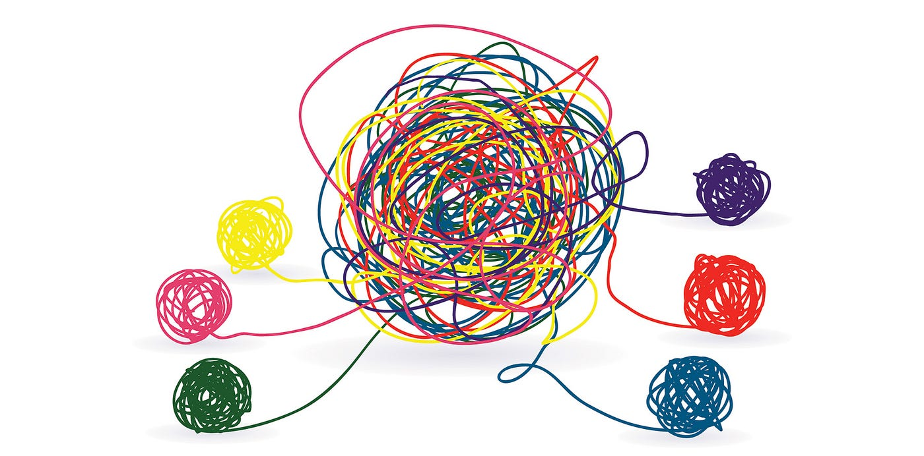
Why Did We Migrate?
We Wanted To Simplify The System

Slide 8
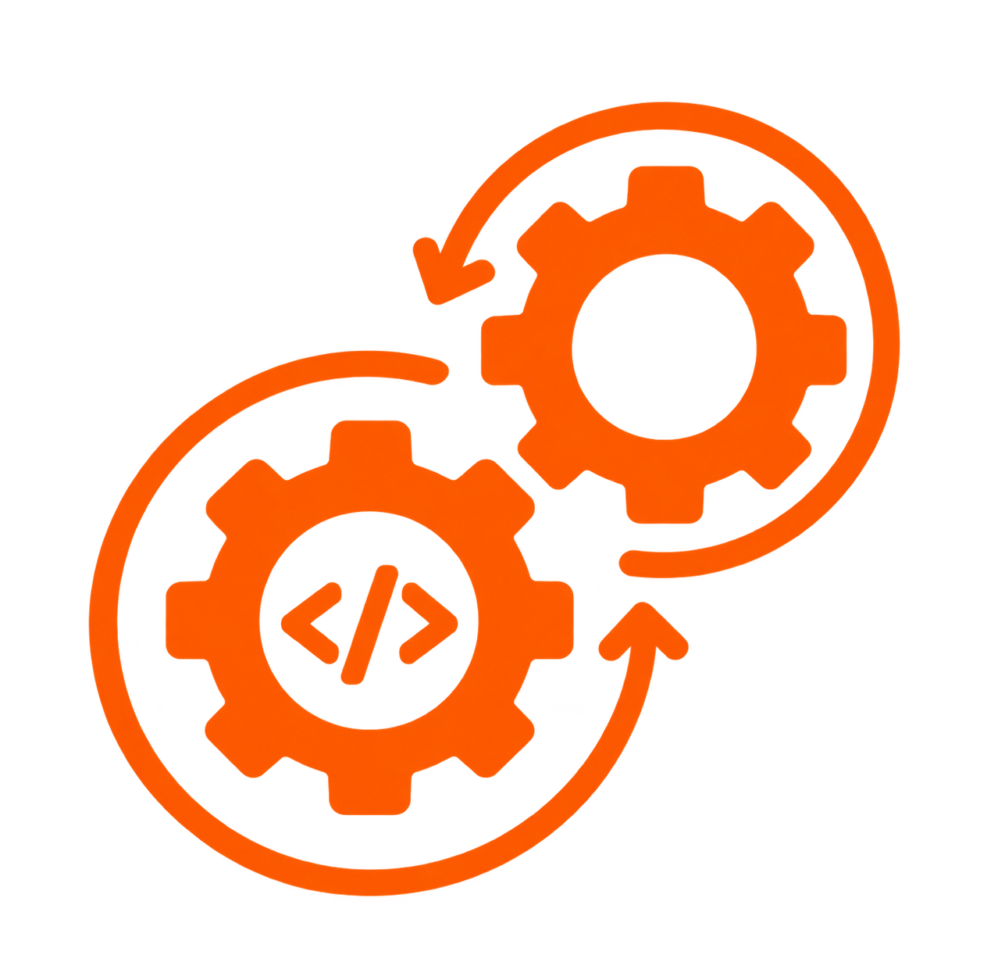

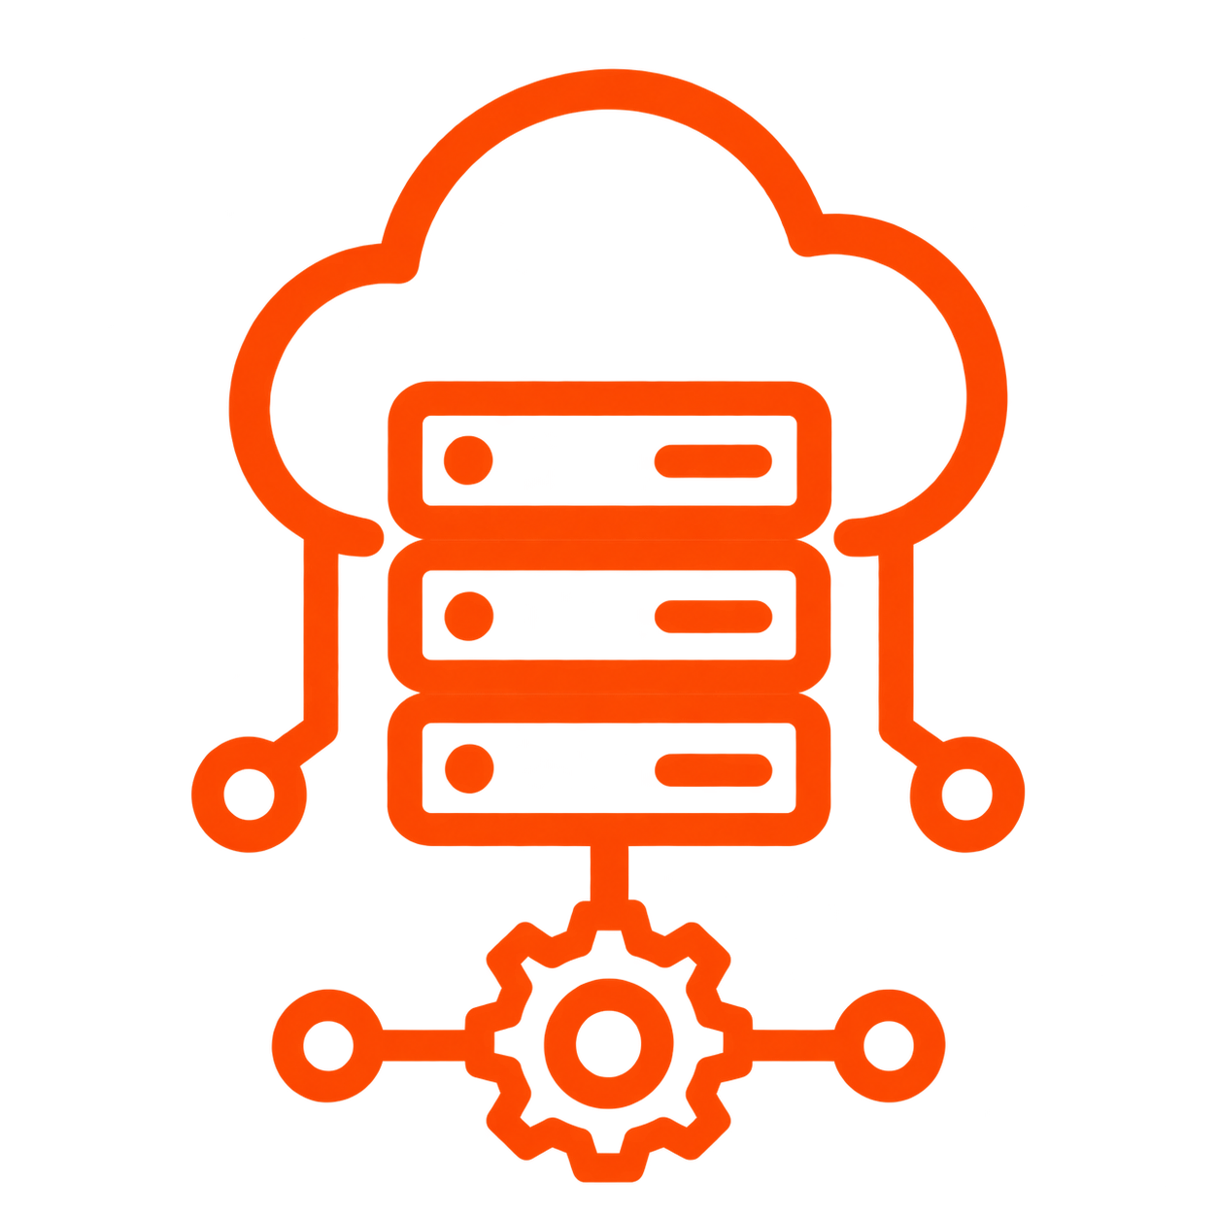

Why Did We Migrate?
The Benefits
CI/CD
Debugging
Infrastructure
RabbitMQ

Slide 9
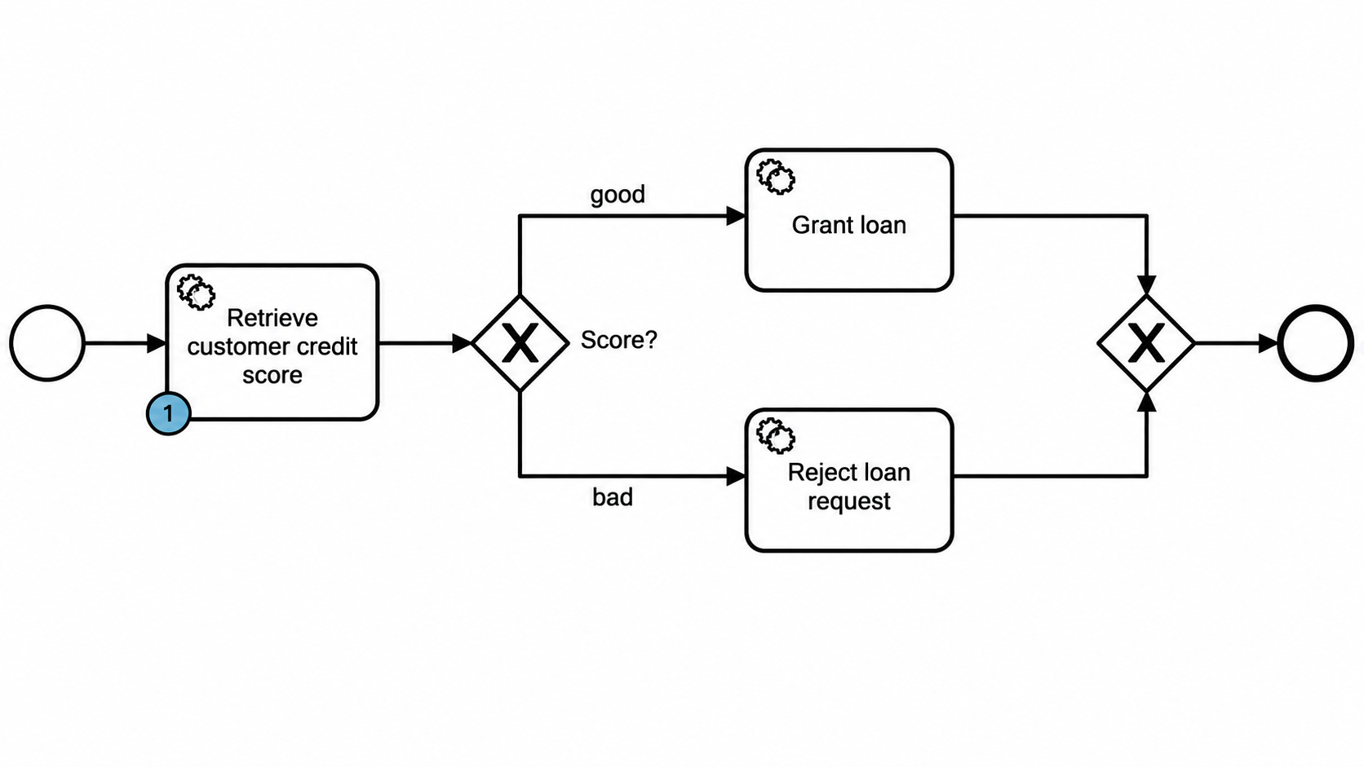
How Did We Migrate?
Feature by Feature migration

Slide 10
Why Choose Microservices?
Independent Teams
Independent Deployments
Independent Scaling
Each team owns a set of services and can develop them independently.
Deploy individual components rapidly without the need of a full system deployment.
Scale specific high-traffic services precisely according to compute and resource demand.

Slide 11

Reality #1 — Independent Teams
Actual Reality
Independent Teams
Some features required team B to help out team A. After going live with the product, the three teams became one.
Each team owns a set of services and can develop independently.

Slide 12
Reality #2 — Independent Deployments
Actual Reality
Independent Deployments
Some pipelines weren't working reliably.
Changing CI/CD providers meant rewriting them.
Deploy individual components rapidly without the need of full system deployment.

Slide 13
Reality #3 — Independent Scaling
Actual Reality
Independent Scaling
Our production traffic never justified independent horizontal scaling of individual services.
Scale specific high-traffic services precisely according to compute and resource demand.

Slide 14



When Do Microservices Make Sense?
Truly Independent Domains
Sustained High Traffic
Divergent Tech Stack Needs
Clear domain boundaries with minimal cross-domain calls and dedicated team ownership.
Scale needs that exceed single-monolith hardware limits or require specialized compute engines.
Services requiring specific tech stacks, runtime environments, or compliance isolation.

Slide 15
Choose An Architecture Based On Today's Requirements.
Microservices Solve Real Problems - But Only When Those Problems Actually Exist.

Slide 16
Questions & Discussion
Thank You For Listening!
Augustas Bastys

