Slide 1
Rx Java intro
Vaidas Kriščeliūnas

Slide 2
Why we use RxJava?
Easier multithreading
Operation composition
Error handling
Testability

Slide 3
Agenda
Rx Java components
Samples
  Basics
  Operation composition
  Error handling
  Testing
Common mistakes

Slide 4
Rx Java components
Observable
Observer
Disposable
Scheduler
Observable.create(ObservableOnSubscribe<T>)
public interface ObservableOnSubscribe<T> {
void subscribe(@NonNull ObservableEmitter<T> emitter) throws Exception;
}
public interface Emitter<T> {
void onNext(@NonNull T value);
void onError(@NonNull Throwable error);
void onComplete();
}

Slide 5
Rx Java components
Observable
Observer
Disposable
Scheduler
Observable.just(T item)
Observable.fromCallable(Callable<T>)
Observable.fromIterable(Iterable)
Observable.fromArray(Array)
Observable.defer(Callable<Observable<T>)
Observable.error(Throwable)
Observable.empty()
Observable.never()

Slide 6
Rx Java components
Observable
Observer
Disposable
Scheduler
public interface Observer<T> {
void onSubscribe(@NonNull Disposable disposable);
void onNext(@NonNull T t);
void onError(@NonNull Throwable error);
void onComplete();
}

Slide 7
Rx Java components
Observable
Observer
Disposable
Scheduler
Observable.just("sample")
.subscribe(new Observer<String>() {
@Override
public void onSubscribe(Disposable d) {
}
@Override
public void onNext(String s) {
}
@Override
public void onError(Throwable e) {
}
@Override
public void onComplete() {
}
});

Slide 8
Rx Java components
Observable
Observer
Disposable
Scheduler
Observable.just("sample")
.subscribe(new Consumer<String>() {
@Override
public void accept(String s) throws Exception {
}
}, new Consumer<Throwable>() {
@Override
public void accept(Throwable throwable) throws Exception {
}
}, new Action() {
@Override
public void run() throws Exception {
}
}, new Consumer<Disposable>() {
@Override
public void accept(Disposable disposable) throws Exception {
}
});

Slide 9
Rx Java components
Observable
Observer
Disposable
Scheduler
Observable.just("sample")
.subscribe(s -> {
}, throwable -> {
}, () -> {
}, disposable -> {
});

Slide 10
Rx Java components
Observable
Observer
Disposable
Scheduler
Observable.just("sample")
.subscribe(s -> {
// onNext
}, throwable -> {
// onError
}, () -> {
// onComplete
}, disposable -> {
// onSubscribe
});
Observable.just("sample")
.subscribe(s -> {
// onNext
}, throwable -> {
// onError
}, () -> {
// onComplete
});
Observable.just("sample")
.subscribe(s -> {
// onNext
}, throwable -> {
// onError
});
Observable.just("sample")
.subscribe(s -> {
// onNext
});
Observable.just("sample")
.subscribe();

Slide 11
Rx Java components
Observable
Observer
Disposable
Scheduler
public interface Disposable {
void dispose();
boolean isDisposed();
}
Disposables.disposed()
Disposables.empty()

Slide 12
Rx Java components
Observable
Observer
Disposable
Scheduler
Observable.just("sample")
.subscribe(s -> {
// onNext
}, throwable -> {
// onError
}, () -> {
// onComplete
}, disposable -> {
// onSubscribe
});
Disposable disposable = Observable.just("sample")
.subscribe(s -> {
// onNext
}, throwable -> {
// onError
}, () -> {
// onComplete
});

Slide 13
Rx Java components
Observable
Observer
Disposable
Scheduler
Provider schedulers
Schedulers.io()
Schedulers.computation()
Schedulers.single()
Schedulers.trampoline()
Schedulers.newThread()
Custom
Schedulers.from(Executor)
Observable.fromCallable(() -> "some result")
.subscribeOn(Schedulers.io())
.observeOn(Schedulers.computation());

Slide 14
Sample #1 Android Sample data loading
@Override
public void onViewCreated(@NonNull View view, @Nullable Bundle savedInstanceState) {
super.onViewCreated(view, savedInstanceState);
new Thread(() -> {
User user = service.loadUser();
showUserOnUi(user);
}).start();
}
private void showUserOnUi(User user) {
// do something with user
}
public interface SyncUserService {
User loadUser();
}

Slide 15
Sample #1 Android Sample data loading
@Override
public void onViewCreated(@NonNull View view, @Nullable Bundle savedInstanceState) {
super.onViewCreated(view, savedInstanceState);
new Thread(() -> {
User user = service.loadUser();
showUserOnUi(user); // NEEDS UI THREAD
}).start();
}
private void showUserOnUi(User user) {
// do something with user
}
public interface SyncUserService {
User loadUser();
}

Slide 16
Sample #1 Android Sample data loading
private Handler handler = new Handler(); // runs tasks on UI thread
@Override
public void onViewCreated(@NonNull View view, @Nullable Bundle savedInstanceState) {
super.onViewCreated(view, savedInstanceState);
new Thread(() -> {
User user = service.loadUser();
handler.post(() -> showUserOnUi(user)); // I FIX
}).start();
}

Slide 17
Sample #1 Android Sample data loading
private Handler handler = new Handler();
@Override
public void onViewCreated(@NonNull View view, @Nullable Bundle savedInstanceState) {
super.onViewCreated(view, savedInstanceState);
new Thread(() -> {
User user = service.loadUser();
handler.post(() -> showUserOnUi(user));
}).start();
}
What if user closes screen?

Slide 18
Sample #1 Android Sample data loading
private Handler handler = new Handler();
@Override
public void onViewCreated(@NonNull View view, @Nullable Bundle savedInstanceState) {
super.onViewCreated(view, savedInstanceState);
new Thread(() -> {
User user = service.loadUser();
handler.post(() -> {
if (isAdded()) { // I FIX AGAIN
showUserOnUi(user);
}
});
}).start();
}

Slide 19
Sample #1 Android Sample data loading
@Override
public void onViewCreated(@NonNull View view, @Nullable Bundle savedInstanceState) {
super.onViewCreated(view, savedInstanceState);
Observable.fromCallable(() -> service.loadUser()); // create source stream
}

Slide 20
Sample #1 Android Sample data loading
@Override
public void onViewCreated(@NonNull View view, @Nullable Bundle savedInstanceState) {
super.onViewCreated(view, savedInstanceState);
Observable.fromCallable(() -> service.loadUser())
.subscribe(user -> showUser(user)); // observe stream
}

Slide 21
Sample #1 Android Sample data loading
@Override
public void onViewCreated(@NonNull View view, @Nullable Bundle savedInstanceState) {
super.onViewCreated(view, savedInstanceState);
Observable.fromCallable(() -> service.loadUser())
.subscribeOn(Schedulers.io()) // add work scheduler for stream
.subscribe(user -> showUser(user));
}

Slide 22
Sample #1 Android Sample data loading
@Override
public void onViewCreated(@NonNull View view, @Nullable Bundle savedInstanceState) {
super.onViewCreated(view, savedInstanceState);
Observable.fromCallable(() -> service.loadUser())
.subscribeOn(Schedulers.io())
.observeOn(AndroidSchedulers.mainThread()) // add observe scheduler
.subscribe(user -> showUser(user));
}

Slide 23
Sample #1 Android Sample data loading
private Disposable disposable = Disposables.disposed(); // observe handle
@Override
public void onViewCreated(@NonNull View view, @Nullable Bundle savedInstanceState) {
super.onViewCreated(view, savedInstanceState);
disposable = Observable.fromCallable(() -> service.loadUser())
.subscribeOn(Schedulers.io())
.observeOn(AndroidSchedulers.mainThread())
.subscribe(user -> showUser(user));
}
@Override
public void onDestroyView() {
disposable.dispose();
super.onDestroyView();
}

Slide 24
Sample #1 Android Sample data loading
private Disposable disposable = Disposables.disposed();
@Override
public void onViewCreated(@NonNull View view, @Nullable Bundle savedInstanceState) {
super.onViewCreated(view, savedInstanceState);
disposable = Observable.fromCallable(() -> service.loadUser())
.subscribeOn(Schedulers.io())
.observeOn(AndroidSchedulers.mainThread())
.subscribe(user -> showUser(user), throwable -> { /* handle error */});
}
@Override
public void onDestroyView() {
disposable.dispose();
super.onDestroyView();
}

Slide 25
Sample #2 Converting listeners to streams
public interface LocationListener {
void onLocationChange(Location location);
}
public interface LocationService {
void addListener(LocationListener listener);
void dropListener(LocationListener listener);
}

Slide 26
Sample #2 Converting listeners to streams
private LocationListener locationListener = location -> updateLocation(location);
@Override
public void onStart() {
super.onStart();
locationService.addListener(locationListener);
}
@Override
public void onStop() {
locationService.dropListener(locationListener);
super.onStop();
}

Slide 27
Sample #2 Converting listeners to streams
public Observable<Location> observe(LocationService service) {
return Observable.create(emitter -> {
service.addListener(location -> emitter.onNext(location));
});
}

Slide 28
Sample #2 Converting listeners to streams
public Observable<Location> observeLocation(LocationService service) {
return Observable.create(emitter -> {
LocationListener locationListener = location -> emitter.onNext(location);
service.addListener(locationListener);
emitter.setCancellable(() -> service.dropListener(locationListener));
});
}

Slide 29
Sample #2 Converting listeners to streams
private Disposable disposable = Disposables.disposed();
@Override
public void onStart() {
super.onStart();
disposable = observeLocation(locationService).subscribe(location -> updateLocation(location));
}
@Override
public void onStop() {
disposable.dispose();
super.onStop();
}

Slide 30
Sample #3 Combining streams
public interface ContactApi {
Observable<List<Contact>> fetchContacts();
}
public interface ContactDatabase {
Observable<List<Contact>> loadContacts();
Observable<List<Contact>> saveContacts(List<Contact> contacts);
}

Slide 31
Sample #3 Combining streams
private ContactDatabase contactDatabase;
private ContactApi contactApi;
public Observable<List<Contact>> contactSource() {
return contactApi.fetchContacts()
.flatMap(contacts -> contactDatabase.saveContacts(contacts));
}

Slide 32
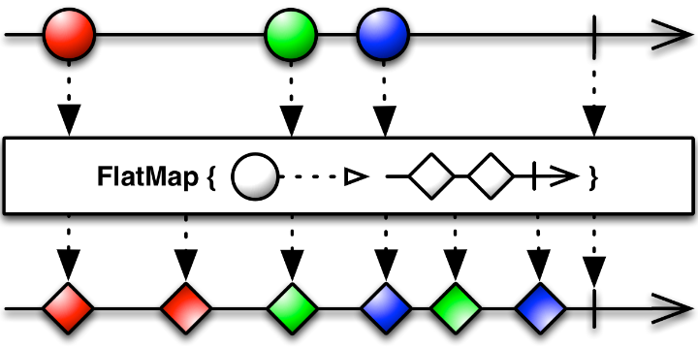
Sample #3 Combining streams

Slide 33
Sample #3 Combining streams
private ContactDatabase contactDatabase;
private ContactApi contactApi;
public Observable<List<Contact>> contactSource() {
return contactApi.fetchContacts()
.flatMap(contacts -> contactDatabase.saveContacts(contacts))
.mergeWith(contactDatabase.loadContacts());
}

Slide 34
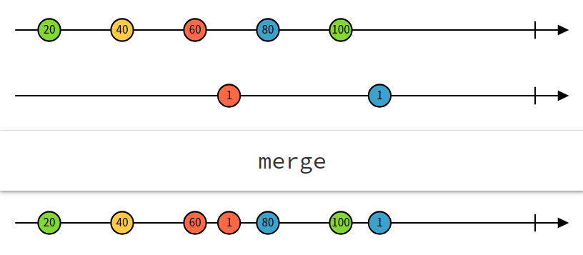
Sample #3 Combining streams

Slide 35
Sample #3 Combining streams
public interface RxLocationService {
Observable<Location> locationSource();
Location lastLocation();
}
public class Contact {
public final String name;
public final Location location;
}
public class DistanceContact {
public final String name;
public final double distance;
}

Slide 36
Sample #3 Combining streams
private RxLocationService locationService;
private ContactDatabase contactDatabase;
private ContactApi contactApi;
public Observable<List<DistanceContact>> contactSource() {
return contactApi.fetchContacts()
.flatMap(contacts -> contactDatabase.saveContacts(contacts))
.mergeWith(contactDatabase.loadContacts())
.map(contacts -> toDistanceContacts(contacts, locationService.lastLocation()));
}
List<DistanceContact> toDistanceContacts(List<Contact> contacts, Location location)

Slide 37
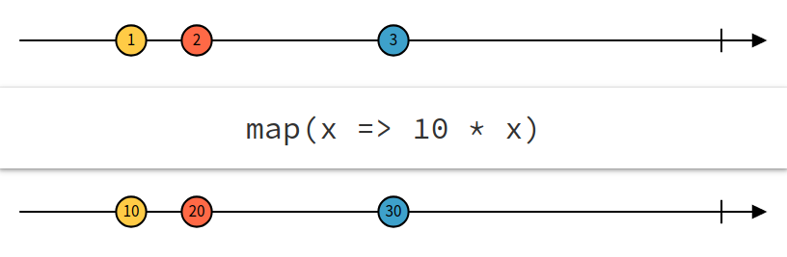
Sample #4 Combining streams

Slide 38
Sample #3 Combining streams
private RxLocationService locationService;
private ContactDatabase contactDatabase;
private ContactApi contactApi;
public Observable<List<DistanceContact>> contactSource() {
Observable<List<Contact>> contactSource = contactApi.fetchContacts()
.flatMap(contacts -> contactDatabase.saveContacts(contacts))
.mergeWith(contactDatabase.loadContacts());
return Observable.combineLatest(
contactSource,
locationService.locationSource(),
(contacts, location) -> toDistanceContacts(contacts, location)
);
}
List<DistanceContact> toDistanceContacts(List<Contact> contacts, Location location)

Slide 39
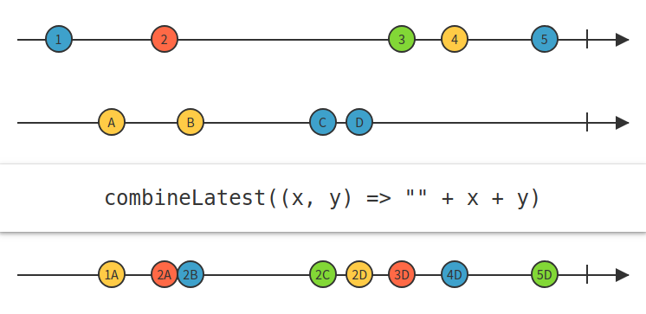
Sample #3 Combining streams

Slide 40
Sample #4 Source testing
public interface TimeProvider {
long currentTime();
}
private TimeProvider timeProvider;
private Scheduler scheduler;
public Observable<Long> timeUpdates() {
return Observable.interval(0, 500, TimeUnit.MILLISECONDS, scheduler)
.map(interval -> timeProvider.currentTime());
}

Slide 41
Sample #4 Source testing
public interface TimeProvider {
long currentTime();
}
private TimeProvider timeProvider;
private Scheduler scheduler;
public Observable<Long> timeUpdates() {
return Observable.interval(0, 500, TimeUnit.MILLISECONDS, scheduler)
.map(interval -> timeProvider.currentTime());
}

Slide 42
Sample #4 Source testing
@Test
public void timeUpdates_returns_time_every_500ms() {
TimeProvider timeProvider = Mockito.mock(TimeProvider.class);
Mockito.when(timeProvider.currentTime()).thenReturn(1L, 2L, 3L);
TestScheduler scheduler = new TestScheduler();
SourceSample sourceSample = new SourceSample(timeProvider, scheduler);
}

Slide 43
Sample #4 Source testing
@Test
public void timeUpdates_returns_time_every_500ms() {
TimeProvider timeProvider = Mockito.mock(TimeProvider.class);
Mockito.when(timeProvider.currentTime()).thenReturn(1L, 2L, 3L);
TestScheduler scheduler = new TestScheduler();
SourceSample sourceSample = new SourceSample(timeProvider, scheduler);
TestObserver<Long> testObserver = sourceSample.timeUpdates().test();
testObserver.assertNoValues();
}

Slide 44
Sample #4 Source testing
@Test
public void timeUpdates_returns_time_every_500ms() {
TimeProvider timeProvider = Mockito.mock(TimeProvider.class);
Mockito.when(timeProvider.currentTime()).thenReturn(1L, 2L, 3L);
TestScheduler scheduler = new TestScheduler();
SourceSample sourceSample = new SourceSample(timeProvider, scheduler);
TestObserver<Long> testObserver = sourceSample.timeUpdates().test();
testObserver.assertNoValues();
scheduler.triggerActions();
testObserver.assertValue(1L);
}

Slide 45
Sample #4 Source testing
@Test
public void timeUpdates_returns_time_every_500ms() {
TimeProvider timeProvider = Mockito.mock(TimeProvider.class);
Mockito.when(timeProvider.currentTime()).thenReturn(1L, 2L);
TestScheduler scheduler = new TestScheduler();
SourceSample sourceSample = new SourceSample(timeProvider, scheduler);
TestObserver<Long> testObserver = sourceSample.timeUpdates().test();
testObserver.assertNoValues();
scheduler.triggerActions();
testObserver.assertValue(1L);
scheduler.advanceTimeBy(500, TimeUnit.MILLISECONDS);
testObserver.assertValues(1L, 2L);
}

Slide 46
Sample #4 Observer testing
public interface TimeDisplay {
void displayTime(long time);
}
private Disposable disposable = Disposables.disposed();
private SourceSample source;
private TimeDisplay display;
public void start() {
disposable.dispose();
disposable = source.timeUpdates().subscribe(time -> display.displayTime(time));
}
public void stop() {
disposable.dispose();
}

Slide 47
Sample #4 Observer testing
@Before
public void setUp() {
timeDisplay = Mockito.mock(TimeDisplay.class);
sourceSample = Mockito.mock(SourceSample.class);
observerSample = new ObserverSample(sourceSample, timeDisplay);
}

Slide 48
Sample #4 Observer testing
@Before
public void setUp() {
timeDisplay = Mockito.mock(TimeDisplay.class);
sourceSample = Mockito.mock(SourceSample.class);
observerSample = new ObserverSample(sourceSample, timeDisplay);
}
@Test
public void start_displays_source_sample_time_updates_to_timeDisplay() {
Mockito.when(sourceSample.timeUpdates()).thenReturn(Observable.just(14L));
observerSample.start();
Mockito.verify(timeDisplay).displayTime(14L);
}

Slide 49
Sample #4 Observer testing
@Test
public void stop_stops_observing_time_updates() {
TestScheduler scheduler = new TestScheduler();
Mockito.when(sourceSample.timeUpdates())
.thenReturn(Observable.just(14L).subscribeOn(scheduler));
observerSample.start();
observerSample.stop();
scheduler.triggerActions();
Mockito.verifyZeroInteractions(timeDisplay);
}

Slide 50
Questions?

