Slide 1

Term Deposit Prediction Case Study
Jacob Macdonald
June 27, 2019

Slide 2
Background & Problem Statement
Term deposits are an effective mechanism for financial institutions to obtain funds they can invest in ventures with higher rates of return.
By subscribing more customers to term deposits, banks have the opportunity to increase profits.
The goal of this work was to develop a model to predict, in advance, which bank clients would be receptive to marketing campaigns for term deposits.

Slide 3

Data Set: Source
The data set for this work was downloaded from the UC Irvine Machine Learning Respository.
It describes the results of marketing campaigns for term deposits conducted over phone by a Portuguese banking institution from May 2008 to Nov. 2010.
This data set is a modification of the data previously reported on by Moro et al.¹
Moro et al. Decision Support Systems. 62 (2014).

Slide 4
Data Set: Contents
Two versions of the data set were available:
Full set (41,188 examples)
Randomly sampled set (4119 examples)
Both sets had the same 20 features in three broad categories.
Client Information
Previous Contact Information
Economic Indicators
Output: “Has the client subscribed to a term deposit?”
Yes: 437
No: 3682

Slide 5
Data Cleaning: Approach
All cleaning, model development, and analysis was performed with Python in Jupyter Notebook.
Data cleaning featured four steps:
Removing redundant data
Removing features leaking information from the future
Correcting or removing missing data
Formatting data for model compatibility

Slide 6
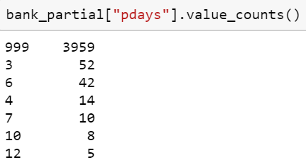
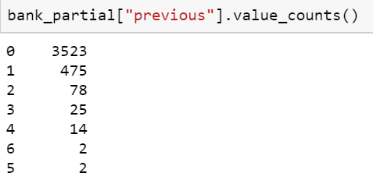
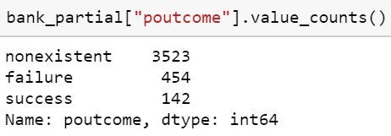
Data Cleaning: Redundant Data
1. Removing redundant data
There were no duplicate rows in the data set.
Three features contained redundant information:
Days since contact for previous campaign
Number of previous contacts with client
Outcome of previous marketing contact

Slide 7
Data Cleaning: Redundant Data
2. Removing features leaking information from the future
Since we want to predict clients we should target in advance, features that cannot be known in advance should be removed.
Two features were removed for leaking information from the future:
Duration: Duration of last phone call
Campaign: Number of contacts performed for client

Slide 8
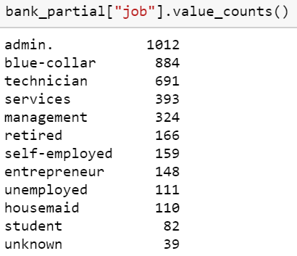
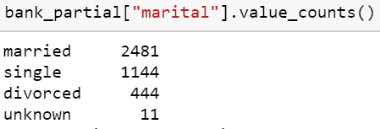
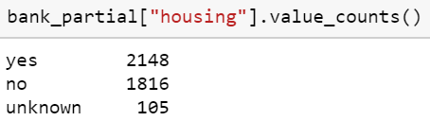
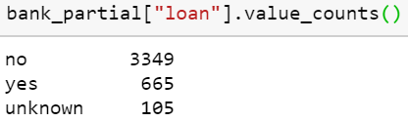
Data Cleaning: Redundant Data
3. Correcting or removing missing data
Missing data was recorded as “unknown” in the data set.
For many parameters, only a small subset was unknown and could not be imputed.
These cases were removed.
Job description
Marital status
Housing loan with bank?
Other loan with bank?
3% of data set

Slide 9
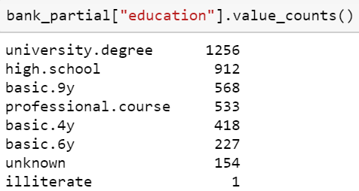
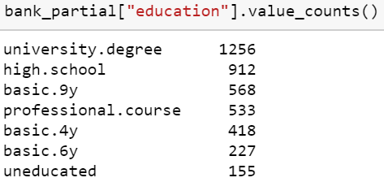
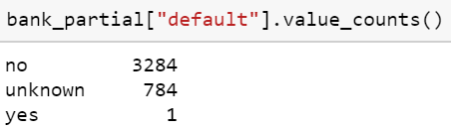
Data Cleaning: Redundant Data
3. Correcting or removing missing data
The education feature had a fair amount of unknown values (>150).
These missing values were grouped with ‘illiterate’ to form an ‘uneducated’ group.
The default feature was removed due to lack of variance in the data.
Credit in default?

Slide 10
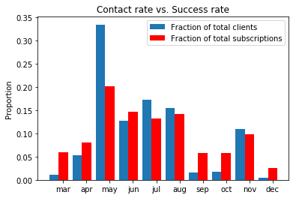

Data Cleaning: Redundant Data
4. Formatting data for model compatibility
All continuous numeric data was scaled using a standard scaler.
Categorial variables were transformed to (k-1) binary dummy variables.
“Month” was transformed to k dummy variables given missing information.
$$z=\frac{x−μ}{s}$$

Slide 11
Model Implementation: Model Selection
Four classification models were investigated:
Logistic regression
Neural Network (Multi-layer perceptron)
Random Forest
Support Vector Machine
A grid search was used to find the optimal model based on F1 scoring.
Prioritizes precision and recall.
Logistic Regression
Solver
Class weight
Warm start
Neural Network
# Hidden layers
Hidden layer nodes
Warm start
Random Forest
# Decision trees
Max depth
Max features
Min samples per leaf
Warm start
Support Vector Machine
Kernel
Class weight

Slide 12
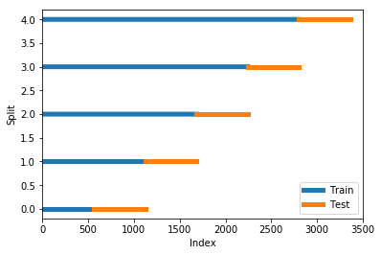
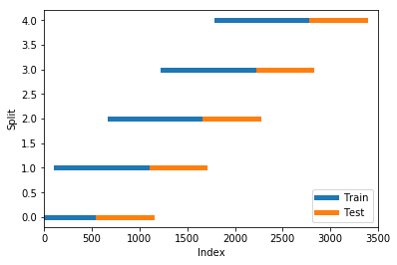
Model Implementation: Train/Test Sets
The last 600 clients were removed from the data set to be used as a test set (≈15%).
Propensity for term deposits may change over time, so time series approaches should be used to further divide training and validation data.
Two approaches were investigated for cross-validation on the training set.
Expanding Window
Sliding Window

Slide 13
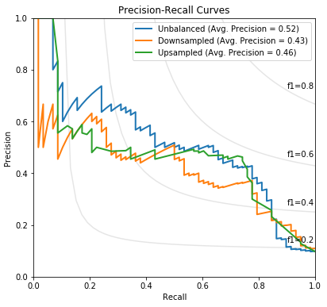
Model Implementation: Accounting for Imbalance
The models were applied to three versions of the training set:
Original, unbalanced classes
SVM (F1 = 0.46)
Upsampled subscriber class
RF (F1 = 0.66)
Downsampled non-subscriber class
RF (F1 = 0.69)
Test Data Results
The resampled classes led to poor model generalization.

Slide 14
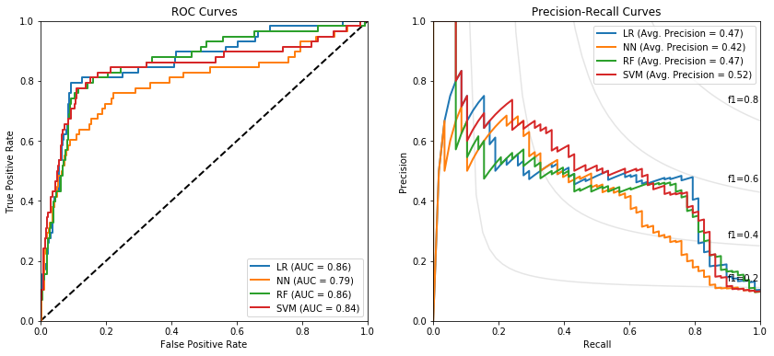
Model Implementation: Test Performance
The performance of the best models on this test data is shown below.

Slide 15
Model Recommendation
Best model
Logistic Regression
Balanced class weights
‘liblinear’ solver
F1 score: 0.60
Precision: 0.48
Recall: 0.79
Alternative
SVM
Balanced class weights
Polynomial kernel
Prior Baseline
10 % success rate

