Slide 1

Deep dive on Halo 2
Daira Hopwood (@feministPLT)
Ying Tong Lai (@therealyingtong)
https://github.com/daira/halographs
(deepdive.odp)
Notes:
To correctly and efficiently express statements for many popular zero knowledge argument systems, we need to understand Rank 1 Constraint Systems. This talk is based on experience optimizing the circuits for Zcash's Sapling protocol upgrade. It aims to teach some of the background needed to:
* design higher-level cryptographic protocols with efficient R1CS implementation in mind,
* specify a statement precisely enough to be able to tell whether it has been correctly implemented;
* understand the R1CS model of computation;
* express various algorithms and types commonly used in cryptography;
* optimize circuit size while reducing the risk of introducing bugs and vulnerabilities.
We concentrate on direct expression of circuits as R1CS, rather than how this would be written in a particular domain-specific language or library.

Slide 2
Outline
Halo 2
  Polynomial circuits and PLONK
  Polynomial commitments
  Recursion and proof-carrying data
Constructing 2-cycles of elliptic curves
  Obstacles to finding cycles of curves
  Complex multiplication to the rescue
  2-adicity
Optimizations
  Scalar multiplication
  Fiat–Shamir and duplex sponges
  Hashes (Sinsemilla and Rescue).

Slide 3
Halo
Halo 2 is like Halo but with a different arithmetization
circuit
arithmetization:
SONIC
polynomials
commitment
scheme
accumulation
scheme

Slide 4
Halo 2
Halo 2 is like Halo but with a different arithmetization
circuit
arithmetization:
SONIC PLONK
polynomials
commitment
scheme
accumulation
scheme

Slide 5
Halo 2
circuit
arithmetization:
PLONK
polynomials
commitment
scheme
accumulation
scheme

Slide 6
Halo 2 and PLONK arithmetization
Any generic proof system needs an “arithmetization”, which is a way of expressing statements as relations between variables.
Halo 2 uses the PLONK [GWC2020] (ia.cr/2020/953) arithmetization, which is slightly different from R1CS.
In R1CS, each constraint is A × B = C, where A, B, and C are linear combinations.
PLONK generalises this to addition gates and public inputs using “selector polynomials”:
q_{L} · x_{a} + q_{R} · x_{b} + q_{O} · x_{c} + q_{M} · (x_{a}x_{b}) + q_{C} = 0

Slide 7
Halo 2 and PLONK arithmetization
q_{L} · x_{a} + q_{R} · x_{b} + q_{O} · x_{c} + q_{M} · (x_{a}x_{b}) + q_{C} = 0
Row | x_{a} | x_{b} | x_{c} | q_{L} | q_{R} | q_{O} | q_{M} | q_{C}
0 | a₀ | b₀ | c₀ | 1 | 1 | -1 | 0 | 0
1 | a₁ | b₁ | c₁ | 0 | 0 | -1 | 1 | 0
2 | PI | 0 | 0 | 1 | 0 | 0 | 0 | -PI
3 | x | x | 0 | -1 | 0 | 0 | 1 | 0
a₀ + b₀ = c₀ (addition)
a₁ × b₁ = c₁ (multiplication)
x_{a} = PI (public input)
x ∈ {0, 1} (booleanity)

Slide 8
PLONK permutation check
PLONK additionally introduces a permutation check to enforce “copy” operations between constraints.
Suppose we have a toy circuit with two addition gates:
Row | x_{a} | x_{b} | x_{c} | q_{L} | q_{R} | q_{O} | q_{M} | q_{C}
0 | a₀ | b₀ | c₀ | 1 | 1 | -1 | 0 | 0
1 | a₁ | b₁ | c₁ | 1 | 1 | -1 | 0 | 0
a₀
+
c₀
b₀
a₁
+
c₁
b₁
{a₀, a₁, b₀, b₁, c₀, c₁}

Slide 9
PLONK permutation check
We want to enforce that c₀ is “copied” to a₁.
We can do this by enforcing that the following two permutations are equal:
V = {a₀, a₁, b₀, b₁, c₀, c₁}
σ(V) = {a₀, c₀, b₀, b₁, a₁, c₁}
In other words: c₀ = a₁ iff V = σ(V) for permutation σ = (14)
a₀
+
c₀
b₀
a₁
+
c₁
b₁

Slide 10
PLONK permutation check
V = {a₀, a₁, a₂, b₀, b₁, b₂, c₀, c₁, c₂}
σ = (02)(156)
a₂
a₀
+
c₂
+
c₀
b₂
b₀
a₁
×
c₁
b₁
Row | x_{a} | x_{b} | x_{c} | q_{L} | q_{R} | q_{O} | q_{M} | q_{C}
0 | a₀ | b₀ | c₀ | 1 | 1 | -1 | 0 | 0
1 | a₁ | b₁ | c₁ | 0 | 0 | -1 | 1 | 0
2 | a₂ | b₂ | c₂ | 1 | 1 | -1 | 0 | 0

Slide 11
PLONK permutation check
Permutation σ: [n] → [n] over multiplicative subgroup {1, ω, ω², …, ω^{n-1}} (where ω^{n} = 1, ω^{n-k} = ω^{k})
Prover has sent f ∈ 𝔽_{n}[X] and wants to prove f = σ(f):
∀i ∈ [n], f(ω^{i}) = f(ω^{σ(i)})
Define two permutation polynomials (which should be equal for a valid permutation):
f’ = f + β · f_{ID} + γ,
g’ = f + β · f_{σ} + γ,
Compute their grand products:
Z_{f}(X) s.t. Z_{f}(1) = 1, Z_{f}(ω^{i}) = ∏ _{j<i} f’(ω^{j})
Z_{g}(X) s.t. Z_{g}(1) = 1, Z_{g}(ω^{i}) = ∏ _{j<i} g’(ω^{j})

Slide 12
PLONK permutation check
To check the equality of the two grand products, these identities must hold over the subgroup {1, ω, ω², …, ω^{n-1}}:
L₀(X)(Z_{f}(X) – Z_{g}(X)) = 0 (first term is correct, Z_{f}(1) = Z_{g}(1) = 1)
Z_{f}(X) f’(X) = Z_{f}(ω·X) (grand product is valid Z_{f}(ω^{i}) = ∏ _{j<i} f’(ω^{j}))
Z_{g}(X) g’(X) = Z_{g}(ω·X) (grand product is valid Z_{f}(ω^{i}) = ∏ _{j<i} f’(ω^{j}))
L_{i}(X)(Z_{f}(ω·X) – Z_{g}(ω·X)) = 0 (grand products are equal)
NB: the L_{i}(X)’s are Lagrange basis polynomials, i.e. L_{i}(ω^{j}) = 1 if i = j, 0 otherwise.
Thus, checking a condition using L_{i} is equivalent to checking it at the point ω^{i}.

Slide 13
Halo 2
circuit
arithmetization:
PLONK
polynomials
commitment
scheme
accumulation
scheme

Slide 14
Inner product argument [Bünz et al, 2017]
...
a^{(k)}
We have vectors a, b each of length n = 2^{k}.
We want to prove that a given inner product c and a commitment P are related as:
c = ⟨a, b⟩
P = ⟨a, G⟩ + ⟨b, H⟩
where G, H are length-n vectors of random group elements.
We can combine this into a single equation P_{k} using a random variable Q:
P_{k} = P + cQ = ⟨a, G⟩ + ⟨b, H⟩ + ⟨a, b⟩Q
The naive solution would be to send the verifier a, b – but this requires sending 2n scalars. Instead, the inner product argument uses O(log(n)) = O(k) communication cost.
b^{(k)}

Slide 15
Modified inner product argument
...
a^{(k)}
We have vectors a, b each of length n = 2^{k}.
Fix b = (1, x, x², …, x^{n-1}) for a chosen evaluation point x, known to both prover and verifier. Since b is known, no vector H is needed.
We want to prove that v, which is an evaluation of a at x, and a commitment P are related as:
v = ⟨a, (1, x, x², …, x^{n-1})⟩
P = ⟨a, G⟩
where G is a length-n vector of random group elements.
We can combine this into a single equation P_{k} using a random variable Q:
P_{k} = P + vQ = ⟨a, G⟩ + ⟨a, b⟩Q
b^{(k)}

Slide 16
Modified inner product argument
round k
a^{(k)}
u_{k} · a_{lo}^{(k)}
We start at the kth round, where we split a, b, G into lo and hi halves. We introduce a random challenge u_{k} and compress the vectors by adding the left and the right halves separated by u_{k}:
a^{(k-1)} = u_{k} · a_{lo}^{(k)} + u_{k}⁻¹ ·a_{hi}^{(k)}
b^{(k-1)} = u_{k}⁻¹ · b_{lo}^{(k)} + u_{k} ·b_{hi}^{(k)}
G^{(k-1)} = u_{k}⁻¹ · G_{lo}^{(k)} + u_{k} ·G_{hi}^{(k)}
Now, we can write an equation P_{k-1} (of the same form as P_{k}) using the compressed vectors:
P_{k-1} = ⟨a^{(k-1)}, G^{(k-1)}⟩ + ⟨a^{(k-1)}, b^{(k-1)}⟩ · Q
u_{k}⁻¹ ·a_{hi}^{(k)}
b^{(k)}
u_{k}⁻¹ ·b_{lo}^{(k)}
u_{k} · b_{hi}^{(k)}

Slide 17
Modified inner product argument
round k
a^{(k)}
u_{k} · a_{lo}^{(k)}
We can examine the compressed P_{k-1} equation in terms of the original vectors:
P_{k-1} = ⟨a^{(k-1)}, G^{(k-1)}⟩ + ⟨a^{(k-1)}, b^{(k-1)}⟩ · Q
= ⟨a_{lo}·u_{k} +u_{k} ⁻¹ ·a_{hi} , G_{lo}·u_{k} ⁻¹ +u_{k} ·G_{hi} ⟩ +
⟨a_{lo}·u_{k} +u_{k} ⁻¹ ·a_{hi} , b_{lo}·u_{k} ⁻¹ +u_{k} ·b_{hi} ⟩ · Q
u_{k}⁻¹ ·a_{hi}^{(k)}
b^{(k)}
u_{k}⁻¹ ·b_{lo}^{(k)}
u_{k} · b_{hi}^{(k)}

Slide 18
Modified inner product argument
round k
a^{(k)}
u_{k} · a_{lo}^{(k)}
We can examine the compressed P_{k-1} equation in terms of the original vectors:
P_{k-1} = ⟨a^{(k-1)}, G^{(k-1)}⟩ + ⟨a^{(k-1)}, b^{(k-1)}⟩ · Q
= ⟨a_{lo}·u_{k} +u_{k} ⁻¹ ·a_{hi} , G_{lo}·u_{k} ⁻¹ +u_{k} ·G_{hi} ⟩ +
⟨a_{lo}·u_{k} +u_{k} ⁻¹ ·a_{hi} , b_{lo}·u_{k} ⁻¹ +u_{k} ·b_{hi} ⟩ · Q
u_{k}⁻¹ ·a_{hi}^{(k)}
u_{k}⁻²R_{k}
u_{k}²L_{k}
b^{(k)}
u_{k}⁻¹ ·b_{lo}^{(k)}
Breaking this down into simpler products:
P_{k-1} = ⟨a_{lo}, G_{lo}⟩ + ⟨a_{hi}, G_{hi}⟩ + u_{k} ²⟨a_{lo}, G_{hi}⟩ + u_{k} ⁻²⟨a_{hi}, G_{lo}⟩ +
(⟨a_{lo}, b_{lo}⟩ + ⟨a_{hi}, b_{hi}⟩)· Q + (u_{k} ²⟨a_{lo}, b_{hi}⟩ + u_{k} ⁻²⟨a_{hi}, b_{lo}⟩) · Q
= P_{k} + u_{k} ² · L_{k} +u_{k} ² · R_{k}
u_{k} · b_{hi}^{(k)}

Slide 19
Modified inner product argument
round k
a^{(k)}
u_{k} · a_{lo}^{(k)}
u_{k}⁻¹ ·a_{hi}^{(k)}
u_{k}⁻²R_{k}
u_{k}²L_{k}
P_{k-1} = P_{k} + u_{k} ² · L_{k} +u_{k} ⁻² · R_{k}
b^{(k)}
u_{k}⁻¹ ·b_{lo}^{(k)}
P_{k-1} is the sum of P_{k} and the cross-terms L_{k} , R_{k} (with coefficients from the round challenge u_{k}).
u_{k} · b_{hi}^{(k)}

Slide 20
Modified inner product argument
round k
round k - 1
a^{(k)}
u_{k} · a_{lo}^{(k)}
We repeat this in the k-1st round, defining the new compressed equation
P_{k-2} = ⟨a^{(k-2)}, G^{(k-2)}⟩ + ⟨a^{(k-2)}, b^{(k-2)}⟩ · Q
a^{(k-1)}
u_{k-1} · a_{lo}^{(k-1)}
u_{k}⁻¹ ·a_{hi}^{(k)}
u_{k-1}⁻¹ ·a_{hi}^{(k-1)}
u_{k}⁻²R_{k}
u_{k}²L_{k}
b^{(k)}
u_{k}⁻¹ ·b_{lo}^{(k)}
b^{(k-1)}
u_{k-1}⁻¹ ·b_{lo}^{(k-1)}
u_{k} · b_{hi}^{(k)}
u_{k-1} · b_{hi}^{(k-1)}

Slide 21
Modified inner product argument
round k
round k - 1
a^{(k)}
u_{k} · a_{lo}^{(k)}
We repeat this in the k-1st round, defining the new compressed equation
P_{k-2} = ⟨a^{(k-2)}, G^{(k-2)}⟩ + ⟨a^{(k-2)}, b^{(k-2)}⟩ · Q
a^{(k-1)}
u_{k-1} · a_{lo}^{(k-1)}
u_{k}⁻¹ ·a_{hi}^{(k)}
u_{k-1}⁻¹ ·a_{hi}^{(k-1)}
u_{k}⁻²R_{k}
u_{k}²L_{k}
u_{k-1}⁻²R_{k-1}
u_{k-1}²L_{k-1}
b^{(k)}
u_{k}⁻¹ ·b_{lo}^{(k)}
and deriving new cross-terms
L_{k-1}, R_{k-1} such that
P_{k-2} = P_{k-1} + u_{k-1} ² · L_{k-1} +u_{k-1} ⁻² · R_{k-1}
b^{(k-1)}
u_{k-1}⁻¹ ·b_{lo}^{(k-1)}
u_{k} · b_{hi}^{(k)}
u_{k-1} · b_{hi}^{(k-1)}

Slide 22
Modified inner product argument
round k
round k - 1
a^{(k)}
u_{k} · a_{lo}^{(k)}
We repeat this in the k-1st round, defining the new compressed equation
P_{k-2} = ⟨a^{(k-2)}, G^{(k-2)}⟩ + ⟨a^{(k-2)}, b^{(k-2)}⟩ · Q
a^{(k-1)}
u_{k-1} · a_{lo}^{(k-1)}
u_{k}⁻¹ ·a_{hi}^{(k)}
u_{k-1}⁻¹ ·a_{hi}^{(k-1)}
u_{k}⁻²R_{k}
u_{k}²L_{k}
u_{k-1}⁻²R_{k-1}
u_{k-1}²L_{k-1}
b^{(k)}
u_{k}⁻¹ ·b_{lo}^{(k)}
and deriving new cross-terms
L_{k-1}, R_{k-1} such that
P_{k-2} = P_{k-1} + u_{k-1} ² · L_{k-1} +u_{k-1} ⁻² · R_{k-1}
= P_{k} + u_{k} ² · L_{k} + u_{k} ⁻² · R_{k}
+ u_{k-1} ² · L_{k-1} +u_{k-1} ⁻² · R_{k-1}
b^{(k-1)}
u_{k-1}⁻¹ ·b_{lo}^{(k-1)}
u_{k} · b_{hi}^{(k)}
u_{k-1} · b_{hi}^{(k-1)}

Slide 23
Modified inner product argument
round k
round k - 1
a^{(k)}
u_{k} · a_{lo}^{(k)}
We repeat this in the k-1st round, defining the new compressed equation
P_{k-2} = ⟨a^{(k-2)}, G^{(k-2)}⟩ + ⟨a^{(k-2)}, b^{(k-2)}⟩ · Q
a^{(k-1)}
u_{k-1} · a_{lo}^{(k-1)}
u_{k}⁻¹ ·a_{hi}^{(k)}
u_{k-1}⁻¹ ·a_{hi}^{(k-1)}
u_{k}⁻²R_{k}
u_{k}²L_{k}
u_{k-1}⁻²R_{k-1}
u_{k-1}²L_{k-1}
b^{(k)}
u_{k}⁻¹ ·b_{lo}^{(k)}
and deriving new cross-terms
L_{k-1}, R_{k-1} such that
P_{k-2} = P_{k-1} + u_{k-1} ² · L_{k-1} +u_{k-1} ⁻² · R_{k-1}
= P_{k} + u_{k} ² · L_{k} + u_{k} ⁻² · R_{k}
+ u_{k-1} ² · L_{k-1} +u_{k-1} ⁻² · R_{k-1}
b^{(k-1)}
u_{k-1}⁻¹ ·b_{lo}^{(k-1)}
u_{k} · b_{hi}^{(k)}
u_{k-1} · b_{hi}^{(k-1)}
(accumulating cross-terms from previous round)

Slide 24
Modified inner product argument
round k
round k - 1
round k - 2
a^{(k)}
u_{k} · a_{lo}^{(k)}
a^{(k-1)}
u_{k-1} · a_{lo}^{(k-1)}
a^{(k-2)}
u_{k}⁻¹ ·a_{hi}^{(k)}
u_{k-1}⁻¹ ·a_{hi}^{(k-1)}
u_{k}⁻²R_{k}
u_{k}²L_{k}
u_{k-1}⁻²R_{k-1}
u_{k-1}²L_{k-1}
b^{(k)}
u_{k}⁻¹ ·b_{lo}^{(k)}
b^{(k-1)}
u_{k-1}⁻¹ ·b_{lo}^{(k-1)}
b^{(k-2)}
u_{k} · b_{hi}^{(k)}
u_{k-1} · b_{hi}^{(k-1)}

Slide 25
Modified inner product argument
round k
round k - 1
round k - 2
...
round 1
a^{(k)}
u_{k} · a_{lo}^{(k)}
a^{(k-1)}
u_{k-1} · a_{lo}^{(k-1)}
a^{(k-2)}
...
a⁽⁰⁾
u_{k}⁻¹ ·a_{hi}^{(k)}
u_{k-1}⁻¹ ·a_{hi}^{(k-1)}
u_{k}⁻²R_{k}
u_{k}²L_{k}
u_{k-1}⁻²R_{k-1}
u_{k-1}²L_{k-1}
...
u₁⁻²R₁
u₁²L₁
b^{(k)}
u_{k}⁻¹ ·b_{lo}^{(k)}
b^{(k-1)}
u_{k-1}⁻¹ ·b_{lo}^{(k-1)}
b^{(k-2)}
...
b⁽⁰⁾
u_{k} · b_{hi}^{(k)}
u_{k-1} · b_{hi}^{(k-1)}

Slide 26
Modified inner product argument
round k
round k - 1
round k - 2
...
round 1
After k rounds, what we are left with is
P₀ = a⁽⁰⁾G⁽⁰⁾ + a⁽⁰⁾b⁽⁰⁾ · Q
with a⁽⁰⁾, G⁽⁰⁾, b⁽⁰⁾ each containing a single term.
a⁽⁰⁾
u_{k}⁻²R_{k}
u_{k}²L_{k}
u_{k-1}⁻²R_{k-1}
u_{k-1}²L_{k-1}
...
u₁⁻²R₁
u₁²L₁
b⁽⁰⁾

Slide 27
Modified inner product argument
round k
round k - 1
round k - 2
...
round 1
After k rounds, what we are left with is
P₀ = a⁽⁰⁾G⁽⁰⁾ + a⁽⁰⁾b⁽⁰⁾ · Q
with a⁽⁰⁾, G⁽⁰⁾, b⁽⁰⁾ each containing a single term.
a⁽⁰⁾
u_{k}⁻²R_{k}
u_{k}²L_{k}
u_{k-1}⁻²R_{k-1}
u_{k-1}²L_{k-1}
...
u₁⁻²R₁
u₁²L₁
Following the pattern of the previous rounds, we also know that
P₀ = P_{k} + ∑ (u_{j} ² · L_{j} +u_{j}⁻² · R_{j}) for j = 1, …, k,
meaning it contains all accumulated cross-terms at each step.
b⁽⁰⁾

Slide 28
Modified inner product argument
round k
round k - 1
round k - 2
...
round 1
After k rounds, what we are left with is
P₀ = a⁽⁰⁾G⁽⁰⁾ + a⁽⁰⁾b⁽⁰⁾ · Q
with a⁽⁰⁾, G⁽⁰⁾, b⁽⁰⁾ each containing a single term.
a⁽⁰⁾
u_{k}⁻²R_{k}
u_{k}²L_{k}
u_{k-1}⁻²R_{k-1}
u_{k-1}²L_{k-1}
...
u₁⁻²R₁
u₁²L₁
Following the pattern of the previous rounds, we also know that
P₀ = P_{k} + ∑ (u_{j} ² · L_{j} +u_{j}⁻² · R_{j}) for j = 1, …, k,
meaning it contains all accumulated cross-terms at each step.
b⁽⁰⁾
The prover only has to send {L_{j}, R_{j}}, a₀ since b and G are known.

Slide 29
Modified inner product argument
round k
round k - 1
round k - 2
...
round 1
After k rounds, what we are left with is
P₀ = a⁽⁰⁾G⁽⁰⁾ + a⁽⁰⁾b⁽⁰⁾ · Q
with a⁽⁰⁾, G⁽⁰⁾, b⁽⁰⁾ each containing a single term.
a⁽⁰⁾
u_{k}⁻²R_{k}
u_{k}²L_{k}
u_{k-1}⁻²R_{k-1}
u_{k-1}²L_{k-1}
...
u₁⁻²R₁
u₁²L₁
Following the pattern of the previous rounds, we also know that
P₀ = P_{k} + ∑ (u_{j} ² · L_{j} +u_{j}⁻² · R_{j}) for j = 1, …, k,
meaning it contains all accumulated cross-terms at each step.
b⁽⁰⁾
The prover only has to send {L_{j}, R_{j}}, a₀ since b and G are known. The verifier can check P_{k} using just 2k + 3 terms.

Slide 30
Modified inner product argument
Note that the verifier can compute G = G⁽⁰⁾ as ⟨s, G⟩ and b = b⁽⁰⁾ as ⟨s, b⟩ where
u₁⁻¹ u₂⁻¹ u₃^{-1 …} u_{k}⁻¹,
u₁ u₂⁻¹ u₃^{-1 …} u_{k}⁻¹,
u₁⁻¹ u₂ u₃^{-1 …} u_{k}⁻¹,
s = u₁ u₂ u₃^{-1 …} u_{k}⁻¹,
.
.
.
u₁ u₂ u₃ … u_{k}

Slide 31
Modified inner product argument
Note that the verifier can compute G = G⁽⁰⁾ as ⟨s, G⟩ and b = b⁽⁰⁾ as ⟨s, b⟩ where
u₁⁻¹ u₂⁻¹ u₃^{-1 …} u_{k}⁻¹,
u₁ u₂⁻¹ u₃^{-1 …} u_{k}⁻¹,
u₁⁻¹ u₂ u₃^{-1 …} u_{k}⁻¹,
s = u₁ u₂ u₃^{-1 …} u_{k}⁻¹,
.
.
.
u₁ u₂ u₃ … u_{k}
alternates every row
alternates every row
alternates every n/2 rows
alternates every 2 rows
alternates every 4 rows
which has a binary counting structure arising from the fact that in each round the inverted challenges are used to scale bases in the first half G_{lo}, while the ordinary challenges scale the bases in the second half G_{hi}.

Slide 32
Modified inner product argument
b = ⟨s, b⟩ can be computed by the verifier in logarithmic time. This is achieved by defining a polynomial
g(X, u₁, u₂, …, u_{k}) = ∏ (u_{i} + u_{i}⁻¹X^{2i – 1}), i = 1, …, k
such that b = ⟨s, b⟩ = g(x, u₁, u₂, …, u_{k}) (recall b = (1, x, x², …, x^{n-1})).
However, G = ⟨s, G⟩ still has to be computed in linear time:
      ⟨s, G⟩ =
u₁⁻¹ u₂⁻¹ u₃^{-1 …} u_{k}⁻¹,
u₁ u₂⁻¹ u₃^{-1 …} u_{k}⁻¹,
u₁⁻¹ u₂ u₃^{-1 …} u_{k}⁻¹,
.
.
.
u₁ u₂ u₃ … u_{k}
g₀,
g₁,
g₂,
.
.
.
g_{n-1}

Slide 33
Modified inner product argument
b = ⟨s, b⟩ can be computed by the verifier in logarithmic time. This is achieved by defining a polynomial
g(X, u₁, u₂, …, u_{k}) = ∏ (u_{i} + u_{i}⁻¹X^{2i – 1}), i = 1, …, k
such that b = ⟨s, b⟩ = g(x, u₁, u₂, …, u_{k}) (recall b = (1, x, x², …, x^{n-1})).
However, G = ⟨s, G⟩ still has to be computed in linear time:
      ⟨s, G⟩ =
u₁⁻¹ u₂⁻¹ u₃^{-1 …} u_{k}⁻¹,
u₁ u₂⁻¹ u₃^{-1 …} u_{k}⁻¹,
u₁⁻¹ u₂ u₃^{-1 …} u_{k}⁻¹,
.
.
.
u₁ u₂ u₃ … u_{k}
g₀,
g₁,
g₂,
.
.
.
g_{n-1}
We will amortise this final linear-time operation across multiple instances using an accumulation scheme.

Slide 34
Halo 2
circuit
arithmetization:
PLONK
polynomials
commitment
scheme
accumulation
scheme

Slide 35
Accumulation schemes
In an accumulation scheme, it is expensive to “decide” validity of an instance, but cheap to combine two (or more) instances.
This is how the idea is described in [BCMS2020] (ia.cr/2020/499).
Accumulator | Accumulation step | Decider
G, {u₁, u₂, …, u_{k}} | Polynomial commitment opening of G. (O(log n)) Accumulator is replaced with fresh instance of G’, {u₁’, u₂’, …, u_{k}’} | Check (in O(n) time) that G = Commit(g(X, u₁, …, u_{k})) = ⟨s, G⟩
Instead of computing G = ⟨s, G⟩ in the circuit, the prover supplies the purported value G as part of their witness, along with the challenges {u₁, u₂, …, u_{k}} which define s.
This value G is used to perform the rest of the checks.

Slide 36
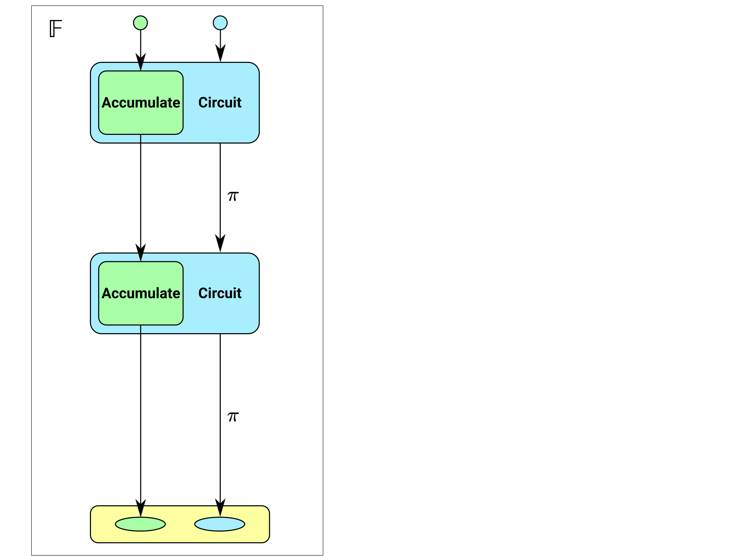
Accumulation schemes
In practice, accumulation schemes and proof systems use arithmetic in a particular field.
So if we tried to literally implement what is shown in the diagram, we’d have to do wrong-field arithmetic in the circuit.

Slide 37
Motivation for cycles
A proof system using E_{p→q} directly supports arithmetic over 𝔽_{q}.
“Wrong-field” arithmetic has an overhead of over 1000 times.
  This is using the sum of residues method for reduction: Zcash #4093
Can’t we solve this using lookups (e.g. Plookup)?
  No; lookups help but wrong-field arithmetic probably still has an overhead of 10-100 times.
  Nothing here conflicts with using lookups for other things in the same proof system.
As we’ll see later, it’s not quite sufficient for recursive proofs to just do arithmetic in the field of definition of the other proof system. We’ll need two instances of the proof system, on E_{p→q} and on E_{q→p}.

Slide 38
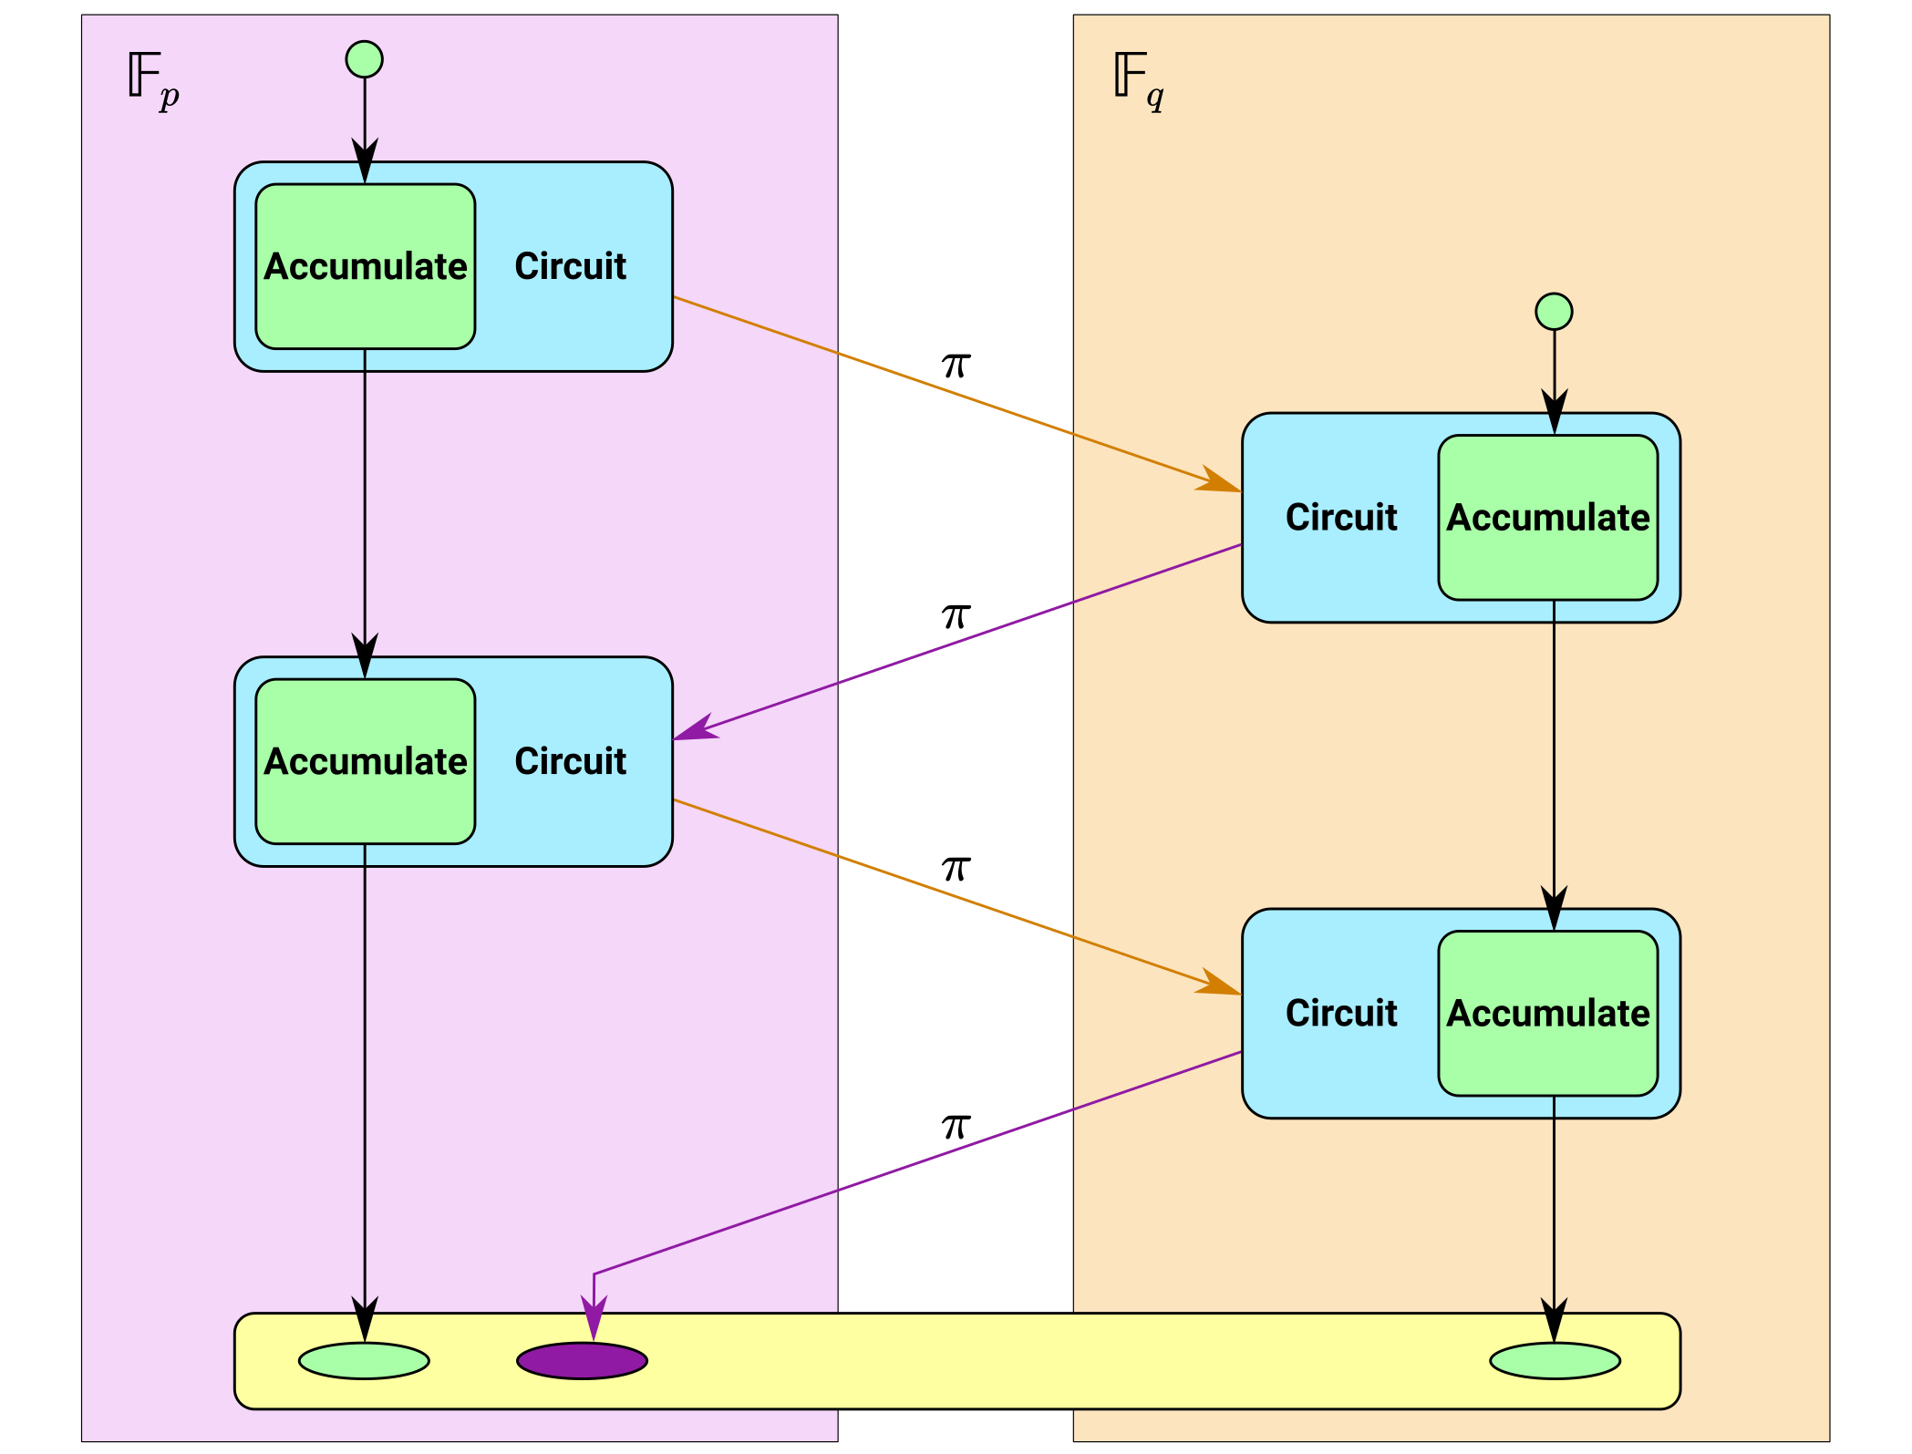
Accumulation schemes on 2-cycles

Slide 39
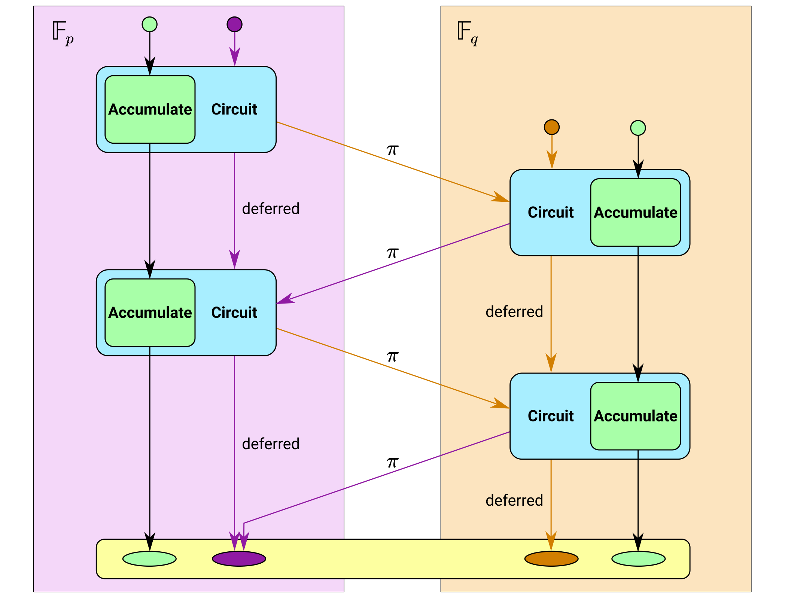
Accumulation schemes on 2-cycles

Slide 40
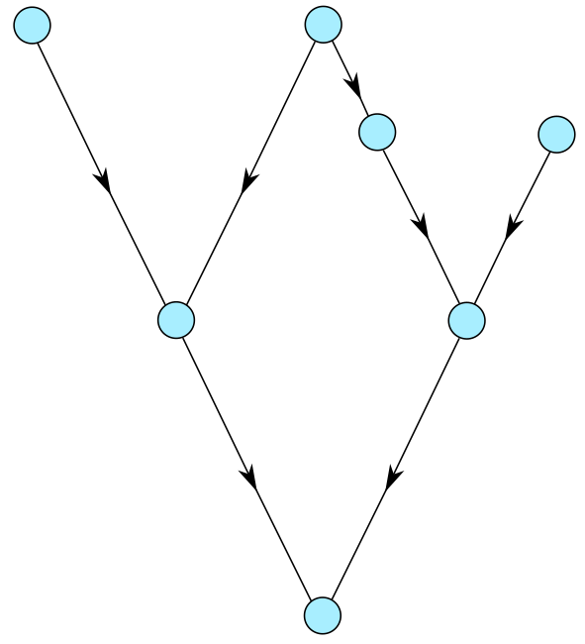
Encoding general Proof-Carrying Data
Let’s consider how this goes for general PCD, where we have a directed acyclic graph of proofs.

Slide 41
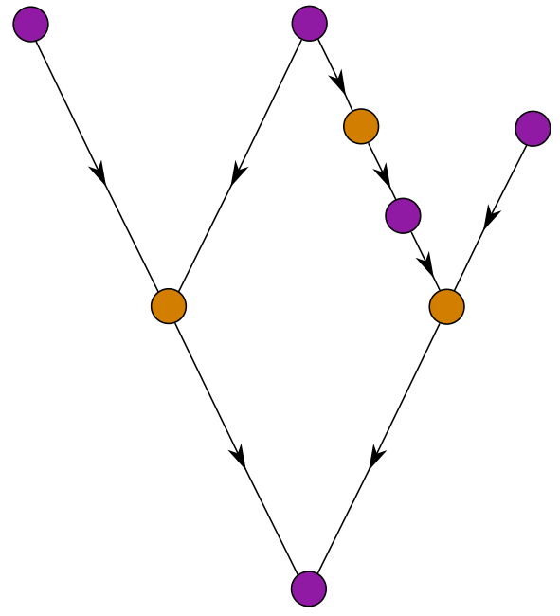
Encoding general Proof-Carrying Data
We might need to add extra wrapper proofs so that 𝔽_{p} and 𝔽_{q} proofs alternate on all paths.

Slide 42
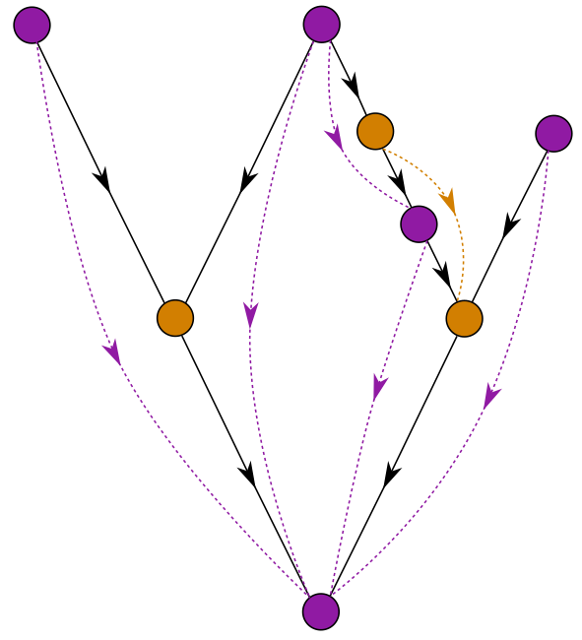
Encoding general Proof-Carrying Data
We might need to add extra wrapper proofs so that 𝔽_{p} and 𝔽_{q} proofs alternate on all paths. Here we also show deferreds.

Slide 43
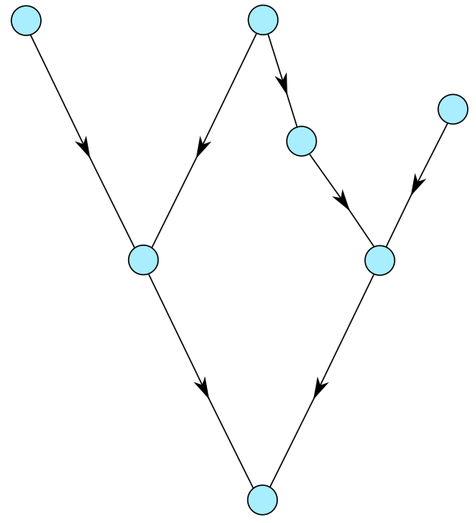
Encoding general Proof-Carrying Data
Another option is to add wrapper proofs after every node.

Slide 44
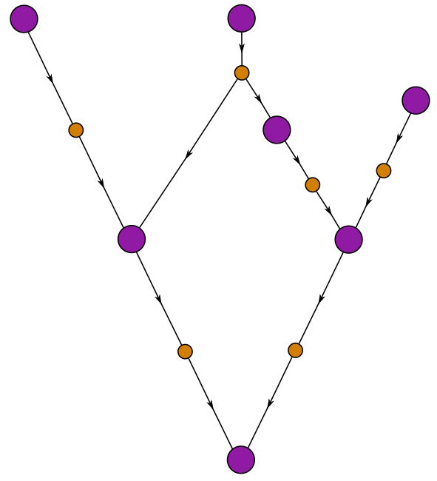
Encoding general Proof-Carrying Data
Another option is to add wrapper proofs after every node, like this.

Slide 45
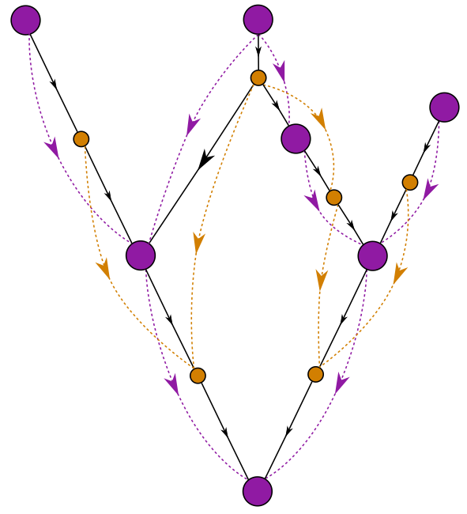
Encoding general Proof-Carrying Data
The data flow for deferreds in PCD might look complicated, but it’s fairly straightforward in practice: a proof just needs to include a lists of deferreds added in that proof, and a list of those added in its antecedent proof(s).

Slide 46
Elliptic curves
An elliptic curve in affine form is:
  a group of points (x, y)
  over a field of definition 𝔽_{p}
  satisfying some cubic equation, say y² = x³ + ax + b,
  with (for this equation) a “point at infinity” as the group identity.
If the group has a prime order q, we’ll name the curve E_{p→q}.
Because it’s a group, we can add points, or multiply them by a scalar.
The scalar field is 𝔽_{q}.
We’ll assume that a proof system using E_{p→q} efficiently supports circuits with arithmetic over 𝔽_{q}.
A cycle of elliptic curves is a pair E_{p→q} and E_{q→p}.

Slide 47
The Tweedle cycle
The Halo paper gives a pair of curves:
  E_{p→q} : y² = x³ + 5 is called Tweedledum.
  E_{q→p} : y² = x³ + 5 is called Tweedledee.
  p = 2²⁵⁴ + 0x38AA1276C3F59B9A14064E200000001
  q = 2²⁵⁴ + 0x38AA127696286C9842CAFD400000001
  Both have 126-bit Pollard rho security, maximal embedding degree, and 2-adicity ≥ 33.
  They have cubic endomorphisms (we’ll explain what that means).
  gcd(p − 1, 5) = gcd(q − 1, 5) = 1
We’re going to explain the construction that found them, and some generalizations of it that allow finding more complicated graphs of curves.

Slide 48

Constructing cycles – the problem
By the Hasse bound, the order of an elliptic curve over 𝔽_{p} lies in the range [ p + 1 − 2√p, p + 1 + 2√p ]. For Tweedle this range is of size ~2¹²⁹.
The Sato–Tate conjecture* concerns the distribution of the order in this range. We don’t need to go into detail, but here’s a picture:
* proven by Taylor et al in 2006.
That is, the order n could be anywhere in the range.
And (if n is a prime q) when we construct a curve E_{q→r} it could also have order anywhere in its Hasse range.
So, it’s exceptionally unlikely that E_{q→r} has order p.

Slide 49
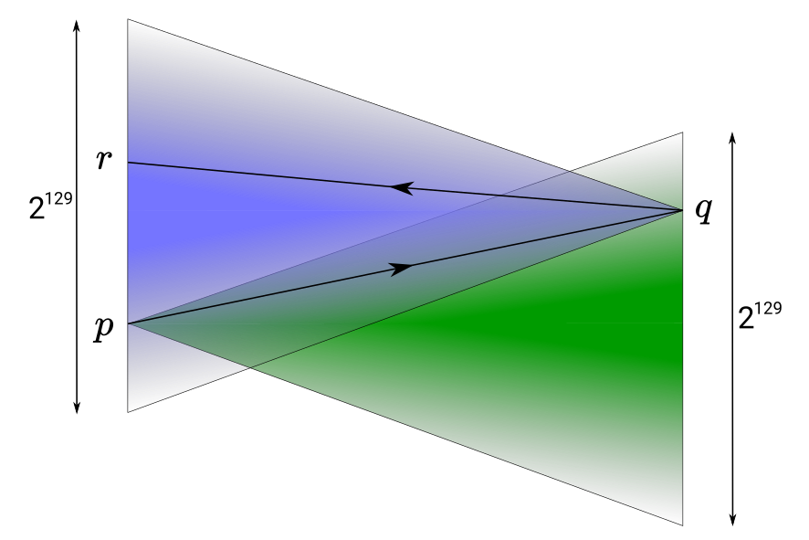
Constructing cycles – the problem
By the Hasse bound, the order of an elliptic curve over 𝔽_{p} lies in the range [ p + 1 − 2√p, p + 1 + 2√p ]. For Tweedle this range is of size ~2¹²⁹.

Slide 50
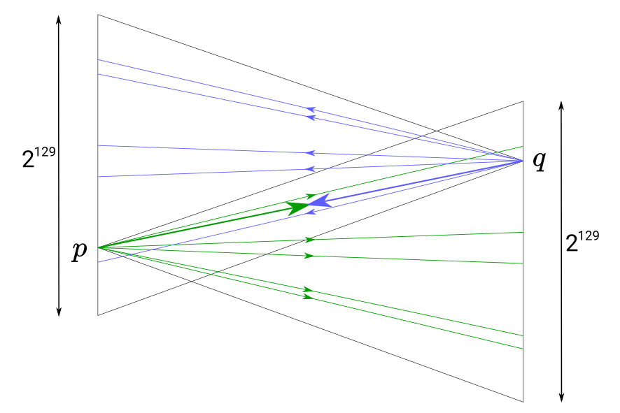
Constructing cycles – the solution
Suppose we were able to restrict the orders to a small number of possibilities, one of which was guaranteed to form a cycle...

Slide 51
CM curves to the rescue
Katherine Stange and Joe Silverman noticed that CM curves have precisely that property [SS2011].
What is a CM curve?
  This is not intended to be a fully precise definition, just to give intuition and make the concept less mysterious.
All curves have an “endomorphism ring”. An endomorphism is a group homomorphism (meaning that it preserves the group structure) from the curve group to itself.
  Why is it a ring? Because you can compose and “add” endomorphisms, and there is an identity endomorphism.
An example of an endomorphism in an elliptic curve group is scalar multiplication by a constant integer.
We can think of endomorphisms on elliptic curves as being generalized scalars.

Slide 52
Complex multiplication
All endomorphisms of an ordinary elliptic curve over a finite field are equivalent to scalar multiplication by an integer.
But an elliptic curve over 𝔽_{p} is a reduction of a curve with the same equation over the complex numbers ℂ.
“Complex multiplication” refers to scalar-multiplying points in the curve over ℂ by complex numbers.
  E.g. consider E : y² = x³ + ax and let [i] (x, y) = (-x, iy). Then [i²] (x, y) = [-1] (x, y) = (x, -y), which is the same as applying the [i] map twice.
  So these scalars are numbers in a complex lattice L, such as ℤ[i] or ℤ[∛1].
Are yous still with me? If not then don’t worry because it all gets a bit simpler again when we map back to finite fields.

Slide 53
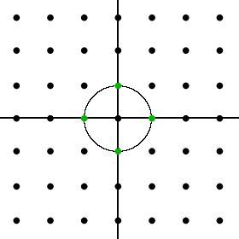
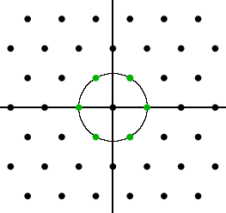
Structure of the endomorphism ring
We said that a generalized scalar can be a number in a complex lattice.
An elliptic curve over ℂ has CM if that lattice has more than one dimension (i.e. it’s bigger than ℤ). The lattice structure depends on something called the curve’s j-invariant.
For example, j = 1728 gives a quadratic lattice (ℤ[i], also called the Gaussian integers):
The example we saw on the previous slide is of this case.
And j = 0 gives a hexagonal lattice (ℤ[∛1], also called the Eisenstein integers):
This case turns out to be really nice for cryptography. This is the case that secp256k1, used in Bitcoin, falls into.

Slide 54
Moving from E_{ℂ→L} to E_{p→q}
The lattice L is a ring, and its units are the elements that have multiplicative inverses. The roots of unity are evenly distributed around the circle of radius 1 in the complex plane.
The units of L will correspond to possible orders of E_{p} as we vary the curve coefficients.
Remember that each point in L is a generalized scalar. But a complex root s can also have a corresponding root s′ in 𝔽_{q}.
Then when we move to the curve over 𝔽_{p}, complex multiplication by s corresponds to ordinary scalar multiplication by the integer s′.
Also, the units that form a basis for the lattice correspond to endomorphisms that provide “shortcuts” to scalar multiplication in the curve over 𝔽_{p}.

Slide 55
Security of CM curves
There are only 13 elliptic curves over ℂ with complex multiplication, up to isomorphism. Whether a curve has CM depends only on its equation.
Even though CM curves are a small fraction of all elliptic curves, there’s no reason to believe they are any weaker. All known pairing-friendly curve constructions produce CM curves, and they are very well-studied.
Note that isomorphism between curves over ℂ isn’t what determines the security of the Discrete Log Problem; that depends mainly on the sizes of p and q.
Curves with the same curve equation over different fields are not isomorphic.

Slide 56
But what does it all mean?
What happens when we map a CM curve back to 𝔽_{p} is that it can only have a small number of possible orders.
How many orders it can have is dependent on the number of units in the lattice we saw earlier, which is in turn determined by the j-invariant.
  For details see On Orders of Elliptic Curves over Finite Fields.
Curves y² = x³ + b (with no x or x² terms) have j-invariant 0.
These curves are interesting because, over 𝔽_{p},
  they have 6 possible orders;
  they have efficiently computable endomorphisms;
  it’s usually easy to solve the CM norm equation.

Slide 57
The CM norm equation
|D|V ² = 4p – T ²
|D| is the absolute fundamental discriminant (D is negative).
p is the field size.
V and T are integers.
V and T determine the trace t, where q = p + 1 – t.
In fact ± T are two of the possible traces.
The Tweedle curves were found using this construction:
  set |D| = 3, pick V and T, then
  p = ¼ (|D|V ² + T ²) and q = p + 1 – T.
The reason for this approach is that we can choose V and T so that both curves in the cycle have high 2-adicity.

Slide 58
Constructing cycles – the solution
For each possible order of E_{p→q} one of the possible orders of E_{p→q} is p.
This is proven by Stange and Silverman, and again with a more elementary proof in the accompanying notes. For more detail on CM see Chenal’s thesis.

Slide 59
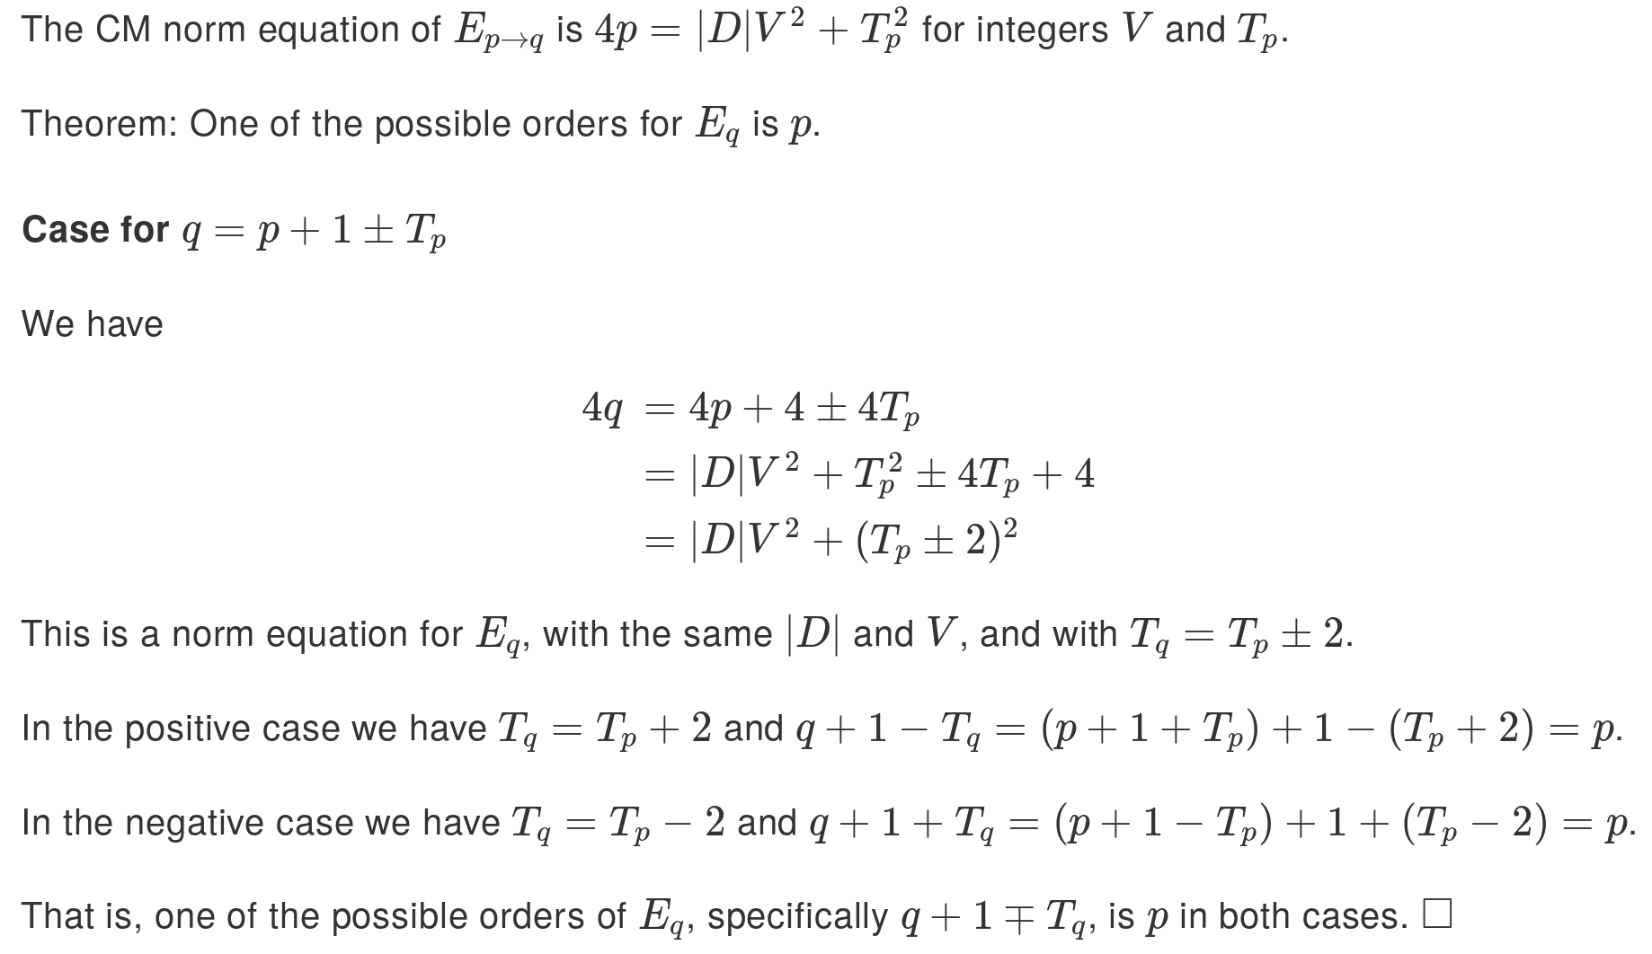
But why?
The norm equation helps to explain why CM curves form cycles.

Slide 60
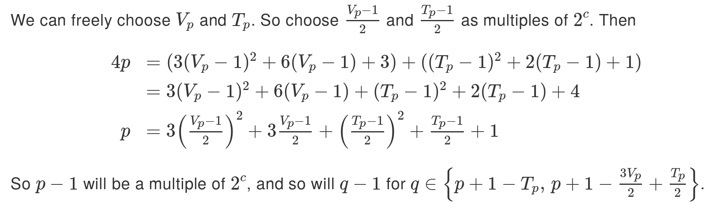
2-adicity
Protocols that use Lagrange basis, or that need to efficiently multiply polynomials, benefit from 𝔽_{p, q} having a “large enough” multiplicative subgroup of size z^{c}. The simplest option is z = 2.
In other words, we need p ≡ 1 and q ≡ 1 (mod 2^{c}).
*

Slide 61
The story so far
We defined what a graph of elliptic curves is.
We explained the difficulty with constructing cycles of curves, and how to solve it by using curves with complex multiplication.
We described (approximately) what complex multiplication is, and how the units of a lattice defined by the endomorphism ring correspond to the possible orders of curves over a given field.
Along the way, we discussed endomorphisms and how they correspond to “shortcuts” for scalar multiplication.
  That part will be useful for an optimization we’re going to describe in this section of the talk.

Slide 62
The Halo verification circuit
Practical circuits tend to be dominated by a small number of operations that are repeated many times. In the Halo verification circuit, we need:
  Multi-scalar multiplications
  A hash function, to generate Fiat–Shamir challenges.
We also need to include the “application” circuit(s), and so any optimizations to the proof system should be made with that in mind.

Slide 63
Scalar multiplication in circuits
Halo uses prime-order short Weierstrass curves, E : y² = x³ + b.
We start with a variation on the scalar multiplication algorithm in Zcash #3924, which takes 6 muls per scalar bit.
This is based on an idea from Kirsten Eisentrager, Kristin Lauter, and Peter Montgomery. Instead of computing [2] A + P directly in a double-and-add algorithm, we compute (A + P ) + A.
To avoid needing two constraints for the conditional, we actually compute (A ± P ) + A.
The λ for the outer addition can be computed from the λ for the inner one, saving one mul.
Naively we need 4 muls for the doubling, 3 for the addition, and 2 for the conditional. This technique costs 3 for the inner addition, 2 for the outer addition, and 1 for conditional negation.

Slide 64
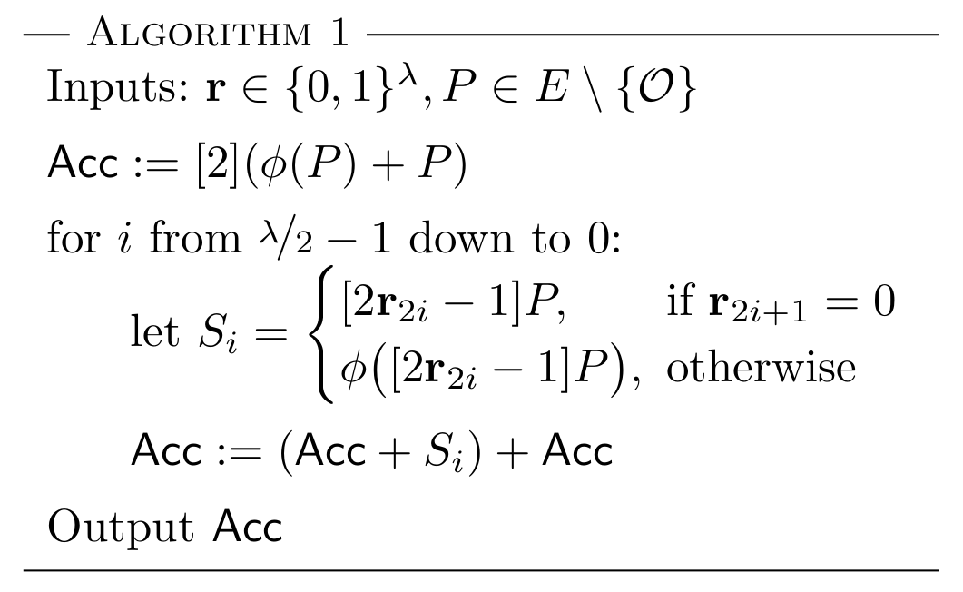
Optimized scalar multiplication
It turns out we can improve 6 muls/bit to 3.5 muls/bit, by using the endomorphism we dicussed earlier.
We only require the multiplications to be of some scalar with at least 128 bits of entropy (depending on the verifier challenges).
The basic idea is to add one of { −P, P, −ϕ(P ), ϕ(P ) } at each step. This takes 7 muls for every 2 bits of entropy (the extra mul is to conditionally apply ϕ).
This has the effect of multiplying by ζa + b, where a and b depend on random r.

Slide 65
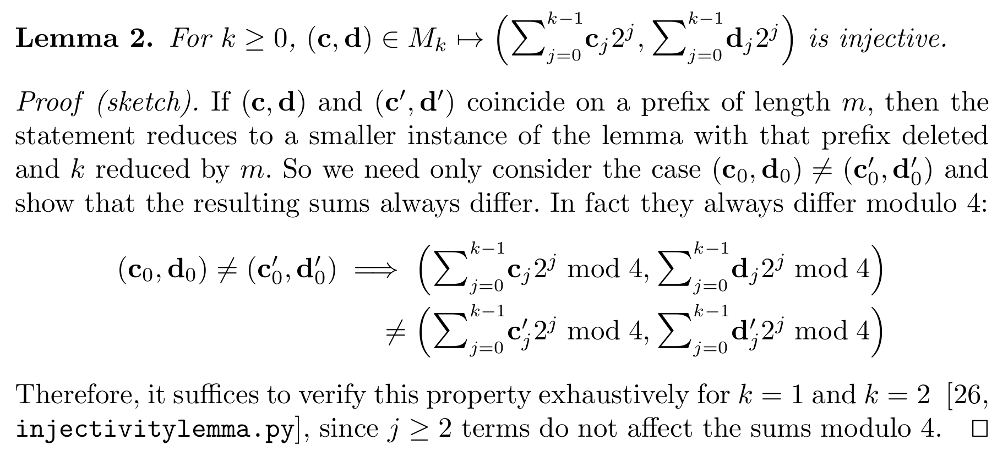
Optimized scalar multiplication
We want the mapping r → ζa + b not to lose any entropy, i.e. to be 1-to-1.
To prove this we show that r → (a, b) and (a, b) → ζa + b are both 1-to-1.
For the first part:

Slide 66
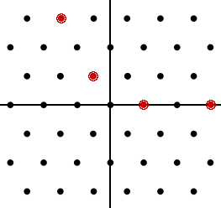
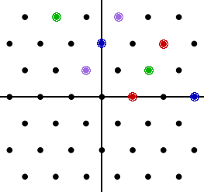
Optimized scalar multiplication
We want the mapping r → ζa + b not to lose any entropy, i.e. to be 1-to-1.
To prove this we show that r → (a, b) and (a, b) → ζa + b are both 1-to-1.
For the first part:
k = 1 k = 2

Slide 67
Optimized scalar multiplication
We want the mapping r → ζa + b not to lose any entropy, i.e. to be 1-to-1.
To prove this we show that r → (a, b) and (a, b) → ζa + b are both 1-to-1.
For the second part, we find the smallest distance between two values of ζa (mod q) for a in A = [0, 2⁶⁵ + 2⁶⁴). If this is ≥ 2⁶⁵ + 2⁶⁴, then a copy of A will “fit between the gaps” of ζA, and so (a, b) → ζa + b must be 1-to-1.
checksumsets.py does this check and also generates this video:

Slide 68
Optimized scalar multiplication
We want the mapping r → ζa + b not to lose any entropy, i.e. to be 1-to-1.
To prove this we show that r → (a, b) and (a, b) → ζa + b are both 1-to-1.
For the second part, we find the smallest distance between two values of ζa (mod q) for a in A = [0, 2⁶⁵ + 2⁶⁴). If this is ≥ 2⁶⁵ + 2⁶⁴, then a copy of A will “fit between the gaps” of ζA, and so (a, b) → ζa + b must be 1-to-1.
checksumsets.py does this check and also generates this video:

Slide 69
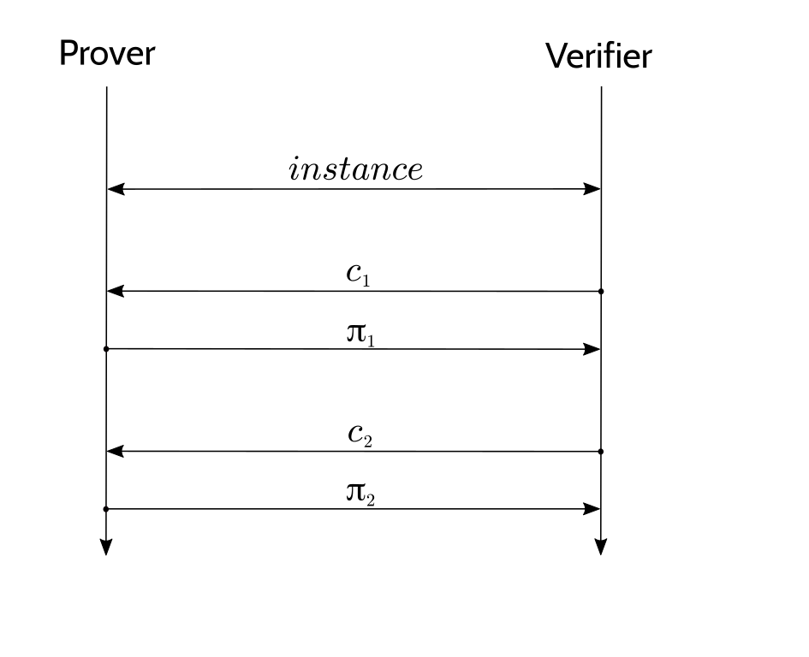
Fiat–Shamir and duplex sponges
The Fiat–Shamir construction takes an interactive public-coin protocol, ...

Slide 70
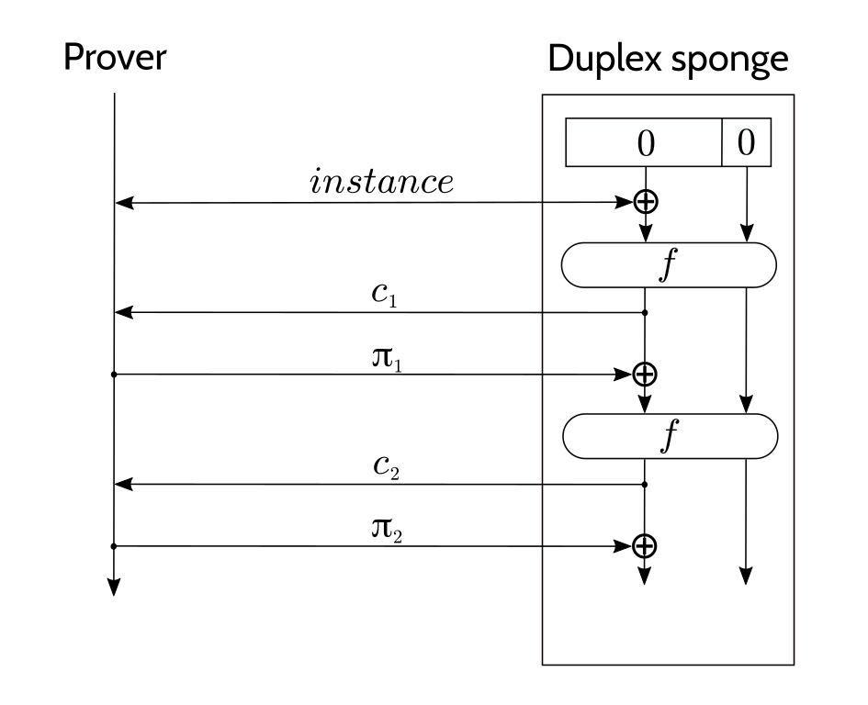
Fiat–Shamir and duplex sponges
The Fiat–Shamir construction takes an interactive public-coin protocol, and replaces the verifier with a hash function.
Using a duplex sponge basically halves the number of f evaluations relative to other hash constructions.

Slide 71
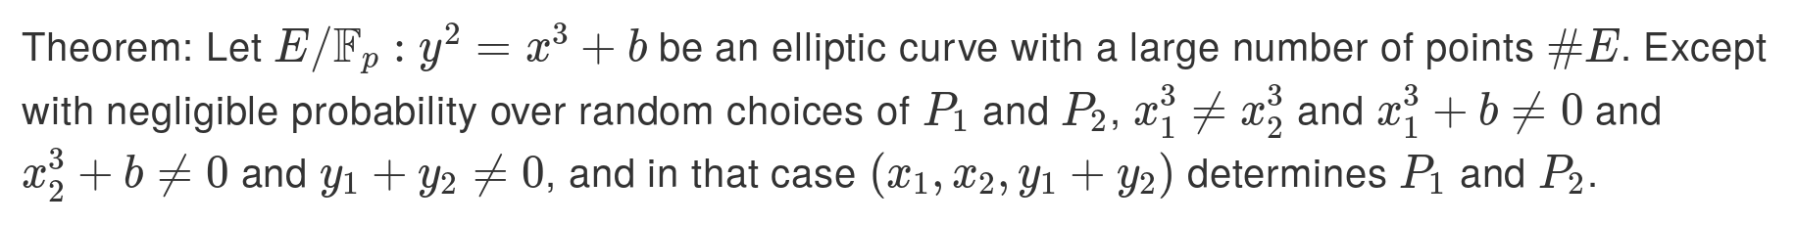
Optimizations for any duplex sponge
Use addition in the field for ⊕, rather than XOR.
Compress the absorbed inputs.
  There’s a way of probabilistically compressing two curve points to three field elements that is much less expensive than standard point compression (see accompanying notes).
Pick a “rate” that is just large enough that we only need one f evaluation per round.
  For the inner product argument we need lg(N) rounds, each of which absorbs two curve points and squeezes out one challenge.

Slide 72
Algebraic hashes
To instantiate f in the duplex sponge, we need a permutation that is efficient in the circuit.
Rescue is a permutation designed to be efficient in circuits over a prime field.
  We also considered Poseidon, but recent attacks have wounded it (eprint 2020/188), so it looks like Rescue has a better security/cost trade-off.
Optimization that we can use with Rescue:
  Choose curves with gcd(p–1, 5) = 1 so that x ↦ x⁵ is a permutation.
  x ↦ x³ cannot be a permutation for curves with the endomorphism (and the latter gives us more of a performance advantage).

Slide 73
Questions?
Daira Hopwood
@feministPLT
@daira#0512 on Discord
https://github.com/daira/halographs
Notes:
To correctly and efficiently express statements for many popular zero knowledge argument systems, we need to understand Rank 1 Constraint Systems. This talk is based on experience optimizing the circuits for Zcash's Sapling protocol upgrade. It aims to teach some of the background needed to:
* design higher-level cryptographic protocols with efficient R1CS implementation in mind,
* specify a statement precisely enough to be able to tell whether it has been correctly implemented;
* understand the R1CS model of computation;
* express various algorithms and types commonly used in cryptography;
* optimize circuit size while reducing the risk of introducing bugs and vulnerabilities.
We concentrate on direct expression of circuits as R1CS, rather than how this would be written in a particular domain-specific language or library.

