Slide 1

Optimizing Halo
and
Constructing Graphs of Elliptic Curves
Daira Hopwood
<daira@electriccoin.co>
@feministPLT
@daira on Discord
Slides at https://github.com/daira/ecgraphs
Notes:
To correctly and efficiently express statements for many popular zero knowledge argument systems, we need to understand Rank 1 Constraint Systems. This talk is based on experience optimizing the circuits for Zcash's Sapling protocol upgrade. It aims to teach some of the background needed to:
* design higher-level cryptographic protocols with efficient R1CS implementation in mind,
* specify a statement precisely enough to be able to tell whether it has been correctly implemented;
* understand the R1CS model of computation;
* express various algorithms and types commonly used in cryptography;
* optimize circuit size while reducing the risk of introducing bugs and vulnerabilities.
We concentrate on direct expression of circuits as R1CS, rather than how this would be written in a particular domain-specific language or library.

Slide 2
Outline
Background
  What is a graph of elliptic curves? Why are they useful?
  Constructing cycles – the problem
  CM curves to the rescue
Detail of curve construction
  Automorphisms
  The CM norm equation
  2-adicity: why we need it and how to get it
  Cycles and chains
  Speeding up searches
  Pairings, half-pairing cycles, and inverted lollipops
  Live coding in Sagemath
Halo optimizations
  Understanding Halo/Sonic/Bulletproofs arithmetization
  Scalar multiplication in circuits
  Optimized scalar multiplication
  Really optimized scalar multiplication
  Fiat–Shamir and duplex sponges
  Algebraic hashes (Rescue).

Slide 3
What is a graph of elliptic curves?
What is a directed graph?
  Set of vertices, set of directed edges
  Our vertices will be primes p, q, …
  Our edges will be elliptic curves E_{p→q}.
What is the curve E_{p→q}?
  Points have coordinates in the field of definition 𝔽_{p}.
  There are n points forming a group, with a prime subgroup of order q dividing n.
  The scalar field is 𝔽_{q}.
  We’ll assume that a proof system using E_{p→q} efficiently supports circuits with arithmetic over 𝔽_{q}.

Slide 4
Examples
Diagram here

Slide 5
Motivation for cycles
Wrong-field arithmetic has an overhead of ~1000 times.
  This is using the sum of residues method for reduction. Zcash #4093
Doesn’t Plookup solve this?
  No; Plookup helps but wrong-field arithmetic probably still has an overhead of 10-20 times.
  Plookup works best for larger circuits, where the cost of tables can be amortized. For Halo we want to minimize the cost of the recursion subcircuit.
  Nothing here conflicts with using plookup for other things in the same proof system.

Slide 6
The Tweedle cycle
The Halo paper gives a pair of curves:
  E_{p→q} : y² = x³ + 5 is called Tweedledum.
  E_{q→p} : y² = x³ + 5 is called Tweedledee.
  p = 2²⁵⁴ + 0x38AA1276C3F59B9A14064E200000001
  q = 2²⁵⁴ + 0x38AA127696286C9842CAFD400000001
  Both have 126-bit Pollard rho security, maximal embedding degree.
  They have cubic endomorphisms (we’ll explain what that means).
  gcd(p − 1, 5) = gcd(q − 1, 5) = 1
We’re going to explain the construction that found them, and some generalizations of it.

Slide 7

Constructing cycles – the problem
By the Hasse bound, the order of an elliptic curve over 𝔽_{p} lies in a range of size ~4√p. For Tweedle this is ~2^{129.5}.
The Sato–Tate conjecture concerns the distribution of the order in this range. We don’t need to go into detail, but here’s a picture:
That is, the order n could be anywhere in the range.
And (if n is a prime q) when we construct a curve E_{q→r} it could also have order anywhere in its Hasse range.
So, it’s exceptionally unlikely that E_{q→r} has order p.

Slide 8
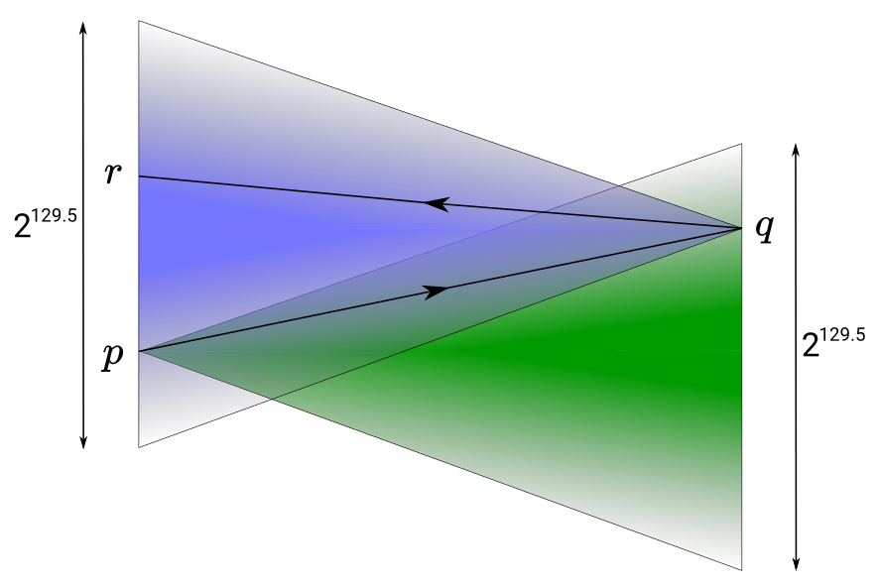
Constructing cycles – the problem
By the Hasse bound, the order of an elliptic curve over 𝔽_{p} lies in a range of size ~4√p. For Tweedle this is ~2^{129.5}.

Slide 9
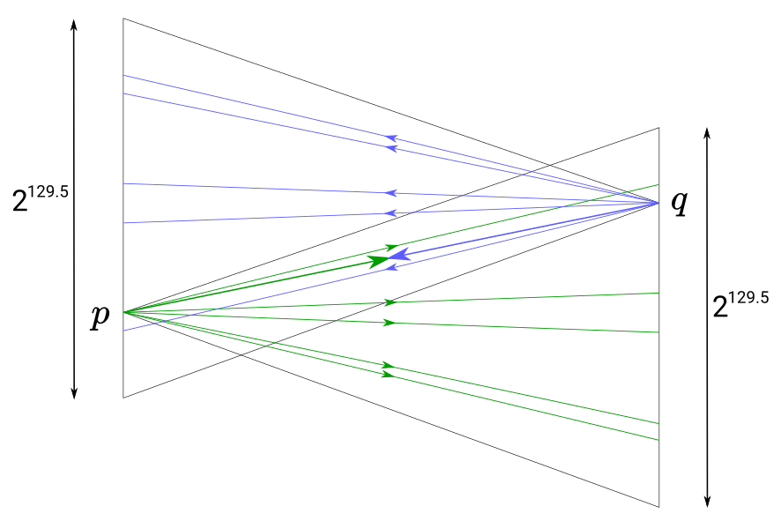
Constructing cycles – the solution
Suppose we were able to restrict the orders to a small number of possibilities, one of which was guaranteed to form a cycle...

Slide 10
CM curves to the rescue
Katherine Stange and Joe Silverman noticed that CM curves have precisely that property [SS2011].
What is a CM curve?
  This is not intended to be a fully precise definition, just to give intuition and make the concept less mysterious.
All curves have an “endomorphism ring”. An endomorphism is a group homomorphism (meaning that it preserves the group structure) from the curve group to itself.
  Why is it a ring? Because you can compose and “add” endomorphisms, and there is an identity endomorphism.
An example of an endomorphism in an elliptic curve group is scalar multiplication by a constant integer. We can think of endomorphisms as being generalized scalars.

Slide 11
Complex multiplication
All endomorphisms of an elliptic curve over a finite field are equivalent to ordinary scalar multiplication by an integer.
But an elliptic curve over 𝔽_{p} is a reduction of a curve with the same equation over the complex numbers ℂ.
“Complex multiplication” refers to scalar-multiplying points in the curve over ℂ by complex numbers.
  E.g. consider E : y² = x³ + ax and let [i] (x, y) = (-x, iy). Then [i²] (x, y) = [-1] (x, y) = (x, -y), which is the same as applying the [i] map twice.
  So scalars are numbers in a complex lattice such as ℤ[i] or ℤ[∛1].
There are only 13 elliptic curves over ℂ with complex multiplication, up to isomorphism. So these are a very small fraction of all curves.
Are yous still with me? If not then don’t worry because it all gets simpler again when we map back to 𝔽_{p}.

Slide 12
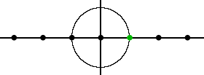
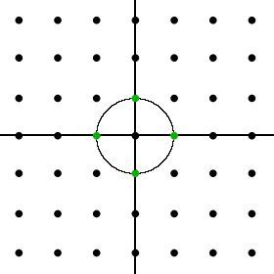
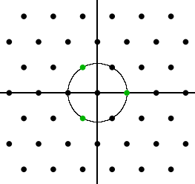
Structure of the endomorphism ring
We said that a generalized scalar can be a number in a complex lattice.
An elliptic curve over ℂ has CM if that lattice has more than one dimension (i.e. it’s bigger than ℤ). The lattice structure depends on something called the curve’s j-invariant.
It’s kinda like this (an integer lattice, j ∉ {0, 1728}):
Or like this (a quadratic lattice ℤ[i], j = 1728):
The example we saw on the previous slide is of this case.
Or like this (a hexagonal lattice ℤ[∛1], j = 0):
The hexagonal case turns out to be really nice for cryptography. This is the case that secp256k1, used in Bitcoin, falls into.

Slide 13
But what does it all mean?
A consequence of … is that a CM curve has only a small number of possible orders.
Which orders it can have is dependent on its j-invariant.
In particular, curves with equation y² = x³ + b (i.e. with no x or x² terms) have j-invariant 0.
These curves are interesting because, over Fp,
  they have only 6 possible orders;
  they have efficiently computable endomorphisms;
  it’s easy to solve the CM norm equation (next slide);
Some of the possible orders are likely to form cycles.

Slide 14
The CM norm equation
|D|V ² = 4p – T ²
|D| is the (absolute) discriminant
p is the field size
V and T are integers
V and T determine the trace t, where q = p + 1 – t.
In fact ± T are two of the possible traces.
The Tweedle curves were found using this construction:
  set |D| = 3, pick V and T, find p = ¼ (|D|V ² + T ²)
  Later we’ll see other constructions that work in other situations.
The reason for this approach is that we can choose V and T so that both curves in the cycle have high 2-adicity.

Slide 15
The CM norm equation
The norm equation helps to explain why CM curves form cycles.
I’ll just go through the ± T case. For j = 0 there are other cases which are very similar.

Slide 16
2-adicity: why we need it and how to get it
Protocols that use Lagrange basis, or that need to efficiently multiply polynomials, benefit from 𝔽_{p} having a “large enough” multiplicative subgroup of size b^{k}. The simplest option is b = 2.
In other words, we need p ≡ 1 (mod 2^{k}).
We can freely choose V and T. So let’s choose ½(V-1) and ½(T-1) to be multiples of 2^{k/2}.
*

Slide 17
Cycles and chains

Slide 18
Speeding up searches

Slide 19
Pairings and half-pairing cycles

Slide 20
Inverted lollipops

Slide 21
Live coding in Sagemath

Slide 22
Halo/Sonic/Bulletproofs arithmetization

Slide 23
Scalar multiplication in circuits

Slide 24
Optimized scalar multiplication

Slide 25
Really optimized scalar multiplication

Slide 26
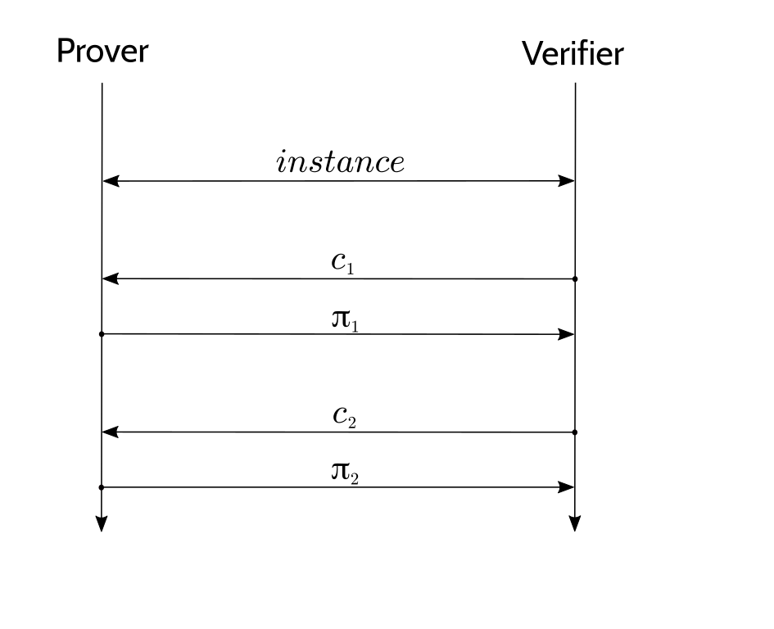
Fiat–Shamir and duplex sponges
The Fiat–Shamir construction takes an interactive public-coin protocol, ...

Slide 27
Fiat–Shamir and duplex sponges
The Fiat–Shamir construction takes an interactive public-coin protocol, ...

Slide 28
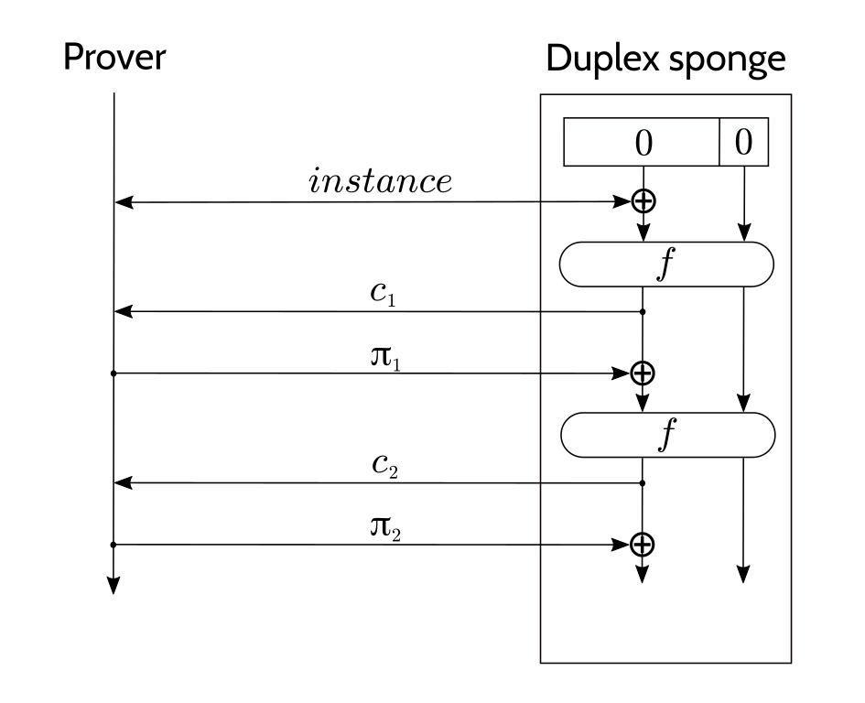
Fiat–Shamir and duplex sponges
The Fiat–Shamir construction takes an interactive public-coin protocol, and replaces the verifier with a hash function.
Using a duplex sponge basically halves the number of f evaluations relative to other hash constructions.

Slide 29
Fiat–Shamir optimizations
Reduce the size of absorbed inputs by “compressing” them.
  there’s a way of compressing two curve points to three field elements that is much less expensive than standard point compression.
Pick a “rate” for the duplex sponge that is just large enough that we only need one f evaluation per round.

Slide 30
Algebraic hashes
To instantiate f in the duplex sponge, we need a permutation that is efficient in the circuit.
Rescue is a permutation designed to be efficient in circuits over a prime field.
  We’re also considering Poseidon for the next version.
Optimizations that we can use with either Rescue or Poseidon:
  Use addition in the field for ⊕, rather than XOR.
  Express the input in as few field elements as possible.
  Set the “rate” to be the number of field elements we need to absorb in each round.
  Choose curves with gcd(p–1, 5) = 1 so that x ↦ x⁵ is a permutation.

Slide 31
Questions

Slide 32
Scalable Privacy
Daira Hopwood
<daira@electriccoin.co>
@feministPLT
@daira on chat.zcashcommunity.com
Slides at https://github.com/daira/zcon
Notes:
To correctly and efficiently express statements for many popular zero knowledge argument systems, we need to understand Rank 1 Constraint Systems. This talk is based on experience optimizing the circuits for Zcash's Sapling protocol upgrade. It aims to teach some of the background needed to:
* design higher-level cryptographic protocols with efficient R1CS implementation in mind,
* specify a statement precisely enough to be able to tell whether it has been correctly implemented;
* understand the R1CS model of computation;
* express various algorithms and types commonly used in cryptography;
* optimize circuit size while reducing the risk of introducing bugs and vulnerabilities.
We concentrate on direct expression of circuits as R1CS, rather than how this would be written in a particular domain-specific language or library.

