Slide 2
Halo 2 and Orchard
Deirdre Connolly
Daira Hopwood
Sean Bowe
Notes:
Speaker: Deirdre

Slide 3
What are Recursive Proofs?
Proofs of knowledge can be used to show you performed a computation
But what if that computation is “verifying a proof of knowledge”?
  This is what is known as proof composition.
But what if the inner proof’s computation is the same as the outer proof’s computation?
  This is what is known as recursive proof composition.
Recursive proofs can be used to show practically unlimited amounts of computation have been correctly performed.
  This leads to a variety of scaling solutions.
Notes:
Speaker: Sean

Slide 4
Background
Recursive proofs finally became a thing we could actually do.
  Prior to ECC’s discovery of Halo (late 2019), they were bulky and inefficient, and required trusted setups.
Recursive proofs help address scalability issues.
More efficient SNARK constructions emerged after Halo appeared which we could borrow ideas from.
This led the ECC team toward Halo 2 — essentially the original Halo, but a more PLONK-like construction with heavy optimization.
Notes:
Speaker: Sean

Slide 5
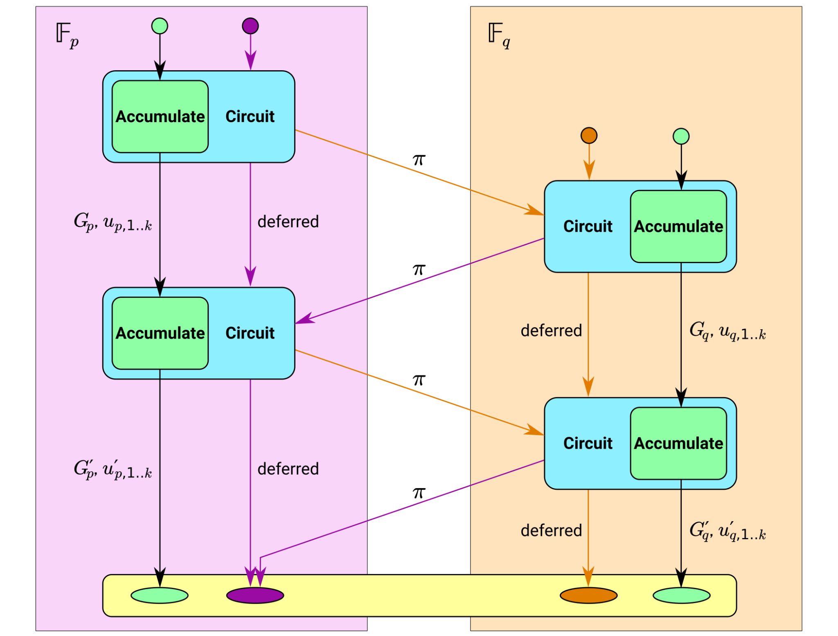
What’s Halo?
Notes:
Speaker: Sean

Slide 6
What’s Halo 2?
Recursive zk-SNARK proving system built on the cyclic prime-order Pasta curves: Pallas and Vesta.
Uses the UltraPLONK arithmetization from PLONK to express the circuits, instead of previously used R1CS.
  Supports higher degree polynomial constraints, letting us constrain more at once.
The Pasta curve cycle allows a proof produced by one curve to be efficiently verified in the circuit of the other curve. See Daira’s ZK Study Club presentation.
Some checks can be deferred to the later verifier, allowing recursion, which allows smaller total proof sizes on the blockchain overall. ¹
Inner-product argument removes the need for a trusted setup:
  When using Groth16, we need to encode the circuit into the Structured Reference String. Halo’s inner product argument, similar to Bulletproofs, does not need this.
Notes:
Speaker: Sean
¹ Halo 2 proofs will be a little larger than Groth16 proofs, but since they allow recursion and aggregation, over time the total byte size of proof data on the chain will be lower than if we kept using non-recursive Groth16

Slide 7

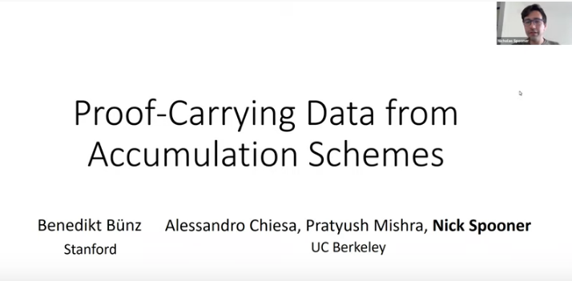
Learn more about Halo
https://youtu.be/yn_j3QJDZ9s
https://youtu.be/UNwlBq1FQ3E
Notes:
Speaker: Sean

Slide 8
Why not just “Sapling on Halo 2”?
We need to change the curves:
  (Efficient) recursion needs a 2-cycle of prime-order curves ¹
  We don’t need pairings, and therefore the curves can be smaller ²
  Gives the opportunity for curve optimization (constant-time hash-to-curve ³ etc.)
Linear verification time would make proof verification too slow without further optimization.
Halo 2 allows for efficient “lookup arguments”, which led us to design Sinsemilla, a collision-resistant hash that is more efficient with lookups.
We wanted to remove hashes that are expensive in a circuit (BLAKE2s ⁴).
“Action” transfers are simpler and leak a bit less metadata ⁵ than separate Spends and Outputs.
Notes:
Speaker: Deirdre
¹ While recursive proofs aren’t being deployed in NU5, deploying the recursive-supporting curves and fields now allows us to make addresses, notes, and commitments dependent on them now, and enable recursion later, without needing to change the curves again.
² Pairing-friendly curves have enough algebraic structure that they need to be larger to be cryptographically secure; if you don’t need pairings, you can use a smaller curve to stay cryptographically secure.
³ IETF’s Hash-to-curve, allows constant time hashing to an elliptic curve point, total: defined on all possible arguments (unlike what we had for Sapling)
⁴ BLAKE2s is currently used twice in the Sapling Spend circuit: once for the nullifier PRF and once to derive ivk.
⁵ N Spends and M Outputs leak both N and M, Actions leak only max(N, M).

Slide 9
So what is Orchard?
A shielded payment protocol, like Sapling.
Take all the good parts of Sapling, drop a couple of less good ones, and optimize for Halo 2!
What is the same as Sapling?
  Support for viewing keys
  Support for efficient signing on hardware wallets
  Support for diversified addresses
  How balance checking works
  Note encryption
  The note commitment tree is a binary tree of the same height (32)
Notes:
Speaker: Deirdre

Slide 10
How is Orchard different from Sapling?
  Optimized for Halo 2 / UltraPLONK arithmetization.
  Actions, rather than Spends and Outputs.
  Different nullifier computation (allows dropping BLAKE2s in the circuit).
  All diversifiers are valid, using the new hash-to-curve function.
  Unified Addresses.
  A full viewing key + ask is sufficient for proving (there is no nsk).
  Note commitments are unique in a valid chain.
Notes:
Speaker: Deirdre

Slide 11
Orchard circuit performance
No “heavyweight” hash functions in the circuit.
Optimized to make use of custom gates and lookups in UltraPLONK.
Circuit size is below 2048 rows × 10 advice columns.
  The Sapling Spend circuit was ~96500 R1CS constraints, and the Output circuit was ~7600 constraints.
  Fits below Halo 2’s recursion threshold.
  ZSAs would also fit within 2048 rows.
Action circuit verification time is ~20ms, with scope for improvement.
  Both proving and verification can be efficiently multi-threaded.
  Can’t give you a benchmark for proving yet; current implementation is dominated by some inefficiencies in witness generation.
Notes:
Speaker: Daira

Slide 12
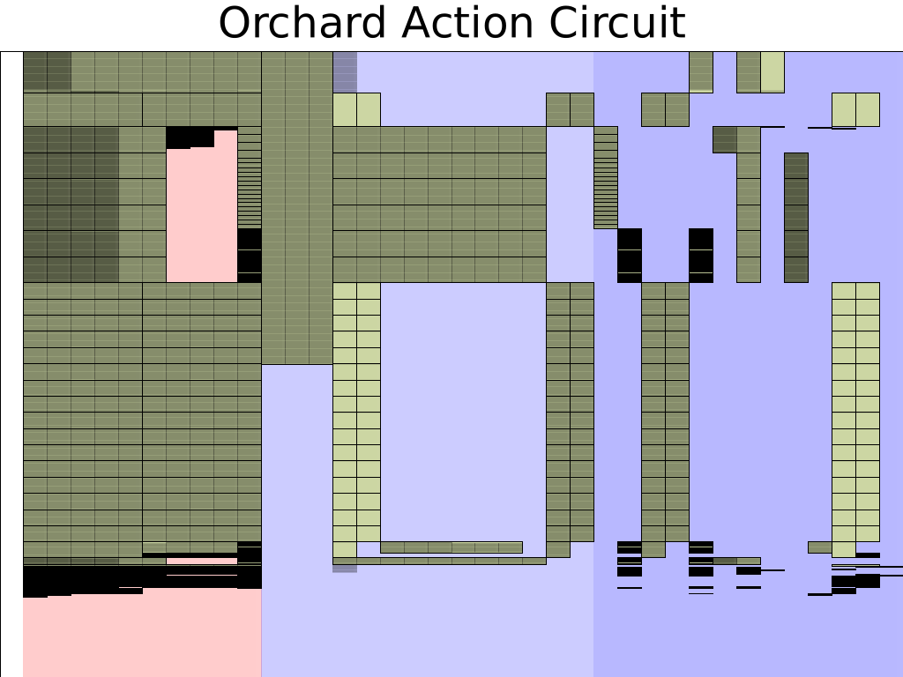
Notes:
Speaker: Daira
This has been updated since the presentation to reflect optimizations as of 19th August.

Slide 13
Sinsemilla hash function
Replaces Bowe–Hopwood Pedersen hashes in the note Merkle tree and in non-homomorphic commitments (NoteCommit and Commit^{ivk}).
Uses lookups to process 10 bits at once (rather than 3 bits as in Bowe–Hopwood).
  There is scope for further optimization, but we opted for simplicity.
  We do 2 Sinsemilla hashes in parallel in the Orchard circuit’s 10 columns.
Basically a vector Pedersen hash “on its side”.
Security tightly reducible to a standard vector Pedersen hash, hence to DLP.
Implemented using incomplete curve additions.
  Failure implies finding a discrete logarithm.
Notes:
Speaker: Daira

Slide 14
Security properties
Balance: can I forge money?
Spend Authentication: can I spend someone else’s money?
Note Privacy: can I gain information about notes sent in-band?
Note Privacy (OOB): can I gain information about notes sent out-of-band, only from the public block chain?
Spend unlinkability: given the IVK but not the FVK for an address, can I (maybe the sender) detect spends of notes sent to that address?
Faerie Resistance: can I cause notes to be accepted that may be unspendable?
Notes:
Speaker: Daira

Slide 15
Security assumptions
 | Sapling | Orchard
Balance Preservation | DL_{Jubjub} | DL_{Pallas}
Spend Authentication | RedDSA unforgeability (DL_{Jubjub}) | RedDSA unforgeability (DL_{Pallas})
Note Privacy | HashDH_{Jubjub}(BLAKE2b) | HashDH_{Pallas}(BLAKE2b)
Note Privacy (OOB) | Perfect | Near perfect ‡
Spend Unlinkability | PRF(BLAKE2s) | DDH†_{Pallas} or PRF(Poseidon)
Faerie Resistance | CR(BLAKE2s) and DL_{Jubjub} | DL_{Pallas}
† We also assume that {PRF_{nk}​(x): nk ∈ 𝔽} for any x gives an adequate range for DDH_{Pallas}.​
‡ Statistical distance <2^{−167.8} from perfect.
Notes:
Speaker: Daira
Updated August 19th: Correct the domain of nk.

Slide 16
Balance preservation – Sapling (informal)
The critical property is that there can only be one nullifier for a given note commitment. If there were more than one, we can forge / double-spend.
A note commitment cm binds (g_{d}, pk_{d}, v, ρ) for the note, given pos.
Check pk_{d} = [ivk] g_{d}. There is only one such ivk for given (g_{d}, pk_{d}).
Check ivk = CRH^{ivk} (ak, nk). This binds ak and nk.
Check nf = PRF_{nk}(ρ).
nf deterministically depends only on fields bound to the note (and the position which is fixed for a given commitment).
Notes:
Speaker: Daira
Updated August 19th: Clarify last point.

Slide 17
Balance preservation – Orchard (informal)
The critical property is that there can only be one nullifier for a given note commitment. If there were more than one, we can forge / double-spend.
A note commitment cm binds (g_{d}, pk_{d}, v, ρ, ψ) for the note (no pos).
Check pk_{d} = [ivk] g_{d}. There is only one such ivk for given (g_{d}, pk_{d}).
Check ivk = Commit^{ivk} (ak, nk). This binds ak and nk.
Check nf = Extract_{P}([(PRF_{nk}(ρ) + ψ) mod q_{P}] G + cm).
nf deterministically depends only on fields bound to the note.
_{rivk}
Notes:
Speaker: Daira

Slide 18
Security assumptions
 | Sapling | Orchard
Balance Preservation | DL_{Jubjub} | DL_{Pallas}
Spend Authentication | RedDSA unforgeability (DL_{Jubjub}) | RedDSA unforgeability (DL_{Pallas})
Note Privacy | HashDH_{Jubjub}(BLAKE2b) | HashDH_{Pallas}(BLAKE2b)
Note Privacy (OOB) | Perfect | Near perfect ‡
Spend Unlinkability | PRF(BLAKE2s) | DDH†_{Pallas} or PRF(Poseidon)
Faerie Resistance | CR(BLAKE2s) and DL_{Jubjub} | DL_{Pallas}
† We also assume that {PRF_{nk}​(x): nk ∈ 𝔽} for any x gives an adequate range for DDH_{Pallas}.​
‡ Statistical distance <2^{−167.8} from perfect.
Notes:
Speaker: Daira
Updated August 19th: Correct the domain of nk.

Slide 19
Note Privacy / Unlinkability – Orchard (informal)
Basically the main thing we need to worry about is leakage of information via note ciphertexts, note commitments, or nullifiers.
Note ciphertexts are encrypted with ChaCha20-Poly1305, as in Sapling.
Note commitments are perfectly blinded.
nf = Extract_{P}([(PRF_{nk}(ρ) + ψ) mod q_{P}] G + cm).
  This construction is designed so that if either Poseidon is a secure PRF, or Poseidon is non-trivial and assuming DDH on Pallas, nf will look like a randomly distributed Pallas x-coordinate.
Notes:
Speaker: Daira

Slide 20
Faerie Gold – Orchard (informal)
In a Faerie Gold attack†, an adversary can create two notes, only one of which can be spent, but the recipient sees both as valid.
This can happen if two notes have the same nullifier.
In Orchard, ρ for a new note is copied from the nullifier of the note spent in the same Action description, which ensures it is unique.
Then, the new note’s nullifier is effectively a (short) Pedersen hash with input that includes ρ, so it is unique to that note:
  nf = Extract_{P}([(PRF_{nk}(ρ) + ψ) mod q_{P}] G + cm).
† Thanks Zooko for finding this attack, and for the name!
Notes:
Speaker: Daira
Updated 19th August: Acknowledge that Zooko found the attack, as well as naming it.

Slide 21
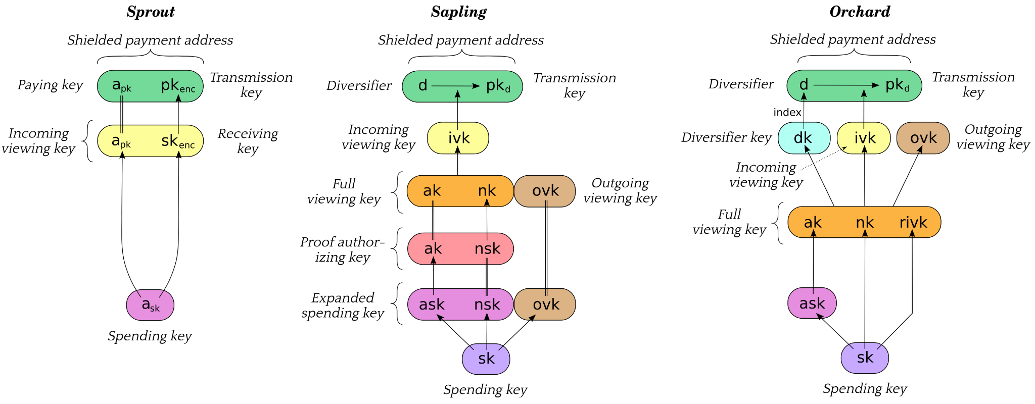
Keys and Addresses
Notes:
Speaker: Deirdre

Slide 22
Unified Addresses
If we added a new Orchard address type, we’d have 4 valid types of Zcash addresses to juggle: Orchard, Sapling, Sprout¹, and Transparent.
What if we could have a bundle of addresses that a user presents as valid to pay them, with the latest shielded one as top priority?
This idea led to Unified Addresses, that combine any/all Zcash “classic” addresses (except Sprout¹) into one encoding.
Supports ‘just Orchard’ or ‘just Sapling’, requires at least one shielded option.
See ZIP 316 for full details.
Notes:
Speaker: Deirdre
¹ But can’t send money /to/ Sprout addresses anymore 😉

Slide 23
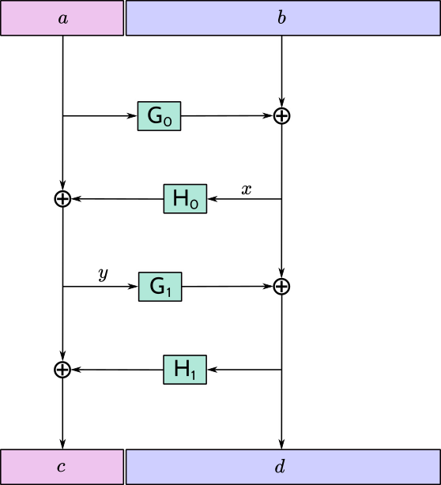
Unified Addresses – F4Jumble
Concating multiple classic addresses together could be more vulnerable to address replacement attacks, if users compare only a subset of the address.
To combine addresses together, came up with an unkeyed 4-round Feistel network, used when encoding and decoding Unified Addresses.
Then encode with Bech32m.
Notes:
Speaker: Deirdre

Slide 24
Orchard Launch 🚀
Targeted for NU5.
Testnet activation planned for July 2021
(delayed to August).
Mainnet activation planned for October 2021
(delayed to November).
Notes:
Speaker: Deirdre
Updated August 19th: Schedule delays.

Slide 25
Thank you! Questions?

