Slide 1

Scalable Privacy
Daira Hopwood
<daira@electriccoin.co>
@feministPLT
@daira on chat.zcashcommunity.com
Slides at https://github.com/daira/scaling
Notes:
To correctly and efficiently express statements for many popular zero knowledge argument systems, we need to understand Rank 1 Constraint Systems. This talk is based on experience optimizing the circuits for Zcash's Sapling protocol upgrade. It aims to teach some of the background needed to:
* design higher-level cryptographic protocols with efficient R1CS implementation in mind,
* specify a statement precisely enough to be able to tell whether it has been correctly implemented;
* understand the R1CS model of computation;
* express various algorithms and types commonly used in cryptography;
* optimize circuit size while reducing the risk of introducing bugs and vulnerabilities.
We concentrate on direct expression of circuits as R1CS, rather than how this would be written in a particular domain-specific language or library.

Slide 2

Disclaimers
This is an opinionated talk that covers only areas of the solution space that I consider most promising.
The Electric Coin Company has committed to researching scaling, and aims to deploy a solution by 2021. It has not committed to using any of the specific techniques described here.
Zcash Sapling has pretty good performance, in concrete terms, already.

Slide 3
Problem statement
A protocol is “horizontally scalable” if by adding compute power in parallel, it is possible to support high (not unlimited) transaction throughput that scales roughly with the number of nodes, and a large number of users.
We don’t demand perfection – in any practical protocol there will be bottlenecks. I still consider a protocol to be horizontally scalable “in practice” if those bottlenecks only manifest at scales much higher than anticipated usage.
Deploy a version of Zcash that is horizontally scalable in practice without compromising on privacy:
  Amounts, senders, and receivers remain private (i.e. the transaction graph is private).
  The note traceability set of any input is “all” previous outputs (that the adversary cannot rule out by information independent of the block chain).

Slide 4
Secondary goals
Allow light clients with weak trust requirements.
  A light client can fully verify the block chain with low bandwidth and storage.
Improve privacy by use of network-layer privacy mechanisms.
  Current Zcash has excellent on-chain privacy but sends transactions in the clear.
Reduce cryptographic assumptions.
  The fact that the zk-SNARK parameter setup requires trust, is a big issue for confidence.
Solve transaction malleability.
  A good payment protocol should be able to provide certainty to payer and payee that a transaction occurred; malleability interferes with this.

Slide 5
Non-goals
Does not need to support general computation.
  A private, scalable, censorship-resistant currency is hard enough.
  The design of private scalability described in this talk can be combined (at significant effort) with other proposals – Zexe, etc.
  Good, auditable contract languages are an unsolved research problem (I like ZkVM and some of the ideas in Move though).
Does not need to support transparent addresses or transactions.
  It’s prohibitively hard to verify Bitcoin script in an R1CS circuit.
  If we can’t verify Bitcoin script, we don’t get Bitcoin compatibility anyway.
  With Sapling (even more so with circuit-friendly hashes such as Rescue or Poseidon), shielded proving time is entirely practical.
  Transparent / only partially shielded transactions are a significant privacy weakness.
Does not need to reuse the Sapling protocol unchanged.

Slide 6
Out of scope for this talk
Reducing latency relative to existing block chains.
  The reduction in verification work per block will probably allow a latency improvement, but other necessary changes may increase latency again.
Secure node discovery.
Alternative designs for assigning resources to shards.
Details of incentivization for miners and various helpers.
Solving Proof of Work’s security problems or resource usage / environmental impact.
Exactly how to preserve continuity from the existing ZEC token.
These are all important problems, but mostly orthogonal to the techniques in this talk.

Slide 7
Privacy properties
Amounts are “easy” to keep private.
  It suffices to use homomorphic value commitments and range proofs.
But this is not enough.
  In a UTXO-style currency, the note traceability set of an input is the set of outputs that could be consumed by that input.
  There are devastating privacy leaks in systems with small note traceability sets, especially (but not only) under active targeted attack.
  “Plausible deniability” is not good enough in the real world.
  Watch Ian Mier’s Zcon1 talk “The State of Privacy in Cryptocurrencies” for details.
  These attacks become infeasible if an input could correspond to “any” previous output (roughly speaking).

Slide 8
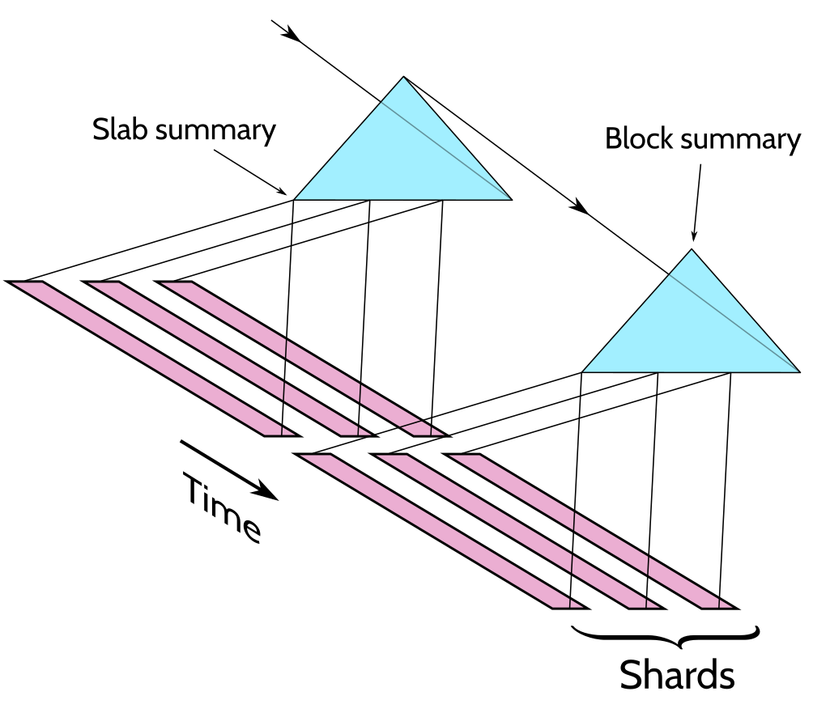
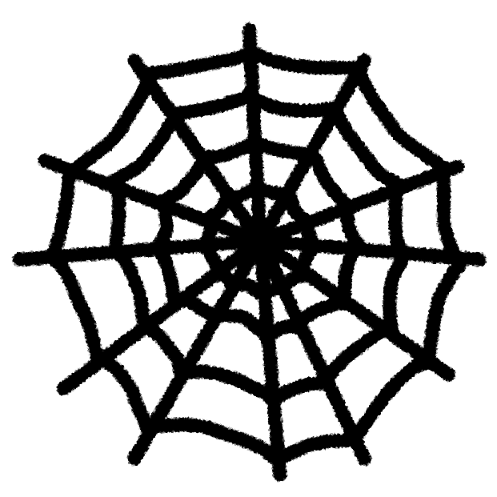
Proposal
Sharding, to scale to high transaction volumes.
Recursive SNARK validation, to create summaries of state updates and to allow clients to catch up almost instantly.
Transparent SNARKs, to limit reliance on trust assumptions.
A mix-net, to replace broadcast of transactions to miners and all potential token receivers, while maintaining privacy.

Slide 9
Sharding + recursive validation

Slide 10
Block chains
Let’s review the block chain model (as used in current Zcash).
We have transactions that describe changes to the system state.
Sets of transactions are collected into blocks.
A chain is a sequence of time-ordered blocks.
We have a set of “consensus rules” that determine which block chains are valid.
  Most transaction consensus rules depend only on a single transaction and the previous block (“independent rules”).
  The only essential exception is the rule preventing concurrent double spends.
We have some consensus protocol that results in nodes eventually agreeing on a prefix of some valid chain.
  This requires certain assumptions that we won’t go into, such as a node having an adequate network view, and an adversary having a bounded proportion of the hash power (in PoW systems) of the whole network.
In more detail: we actually have a tree of possible valid chains, and some rule for deciding which is the “best” valid leaf.

Slide 11
How Zerocash/Zcash works
At a high level, we use the UTXO model from Bitcoin.
Carriers of value are called “notes”.
Notes have a value, a “commitment”, and a “nullifier”, and are linked to an address.
Commitments are binding (only one note can correspond to a commitment).
Commitments are hiding (they don’t reveal information about the note).
Creating an output note:
  reveals its commitment, which goes into a commitment tree;
  fixes a unique nullifier, which is not revealed.
Spending a note:
  reveals its nullifier, preventing it from being spent again;
  proves (in zero knowledge) that it was a valid note, by giving its path in the commitment tree;
  proves (in zero knowledge) that the nullifier and commitment are correctly linked;
  demonstrates spend authority for the note’s address.
The state of the commitment tree and nullifier set is called a treestate.

Slide 12
Zero knowledge proving systems
A statement is a proposition we want to prove. It depends on:
  Instance variables, which are public.
  Witness variables, which are private.
Given the instance variables, we can find a short, efficient-to-verify proof that we know witness variables that make the statement true, without revealing any other information.
A proof of knowledge is stronger and more useful than just proving the statement is true. For instance, it allows me to prove that I know a secret key, rather than just that it exists.
The proof can be just a string; anyone can verify it without interacting with the prover.
I’m glossing over some details, such as setup and variations of the security properties.

Slide 13
How Zerocash/Zcash works, contd.
How does a token-receiver know which transactions are sending tokens to it?
Addresses also have incoming viewing keys.
Output descriptions are public-key encrypted to the key in the destination address.
  The encryption is key-private, so that the ciphertext does not reveal information about the key/address.
Each token-receiver trial-decrypts all transactions using its incoming viewing key.
  We are treating the block chain as a broadcast channel for all transactions.
Privacy doesn’t depend on soundness of the proof system.

Slide 14
Sapling-specific detail
Transactions have a Spend proof for each shielded input, and an Output proof for each shielded output.
  Spend proofs are essential to the idea of the protocol: we need to prove in zero knowledge a rather complicated statement involving showing a path in the commitment tree, deriving the nullifier via a PRF, etc. This requires the full power of zk-SNARKs. Output proofs are more of a technical convenience.
Spend and Output proofs don’t directly check that values balance; they do so via homomorphic value commitments (like in Confidential Transactions, Monero, or Mimblewimble).
The proving system makes use of a particular scalar field efficient in the circuit. We rely on that heavily for optimization, using Pedersen hashes in an elliptic curve over that field, etc.
Viewing keys and payment disclosures allow selectively revealing the content of transactions.
Other features (diversified addresses, possibility of threshold shielded multisig) don’t interact with scaling.

Slide 15
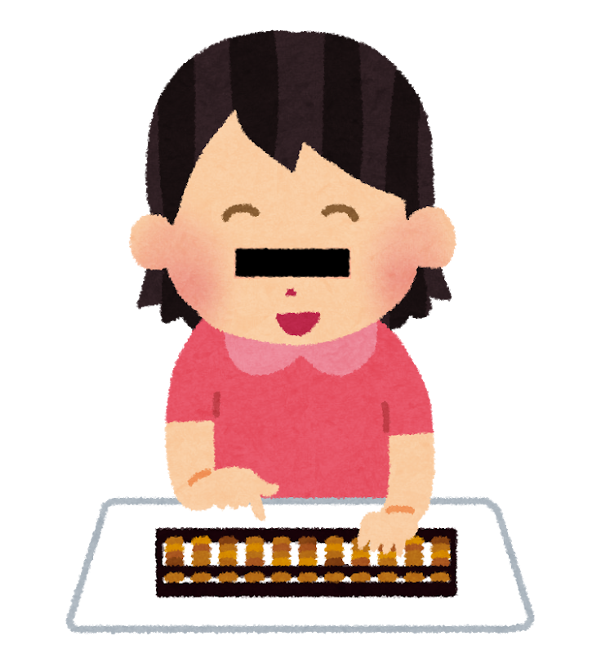
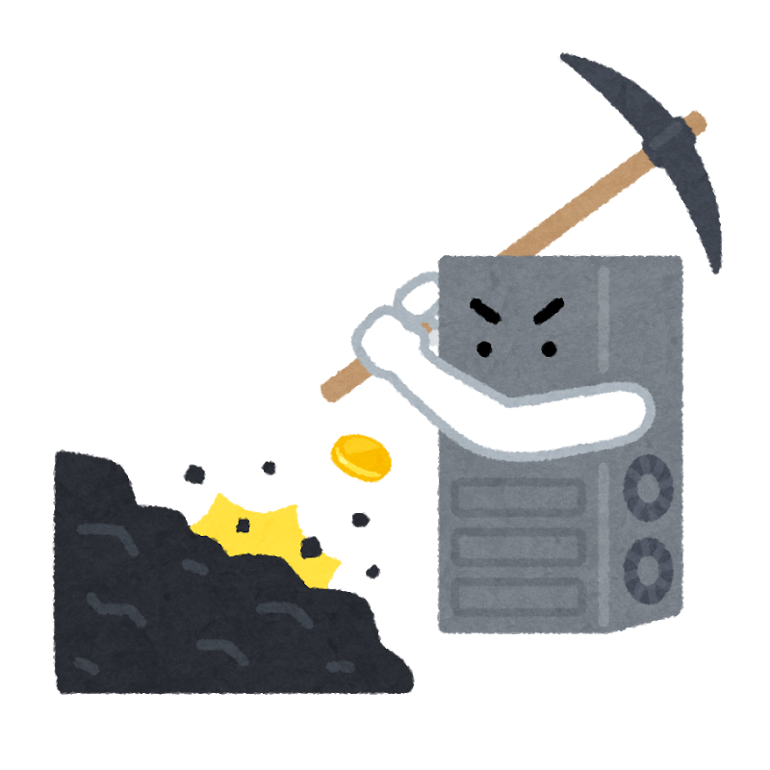
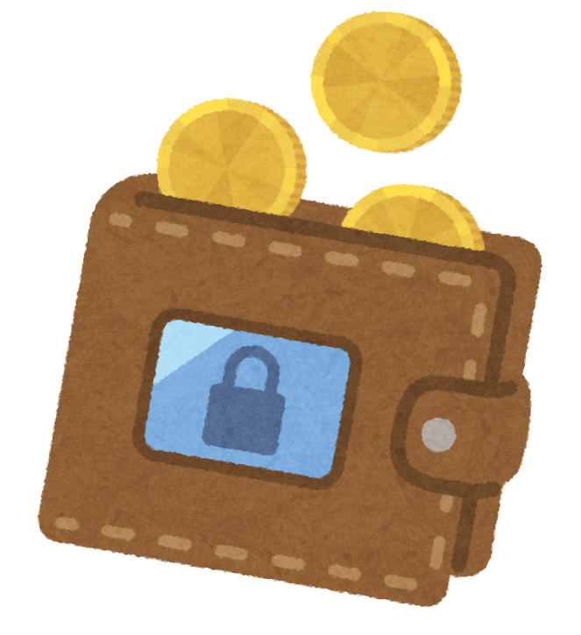

Separated signing
Spend authorization is demonstrated by a signature (with randomized public key for privacy), so that it can be done on a hardware wallet.
Transaction
creation
Spend
authorization
Mining
RedDSA
signatures
zk-SNARK
proofs
Proof of Work
Images: irasutoya.com © いらすとや

Slide 16
Protocol bottlenecks
All validators must validate each transaction.
All validators must update the commitment tree.
All validators must update the nullifier set.
All transactions must be broadcast to every validator and every potential token-receiver.
All token-receivers must check each output in case it is sent to them.
Miners must validate transactions for inclusion in blocks.
Blocks must be broadcast.
  A block includes its transactions, each of which must have been broadcast at some point.
Validators that have been off-line must catch up to the current head.
Note holders update note witnesses per output (in the current Sapling implementation).

Slide 17
Scaling
Conventional block chains aren’t scalable.
Every full validator needs to check every transaction.
Miners are supposed to check every transaction… but we have no reason to trust miners.
What if a miner included a proof that the transactions were valid?
Problems:
  There are a variable number of transactions in each block.
  Doesn’t address bandwidth issues.
  Doesn’t address detection of transactions involving you.
  Doesn’t address storage of commitment trees and nullifier sets.
Broadcast communication of all transactions for anonymity also isn’t scalable.
So we need to combine this with other ideas.

Slide 18
Sharding
Sharding is a common technique for achieving horizontal scalability.
The basic idea is that we split some aspect of a distributed system into multiple communicating copies, or shards.
Sharding can be more or less obtrusive at the payment system layer.
  If it is obtrusive, then payment system layer resources may belong to particular shards, and there may be greater overhead for cross-shard interactions than intra-shard.
  If it is user-obtrusive, then this resource allocation/overhead is visible to users. If it is wallet-obtrusive, then it is visible to wallet (and potentially other ecosystem) software but hidden from the user.
  If it is unobtrusive, then payment system layer resources are global and there is uniform overhead.
The approach described in this talk is wallet-obtrusive. (Notes are assigned to shards; addresses are not.)
I believe user-obtrusive sharding is unnecessary.

Slide 19
Clarifications about sharding
It’s not necessary for shards to be complete copies of the system.
We can pick and choose which resources to shard based on where the bottlenecks are.
The sharding design I’ll be talking about:
  does not shard addresses (there is one global address space);
  does not split the anonymity set;
  does not require end-users to be aware of sharding (although it can affect latency);
  does shard processing of transactions;
  does shard storage of the archival block chain;
  does shard processing of nullifiers;
  does shard the set of notes.
A client sending a transaction to a shard doesn’t need to “catch up” with other transactions.
Technically, there is an limit on scaling due to communication between the shards. But this is not a practical obstacle to achieving the scaling we want.

Slide 20
Censorship-resistant consensus
The hard part of distributed consensus is agreeing on the input.
Three techniques:
  Competition
    e.g. PoW;
  Sortition (selecting parties at random)
    most PoS protocols have this as a component;
  Fault tolerance
    e.g. BFT protocols, MPC, anytrust.
Consensus protocols often combine these.
For this talk, assume we have a censorship-resistant way to select non-conflicting transactions for each time period in each shard.

Slide 21
Zero knowledge proving systems
A statement is a proposition we want to prove. It depends on:
  Instance variables, which are public.
  Witness variables, which are private.
Given the instance variables, we can find a short, efficient-to-verify proof that we know witness variables that make the statement true, without revealing any other information.
A proof of knowledge is stronger and more useful than just proving the statement is true. For instance, it allows me to prove that I know a secret key, rather than just that it exists.
The proof can be just a string; anyone can verify it without interacting with the prover.
I’m glossing over some details, such as setup and variations of the security properties.

Slide 22
Recursive SNARKs
A conventional SNARK has a fixed-size statement.
We can work around this by using a tree or chain of proofs.
Because proofs can be verified in constant time, the verification can be expressed in a statement. Each non-leaf node proves that “I know n verified child proofs”.
We end up proving all of the statements at the leaves of the tree.
  We don’t prove that any single party knew all of the witnesses at the leaves. This is a feature, because we don’t have any single party that knows all of the private keys used in transactions.

Slide 23
Recursive SNARKs
In general we can transform protocols that use zk proofs in a “flat” way, where all proofs are public, into protocols that use trees of proofs as necessary.
  However, we might need to add proofs of things that were previously proven outside zk-SNARK circuits, in order to make this work.
The proofs at each layer can use different proving systems or parameters.
Security properties we need from the proving system:
  All SNARKs, even if public-coin, have a trapdoor that allows creating valid proofs of false statements (or statements for which the witness is unknown). Therefore we need knowledge soundness, since it is vacuous that a valid proof exists for any instance.
  We don’t necessarily need zero knowledge for scaling.
Aside for language geeks: we can model protocols that use recursive proofs using S-attributed grammars.
  A string in the language is the whole state we’re proving things about; the synthesized attributes are summaries.

Slide 24
Evolution of SNARKs
“Private-coin” SNARKs require a trusted parameter setup. If the setup goes wrong, then proofs can be forged.
The design of parameter setup protocols has advanced considerably. We now know how to create proving systems (e.g. Sonic, PLONK, Marlin) with updatable parameters and “universal” setups that work for any statement.
But, pairing-based SNARKs are subtle, and it would be nice to base security on weaker (discrete log) assumptions, with no trusted parameter setup.
Systems such as Bulletproofs satisfy this, but:
  Verification time is roughly linear in the circuit size (and arguably too long in practice).
  Proof size is roughly logarithmic in the circuit size, not constant.

Slide 25
Evolution of SNARKs
Recently there has been an explosion of SNARK designs that try to address these issues.
SHARKs have two verification modes: a public-coin “prudent mode”, and a faster private-coin “optimistic mode”. If the optimistic mode is broken, proofs can be regenerated.
Halo is public-coin and provides “amortized succinctness”, when verifying a chain of proofs (can be generalized to a tree).
  Security relies only on discrete log, similar to Bulletproofs, using easily constructed cycles of small elliptic curves.
  Not zero knowledge in the current paper, but that’s expected to be easy to fix.
Supersonic is the first SNARK to be transparent and also succinct for individual proofs.
  Security for the transparent variant relies on class groups of imaginary quadratic orders. These have a long history and were proposed for cryptographic use by Buchmann and Williams in 1988, but are still unfamiliar to most implementors.

Slide 26
Conclusions about SNARKs
Sonic, Halo, PLONK, Marlin, and Supersonic all use similar constructions that “compile” a SNARK from an information-theoretic proof protocol (of a particular kind), and a polynomial commitment scheme.
This is a breakthrough that allows independent development of proof protocols and polynomial commitment schemes.
We can expect rapid progress both on security assumptions and on concrete efficiency.
For the purpose of this talk, I’m going to assume availability of an “ideal” SNARK that is:
  Public-coin (no trusted setup)
  Succinct (proofs are small and easy to verify)
  Capable of recursive proofs with practical efficiency.
I’ll assume that latency of proving is small compared to the block time.
  This can be relaxed at the expense of some protocol complexity.

Slide 27
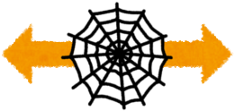
Preserving separated signing
Sending transactions to a shard via a mix-net, instead of broadcasting directly to miners, does not by itself affect separated signing.
But, we have to be able to verify the RedDSA signatures in a circuit. This turns out to be quite practical.
Transaction
creation
Transaction
aggregation
Spend
authorization
Mix-net
RedDSA
signatures
zk-SNARK
proofs
Recursive
SNARK proofs
Images: irasutoya.com © いらすとや

Slide 28
Efficiency for transaction creators
We want creating Spend proofs to still be practical on small client devices.
So, we need to make sure the Spend circuit is still as small as possible.
The public-coin, recursive proof system may be more expensive than Groth16. However, we can potentially use more circuit-efficient hashes for the Merkle tree than Sapling’s current Pedersen hashes.
Additional proof(s) for validation that would be done outside the circuit in Sapling, can either be done by the transaction creator or by a shard participant.
Additional things that need to be proven include:
  verifying RedDSA signatures;
  verifying overall balance and nonmalleability;
  nullifier set updates.
Recursive validation proofs need to be done by a shard participant.

Slide 29
Accumulators and witnesses
A SNARK statement must be represented by a fixed-size circuit.
To prove things about large data structures, we can use cryptographic accumulators.
These are protocols that allow acting on a potentially large structure via a succinct “summary”, and “witnesses” for particular elements.
The accumulators we will use are based on Merkle trees:
  The summary is the root (or collection of roots).
  The witnesses are authentication paths.
We’ll need accumulators for note commitments, and nullifiers.
  Zcash already uses a Merkle tree accumulator for note commitments.
  We need to add one for nullifiers, because we need to verify that notes have not been spent before within a circuit.
In both cases, knowing which witnesses a client is interested in can leak private information.

Slide 30
Nullifier accumulator
Detecting concurrent double spends seems to require merging information across shards. But does it really require that?
Straw proposal:
  Partition the nullifier space, assigning each partition to a shard.
  To spend several notes, they must be in the same shard. Each transaction is sent to the right shard for the notes it is spending.
  If we don’t have enough value in a single shard, we have to move it in a separate transaction.
  The nullifier accumulator can be updated at the same time as aggregating transactions, without inter-shard communication. This is partly sequential, but the actual proofs can be made in parallel.
This solution does not require token holders to maintain witnesses for the nullifier accumulator.
There are privacy concerns about transactions being linked (e.g. if a wallet were to preemptively move all its notes to the same shard). So privacy depends to some extent on wallet behaviour.

Slide 31
Nullifier accumulator
A leaf proof represents the operation “add a nullifier provided that it did not already exist in the set”.
  This has to be combined with a proof that the nullifier is correct for some Spend, but that’s already part of the Sapling Spend circuit; here we’re concentrating on the new part.
Existing constructions for use outside circuits tend to use optimizations that don’t work efficiently in a circuit.
We can use a sparse bucketed Merkle tree.
Nullifiers already have a small probability of clashing by accident due to hash collisions. We can limit the size of buckets provided that the probability of any bucket becoming full is negligible.

Slide 32
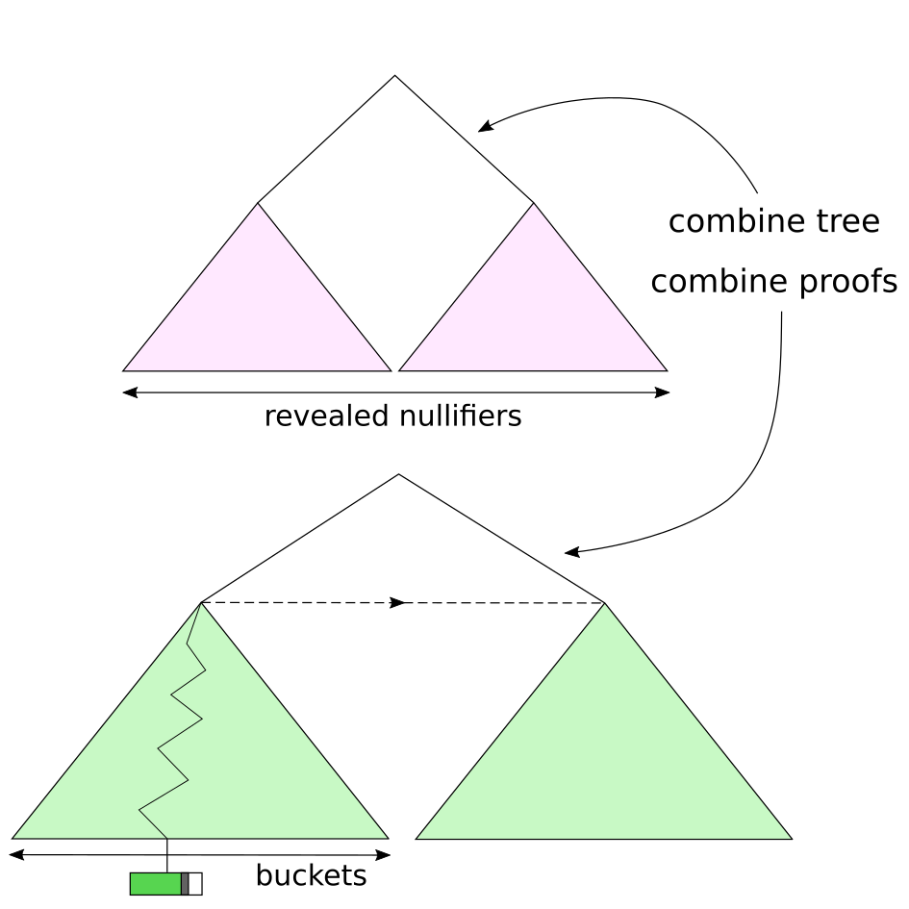
Nullifier accumulator (simplified)

Slide 33
Note commitment accumulator
The note commitment accumulator has to support addition, and membership proofs.
It is sequential-access, i.e. we only add commitments “at the end”.
This allows some nice scalability optimizations: we pay a small cost to increase the depth of the tree, then we can add commitments in batches (as a Merkle subtree per block, say) rather than individually.
Witnesses for held notes then only need to be updated per block – not too much of a problem.
Note holders must keep their witnesses secret and update them secretly, otherwise they leak when the note was created.
This per-block portion of the witness could possibly be represented as a Merkle Mountain Range to further reduce overhead.

Slide 34
Protocol bottlenecks revisited
All full validators must update the commitment tree. Per shard
  The commitment tree is global, but updates are to a particular shard’s subtree.
All full validators must update the nullifier set. Per shard
  Nullifier update proofs are concretely quite expensive. Unclear how much of a problem this is.
All full validators must validate each transaction. Per shard
All transactions must be broadcast to every full validator. Per shard
All transactions must be broadcast to every potential token-receiver.
All token-receivers must check each output in case it is sent to them.
Miners must validate transactions summaries for inclusion in blocks. O(1) per shard
Blocks must be broadcast. Per shard
  A block includes its transactions, each of which must have been broadcast at some point. Per shard
Full validators that have been off-line must catch up to the current head. Per shard
Fast validators need only verify one SNARK proof.
Note holders must update note witnesses per block.

Slide 35
Protocol bottlenecks revisited
Current Zcash includes an anonymous communication protocol that uses the P2P network to broadcast note ciphertexts, encrypted with key-private Diffie-Hellman.
Advantages: simplicity; ideal “on-chain” privacy; clients can recover incoming payments after forgetting all but their private key seed.
Flood-broadcasting all ciphertexts doesn’t scale.
Requesting ciphertexts (if you don’t receive everything) leaks which transactions you’re interested in.
Clients have to trial-decrypt all ciphertexts.
No transport privacy: transactions are submitted in the clear.
Transport privacy is useful for several reasons:
  Even when transactions are fully shielded, some metadata is leaked (e.g. number of Spends and Outputs).
  If I’m the recipient of a payment (or have the viewing key) and also a passive global adversary, I can see where that transaction entered the network.
  Defence in depth.

Slide 36
Scalable anonymous communication
There have been proposals for horizontally scalable mix-nets.
For example, Atom: Horizontally Scaling Strong Anonymity (2017).
Basic idea: verifiable mix-net, in which each node is an “anytrust group”.
When submitting a message, use a non-malleable NIZK to prove you knew the plaintext. (This prevents replay attacks.)
Use ElGamal reencryption to shuffle ciphertext batches; prove within each group that they are correctly shuffled.
Communication cost is O(M/N) → horizontally scalable.
This is an active area of research; there might be better proposals.
There is a prototype of support for Zcash on Katzenpost (an implementation of Loopix).

Slide 37
Payment protocol
How does a payer verify whether or not its transaction got into the chain?
  In current Zcash or pre-segwit Bitcoin, it effectively can’t because transactions are malleable. But we can fix that (it’s simpler for shielded-only).
Better: How does a payer verify that its note was spent in a given transaction?
Modern mix-net designs –Mixminion and later– support “Single Use Reply Blocks” (SURBs). Each SURB allows a message-recipient to reply to a sender once without breaking anonymity.
The destination shard can use this to reply with a receipt that the payer can use to determine whether the transaction got into the chain.
  Unresolved: The shard could include your transaction without sending back a valid receipt.
The payee also gets a message (could be either from the payer or the shard) containing a note.
  Payer has incentive to retry sending to the payee until they confirm.
  If payee doesn’t confirm but keeps the money, then the receipt can be used in disputes.
  We also want to support applications where the transaction is transmitted directly to the recipient.
Unresolved: How do I trial-decrypt with a viewing key without downloading all transactions?

Slide 38
Scalable Privacy
Daira Hopwood
<daira@electriccoin.co>
@feministPLT
@daira on chat.zcashcommunity.com
Slides at https://github.com/daira/zcon
Notes:
To correctly and efficiently express statements for many popular zero knowledge argument systems, we need to understand Rank 1 Constraint Systems. This talk is based on experience optimizing the circuits for Zcash's Sapling protocol upgrade. It aims to teach some of the background needed to:
* design higher-level cryptographic protocols with efficient R1CS implementation in mind,
* specify a statement precisely enough to be able to tell whether it has been correctly implemented;
* understand the R1CS model of computation;
* express various algorithms and types commonly used in cryptography;
* optimize circuit size while reducing the risk of introducing bugs and vulnerabilities.
We concentrate on direct expression of circuits as R1CS, rather than how this would be written in a particular domain-specific language or library.

