Slide 1
Designing zero knowledge circuits
Daira Hopwood
daira@jacaranda.org
@feministPLT
https://github.com/daira
@daira on chat.zcashcommunity.com

Slide 2
Zero knowledge proving systems
A statement is a proposition we want to prove. It depends on:
  Instance variables, which are public.
  Witness variables, which are private.
Given the instance variables, we can find a short proof that we know witness variables that make the statement true, without revealing any other information.
A proof of knowledge is stronger and more useful than just proving the statement is true. For instance, it allows me to prove that I know a secret key, rather than just that it exists.
The proof can be just a string; anyone can verify it without interacting with the prover.
I’m glossing over some details, such as setup and variations of the security properties, which are not the focus of this talk.

Slide 3
ZK proving systems in the real world
Since ~2013, zk proving systems have become practical for real-world applications.
Example: Zcash (https://z.cash)
  Private Bitcoin-like cryptocurrency, with hidden amounts, senders and recipients.
  (Simplified.) “I know the private key that shows I own n, which is a valid note with nullifier nf and a value that balances this transaction.”
  Ensuring that a nullifier is not repeated prevents double spending.
But... only just practical:
  e.g. proof for a private payment at the initial launch of Zcash took > 40 seconds (reduced to 2.5 seconds using some of the techniques described later in this talk).
This talk isn’t about Zcash, but it shows the kind of things we want to be able to prove.

Slide 4
ZK proving systems in the real world
The current focus is on proving cryptographic protocols are followed correctly.
What kinds of things are used in cryptography?
  Hash functions: R = H(B)
  One-way functions: Q = [x] P
  Building blocks: B is a bit string; 0 ≤ x < y; P is a valid elliptic curve point; arithmetic; boolean logic; conditionals; …
  Recursive validation: π is a valid proof for instance X.

Slide 5
Languages for statements
In the future, statements will be written in high-level languages (e.g. Snarky, Zokrates).
This talk is not about how to express statements in a concrete programming language. For that see:
  https://z.cash/blog/bellman-zksnarks-in-rust/ for bellman (Rust library; used by Zcash)
  https://o1labs.org/blog/posts/snarky.html for Snarky (O’Caml embedded DSL; used by Coda)
  https://github.com/Zokrates/ZoKrates for ZoKrates (dedicated language; used in the Ethereum community).
All of these systems compile to a language called R1CS (Rank 1 Constraint Systems), which is the subject of this talk.

Slide 6
R1CS
Even when programming in a higher-level language, it’s necessary to know R1CS.
  just as understanding the machine model is useful for writing efficient code in conventional programming languages…
  but even more so, because Snarky, Zokrates, etc. expose many details of the R1CS model (and future proof-oriented languages are also likely to do so).
We call R1CS programs circuits. This talk aims to give a flavour of how R1CS circuits are written and optimized.
Many different proving systems use R1CS, and it’s a current focus of standards development, so this knowledge is transferrable between systems.

Slide 7
R1CS is only a compilation target
It is untyped (all values are field elements).
  Always use types in specifications or when using a proving library / DSL.
It has no direct support for abstraction.
  It would be difficult to reverse-engineer the intended statement from an R1CS description. Use abstraction mechanisms supported by the proving library / DSL.
It’s very error-prone.
  Overflow, missing constraints, unhandled exceptional cases, etc. can cause silent fatal security flaws.

Slide 8
Fields
We have instance and witness variables. Variables have values in a field.
A field supports addition, subtraction, multiplication and division of elements, with the following laws:
  associativity: (a · b) · c = a · (b · c) and (a + b) + c = a + (b + c)
  commutativity: a · b = b · a and a + b = b + a
  identities: a + 0 = a and a · 1 = a
  inverses: a + (−a) = 0 and a ≠ 0 ⇒ a · (1/a) = 1 (we write a · (1/b) as a/b)
  distributivity: a · (b + c) = a · b + a · c
Examples: real numbers, complex numbers, integers modulo a prime.
We use finite fields for cryptography, because elements have “short”, exact representations. In this talk, we only need integers modulo a prime: 𝔽_{p}.

Slide 9
Consequences of using 𝔽_{p}
Field elements are not integers.
We can use them to represent integers, if we’re careful.
“Short” means ~255 bits
  which is enough to represent a lot of integers, but
  we always need to be careful of overflow.
We can also use them to represent bits: 0 or 1.
  this is inefficient (but often necessary)
  because the proving system still operates on the full field width.
We can use them to represent themselves!
  very useful for elliptic curve cryptography
  but only if the field matches the prime we need.

Slide 10
Rank 1 constraints
A rank 1 constraint system is a set of rank 1 constraints, each of the form:
  (A) ╳ (B) = (C)
where (A), (B), (C) are each linear combinations c₁ · v₁ + c₂ · v₂ + ...
The c_{i} are constant field elements, and the v_{i} are instance or witness variables (or 1).
By convention we write “╳” for the multiplications that we need to count, but it’s the same operation as “·”.
Think of general multiplications and divisions as costing 1 constraint; additions, subtractions and scaling by constants are “free”.
  This is not quite accurate but still a good mental model for optimization. The cost of the circuit will be roughly dependent on the number of constraints (not the complexity of the linear combinations).

Slide 11
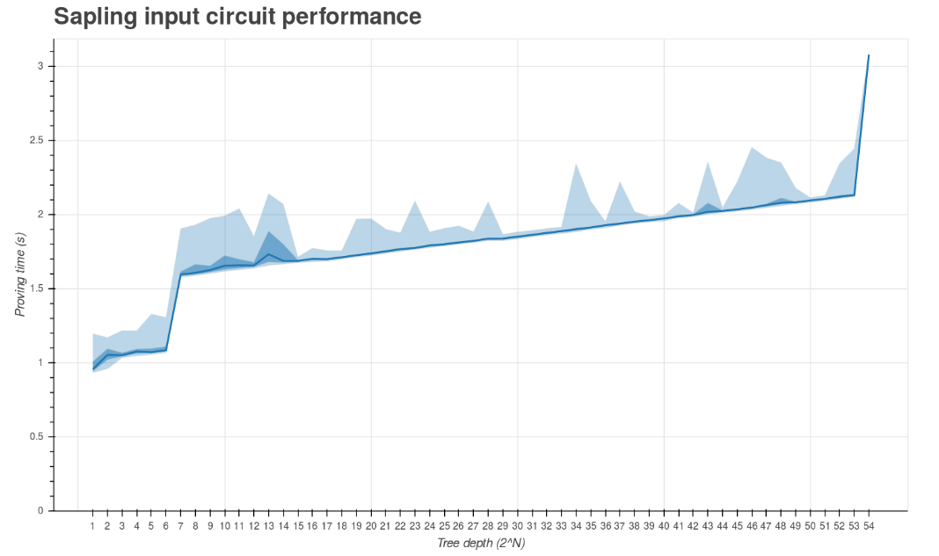
Dependence of proving time on circuit size

Slide 12
Rank 1 constraints
R1CS is a constraint language.
The inputs and outputs of a subcircuit are not predetermined.
  (A) ╳ (B) = (C) doesn’t mean (C) is computed from (A) and (B), just that (A), (B) and (C) are consistent.
  more generally, an implementation of “x = f(a, b)” doesn’t mean that x is computed from a and b, just that x, a, and b are consistent.
Constraint languages can be viewed as a generalization of functional languages:
  everything is referentially transparent and side-effect free
  there is no ordering of constraints
  composing two R1CS programs just means that their constraints are simultaneously satisfied.

Slide 13
Correctness and efficiency
Multiplication and linear combinations allow us to represent arbitrary circuits:
  (1 - b) ╳ (b) = 0 is a boolean constraint for b.
  “a AND b” can be implemented as (a) ╳ (b), and “NOT b” as 1 – b.
  This is a complete set of boolean/bit operations.
The question is how to represent circuits
  efficiently (roughly: in the fewest constraints), and
  correctly (expressing what we intended).
Correctness is a prerequisite for security. It is not sufficient (we also need to be implementing a secure protocol), but it is necessary.
Efficient use of fields can allow 4 orders of magnitude improvement over naive use of bit operations.
  multiplying two 255-bit numbers would require ~34000 bit operations, but we can do it in one constraint.

Slide 14
Starting with the basics
We’ve already seen (1 - b) ╳ (b) = 0.
This is an instance of a common pattern:
  (A) ╳ (B) = 0 implements “A = 0 or B = 0”.
We can substitute A = P - Q and B = R - S, to get “P = Q or R = S”.
We did not “reify” A = 0 and B = 0 as boolean variables and explicitly implement OR.
  Don’t reify constraints as booleans unless you have to. There is a way to do that, but it’s complicated (and costs 3 constraints).
This isn’t the only way to do a boolean constraint: (b) ╳ (b) = (b) also works.
  It’s useful to be able to recognise alternative ways of doing the same thing when reverse engineering R1CS circuits written by others / generated by other libraries.

Slide 15
Inequalities
What about A ≠ 0 ?
0 is the only field element that doesn’t have a multiplicative inverse (1/0 does not exist).
So (A) ╳ (A_{inv} ) = 1 ensures that A ≠ 0.
We’ve added a witness variable, A_{inv}, that is just an implementation detail rather than part of the original statement. This is very common.
  It is a witness variable, not an instance variable, because it would leak information, in this case the value of A, if made public.
A - B ≠ 0 is equivalent to A ≠ B. From now on we’ll take equivalences like this as obvious.

Slide 16
Division
a = c/b is equivalent to (a) ╳ (b) = (c).
What does (a) ╳ (b) = (c) do when b = 0?
  It constrains c to 0 and leaves a unconstrained.
  This makes sense, but is probably not what you want. So don’t do that (either constrain or prove b ≠ 0).
Notice that division is the same cost as multiplication. This is different from computing inverses in a prime field “outside the circuit”, which is much more expensive than multiplication.
  Technically, you still need to compute the division when proving. But the cost of that is far outweighed by the per-constraint cost of proving.
  The different relative costs of operations may lead us to choose different algorithms and representations.

Slide 17
Inversions
Division being expressed via multiplication is a special case of a general principle: inversions are easy to express.
If f is invertible, y = f ⁻¹(x) is equivalent to f(y) = x.
(In the previous slide, f ⁻¹(x) was x/b.)

Slide 18
Boolean operations: AND
Let’s use n-ary AND as an example.
How many constraints do we need to implement b = AND_{i ∈ {1..n}} a_{i} ?
There’s an obvious implementation in n - 1 constraints. Can we do better?
We know the answer is boolean:
  (1 - b) ╳ (b) = 0
If the answer is 1, then all of the a_{i} must be 1:
  (n - ∑ _{i ∈ {1..n}} a_{i} ) ╳ (b) = 0
If the answer is 0, then not all of the a_{i} must be 1:
  (n - ∑ _{i ∈ {1..n}} a_{i} ) ╳ (inv) = (1 - b)
So, at most 3 constraints independent of n.
Notice how we’re making use of the representation of booleans as 0 or 1 and doing arithmetic on them, in order to take advantage of “free” linear combinations. (This won’t overflow because n < p.)
n-ary OR can be implemented similarly.

Slide 19
Range constraints
For binary ranges a ∈ {0..2^{n}-1}:
  boolean-constrain a_{i} for i ∈ {0..n-1}
  ( ∑ _{i ∈ {0..n-1}} a_{i} · 2^{i}) ╳ (1) = (a)
For a ∈ {0..c-1}, let n be the bit length of c and constrain a ∈ {0..2^{n}-1} and a + 2^{n} - c ∈ {0..2^{n}-1}.
There’s a more efficient approach that depends on the bit pattern of c - 1. [Zcash specification, appendix A.3.2.2]
The “╳ (1)” is technically redundant: we could perform a substitution to eliminate it. In general it’s always possible to substitute linear combinations rather than adding another constraint.
  Your constraint proving library/language should do the substitutions for you. bellman supports this; not sure about Snarky or ZoKrates.

Slide 20
Boolean operations: XOR
c = a XOR b can be implemented as:
  (2 · a) ╳ (b) = (a + b - c)
which is equivalent to c = a + b - (a AND b) ? 2 : 0.
What about n-ary XOR? How many constraints do we need to implement b = XOR_{i ∈ {1..n}} a_{i} ?
b is the least significant bit of ∑ _{i ∈ {1..n}} a_{i}.
  boolean-constrain b_{j} for j ∈ {0..ceiling(lg(n))-1}
  (∑ _{i ∈ {1..n}} a_{i} ) ╳ (1) = (∑ _{j ∈ {0..ceiling(lg(n))-1}} b_{j} · 2 ^{j})
Now the answer is b₀.
So, at most ceiling(lg(n)) + 1 constraints independent of n.

Slide 21
Conditionals
A selection constraint (b ? x : y) = z, where b has been boolean-constrained, can be implemented as:
  (b) ╳ (y - x) = (y - z)
We can see this is correct by case analysis on b:
  If b = 1 then y - x = y – z therefore z = x.
  If b = 0 then y - z = 0 therefore z = y.

Slide 22
Elliptic curves
The most commonly deployed public key cryptosystems use elliptic curves.
With elliptic curves we can also implement collision-resistant hash functions.
  Hash functions are the “nails” of cryptography, used everywhere.
EC crypto can be very efficient in a circuit, compared to symmetric crypto:
  SHA-256 takes ~27000 constraints.
  A comparable elliptic curve Pedersen hash takes ~864 constraints, not including boolean-constraining the input.
  This is because SHA-256 is mainly bit operations, while Pedersen makes full use of the field.
  This is completely the opposite situation to crypto “outside the circuit”.

Slide 23

Edwards curves
Equation of a circle: u² + v² = 1
Equation of an Edwards curve: a · u² + v² = 1 + d · u² · v²
Over real numbers, the curve looks something like:

Slide 24
Edwards arithmetic
The circuit implementation basically follows the textbook “affine” equations:
  naive: 7 constraints for addition and doubling
  optimized: 6 constraints for addition, 5 for doubling
  Details in the Zcash protocol spec, appendix A.3.3.
Circuit implementations of elliptic curve arithmetic are actually simpler than out-of-circuit ones, because field division is as efficient as multiplication.

Slide 25
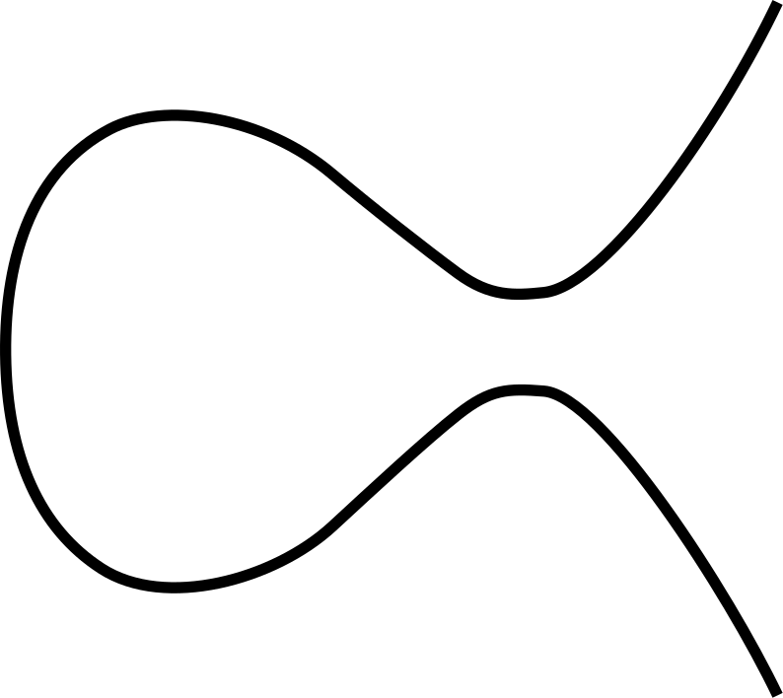
Montgomery curves
Each Edwards curve is “birationally equivalent” to a Montgomery curve:
↔

Slide 26
Montgomery arithmetic
For a Montgomery curve, addition takes 3 constraints, and doubling takes 4 constraints
… but the Montgomery addition doesn’t work in all cases; we have to prove that the exceptional cases don’t occur.
We can use the birational equivalence to convert between the fast-but-tricky Montgomery curve, and the slower-but-easier Edwards curve.
Best to leave this optimization to libraries that are thoroughly reviewed.
Edwards scalar multiplication [x] P:
  fixed P: 750 constraints, variable P: 3252 constraints.
Optimized Montgomery scalar multiplication [x] P:
  fixed P: 506 constraints, variable P: 2249 constraints (a third better).

Slide 27
Side rant about correctness proofs
Common wisdom about use of proofs of (conventional) program correctness: “too hard”, “not ready for prime time”, “the tooling is not there”, “doesn’t scale to real-world programs”, “too hard to maintain when program changes”.
No! DO PROOFS OR YOU WILL FAIL
  Optimizations used in Zcash Sapling had proofs of correctness, so this is practical.
Do not whine about needing to do proofs. If you can’t do them, ask a mathematician / cryptographer / appropriate expert. There is a cultural problem with viewing proofs as rocket science, don’t make it worse.
You don’t necessarily need to use formal theorem provers.
Do proofs about things that are non-obvious
  to you, or to a reviewer
  a lot of things are obvious because the constraint system directly matches the high-level specification.
Typical proofs are of “this unhandled case can’t occur”, “these algorithms are equivalent”. They will mostly stay valid, or be adapted easily, for changes in the lower-level detail of the constraint system.

Slide 28
Recursive validation
Suppose we want to validate a zk proof inside a circuit.
This allows proving a tree of computation of arbitrary size, in just one proof with constant size and validation time.
This is a bit of a tour de force and requires much more math than we have time for. The key component is a “pairing”, which is another kind of elliptic curve algorithm.
Pairings can be implemented in ~7000 constraints, and a full validation (for Groth16) in ~25000 constraints (i.e. less than SHA-256).
  These are preliminary numbers for a specific curve that might not be quite secure enough, but further optimizations are possible.

Slide 29
Conclusions
Writing R1CS programs is interesting and fun…
but very error-prone. Better tools will be needed.
Huge performance gains are possible by choosing the right algorithms, representations, and fields.
Do proofs of correctness where needed.
These slides are at https://github.com/daira/zcon0/blob/master/zkproofs.pdf

Slide 30
Bonus slides: optimization
Find equivalent expressions of algorithms and use the one with the fewest constraints.
If expressions are equivalent except for corner cases:
  constrain the corner cases not to occur, or
  (better, because no extra constraints) prove that they never occur.
Switch between multiple representations.
Change the higher-level protocol to avoid/minimize use of expensive primitives.
Find non-optimizable things first. Try to reuse values that are unavoidably needed.
Use algebraic rearrangement to find common subexpressions / make the remaining computations linear.
Linear expressions are (almost) free. If you are left with linear constraints, remove them by substituting into uses.
  Ideally, your proving library API / DSL should make this easy.

Slide 31
Bonus slides: optimization
Merge to do two things at once.
  Example: merging with boolean constraints in constant comparisons (Zcash spec A.3.2.2).
Specialize for constants.
  Example: lookup from a constant window table in fixed-base scalar multiplication.
Use nondeterminism.
  Examples: proving that a value is a square, or non-zero.
We have concentrated on minimizing number of constraints, but there is also a cost to computing the witness. This can often be optimized by combining operations.
n-ary operations can often be made less than n times as expensive as 2-ary.
Trade operations inside the circuit for operations outside.
Booleans are (typically) represented as field elements and you can do non-boolean arithmetic on them.
The most efficient operations are those you can remove.

Slide 32
Bonus slides: opinionated advice
Avoid 90s crypto
  hashes before SHA-256; ciphers before AES.
  They tend to be inefficient, particularly so in a circuit, even before considering security.
Many standardized algorithms incur expense that is unnecessary for the small fixed input sizes typically used in circuits.
  e.g. can use BLAKE2s on a single block directly as a PRF, no need for HMAC/HKDF
  check with a cryptographer if you are not one.
Scour the cryptographic literature for cheaper primitives (maybe discarded because they weren’t competitive in out-of-circuit computation).
Use personalization. It’s typically free or very cheap, and prevents some chosen-protocol and replay attacks.
Minimize the primitives used. Circuit programming is difficult and the fewer distinct primitives, the less chance of mistakes and the easier review will be.
But don’t be afraid to specialize if it really helps performance.
Include redundant checks if they simplify the security analysis and are cheap enough.
Don’t spend time optimizing stuff that makes little difference to overall performance. “Premature optimization is the root of all evil” still applies.
Set a well-defined “good enough” criterion and stick to it.
If you don’t have imposter syndrome about designing zk circuits in 2018, you’re probably doing something wrong.

