Slide 1
Analog Voltmeter Clock
Leonard Chau, Fall 2024
San Francisco State University

Slide 2
What Does it Do?
Displays the current hour, minute, and second
Displays the current pressure, temperature, and humidity
Keeps clock time when powered down
Clock time is adjustable

Slide 3
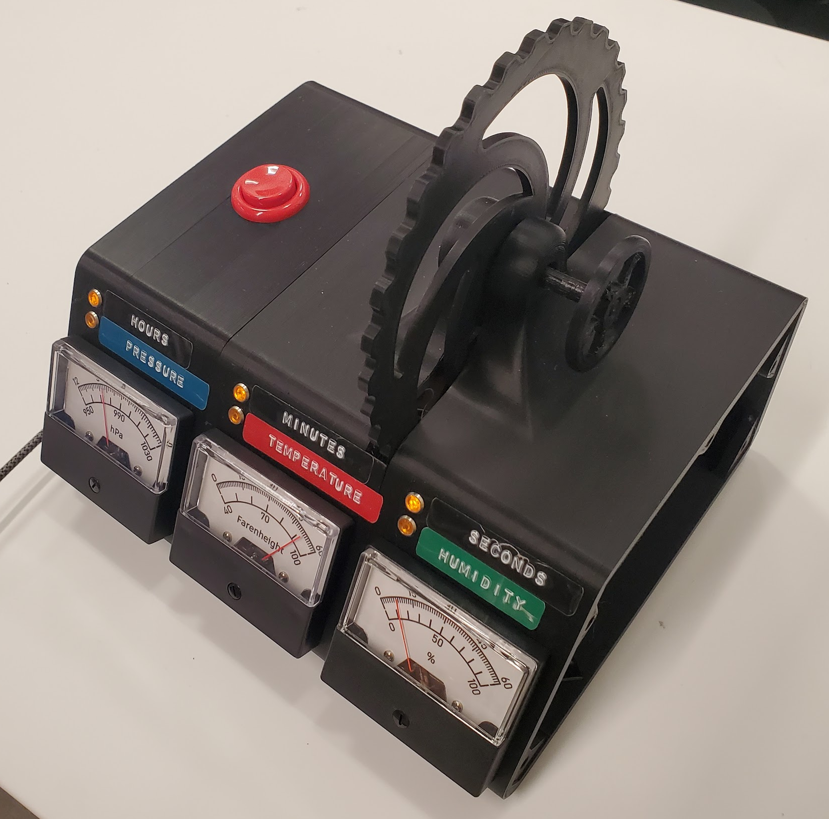
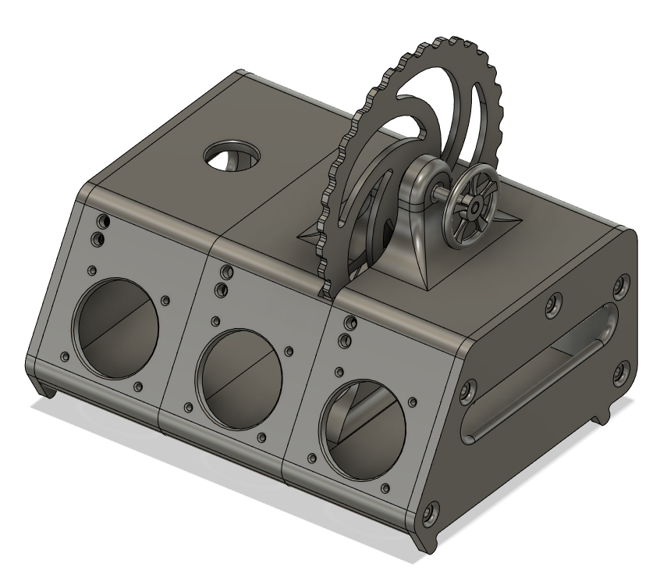
Why Build This?
Something unorthodox, unique, unconventional, clunky
I think analog displays are cool
I’ve been wanting to build a clock with analog display for my living space
I would like to monitor local temperature, pressure, and humidity
Gain experience with microcontrollers

Slide 4
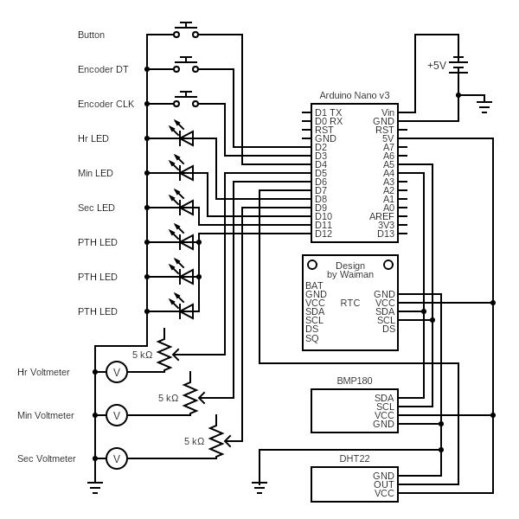
Wiring Schematic
1 Arduino Nano
1 DS3231 RTC Module
6 6V LEDs
1 Button
2 Limit Switches (rotary encoder)
3 5 kohm Potentiometers
3 Analog Voltmeters
1 BMP180 Pressure Sensor
1 DHT22 Humidity Sensor
circuit-diagram.org

Slide 5
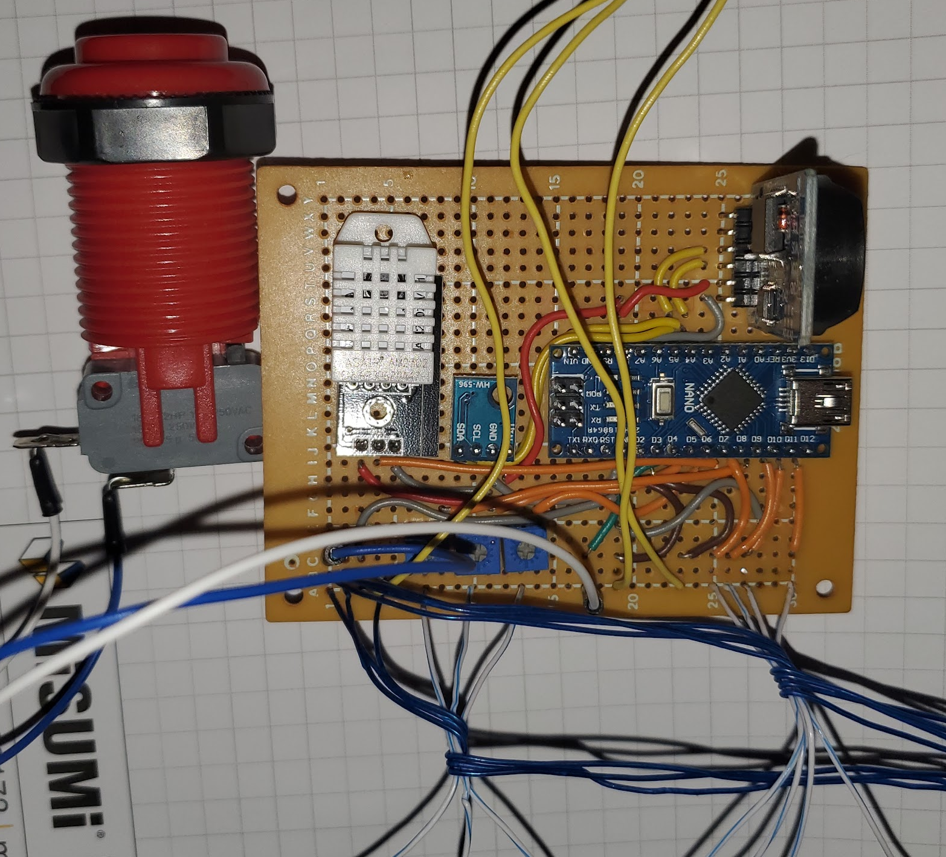
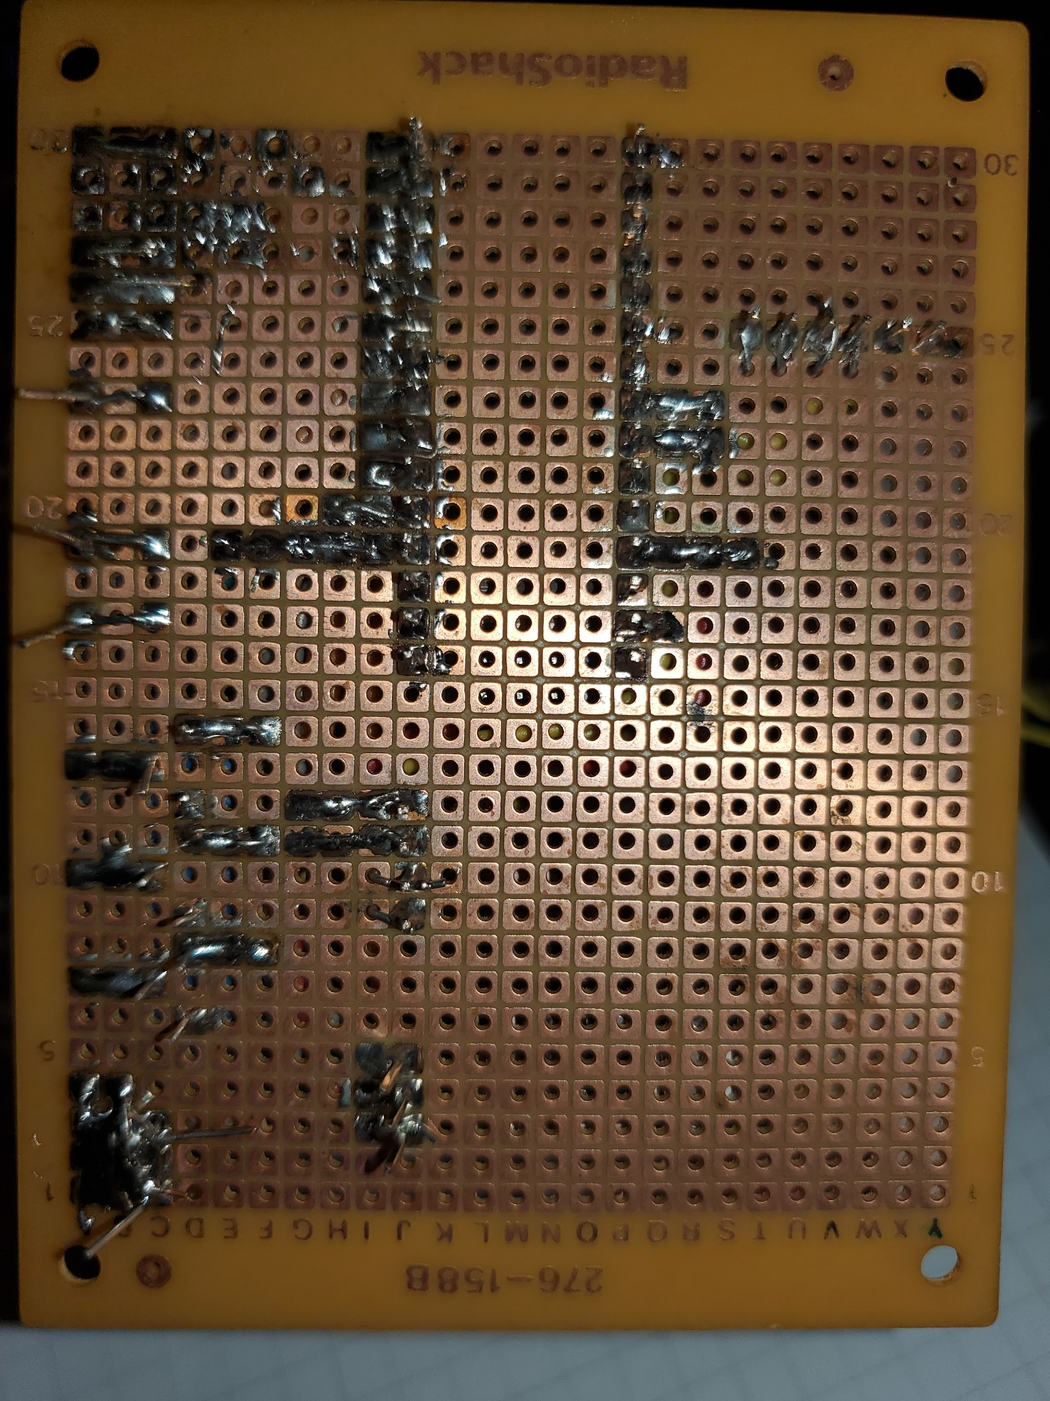

Slide 6
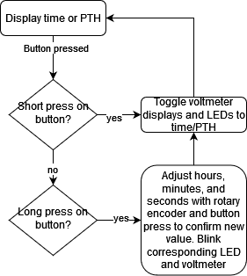
Flowchart
diagrams.net

Slide 7
Testing Process
Modularize circuits and code
  Time retrieval and display
  Time updating
  Pressure reading
  Temperature reading
  Humidity reading
  PTH display
  Rotary encoding
  LED states
Build circuits on breadboard and test components
Combine functions in a combined program
ChatGPT for learning, ideas, inspiration, help, guidance, and debugging
  Use it as a tool, not a solution!

Slide 8
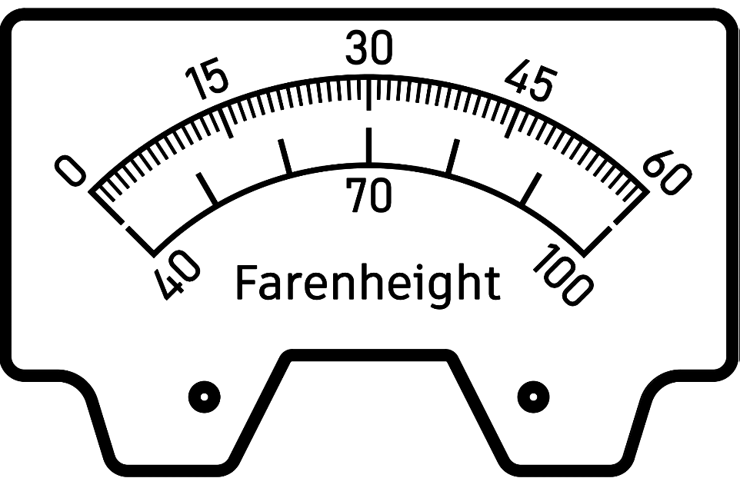
Voltmeter Displays
Modified to be 0-5V by removing internal resistor and using potentiometer
Hours display: 0-12 hours or 950-1030 hectopascals/millibar
Minutes display: 0-60 minutes or 40-100 degrees Farenheight
Seconds display: 0-60 seconds or 0-100% relative humidity
Custom printed scales to suit
seconds/temperature

Slide 9
Code
https://docs.google.com/document/d/1KVLUEeqVKWLGFJV9ItJOi_4preeNTFYhQCk6heJ7_aY

Slide 10
LED Indicators
Displays values indicated by labels
Adjusting time blinks individual LEDs

Slide 11
Sensors
I2C (SDA and SCL pins): RTC and pressure sensors
PWM: Voltmeters and humidity sensor

Slide 12
Now What?
Improve, optimize, and clean the code
Finish 3D printed housing
Finish soldering USB power supply cable
Wireless data transmission of time, pressure, temperature, humidity
Logging and graphing of data
Add function to rotary encoder in display mode
  I ran out of PWM output pins
  Wirelessly control light output, volume, moving art, or something else?
Voltmeter backlighting?

Slide 13
Next Time…
Use a better/newer prototype board
Try different soldering techniques
Using higher quality wire

Slide 14
Thank You!
lchau@sfsu.edu
leonardchau.com

