Slide 1
Technique Exploration Interface
Node-Red Dashboard
…
Unification API
DatasetsAAS
ModelsAAS
ExplanationsAAS
CIFAR-10
ImageNet
…
VGG CNN
SVM
…
LIME
Deep Taylor
…
CIFAR-10
ImageNet
…
VGG CNN
SVM
…
LIME
Deep Taylor
…

Slide 2
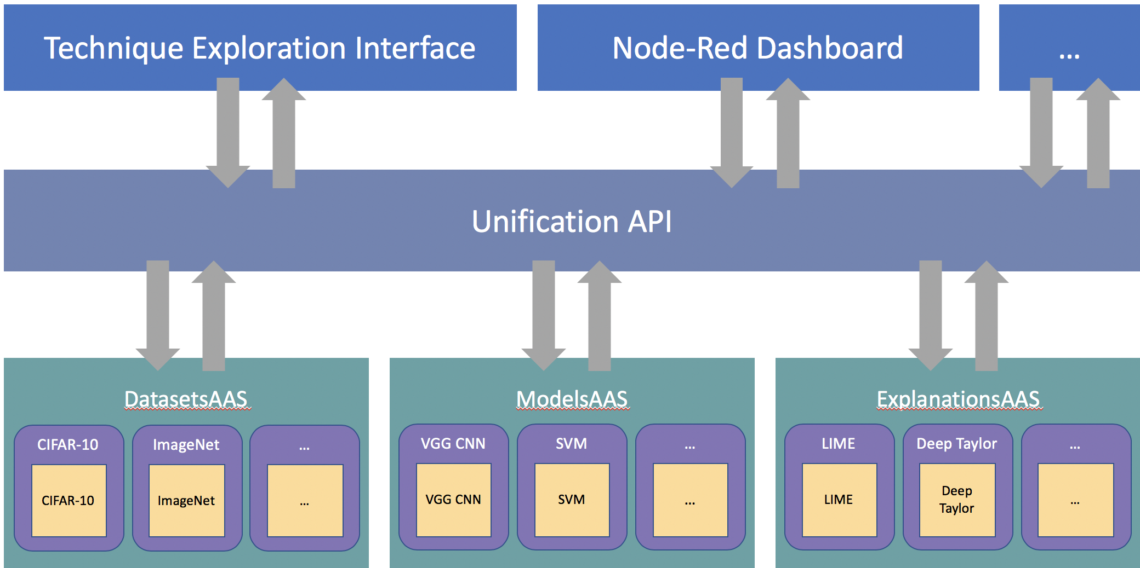
Interface Layer Decoupled interfaces that utilize the Unification API to offer customized ways to interact with the datasets, models and explanations offered in the framework.
Unification Layer An API that offering a single end point for accessing the items within the framework, simplifying the process of integrating them in to applications.
Service Layer “~AAS” (As A Service) web servers existing for each item type. These handle the instantiation and running of the frameworks classes.
Class & Implementations Layer Wrapper classes are implemented around datasets, models and explanation techniques. These provide normalized input and output signatures for using the items. This streamlines the creation of pipelines of items and allows for the inclusion of models and techniques without requiring the use of a single, specific Machine Learning.

