Slide 1
Business Customization
Net API
OkHttp Implementation

Slide 2
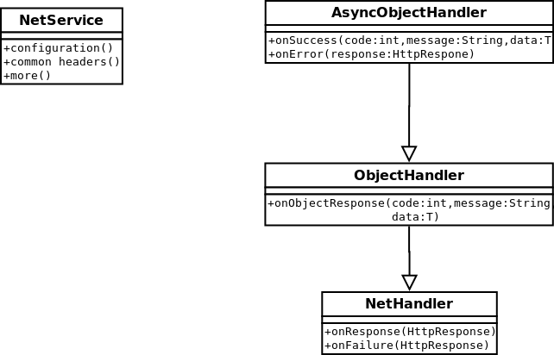
Business Customization

Slide 3
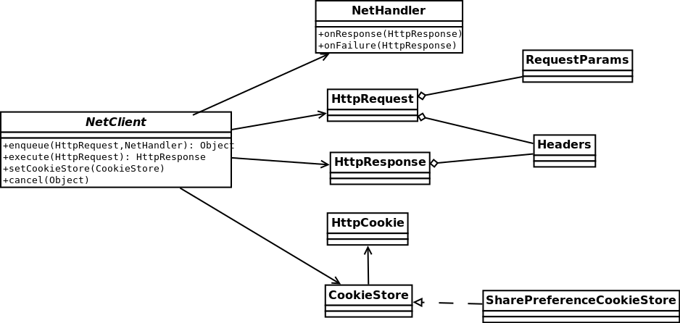
Net API

Slide 4
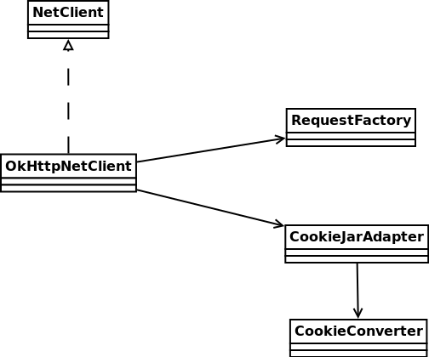
OkHttp Implementation

