Slide 1

Big Mountain Resort New Price Strategy

Slide 2
Problem identification
1. Recover the investment of $1.54 MM for installing new chair lift this season
2. Increasing profit margins from ticket sales during this current ski season.
Can Big Mountain Resort increase its ticket prices?
If so, by how much?

Slide 3
Recommendation and key findings
The resort can increase the weekend ticket prices
Tickets prices increase from $81 to $83 (↑ $1.99)
A total of $3,474,638 over the ski season

Slide 4
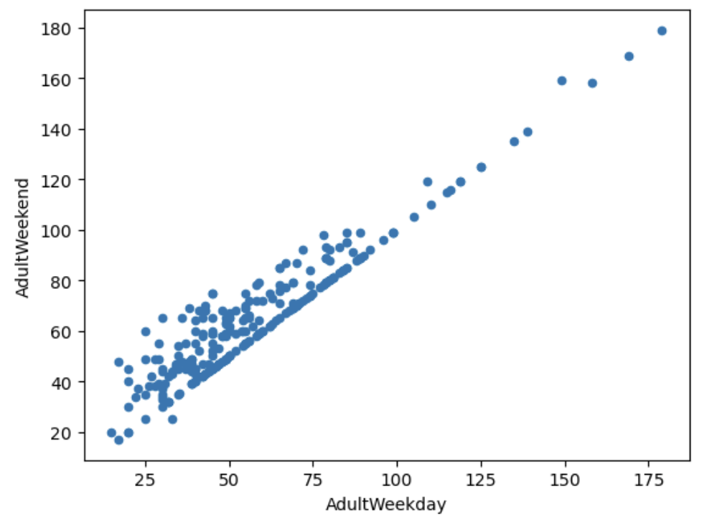
Modeling results and analysis
National Market Share: Weekend prices being higher than weekday prices seem restricted to sub $100 resorts
Big Mountain Resort weekend/weekdays ticket: $81

Slide 5
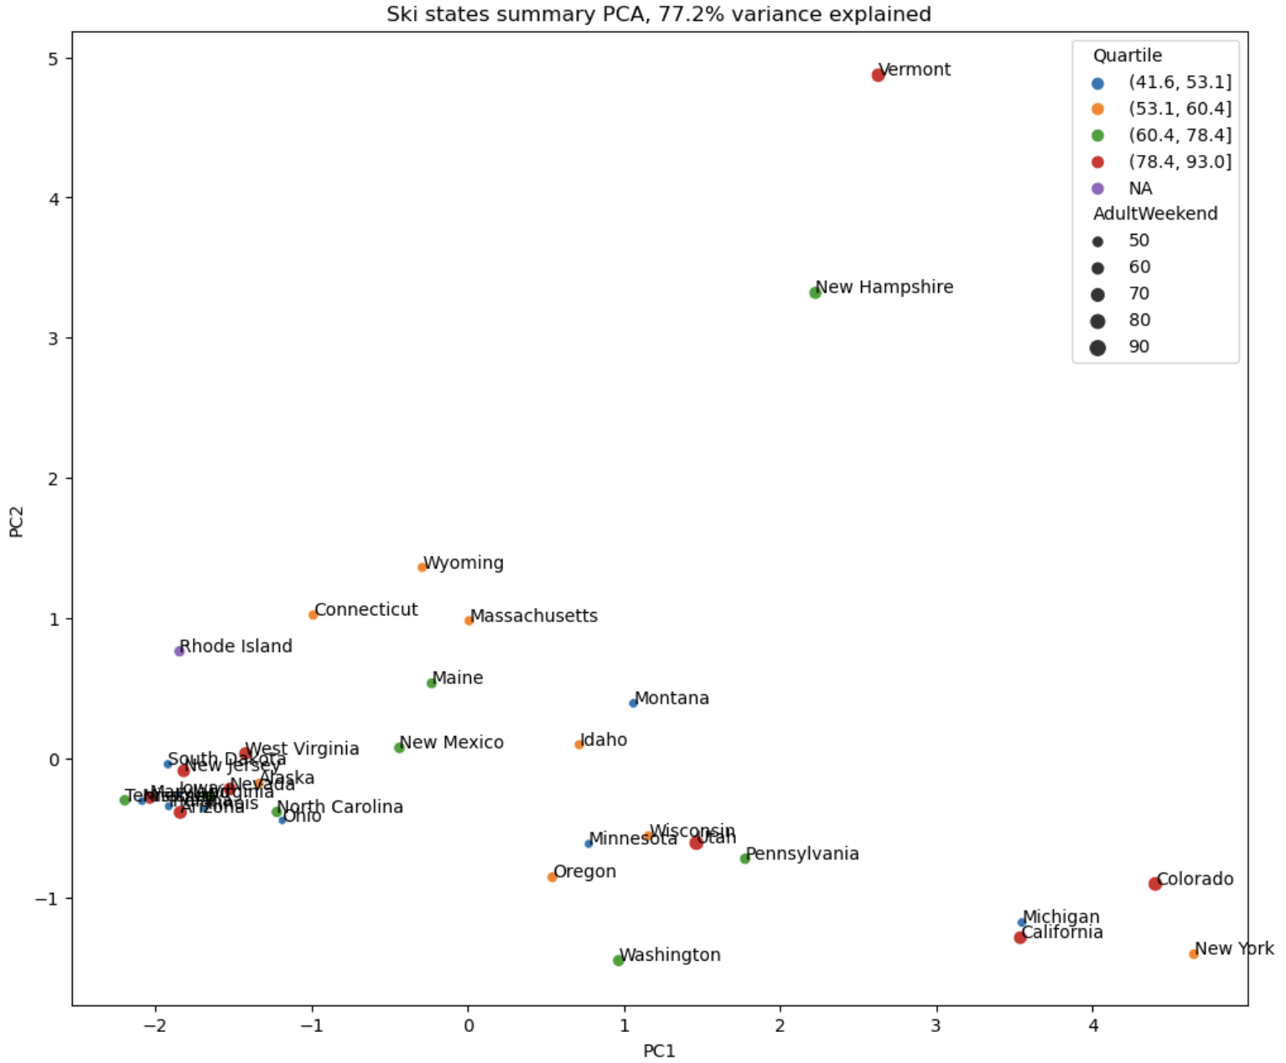
Modeling results and analysis
Two components account for 75% of ticket price variance
No correlation between states and ticket price

Slide 6
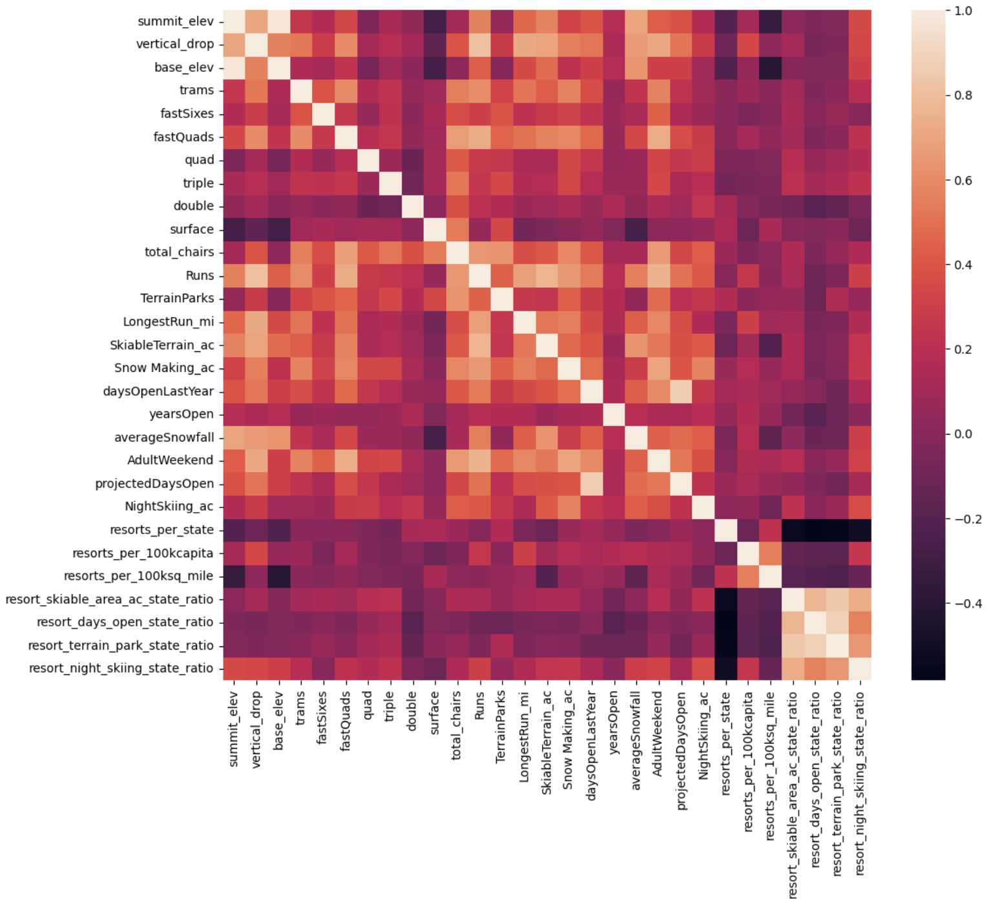
Modeling results and analysis
Primary features impacting prices: FastQuads, Runs, Vertical Drop, and Total Chairs
Parameters for modeling ticket price

Slide 7
Modeling results and analysis
Scenario 1 - Closing up to 10 of the least used runs.
✘ Result: From no difference (1 run) to losing ticket price and revenue (+2 runs).
Scenario 2 - Adding a run, increasing the vertical drop by 150 feet, and installing an additional chair lift.
✓ Result: +$1.99 in weekend ticket price
Scenario 3 - Adding a run, increasing the vertical drop by 150 feet, installing an additional chair lift, plus 2 acres of snow making.
✘ Result: +$1.99 in weekend ticket price
Scenario 4 - Increasing the longest run by .2 miles and guaranteeing its snow coverage by adding 4 acres of snow making capability.
✘ Result: No difference

Slide 8
Summary and Conclusion
Data from 330 resorts in the US
Data analysis
Increasing price for adult weekend tickets from $81 to $83
(↑ $1.99)
Machine Learning

