Slide 1
CreditOne
Analysis of Approving Credits for Customers
Li Ma
May 14 2021

Slide 2
Agenda
Data Science Process Framework
Statement of Goals
Analysis Plan
Data Collection
Data Analysis Process and Potential Pitfalls
Key Insights About Data Outcome
Future Recommendations

Slide 3
Data Science Process Framework
Badir
Reasons why this framework is selected:
Badir aims to provide actionable insights through data
Badir is the best applied to business outcomes and KPIs
Badir uses historical data to solve a business problem
Badir focus on accelerated improvement versus stability
Badir has an inbuilt system to any business context

Slide 4
Statement of Goals
Background Information
Credit One has seen an increase of customers who have defaulted on loans, this needs to be addressed and solved straight away otherwise Credit One could risk loosing business.
Statement of Goals
Our Data Science team is going to use different data analysis techniques to find out how much credit should be given to customers or at least whether they should be approved for having any credits.
Credit One could maximize its profit by setting credit restrictions on customers with poor credit rating and encouraging customers who have good payment history.

Slide 5
Analysis Plan
Analysis Goal - Predict how much credit should be approved for customers
Hypotheses are to be tested - customers who have better education / are married / have default on payment should be given higher credit limit
Data required / available to test Hypotheses - data ‘Credit’ needs to be fetched, cleaned, validated before using
Methodology - Decision Tree Classifier ( useful when there are complex relationships between the features and the output variables )
Project Plan
Timeline - minimum 2 weeks to complete
Risk Involved - risk of the predicted outcome may not be as good as expected as there is very little relationship between given features, new features might be introduced such as income to predict more accurate result

Slide 6
Data Collection
Data Collection includes Data Description / Acquisition and Data Validation.
Description & Location of data obtained
Description - Credit One is an external client and stores all of their data in a MySQL database
Location - We used Structured Query Language ( SQL ) to query the database table and retrieve the data into a Pandas Dataframe
Pandas DataFrame is a widely used data structure which works with a two-dimensional array with labeled axes ( rows and columns )

Slide 7
Data Collection
Data Cleaning and Validation
there is a duplicated row 202 in the dataset has been removed
no missing values found after running missing value function
columns ‘sex’, ‘ education’, ‘marriage’ and ‘default payment next month’ have been label encoded so they have numeric values
the remaining columns have been converted from object to numeric values
deleted header ‘X1’, ‘X2’, ‘X3’ and have header ‘LIMIT_BAL’, ‘SEX’, ‘EDUCATION’ instead
data validation includes checking data types, data info. etc to ensure data functioning properly

Slide 8
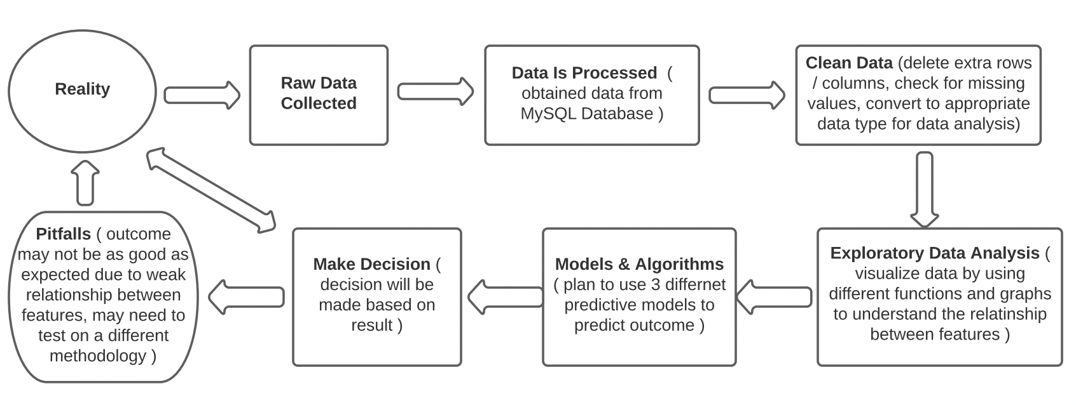
Data Analysis Process and Potential Pitfalls

Slide 9
Key Insights
Relationship between data found that needs to be focused on:
Negative relationship between ‘Age’ & ‘Pay’ ( payment not tied to customers’ age )
Positive relationship between ‘EduUniversity’ & ‘Pay’ ( customers tend to pay on time with University degree )
Positive relationship between ’Limit_Bal’ & ‘Bill_Pay’ ( bill statement is slightly higher when credit limit is higher )
Positive relationship between ‘Pay’ & ‘Default_Payment’ ( customer have default payment for next month tend to pay bill on time )

Slide 10
Future Recommendations
More features should be tested to decide credit allowance such as:
- income ( do customers make enough money to cover their bills? )
- debt ( how much do customers owe, how much credit are they using? )
- current accounts ( how many accounts do they have open for what type of loans? )
- account history ( how long they have for current accounts, and how many more
new accounts they’ve opened recently? )
Reward customers with good payment history
- higher credit limit can be offered
- vouchers can be rewarded to those customers

