Slide 1
Motion Planning

Slide 2
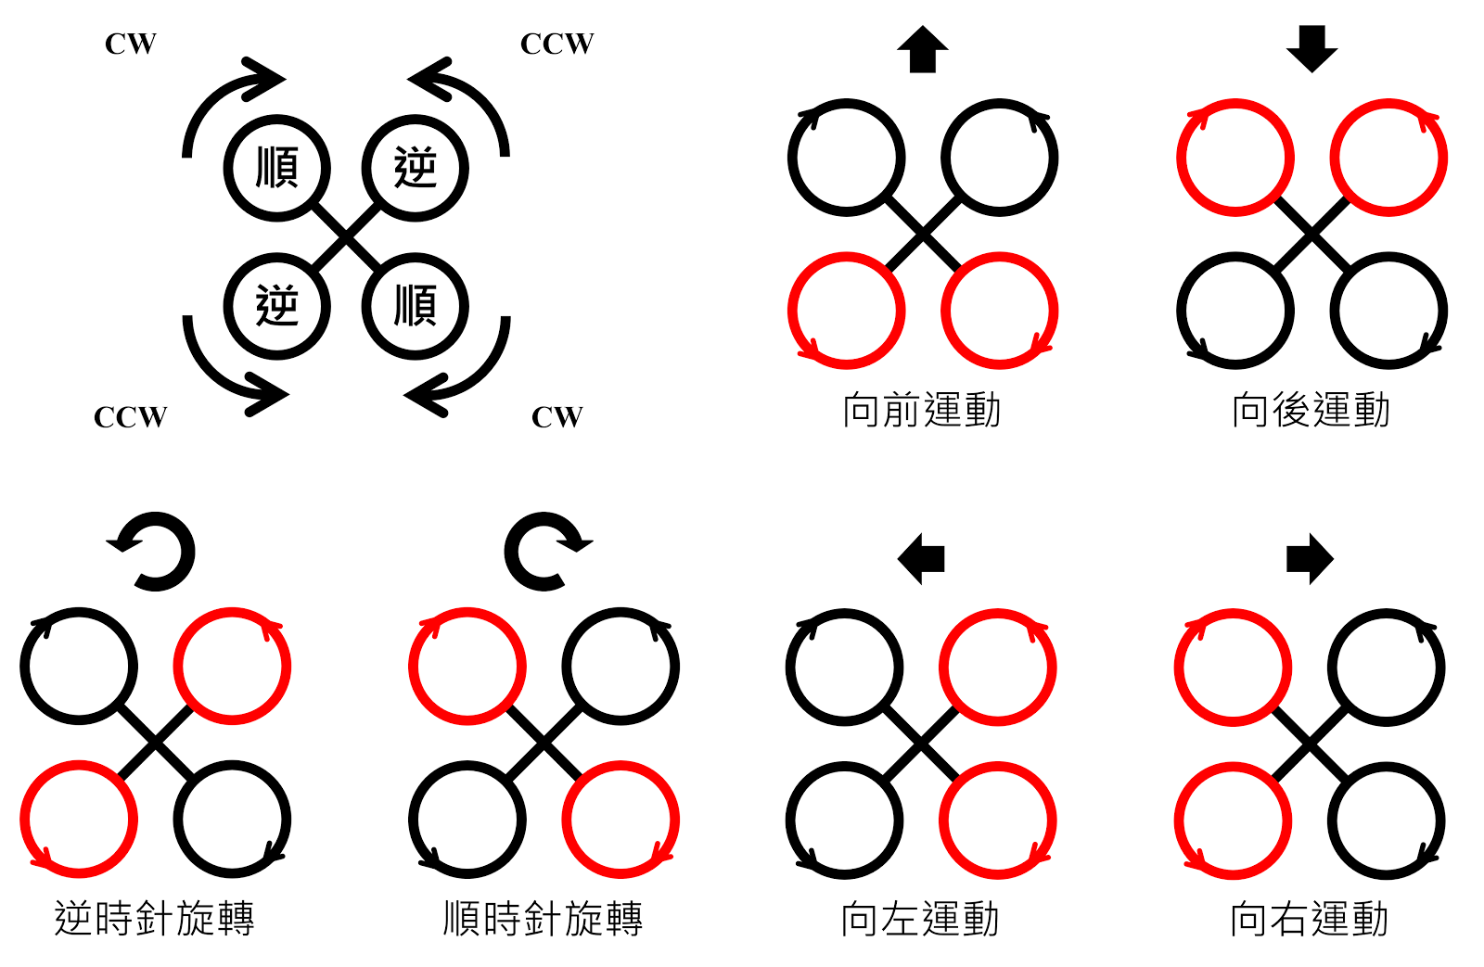

Slide 3
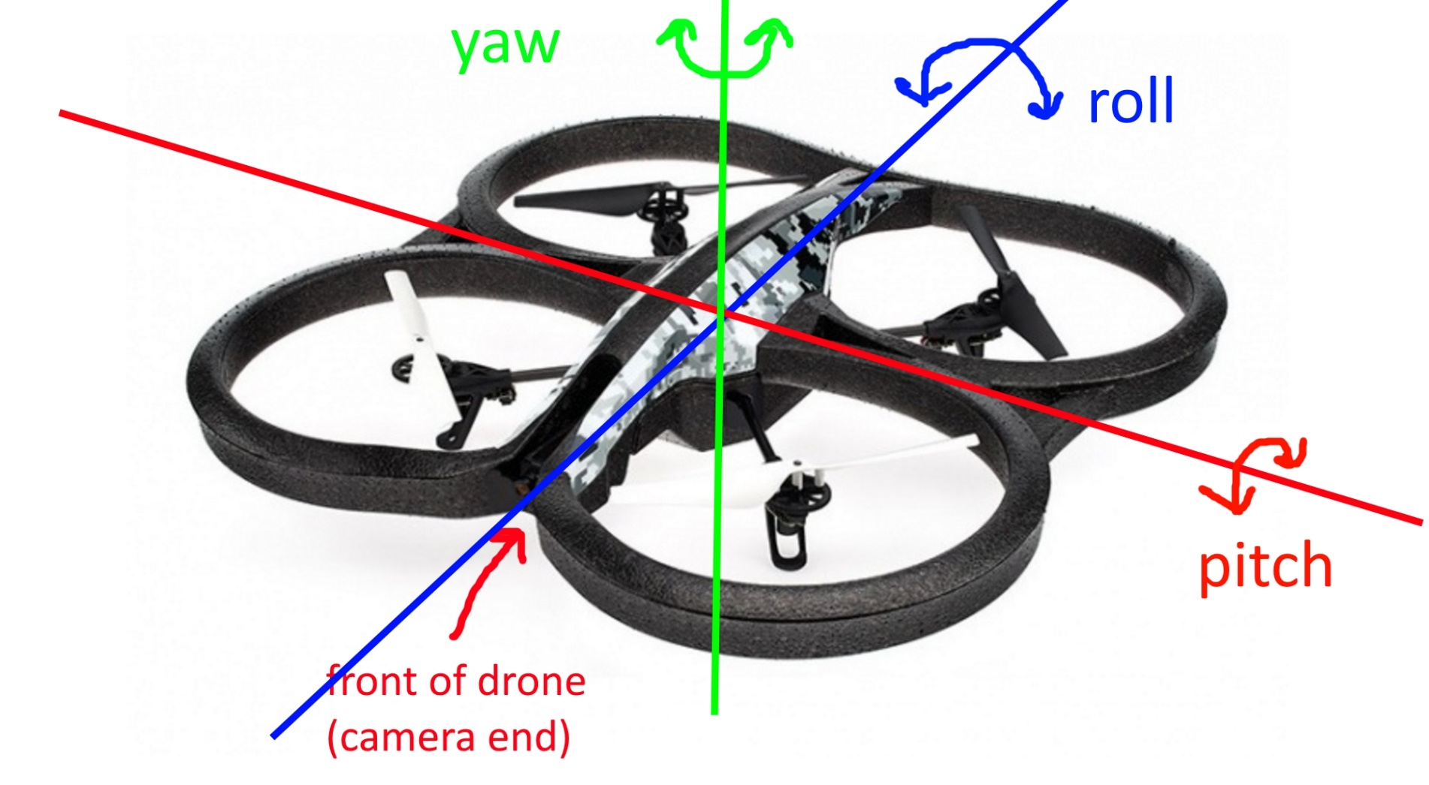
Yaw : 繞物體的ｚ軸旋轉
Pitch : 繞物體的ｙ軸旋轉
Roll : 繞物體的ｘ軸旋轉

Slide 4
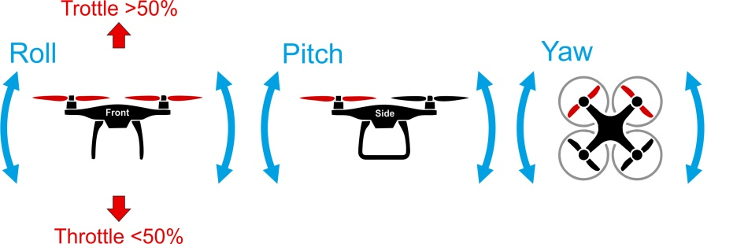
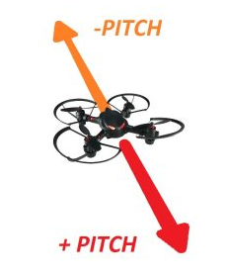
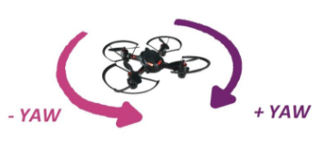
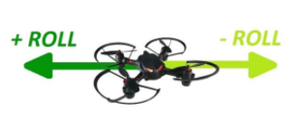

Slide 5
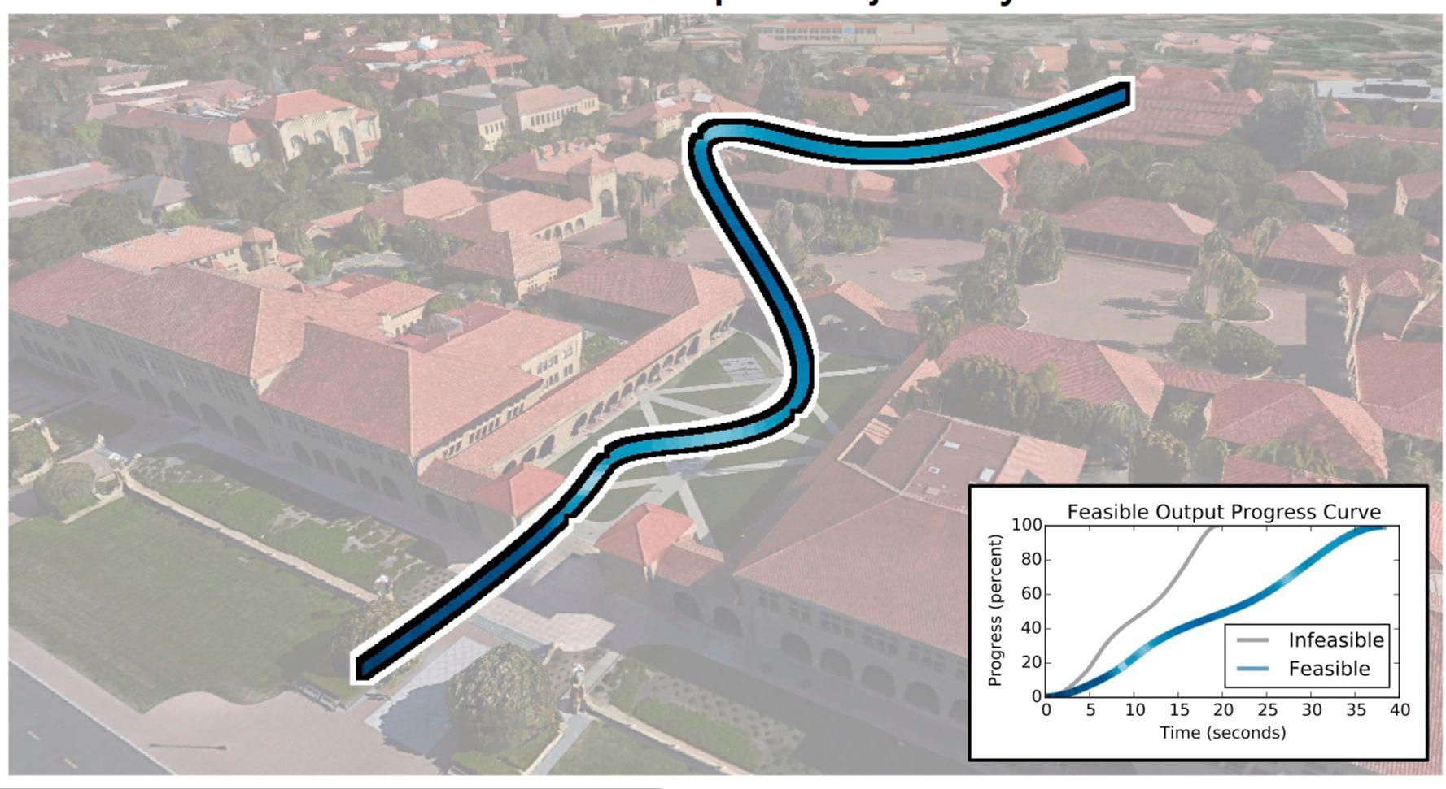

Slide 6
PID Control

Slide 7
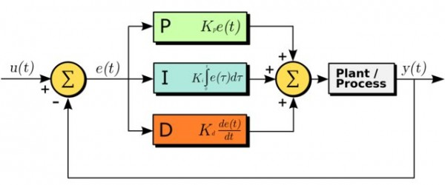
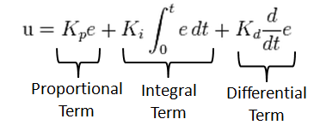
Theory

Slide 8
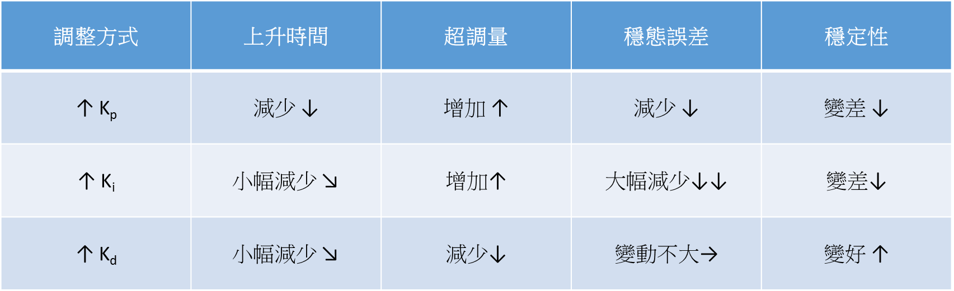

Slide 10
Algorithm
#Note: Set dt to small value, tuning constants Kp, Ki and Kd to appropiate values, and goal_speed to the desired flight speed.
previous_error = 0
integral = 0
while true{
actual_speed = getGroundSpeed()
error = goal_speed - actual_speed
integral = integral + error*dt
derivative = (error - previous_error)/dt
output = Kp*error + Ki*integral + Kd*derivative
previous_error = error
setThrottleLevel(output)
wait(dt)
}

Slide 11
Landing

Slide 12

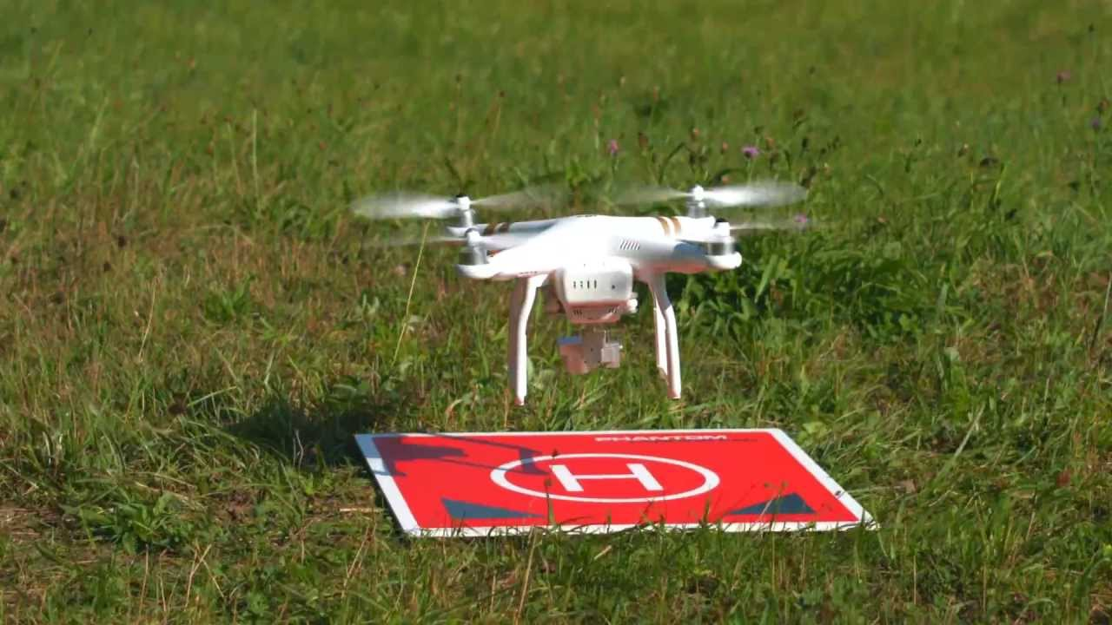

Slide 13
Lab06
PID Control

Slide 14
PID Control (100%)
目標 : 調整PID參數使無人機能流暢穩定地移動，且在追蹤marker
時能保持一定距離並讓marker在畫面中間
評分：１～１０分由助教依各組無人機表現狀況給分，而實際總
分則為７０＋得分＊３

Slide 15
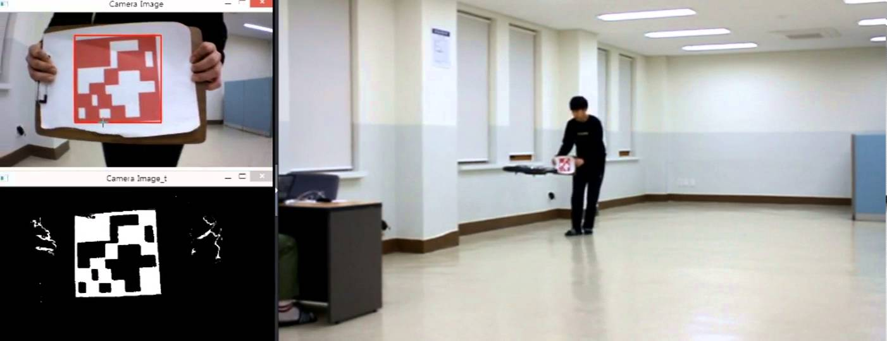

Slide 16
Midterm Project

Slide 17
