Slide 1
AriZona Beverage Company IT Infrastructure Solution
Carlyle Deauna, Jenny Harmsen, Daisy LaFlamme, Leo Wu, Gregor Merkle

Slide 2
Company Background:
One of the leading beverage companies in U.S.
Iced teas, sport drinks, energy drinks, and specialized water.
Direct sale company, large retail chains, and independent stores.
International - Canada, Mexico, Panama, Puerto Rico and the Caribbean.

Slide 3
Existing IT Infrastructure
SAP software – core distribution operations.
Route settlement information is stored to general ledger and warehouse management solutions.
SAP landscape runs on multiple 80-core Intel-architecture production landscape, and complex web of dependencies combined with limits on processing capacity
Reliability and scalability problems.
Reporting issues.

Slide 4
Problem
Route settlements - 120 employees take 10 hours to finish inventory report.
Employees checking each and every shipment to make sure the correct shipment was received.
Problems with the morning reports.
The existing IT infrastructure is unreliable and lacks scalability.

Slide 5
Solution
We will implement the use of handheld reporting devices that drivers will bring along with them while they make deliveries.
Built-in barcode scanners to document that an order is correct, and a digital signature will confirm that an order was received.
Internet-ready in order to forward real-time information to AriZona's warehouse.
AriZona's enterprise software will be integrated to the handheld device’s software thought APIs provided from the vendor, allowing for seamless integration of the data acquired during deliveries into the general ledger.
The use of the handheld devices will eliminate the need to take stock of shipments at the end of the day. This process will be automated and the company will save 32 working hours (from different employees) for each working day.

Slide 6
Budget: $750.000

Slide 7
Identifying Alternatives:
Updating the old system
Custom-built software – in-house build
Custom-built software – outsourced
Off-the-shelf software
Off-the-shelf software with customization

Slide 8
Defining Feasibility
Updating the old legacy systems will be undo-able because it is written with old programming language and standards.
Custom-built software with outsourcing will be very costly in matter of consulting and pay by hour programming labor.
Examining different off-the-shelf enterprise systems and software, our team could not find a complete match of the software services provided with company’s needs.
We decided to order an off-the-shelf software product and customize it to suit AriZona’s needs.

Slide 9
Defining Total Cost of Ownership
Outsourced Custom-built Enterprise Solution:
Direct cost: $400,000
Indirect cost: $450,000.
Indirect cost: $50,000
Total: $900,000
In house Custom-built Enterprise Solution:
Direct cost: $400,000
Indirect cost: $250,000
Indirect cost: $250,000
Total: $900,000
Off the shelf Enterprise Solution:
Direct cost: $350,000
Indirect cost: $200,000
Indirect cost: $250,000
Total: $800,000
Off-the-shelf product with customization:
Direct cost: $350,000
Indirect cost: $300,000
Indirect cost: $50,000
Total: $700,000

Slide 10
Defining Total Benefits of Ownership
Off-the-shelf software with customization will provide the following benefits:
Reducing time for preparing paperwork and reports.
Easier communication between Financial, Shipping, and Inventory departments.
Eliminating data redundancy and data inconsistency.
Faster order placing and shipping. That will increase customer satisfaction – better and faster customer service.
More efficient and faster reporting – delivery and inventory reports will lead to better decision making in the Inventory and Marketing Department.

Slide 11
Analyzing Alternatives
Custom-built solution for AriZona’s problem will be expensive and 200,000 over budget.
Off-the-shelf system will be affordable but it will cost too many changes in AriZona’s business processes. Major changes to the business might turn to employee loss or higher percent of employee turnover.
Off-the-shelf product with customization will be on budget because the company will buy enterprise system modules for the Shipping and Inventory departments, and it will customize the module for the Financial and Marketing department. Hardware cost will be more significant than software cost because AriZona will have to buy handheld mobile devices for each delivery track. Another hardware expense will be for more powerful servers that will handle processes of data delivery, updating inventory data, and reporting.

Slide 12
Mobile Handheld Device will provide the following solutions to AriZona:
Accurate Deliveries with Consignee Signature Capture
Wireless Data Communications
Greener, More Efficient Operation
GPS Location Technology
Reports
Automatic Integration
Management Reports
Loading Reports

Slide 13
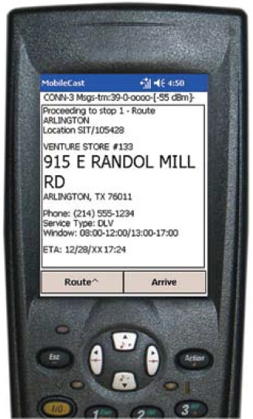
The Device

Slide 14
The new server will offer the following solutions to AriZona:
Real-Time Dispatch and Route Execution
Proactive Customer Service
Data Integrity
Exchange Information
Management Reports

Slide 15
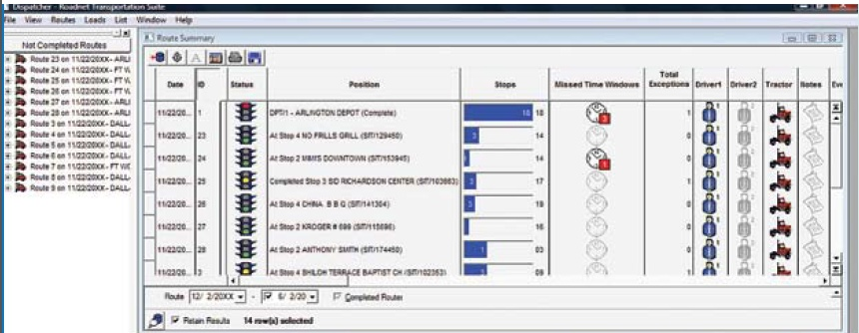
Software Interface

Slide 16
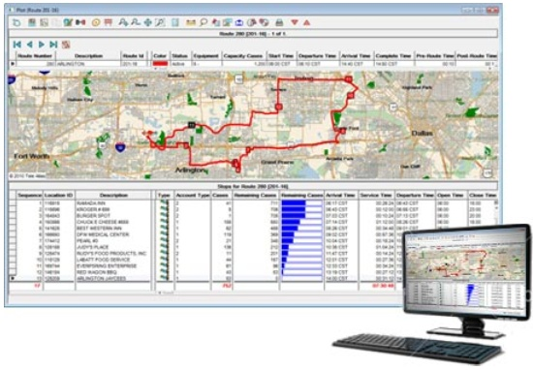
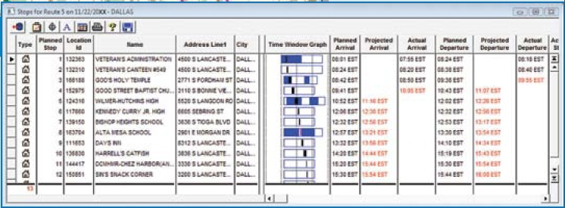

Slide 17
Expected long-term results
Reduction in miles driven
Increased driver productivity and delivery accuracy
Improved customer service
Reduction in vehicle expenses

Slide 18
Assumptions
AriZona is not yet using handheld devices on deliveries
Drivers are capable and willing to use handhelds in their daily work
It is easily possible to equip bigger delivery units of AriZona products with barcodes or they already have them

Slide 19
Rationale
Arizona grew exceptionally in last 20 years
problem of scalability
Required changes bear opportunity to do things right from ground up
→ Handhelds will increase profit and decrease cost

Slide 20
References
http://www.roadnet.com/pub/products/MobileCast/Handheld/
http://www.01.ibm.com/software/success/cssdb.nsf/cs/STRD8RAEED?OpenDocument&Site=wsportal&cty=en_us

