Slide 1
Circuit Design
By Daisy LaFlamme

Slide 2
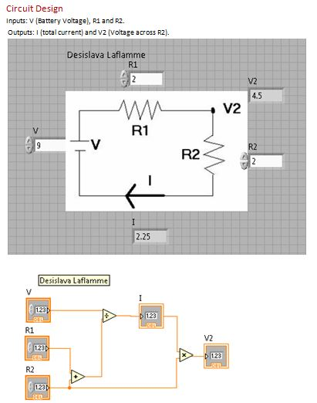

Slide 3
