Slide 1
Comparison Shopping
Smart Shopping

Slide 2
What the user wants?
To find the lowest possible price on a specific product (
To find information and reviews in order to make a selection.

Slide 3



Online comparison using shopping engines:
http://www.pricegrabber.com/
http://www.comparisonshopping.com/
http://www.bizrate.com/
http://www.nextag.com/
http://www.shopzilla.com/

Slide 4
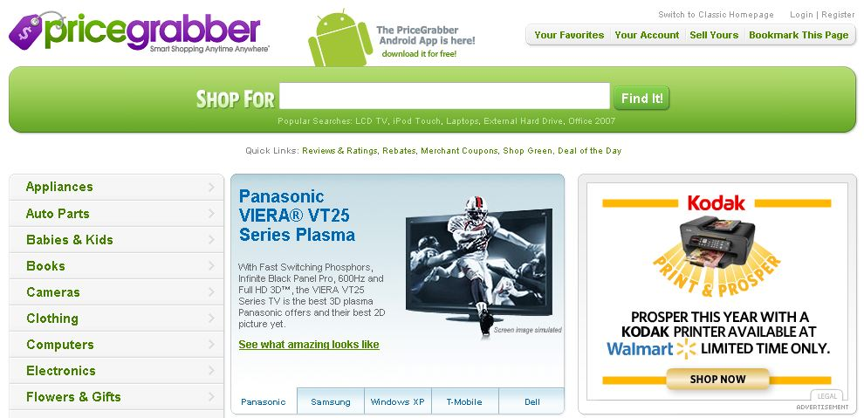
Example of a shopping engine: http://www.pricegrabber.com/

Slide 5
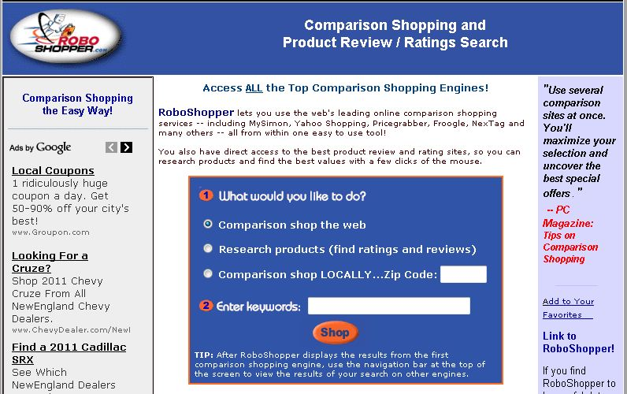
New Future: RoboShopper.com!

Slide 6
Local Shopping Search
Search online
Compare local store prices
Go to the store and buy

Slide 7
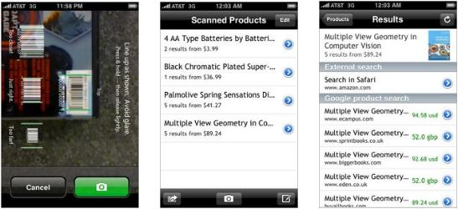
Cell Phone Bar Code Scanners
Red Laser for iPhone
ScanLife Barcode Reader for Blackberry
Android Barcode scanner

