Slide 1
Engineering Solutions with LabView
By Daisy LaFlamme

Slide 2
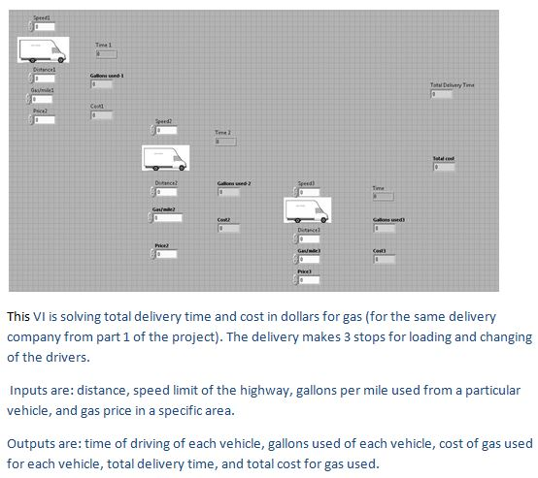
Shipping

Slide 3
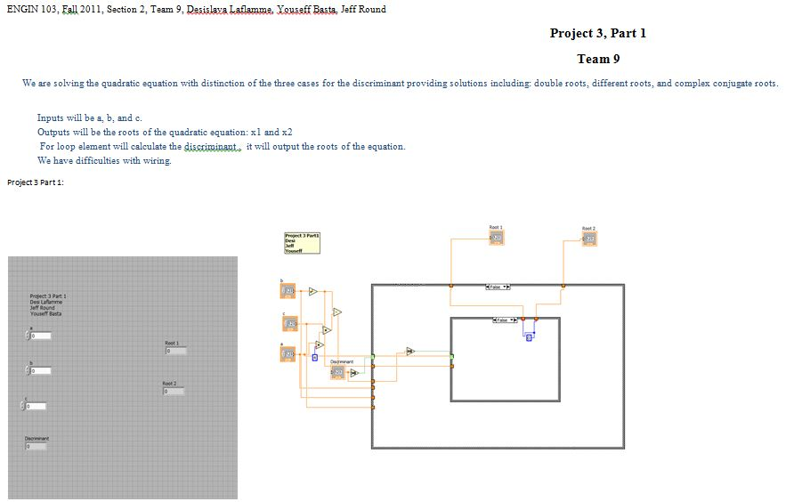
Quadratic Equation Solution

Slide 4
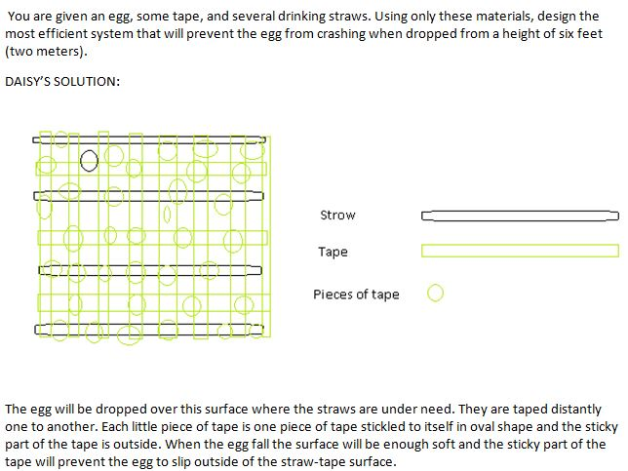
Egg, Tape, and Few Straws

