Slide 1

Open Source Software
Daisy LaFlamme

Slide 2
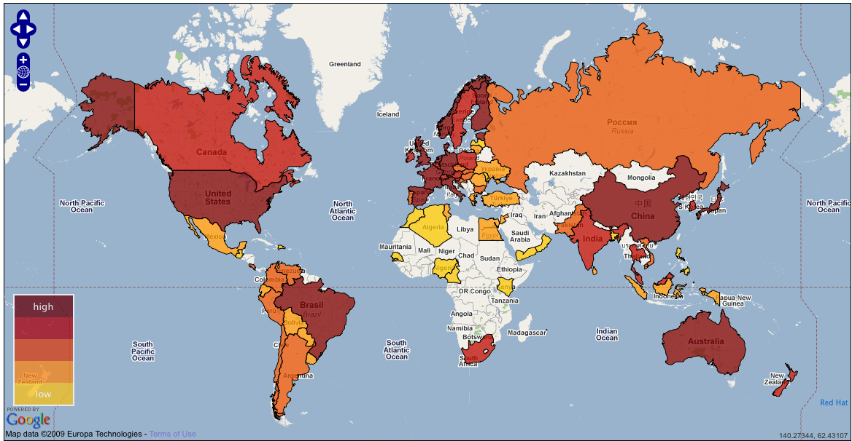
Open Source Adopton

Slide 3
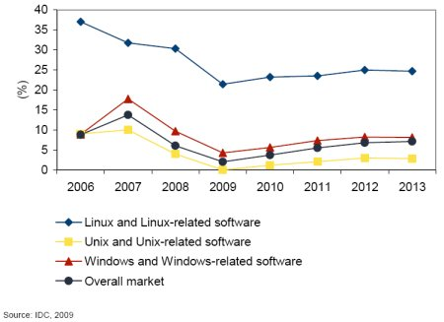
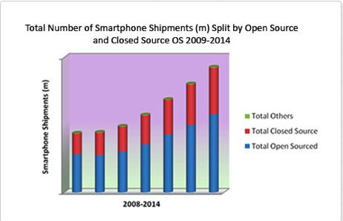
Open source software is better for society than proprietary closed source software
OS Software
Smart Phone Software
Notes:
http://www.linuxfordevices.com/c/a/News/IDC-open-source-study/
http://zhiq.posterous.com/smartphones-by-openclosed-source-os-2009-2014

Slide 4

Why Consider it? (Strengths)
Army of free labor (community of users, and feedback)
. Better project quality

Slide 5

Better project quality
Internet Explorer vs Firefox, Safari, Chrome and Konqueror.

Slide 6
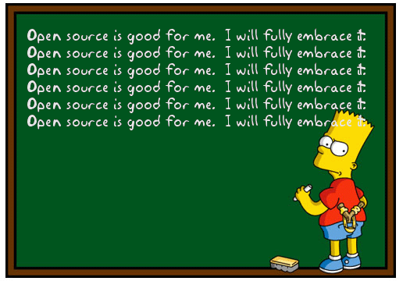
Sell service, not a product
Service costs vs. Service AND product. Product is given away, so income must come from selling services.
Types of services:
1. tech help / education
2. updates

Slide 7


Examples of Successful OS projects
FIREFOX
APACHE

Slide 8


Examples of Successful OS projects
MEDIA WIKI
MySQL
Notes:
Purchased by Sun
Then aquired by Oracle
Caused a litigation debate within the EU, regarding the loss of
social benefit provided by MySQL
Oracle VOWS to keep MySQL Open

Slide 9
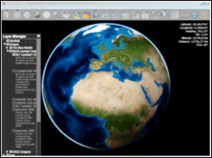
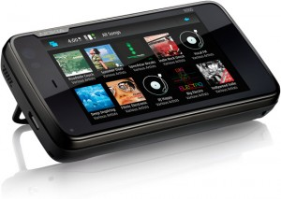
EXAMPLES
NASA is utilizing OSS to cut costs and ensure higher quality
Nokia N900, Samsung
Notes:
Nasa: http://www.nasa.gov/open/plan/open-source-development.html
IBM + Sun: http://news.cnet.com/8301-13505_3-10198900-16.html
Oled car: http://www.reghardware.com/2009/03/04/edag_demos_lcos_at_geneva/

Slide 10
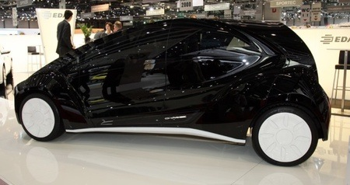
Electric vehicle with an OLED tail-gate
l

Slide 11
Sources
Nasa: http://www.nasa.gov/open/plan/open-source-development.html
Oled car: http://www.reghardware.com/2009/03/04/edag_demos_lcos_at_geneva/

