Slide 1
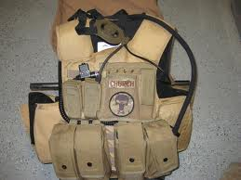
Dragon Skin
- Dragon Skin is a type of ballistic vest made by pinnacle armor.
It is currently produced in Fresno, California
Developed since the early 1990’s
Tested by all military branches, utilized by the CIA, Navy, Air Force, and marines.

Slide 2
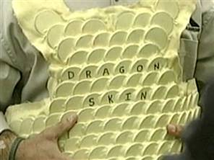
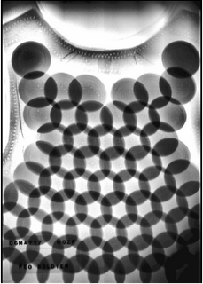
design
The Armor is available in 3 basic protection levels (depends on the effectiveness of the armor.
SOV-2000 level-3
SOV-3000 Level-4
Third model not available to general public.
SOV-2000 armor is made of an imbricated overlapping configuration of high tensile ceramic discs encased in an aramid textile cover.
Different layout configurations with variations in coverage are available

Slide 3
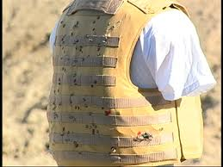
Test results
Dragon skin has been put through many firing tests, a majority of which are extremely positive
Fragmentation grenade – No penetration
5.57 M16 Round- No penetration
7.75 AK47 Round- No penetration
Adjusted Temperatures- penetration at 120+ Fahrenheit

Slide 4

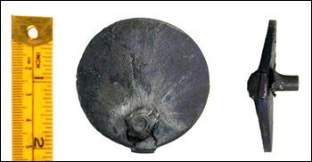
development
Strongest and lightest body armor to date
Demonstrated a 45-52% reduction in back face deformation and reduce trauma to the body
Provides much greater coverage without sacrificing flexibility

Slide 5
Careers
CAD Drafter – must have 3-5 years of mechanical CAD drafting experience.
Mechanical Engineer – This position involves the design and development of complex mechanical systems
Estimator – can handle plan take off, purchase and sales.

