Slide 1
Introduction to materials science engineering
What is it? A field of engineering that encompasses the spectrum of materials types and how to improve the quality of life.
History: One of the oldest forms of engineering. Evolved from metallurgy, which evolved from mining, ceramics and the use of fire.
Why is it important? We live in a world that is both dependent upon and limited by materials, materials science engineering allows us to create things like Biomedical devices, space shuttles, TVs, cars, airplanes, computers, and dishes
Different corporations involved: Microsoft, Motorola, Boeing, General Electric, and General Motors, Material science engineering is involved with many different types of corporations these are just a few.

Slide 2




Material scientist and engineers societies
There are different societies to promote the global science and engineering professions concerned with material. And here are some:
The mission of TMS is to promote the global science and engineering professions concerned with minerals, metals, and materials.
Objective of ACerS is to understand and study
ceramic and related materials, for the benefit of our members and society.
The MRS is an organization of materials researchers from academia, industry, and government that promotes communication for the advancement of interdisciplinary materials research to improve the quality of life.
ASM International serves materials professionals, worldwide by providing high-quality materials information, education and training, networking opportunities, and professional development resources in cost-effective and user-friendly formats.

Slide 3
Founded in 1973
The society’s Core Principles were interdisciplinary, focused symposia, and greater interaction among researchers.
Over 16,000 members from the U.S. and over 80 other countries.
Allowed research for self strengthening nano composites and electro gram sensors to be viewed and tested by other researchers.

Slide 4
Fundementals
The basis of materials science relates the desired proportions and relative performance of materials in certain applications to the structure, or atomic architecture.
Other than Industrial interest, materials science has gradually developed into a field that develops tools for all sectors of scientific research, medical facilities, and military technology.

Slide 5
Engineering fields
Jobs include research development for mechanics, medical fields/instruments, MEMS (micro-electro-mechanical systems), micro and nano-tech.
Disciplines include computational materials science, corrosion and environmental effects, and bio-technology.
Engineers are problem solvers– people who make things work better, more efficiently, quicker, and less expensively. They use their skills to search for better and easier way to solve any problem.

Slide 6
The American Ceramic Society (ACerS)
Founded in 1899 by the members of the National Brick Manufacturer’s Association.
It’s a non-profit professional organization for ceramics, with a focus on scientific research and emerging technologies. It’s located in Westerville, Ohio.
It’s organized into ten divisions. The following three divisions are the most important divisions.
Electronics examines ceramic materials for use in electronic devices.
Cements centers on the development and manufacture of cements, limes and plasters.
Engineering Ceramics deals with the use of ceramics and their composites.

Slide 7
How has Material Science Engineering improved the quality of life?
We live in a world that is both dependent upon and limited by materials. Everything we see and use is made of materials: cars, airplanes, computers, refrigerators, microwave ovens, TVs, dishes, silverware, athletic equipment, and even biomedical devices such as replacement joints and limbs. All of these require materials specifically tailored for their application.
It’s an engineering field that encompasses the spectrum of materials types and how to use them in manufacturing.
Materials span the range: metals, ceramics, polymers (plastics), semiconductors, and combinations of materials called composites.

Slide 8
How does Material Science engineering affect the world?
Developments in metals like iron and bronze enabled advances in civilization thousands of years ago, a synergy which continues today in the fiber optics that have created the World Wide Web and in the development of biomaterials that mimic living tissue.
Materials engineering also consists of protection and prevention like paints and finishes. Alloying is another aspect of material engineering, combining two different types of metals to produce a stronger metal.

Slide 9

American Society for Metals (ASM)
Starts as a society interested of steel treating, 1920
Now ASM is network of 36,000 members worldwide
ASM is dedicated to serve the materials science and engineering profession
ASM provides authoritative information and knowledge on materials and processes
Serves material professionals, nontechnical personnel, and managers worldwide by providing high-quality materials information, education and training

Slide 10
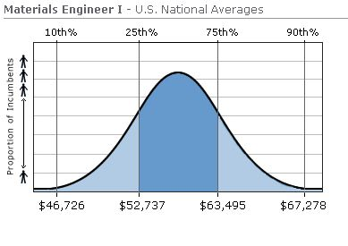
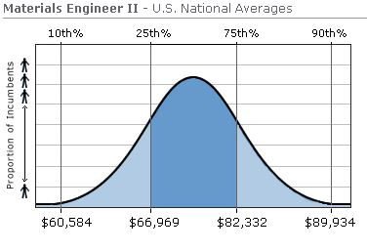
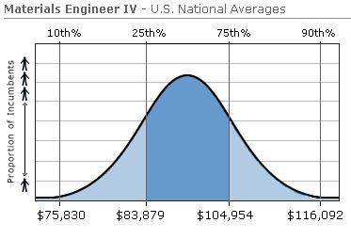
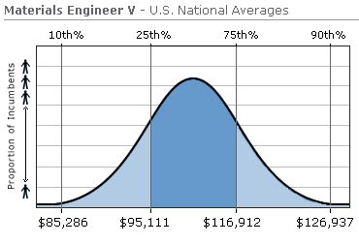
Annual Income
Notes:
Here I am going to give a short job description for Materials Engineer I,II,IV and V and their median expected salary.

Slide 11
Education – best engineering schools
Massachusetts Institute of Technology, MA - $38,940
Thermodynamics
Kinetics
Materials structure
Electronic and mechanical properties of materials
Bio- and polymeric materials
Materials processing
2. University of Illinois--Urbana-Champaign, IL - $14,932
3. Northwestern University (McCormick), IL - $39,840
4. University of California--Santa Barbara, CA - $15,102
5. Stanford University - Stanford, CA - $41,220
Notes:
Here I am going to talk about the 5 best materials engineering schools in USA, tuition fees per year. Number 1 school in the world is MIT and I will talk about the undergraduate and graduate programs they have.

Slide 12

The Minerals, Metals & Materials Society (TMS) is a member-driven professional society consisting largely of scientists and engineers. working in industry, academia and government, as well as students studying in the materials field. Included among our 11,200 professional and student members are metallurgical and materials engineers, scientists, researchers, educators, and administrators. coming from more than 70 countries on six continents. The vision of TMS is to be the professional society of choice for the worldwide minerals, metals, and materials community. The mission of TMS is to promote the global science and engineering professions concerned with minerals, metals, and materials

Slide 13

Study of atomic structure of Metals
Fig: Study of atomic structure of metals using Sum Frequency Generation Vibration Spectroscopy
Material engineers use above method to learn about atomic structure of metals.
Discoveries by the study of atomic structure of metal
Electric conductivity of metal is due to free moving electrons.
Ductility in metal due to strong elastic bonding between atoms. Etc.
Result from the discoveries
With the help of these discoveries scientist and engineers started making different types of alloys( mixture of elements) which were advance then their parent metal.
Brass mixture of copper and zinc is stronger than both of its parent metal
Steel mixture of iron and carbon conducts electricity than coppers.

Slide 14
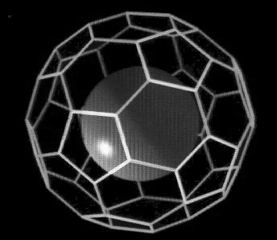

Research Material engineers are working on:
They are working with this cool little carbon molecule called buckyballs, to see if it can deliver drugs to cell infected by cancer virus. Buckyballs can work like a small first aid kit for cells.
Fig: Buckyballs
Magneto-rheological fluid morphs from liquid to solid when it’s around a magnet, so it can help keep building safe during natural disaster. Since MR fluids respond to magnetic fields by becoming thicker, they can work as giant “shock absorbers” to counteract vibrations caused by earthquakes or high winds. When buildings detect a tremor, powerful magnets are activated causing the fluid to thicken and provide resistance.
Fig: The Dong Ting Lake Bridge in China uses MR motion dampers to counteract gust of wind

Slide 15
Future of Material Engineering
Material engineers and scientist has developed lots of stuff from compact disc to titanium alloy joints that can be used as a permanent hip bone replacement, from designing a ceramic car engine that is lightweight, fuel efficient, and can run at high temperatures without a cooling system to develop a way to recycle non-metallic components of old computers to create park benches, fences, and sewer grates. Now also material engineers are researching to develop new product that will ease our life.

