Slide 1
iMass Team Project
VPN on Ubuntu Server
Developers : Daisy, Jay, and Runcong
2012 iMass IT Solution Group

Slide 2
Scenario
Creating a VPN on Ubuntu server by using openVPN.
It will bypass most university and public firewall.
Providing a convenient and secured way for end users to connect to our VPN server.
It is resided in itvm22-4.it20.cs.umb.edu
2012 iMass IT Solution Group

Slide 3
Scope and Objectives
Creating remote office services for company’s employees. They should be able to work from home or other traveling destinations.
Interviewing each employee for preferred services, functional support, graphical and command-line interface
Cutting administrative cost to 40%
Creating secured and reliable connection to the office server
Creating automated backup system
Finishing the project in 10 weeks
2012 iMass IT Solution Group

Slide 4
What services we provide?
VPN
File Sharing
Web hosting
Email Service
2012 iMass IT Solution Group

Slide 5
Why Private Tunnel?
Private Tunnel is a new approach to true Internet security creating a Virtual Private Tunnel (VPT) or Virtual Private Network (VPN) that encrypts, privatizes, and protects your Internet traffic.
2012 iMass IT Solution Group

Slide 6
How Does It Work?
By using a VPN a secure connection is made to one IP address and all traffic from that point will be encrypted and sent through the VPN
Encryption Private Tunnel encrypts all data between your computer and our server.
Protection It uses advanced DNS technology to prevent your access to malicious websites.
Privacy All your Internet traffic exits the VPN from our server, preventing web sites and other devices from seeing your IP address
2012 iMass IT Solution Group

Slide 7
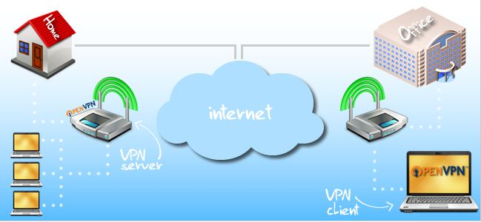
How Does It Work?
2012 iMass IT Solution Group

Slide 8
Examples:
Bypass Firewall
Bypassing University Firewall our VPN server will use port TCP 443, which was open by most public wireless network
Using a VPN to bypass the Great Firewall of China
2012 iMass IT Solution Group

Slide 9
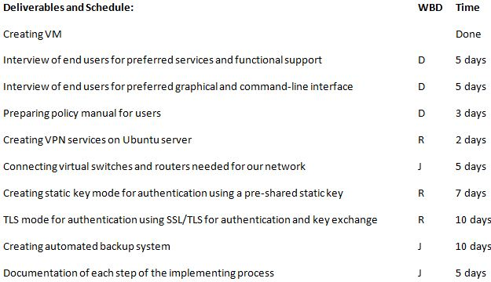
2012 iMass IT Solution Group

Slide 10
Questions ?
Developer : Desi, Jay, Runcong
2012 iMass IT Solution Group

