Slide 1

PBL4 G1-2
Multi-projector system
Team progress presentation
Ritsumeikan University
Development, Documentation and Management
12 November 2026
Notes:
Opening: introduce the multi-projector project and the three departmental presentations. Keep the opening brief; each department has its own seven-minute limit.

Slide 2
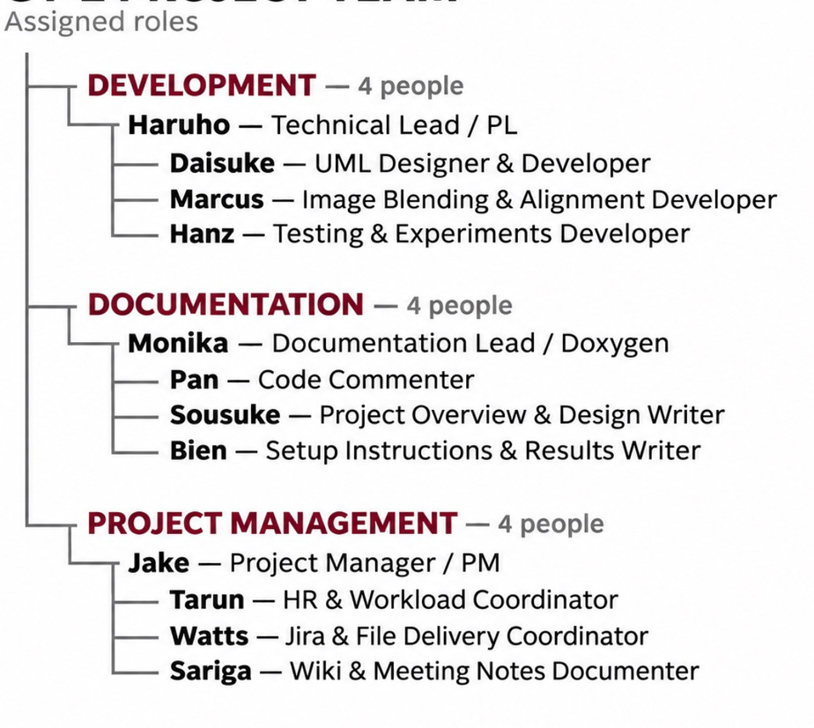
G1-2 project team
2
Notes:
Briefly introduce the teams. Each department has about six minutes of planned speaking and one minute for transitions. Each student must present a personal contribution. Source: https://lms.ritsumei.ac.jp/mod/assign/view.php?id=406464 .

Slide 3
Development: team progress
Team contributions
Haruho — experiments and analysis
Daisuke — repository and UML
Marcus — cropping and blending
Hanz — testing and defects
Demonstrated build
main_alpha_blender.py + config.json
Latest reported result
Continuous landscape image across two 1280 × 800 projectors.
Haruho’s gamma 2.2 test shows a uniform overlap.
Remaining limitation
Projector tilt and height still require manual alignment.
Haruho 1:00 Jira: PG1-45
Notes:
Haruho, 1 minute. Introduce the development responsibilities and the latest confirmed build result. Replace version, outcome and remaining issue prompts with verified details. Source: Jira PG1-45, https://ed-team-fqz0grjq.atlassian.net/browse/PG1-45 .

Slide 4
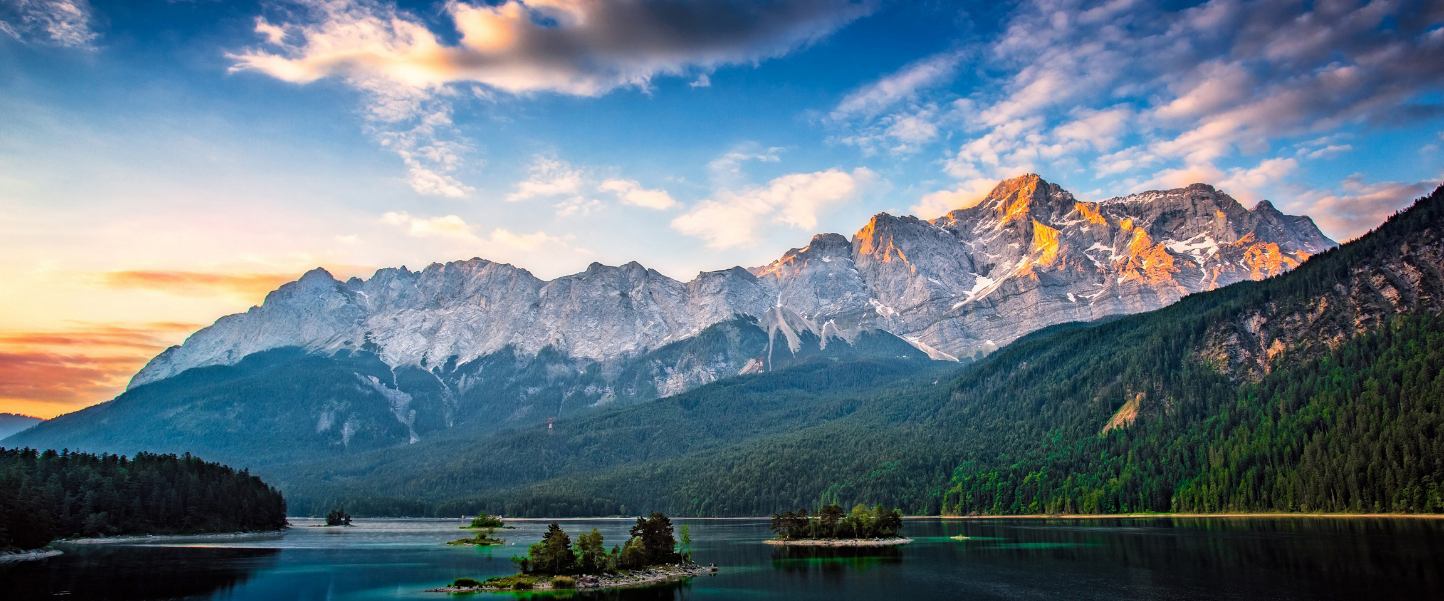
Test input: landscape (7680 × 3200)
Haruho (with slide 3) Same input for all Development tests
Notes:
Haruho, 1 minute. Introduce the development responsibilities and the latest confirmed build result. Replace version, outcome and remaining issue prompts with verified details. Source: Jira PG1-45, https://ed-team-fqz0grjq.atlassian.net/browse/PG1-45 .

Slide 5
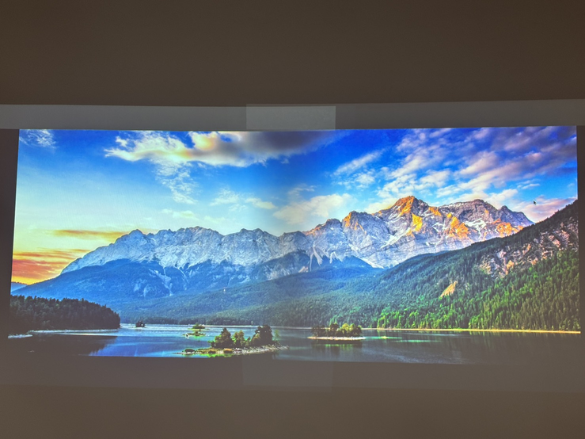
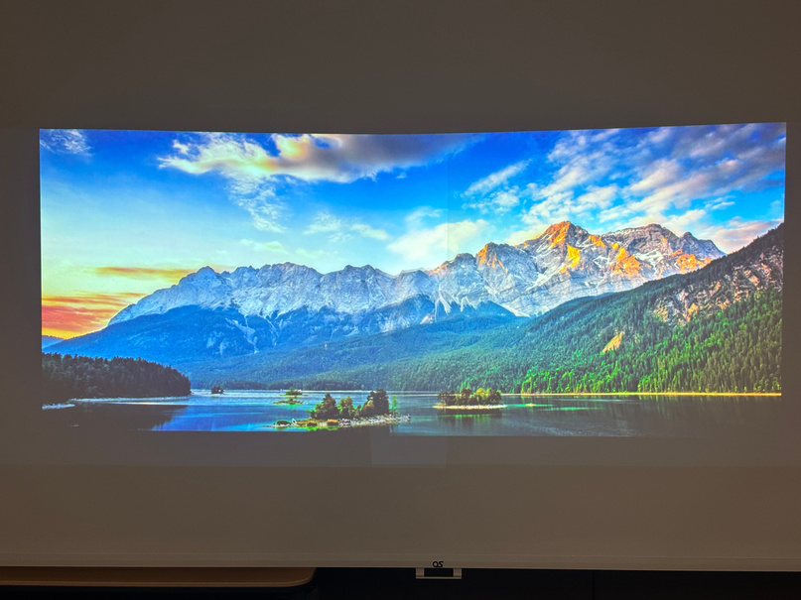
Development: demonstration
Input and settings
Landscape image (7680 × 3200, about 2.4 : 1)
Projector: 1280 × 800 each, overlap 213 px (17%), gamma 2.2
Output comparison
Demonstrated revision
Run: python3 main_alpha_blender.py
Keys: g / h = gamma down / up, f = full screen, q = quit
Gamma 1.0: overlap slightly dark
Gamma 2.2: uniform brightness
Projector test: gamma 1.0 vs 2.2
Notes:
Haruho, 1 minute. Demonstrate one known input and its actual output. State the version and settings. Explain whether the test used software only or real projectors. Add actual team screenshots; do not present unrun tests as results.

Slide 6
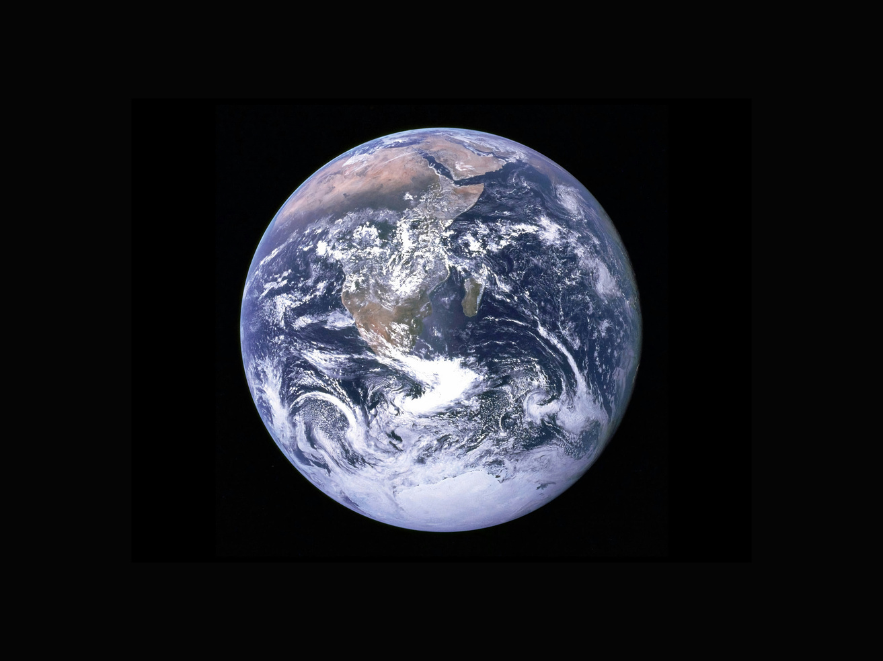
Haruho: experiments and analysis
My focus
Real-projector experiments and result analysis
Gamma comparison
Compared overlap brightness at gamma 1.0 and 2.2.
Gamma 1.0: overlap slightly dark.
Gamma 2.2: uniform brightness in the shown test.
Image choice
Used a wide landscape image (about 2.4:1)
to fit this two-projector setup.
Next step
Explore automatic alignment using feature matching
and a homography. Prototype evaluation is ongoing.
Earth image: poor fit
Jira: PG1-52
Notes:
Haruho, 1 minute. Explain one personal contribution in the assigned focus area. Replace bracketed prompts with your actual decision, change and result. Add the suggested evidence and its revision/date. Assignment descriptions establish your responsibility, not proof that work is finished. Clearly distinguish completed work from remaining checks. Source: https://ed-team-fqz0grjq.atlassian.net/browse/PG1-52 .

Slide 7
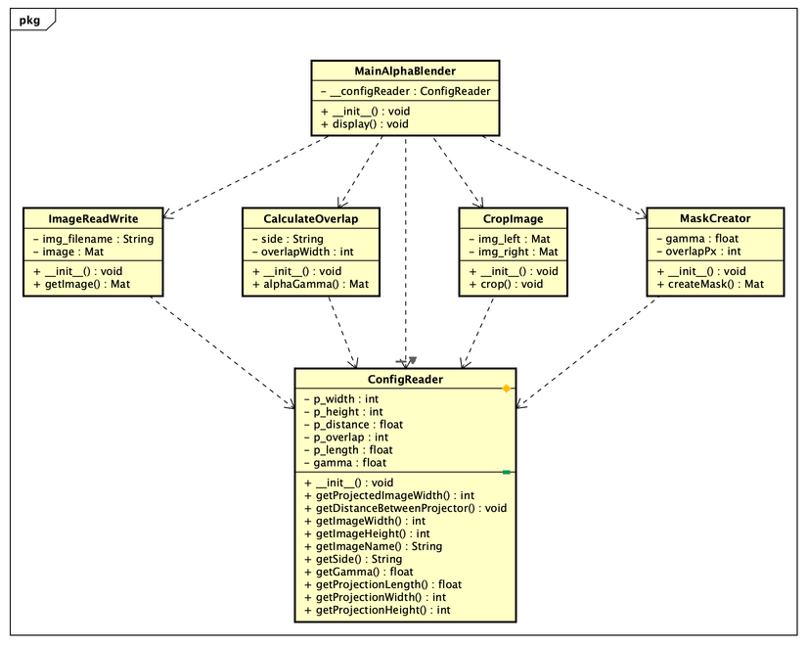
Daisuke: repository and UML
UML Diagram
Code: main_alpha_blender.py, config_reader.py, etc.
Diagram: 2026-11-11
Jira: PG1-53
My focus
Repository structure and UML
Design decision
Reviewed ConfigReader class to store all settings in one config.json file instead of hardcoding values in each class.
Code consistency
Made sure every class has the same getter and setter methods so the code matches the UML diagram.
Notes:
Daisuke, 1 minute. Explain one personal contribution in the assigned focus area. Replace bracketed prompts with your actual decision, change and result. Add the suggested evidence and its revision/date. Assignment descriptions establish your responsibility, not proof that work is finished. Clearly distinguish completed work from remaining checks. Source: https://ed-team-fqz0grjq.atlassian.net/browse/PG1-53 .

Slide 8
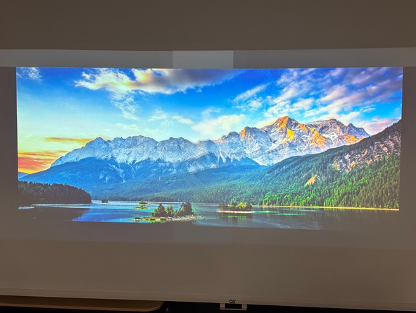
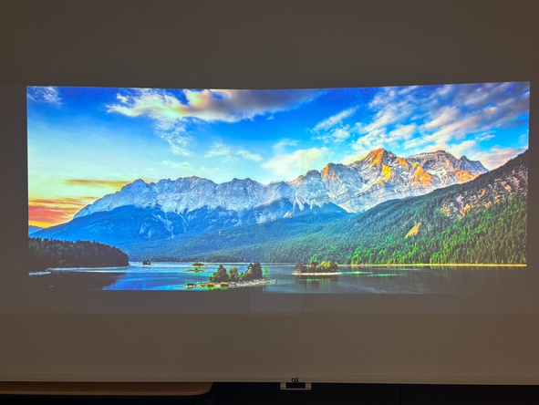
Marcus: cropping and blending
My focus
Cropping and blending validation
Setup
Landscape input: 7680 px × 3200 px
Overlap: 213 px (about 17% of the projector width)
Method: fade across the overlap
Observed Results:
Resizing removed the grey borders.
Remaining Validation:
A dark band remained at the bottom
of the overlap in this test.
Setup evidence
Same input
before and after
Each projector:
1280 px × 800 px
Gamma: 2.0
Jira: PG1-54
Before Resize
After Resize
Notes:
Marcus, 1 minute. Explain one personal contribution in the assigned focus area. Replace bracketed prompts with your actual decision, change and result. Add the suggested evidence and its revision/date. Assignment descriptions establish your responsibility, not proof that work is finished. Clearly distinguish completed work from remaining checks. Source: https://ed-team-fqz0grjq.atlassian.net/browse/PG1-54 .

Slide 9
Hanz: gamma 1.5 test
Test case
Overlap brightness at gamma 1.5
Environment
Two projectors, Python/OpenCV
Input: landscape image
Gamma: 1.5
Overlap setting: not confirmed
for this recorded test
Observed Result:
Commit: 175f0b5
Test date: 5 November 2026
Jira: PG1-55
Expected Result:
Smooth uniform brightness
Observed Result:
Visible dark band in the center
Notes:
Hanz, 1 minute. Explain one personal contribution in the assigned focus area. Replace bracketed prompts with your actual decision, change and result. Add the suggested evidence and its revision/date. Assignment descriptions establish your responsibility, not proof that work is finished. Clearly distinguish completed work from remaining checks. Source: https://ed-team-fqz0grjq.atlassian.net/browse/PG1-55 .

Slide 10
Hanz: test findings and follow-up
Recorded finding
A dark band was visible in the overlap
at gamma 1.5 on 5 November.
Follow-up result
Testing at gamma 2.2 showed improved brightness uniformity
Remaining validation
  Confirm the original test’s overlap setting.
  Record the final configuration and repeat the brightness and alignment check on both projectors.
Notes:
Hanz, 1 minute. Explain one personal contribution in the assigned focus area. Replace bracketed prompts with your actual decision, change and result. Add the suggested evidence and its revision/date. Assignment descriptions establish your responsibility, not proof that work is finished. Clearly distinguish completed work from remaining checks. Source: https://ed-team-fqz0grjq.atlassian.net/browse/PG1-55 .

Slide 11
Documentation: team progress
Contributions shown in this presentation
Monika — Main Page and documentation review
Pan — run instructions and source comments
Sousuke — overview and design review scope
Bien — Doxygen generation and offline files
Outputs
Main Page, detailed class pages.
Final handover checks
Confirm the documentation matches the delivered build.
Include the complete HTML folder, images and configuration.
Monika and Bien coordinate the final documentation check.
Jira: PG1-44
Notes:
Monika, 1 minute. Introduce the documentation responsibilities and current reviewed output. Confirm the version and remaining issue. Source: Jira PG1-44, https://ed-team-fqz0grjq.atlassian.net/browse/PG1-44 .

Slide 12
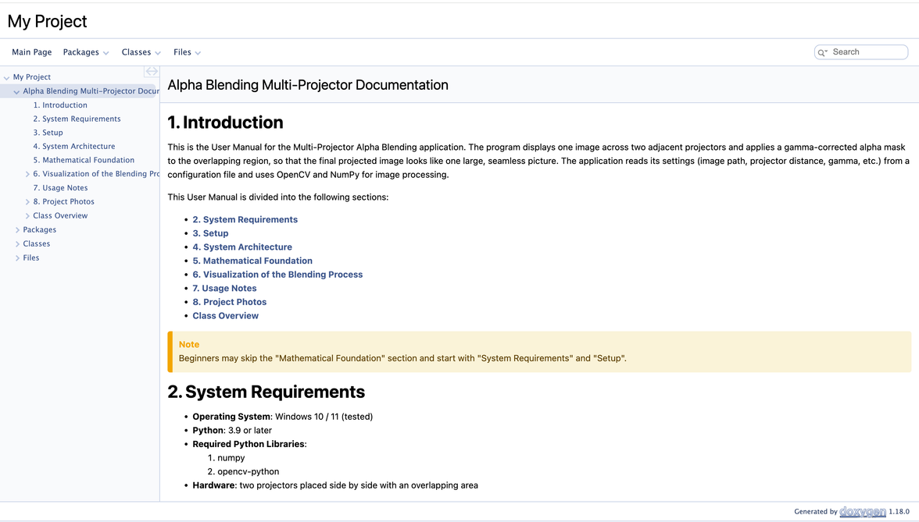
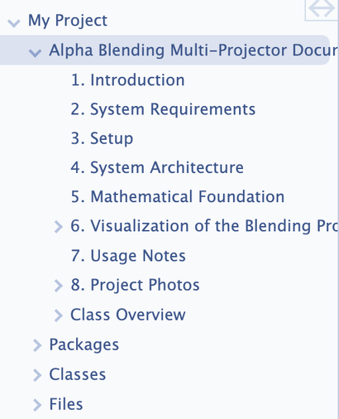
Documentation: Main Page
Project overview, requirements and navigation
Generated HTML preview
Notes:
Monika, 1 minute. Show the generated project HTML and one source-comment example. State which page, image or link you checked and its result. Include the whole HTML folder and assets when preparing delivery.

Slide 13
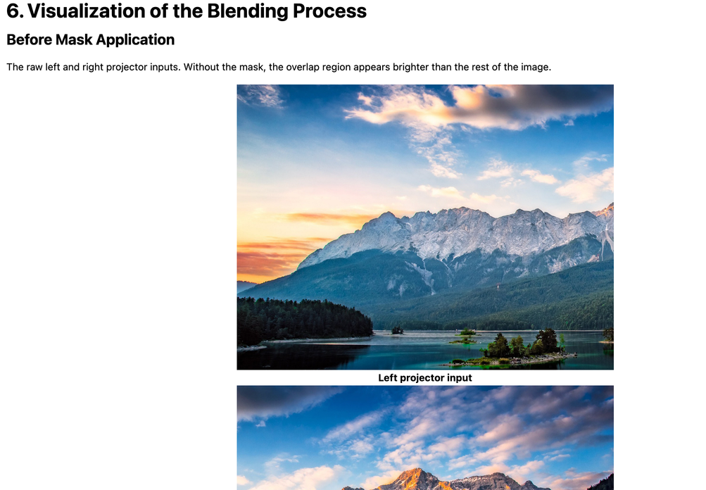
Documentation: blending explanation
Input images and blending process
Generated HTML preview
Notes:
Monika, 1 minute. Show the generated project HTML and one source-comment example. State which page, image or link you checked and its result. Include the whole HTML folder and assets when preparing delivery.

Slide 14
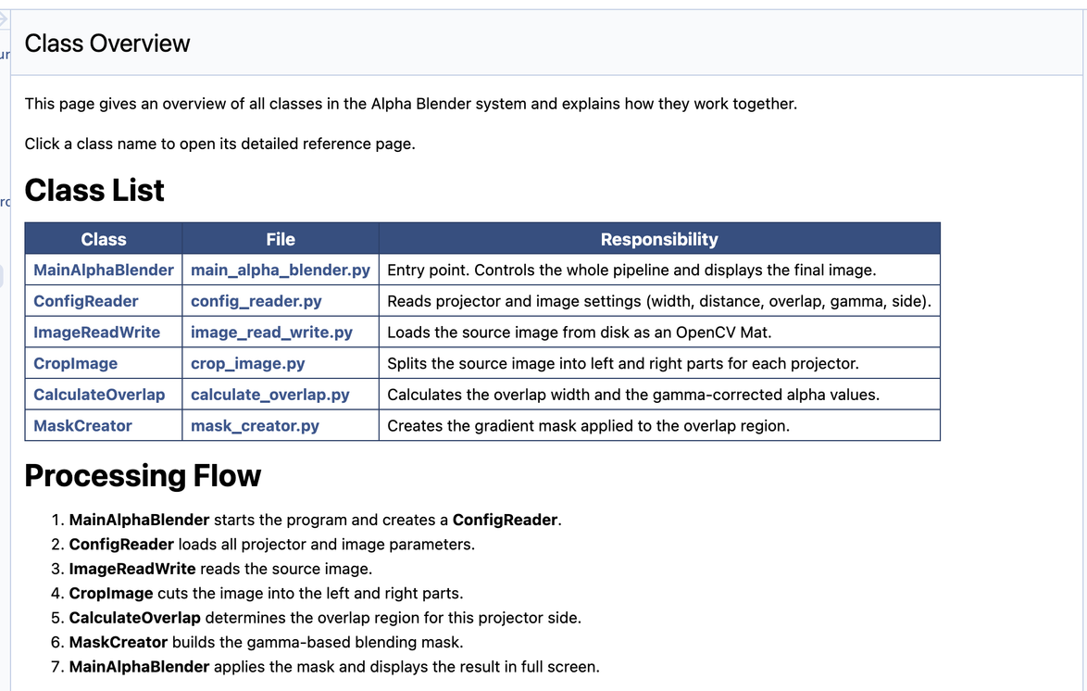
Documentation: classes and processing flow
Generated HTML preview
Notes:
Monika, 1 minute. Show the generated project HTML and one source-comment example. State which page, image or link you checked and its result. Include the whole HTML folder and assets when preparing delivery.

Slide 15
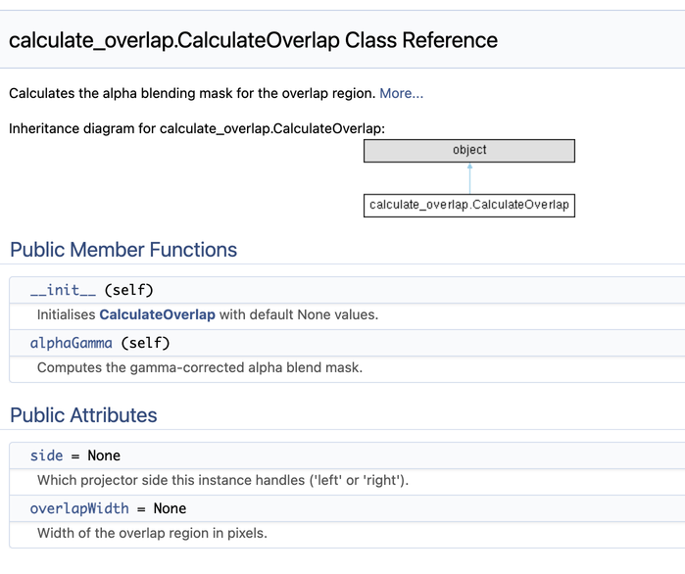
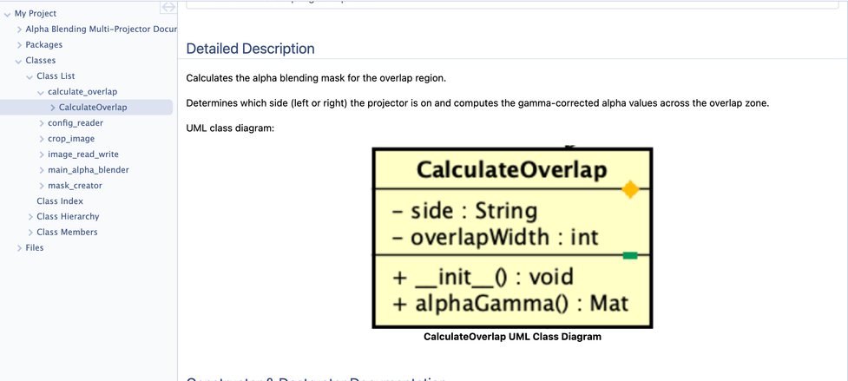
Documentation: class reference
Class methods and diagram
Notes:
Monika, 1 minute. Show the generated project HTML and one source-comment example. State which page, image or link you checked and its result. Include the whole HTML folder and assets when preparing delivery.

Slide 16
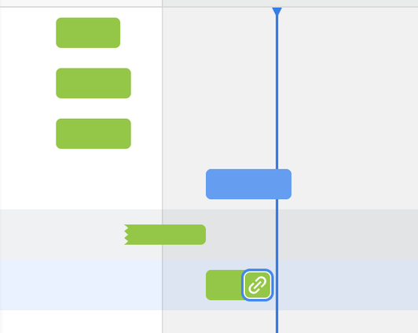
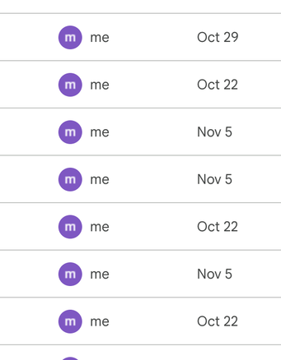
Monika: documentation review
My contribution
Coordinated the documentation team.
Drafted and revised the Main Page.
Collected files and shared updates
with the other teams.
Kept Jira tasks updated.
Result
Main Page delivered with input images,
a projection photo and a team photo.
Reported mismatches to the code team.
Notes:
Monika, 1 minute. Explain one personal contribution in the assigned focus area. Replace bracketed prompts with your actual decision, change and result. Add the suggested evidence and its revision/date. Assignment descriptions establish your responsibility, not proof that work is finished. Clearly distinguish completed work from remaining checks. Source: https://ed-team-fqz0grjq.atlassian.net/browse/PG1-48 .

Slide 17
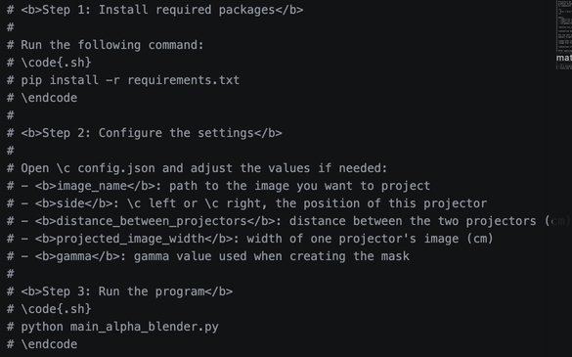
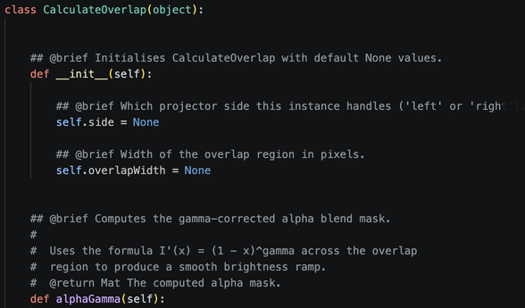
Pan: run guide and comments
My focus
Wrote the step-by-step run instructions and clarified comments in key source files.
Reader’s task
Install the required packages, configure config.json, and start the program.
Check performed
Checked that the documented commands and configuration steps match the project files.
Jira: PG1-49
Pan 1:00
Notes:
Pan, 1 minute. Explain one personal contribution in the assigned focus area. Replace bracketed prompts with your actual decision, change and result. Add the suggested evidence and its revision/date. Assignment descriptions establish your responsibility, not proof that work is finished. Clearly distinguish completed work from remaining checks. Source: https://ed-team-fqz0grjq.atlassian.net/browse/PG1-49 .

Slide 18
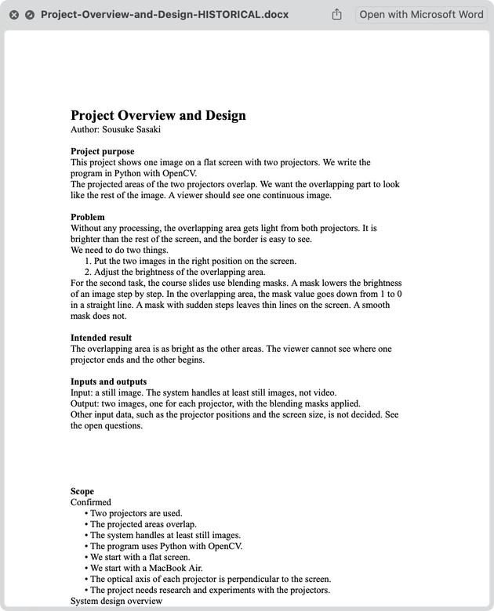
Sousuke (Ben): project overview
Sousuke wrote the project overview
and design document.
It explains:
• The goal: one image using two projectors.
• The problem: the overlap looks too bright.
• The approach: align and blend the images.
Original overview draft by Sousuke Sasaki
Presented by Ben
Notes:
Sousuke, 1 minute. Explain one personal contribution in the assigned focus area. Replace bracketed prompts with your actual decision, change and result. Add the suggested evidence and its revision/date. Assignment descriptions establish your responsibility, not proof that work is finished. Clearly distinguish completed work from remaining checks. Source: https://ed-team-fqz0grjq.atlassian.net/browse/PG1-50 .

Slide 19
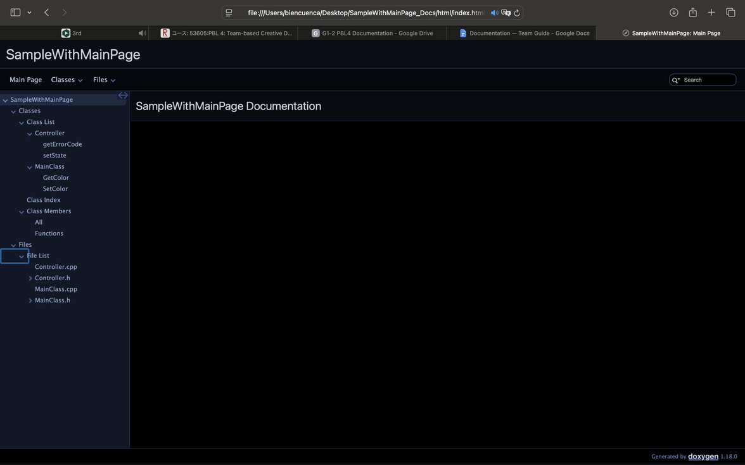
Bien: Doxygen and offline files
My contribution
Checked the Doxygen configuration
using Doxywizard.
Generated the HTML documentation.
Reviewed pages, images and assets.
Saved output
Doxygen configuration, HTML folder
and index.html.
Offline review
Opened the documentation locally
and checked pages and navigation.
Keep the full folder together for delivery.
Notes:
Bien, 1 minute. Explain one personal contribution in the assigned focus area. Replace bracketed prompts with your actual decision, change and result. Add the suggested evidence and its revision/date. Assignment descriptions establish your responsibility, not proof that work is finished. Clearly distinguish completed work from remaining checks. Source: https://ed-team-fqz0grjq.atlassian.net/browse/PG1-51 .

Slide 20

Jake: Management Overview
Our role: help the three teams work together.
  We divided the work and planned deadlines.
  We used Jira tickets and the Gantt chart to track progress of the project
  We checked in with members and collected updates.
Jake (PM): planning and team coordination
Tarun: workload and access
Sariga: wiki and meeting records
Shranjay: Jira coordination and file delivery
Notes:
Jake — 1 minute. Explain how you turned team work into Jira tasks: PG1-40 epic, department tasks PG1-44/45, and individual subtasks PG1-48–55. Describe the owner, expected deliverable, target date and evidence needed for each ticket. Share your example of helping a teammate create a ticket. The dashboard image is a 5 November snapshot before additional tasks were added; its counts are not a completion percentage. With slides 15 and 21, your leader section is 3 minutes. Current Cloud export, 9 November: 52 PG1 records, 13 Done, 1 In Progress, 38 To Do. Types: 6 epics, 35 tasks, 11 subtasks. These are status counts, not a completion percentage.

Slide 21
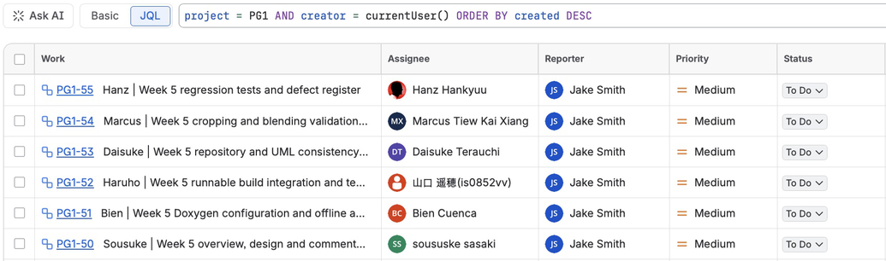
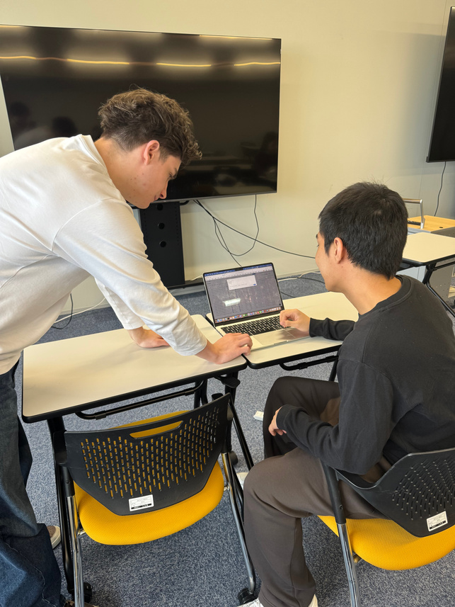
Jake: creating Jira tickets
I created tickets and assigned work to teammates.
I described the output needed for each task.
I split larger jobs into smaller tasks.
We used statuses to track progress.
I also helped Ben create his own Jira ticket.
Notes:
Jake — 1 minute. Explain how you turned team work into Jira tasks: PG1-40 epic, department tasks PG1-44/45, and individual subtasks PG1-48–55. Describe the owner, expected deliverable, target date and evidence needed for each ticket. Share your example of helping a teammate create a ticket. The dashboard image is a 5 November snapshot before additional tasks were added; its counts are not a completion percentage. With slides 15 and 21, your leader section is 3 minutes. Current Cloud export, 9 November: 52 PG1 records, 13 Done, 1 In Progress, 38 To Do. Types: 6 epics, 35 tasks, 11 subtasks. These are status counts, not a completion percentage.

Slide 22
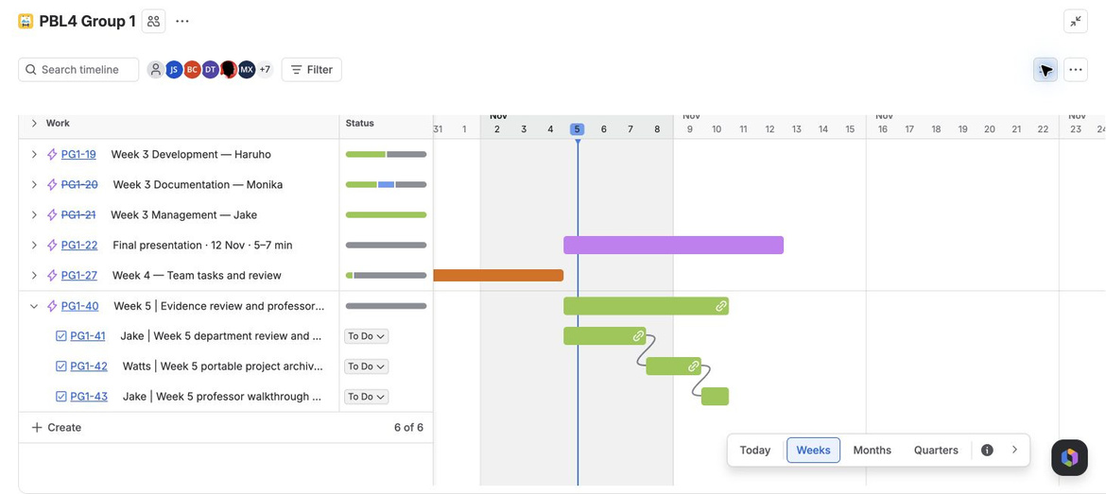
Jake: Planning with the Gantt chart
I used the Gantt chart to plan tasks and deadlines.
The bars show when each task was planned.
I checked progress through meetings and individual check-ins.
This helped me see which tasks needed to happen first.
Notes:
Jake — 1 minute. Introduce management’s role in coordinating the three departments. Explain your start/end-of-class meetings and individual check-ins. Walk through the planned sequence: evidence review (PG1-41), Watts’s ZIP check (PG1-42), then professor walkthrough (PG1-43). Internal targets were 7, 9 and 10 November. Screenshot captured 5 November; all three handover tickets still To Do when checked 9 November. Explain one real coordination example; do not claim the ZIP is finished. Sources: Jira PG1-40–43 and the 5 November Gantt capture.

Slide 23
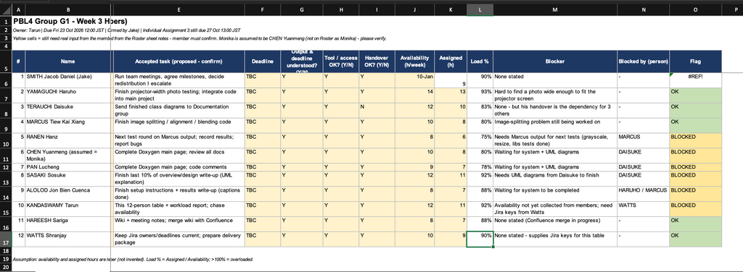
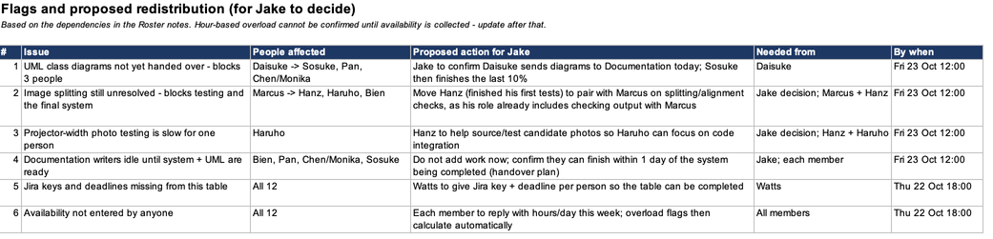
Tarun: Workload and access
My role
Check ownership,
availability and access.
Recorded evidence
12-person workload table
attached to PG1-10.
Tracker status · 11 Nov
PG1-10 and PG1-46:
marked Done.
Remaining check
Confirm current entries
and handover readiness.
Tarun · 1:00
Notes:
“My role was to check task ownership, availability and access for the team. The evidence is the 12-person workload table attached to PG1-10. It lists each member’s task, hours, blockers and who they’re blocked by.
A blocker example: Daisuke had finished the class diagrams, but the handover to documentation wasn’t done, so I marked his handover as No. That held up Sosuke, Pan and Chen, who were waiting on the UML diagrams. I flagged it in the table and put it to Jake as a dependency to follow up.
As of 11 November, PG1-10 and PG1-46 are marked Done in the tracker. The remaining check is to confirm the current entries are still correct and that every handover is ready.”

Slide 24
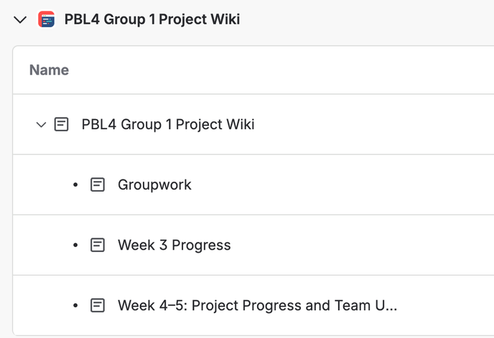
Sariga (Tarun): Meeting records
My role
Maintain the project wiki and record team progress,
meeting discussions and follow-up actions.
My contribution
Created the project wiki in Confluence.
Collected development and documentation updates.
Organised responsibilities and team progress.
Recorded pages
Project Wiki · Week 3 · Weeks 4–5
Next step
Confirm missing meeting dates,
decisions and action owners.
Notes:
For Sariga's part, her role is to manage and maintain the project wiki, making sure that all the information is organized and easy for team members to access. She created the initial wiki structure, including the main page and separate pages for weekly progress updates. She also collected information from the development and documentation teams and organized each member's responsibilities, completed work, and ongoing tasks into weekly summaries. Her main focus was to keep the wiki clear and updated so that everyone could easily refer back to previous information and track the project's overall progress. On the right, you can see the wiki pages she has worked on so far, including the Week 3 and Week 4–5 progress reports.

Slide 25
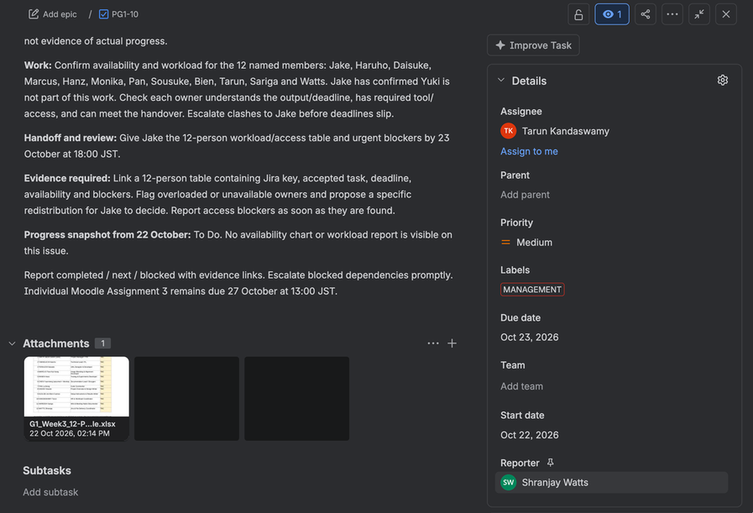
Watts: Jira coordination
My contribution
Created and assigned team tasks.
Set deadlines and followed progress.
Created subtasks for team leaders.
Helped members use Jira.
Purpose
Make ownership and expected
outputs clear across the teams.
Watts 0:30
Notes:
As part of the project management team, one of my main responsibilities was managing our Jira records and keeping track of project delivery.
Here, the initial assignments PG1-16 and PG1-17 have been completed. For project delivery, I was also responsible for PG1-42, where we collected the different project files, including the code, UML, HTML, configurations, images, and presentation slides.
The Jira record also shows me as the reporter for this task. Before the final upload, I checked the collected ZIP file on another computer to make sure the deliverables worked correctly.

Slide 26
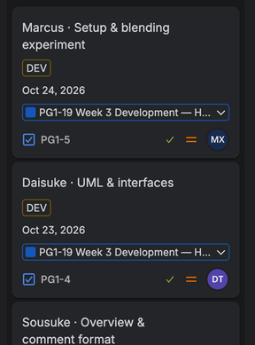
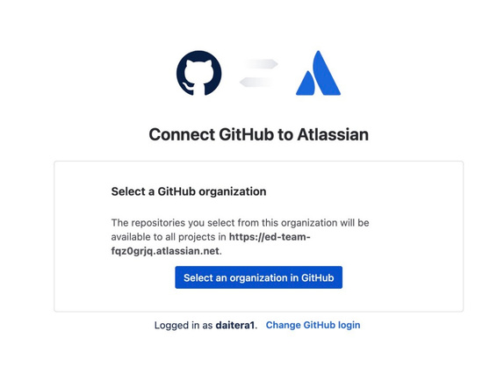
Watts: task examples and next steps
Task examples
PG1-16 — initial assignments
PG1-17 — assign Jake and Sousuke
Both marked Done in the
11 November export.
Ongoing coordination
Updated descriptions, owners and deadlines.
Tracked progress and helped teammates use Jira.
Tools explored
GitHub/GitLab integration
Confluence integration
Gantt charts for scheduling
Exploration does not mean integration is complete.
Notes:
At the beginning of the project, I helped set up our Jira workflow. For example, PG1-16 involved adding the team members and assigning their initial tasks, while PG1-17 was another assignment task. Both of these were eventually completed.
As the project progressed, I continued creating and updating tasks, setting deadlines, assigning subtasks to the different team leaders, and monitoring their progress. I also helped team members understand Jira features when necessary.
To improve our workflow further, I explored GitHub and GitLab integration with Jira, researched Confluence for documentation, and looked into Gantt charts for scheduling and progress tracking. The overall goal was to keep the project organized and make responsibilities and progress clear to the whole team.

Slide 27
Thank You!
Notes:
Jake, 1 minute. Explain the handover requirements: PG1-41 evidence index, PG1-42 portable archive and independent ZIP check, PG1-43 professor walkthrough. Show how a Jira key connects to a versioned artifact, reviewer and check result. All three were To Do on 9 November; replace the outcome prompt with actual verified progress. Sources: Jira PG1-41–43. Management total: Jake 3 minutes, Tarun 1, Sariga 1, Watts 1 across two slides, plus one minute buffer.

