Slide 1

Thịnh Nguyễn

Slide 2
Contents
React Native.
Firebase.
Demo Chat App.

Slide 3
What is React Native ?
Framework for building native mobile apps using only JavaScript, released by Facebook.
Advantages:
Build native mobile apps using JavaScript and React.
A React Native app is a real mobile app.
Don't waste time recompiling.
Use native code when you need to.
Disadvantages:
Can not make a complex app without Native code.

Slide 4
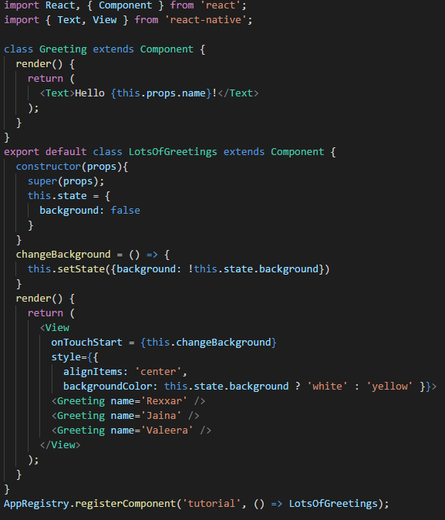
Components, props and state:

Slide 5
Lifecycle
Start
Props/States changed
constructor(props)
shouldComponentUpdate
componentWillMount
componentWillUpdate
render
componentDidUpdate
componentDidMount
componentWillUnMount
End

Slide 6
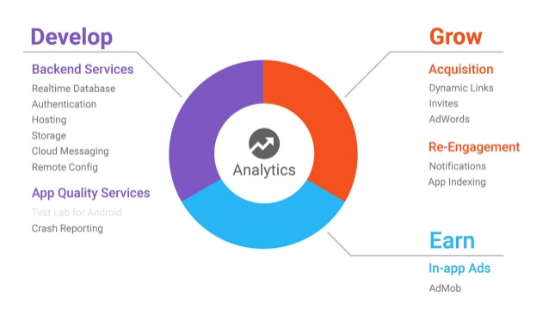
Firebase
Firebase is a mobile and web application development platform developed by Firebase, then acquired by Google.
Provide a set of services, including realtime database, user authentication, … Help developers can focus on creating user experiences.

Slide 7
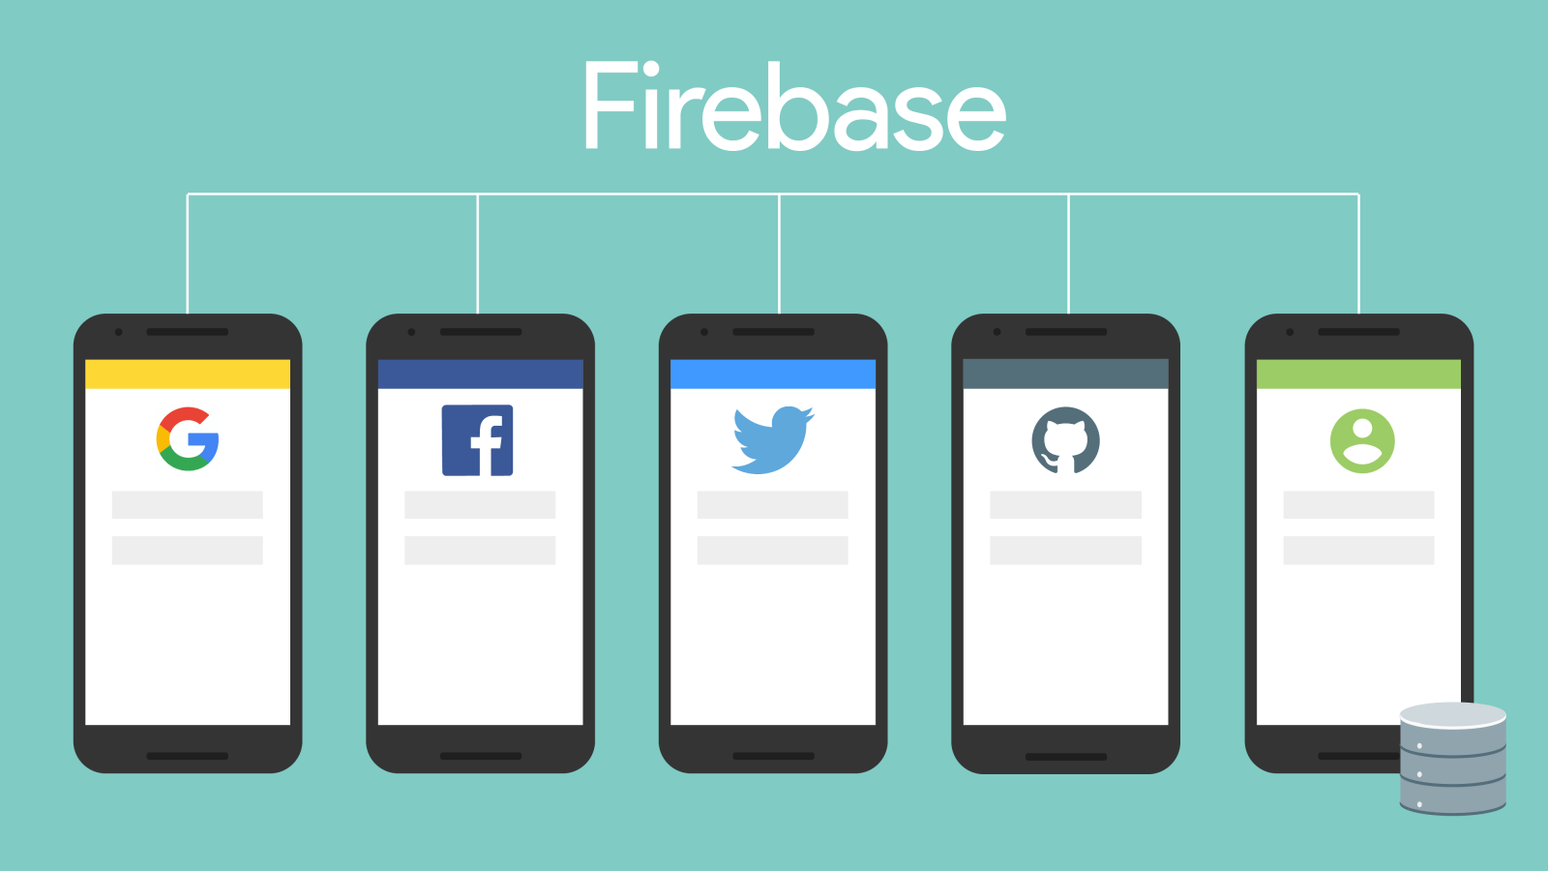
Firebase Authentication
Use to authenticate the identity of a user.
You can register a user, login, logout and trigger whenever the authenticate state changed.
After a successful sign in, you can access the user's basic profile information, also use the provided token to verify the identity of users in your own backend services.

Slide 8
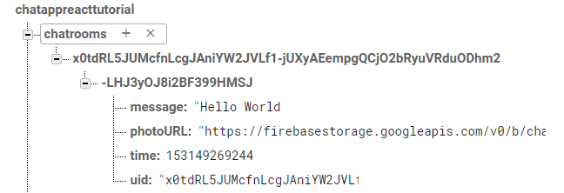
Realtime database
The Firebase Realtime Database is a cloud-hosted database.
Data is stored as JSON and synchronized in realtime to every connected client.
Unlike a SQL database, there are no tables, the data is store in JSON tree, when you add a data, it becomes a node.
Firebase

Slide 9
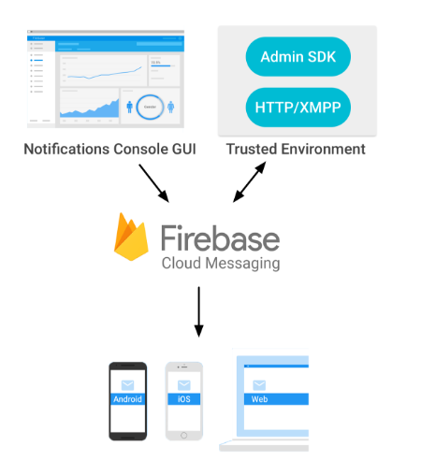
Firebase Cloud Messaging ( FCM )
Using FCM, you can notify a client app that new data is available to sync.
A message can transfer a payload of up to 4KB to a client app.
How does it work?
An FCM implementation includes two main components for sending and receiving:
A trusted environment such as Cloud Functions for Firebase or an app server on which to build, target, and send messages.
An iOS, Android, or web (JavaScript) client app that receives messages.

Slide 10
Demo

