Slide 1
SUPPORT Documents of
Fossology and SW360 for users who using its.
During i install fossology and sw360, I feel something written under.
So I write memo in this paper as support document.
------------------------------------- contant 2
・ Where are each proxy / port setting files...?
- > mvn, git, apache, tomcat(liferay), coucudb,
・ and major application's binary files(exec files)...?
------------------------------------ contant 1
・ How it work when did I install on linux?
・ Where are execfile installed and What type?
memo: どこに実行ファイルがインストールされて、どの形式なのか.
memo: /etc/init.d/ なら service関連, or $home/bin なら実行ファイル, /usr/local/binならコマンド. 実行形式が異なる.
written by daito keigo

Slide 2
How it work when did I install on linux?
メモです
1 -> make,makeinstallとconfigure/maven、systemd. パッケージとsourceからのインストールの違い. package(something use apt or yum is all package)
source ---------------------------------------------------------------
・git cloneならプロジェクト(フォルダとして).
・curlなら ファイル単体.
・ビルドの方法は、 ソースコードによって異なる.
source ---------------------------------------------------------------
package -------------------------------------------------------
2 -> /etc/ にインストールされるものが
written by daito keigo

Slide 3
CONTENT
1-1. How it work when did I install
on linux?
Where are each proxy / port setting files...?
Maked Folder and Pachage
・ this paper is based on ⇓
sw360 install :
https://qiita.com/K-Hama/items/90a6105a16400ce3e718
fossology:
https://github.com/OpenChain-Project/Japan-WG-General/blob/master/Compliance-Tooling/FOSSology/Installation/install_from_source_debian_jp.md

Slide 4


Setting, exected files AND
Log folders of fossology, sw360
Web application server
Front end
Database
PORT / PROXY
execed file (auto or manual / by name)
Fossology
/usr/local/etc/fossology/
fossology.conf
Apache
--
Liferay/Tomcat
$CATALINA_HOME/con/
server.xml
Maven
~/.m2/settings.xml
/etc/
Git
~/.gitconfig
Apatch
$Apatch/conf
Sw360
Fossology
$CATALINA_HOME/bin/.catalina start / stop
/etc/init.d/fossology.service (manual:systemd)
Liferay
IPADDR/8080
--
Tomcat
Apatch2
$tomcat/bin/ (manual)
systemd(auto)
IPADDR/radis
CouchDB
PostgreSQL
:8080
Systemd(auto:systemd)
systemd(auto:systemd)
IPADDR/5298/utils
ブラウザより設定できる
LOG
Fossology : /var/log/fossology/ Apache2 : /var/log/apache2/
Postgresql: /var/log/postgresql/ Tomcat : /$CATALINA_HOME/logs/
CouchDB : /usr/local/var/log/couchdb/
Liferay : /home/daitokeigo/liferay-portal-6.2-ce-ga5/logs
CATALINA_HOME:
liferay ga: liferayフォルダの中に付属
systemdとついているものは、自動で設定されsystemctl statusで見れる. ついていないと psでしか確認できない

Slide 5
Major maked folder And Linux File construdtion.
Linux Construction Folders
/etc : almost all setting-files is here. (It may be made under some-folder, and placed in /usr/etc.)
/bin : basic cmd (system controal)
/usr : program and library datas(are made when you compile) are used by each user
| /bin : Basic command usied by user.
| /usr/local:
| /usr/local/bin/
| /usr/local/bin/
| /usr/local/etc/
(next_page)
/var : tempolatory files as a log file.(But 再起動しても消えない.)
/var/log:
Other:
/lib, /usr/local/lib: be placed files
required when user exec some
commands.
/tmp :
/sbin:
Maked folder
etc/init.d/ (deamon)
|-postgresql.service PostgreSql
|-couchdb.service CouchDB
|-fossology.service Fossology
|-apache2. Apache2
etc/
|-fossology
|-fossology.conf
usr/local/
|-etc/
|-couchdb Couchdb
|-fossology/Db.conf Fossology
|-init.d/couchdb Couchdb
|-bin/
|-composer Composer(php tool)
|-thrift Thrift
|-couchcb Couchdb

Slide 6
Major Package in sw360(part in fossology), and what is used
--- All ---
git, java(jdk-1.8.x), php, g++, pkg-config, make, maven.
*thrift(option)
-build-essential
-libboost(-dev,-test-dev,-program-options-dev)
-libevent-dev automake libtool
-flex bison pkg-config libssl-dev
----------------------------------------
Couchdb : Database
-g++
-erlang(-base, -dev,-eunit, -nox)
-*libmozjs185-dev
-libicu(-dev, 4-gnutls-dev)
- libtool
Tomcat(7.x,8.x)
-jdk
--- Required application ---------------------------------
[Fossolog]:
・apache -
・postgresql -
[sw360]
・Lifeway -
・couchdb
・tomcat

Slide 7
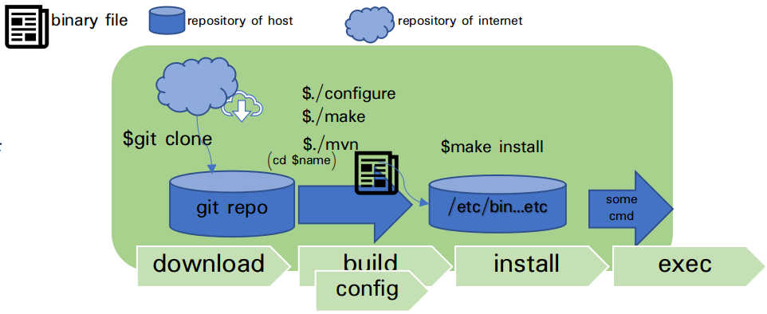
On LINUX, install is used package-install or source-install Installe.
Package install is
package : It is complimently,
source :
Figure1 show you installing from source. (fossology / sw360 / )
souce-install is consist of 3 steps.
・step1 is download
・step2 is build and config
・step3 is installing.
・Next page is explain each steps.
package : It is complimently
souce
Pls confirm table1 written under.
This is major programs used fossology and sw360.
・sw360 - couchdb / apache /
figure 1 way of sourceCode's download and install.

Slide 8
DOWNLOAD
MajorCmd | briefly explaination | is used about
git clone | Download a folder(in some sources).using git. | Liferay ・fossology ・sw360・
curl | Download a sourcefile using HTTP-GET.
apt install | Install Package tools on Ubuntu | couchdb/postgresql/maven/
yum install | install Package tools on CentOS
↑
↑
Notes:
Pa

Slide 9
BUILD/CONFIG
Majorcommand | command briefly explaination | is used about
make |  | Liferay ・fossology ・
configure |  | couchdb/postgresql/maven/
mvn | Package install tools on CentOS
Notes:
Pa

Slide 10
INSTALL
Majorcommand | command briefly explaination | is used about
make install |  | Liferay ・fossology ・
Notes:
Pa

Slide 11

Other Contants HOW THERE WORKED?
MAKE, CONFIGURE, DEAMON, SSH
ssh
* versionに注意
* versionに注意
3 インストール
コマンドなら
/usr/local/bin
/bin/
/sbin ....のどれか
デーモンなら
/lib/systemd/system/
... (下記参照)
1. 前提パッケージのインストール
git cloneやapt installを使う. 左を参照してください
2. ダウンロード
・git cloneやapt installを使う.
2. ビルド(実行ファイルの作成)

