Slide 1
From Install and build to operation check
on Fossology and SW360.
For all beginners.
Tested by
Linux: Ubuntu (
written by daito keigo

Slide 2
TITLE
Contants
Install major way(Package and Souce )
Installing Step1
Installing Step2
Installing Step3
Maked Folder and Pachage

Slide 3
TITLE
NOTE
This pdf is not expained to procedure of install or build.
Please show under URLs, if you install and build of fossology and sw360.
But you may be helped when you know how it work on Linux during install and
build by this paper!!.
It is targeted fossology and sw360, but this is for all beginners using Linux.
sw360 and fossology Installing proceduer
https://qiita.com/K-Hama/items/90a6105a16400ce3e718
sw360 install :
https://qiita.com/K-Hama/items/90a6105a16400ce3e718
fossology:
https://github.com/OpenChain-Project/Japan-WG-General/blob/master/Compliance-Tooling/FOSSology/Installation/install_from_source_debian_jp.md

Slide 4
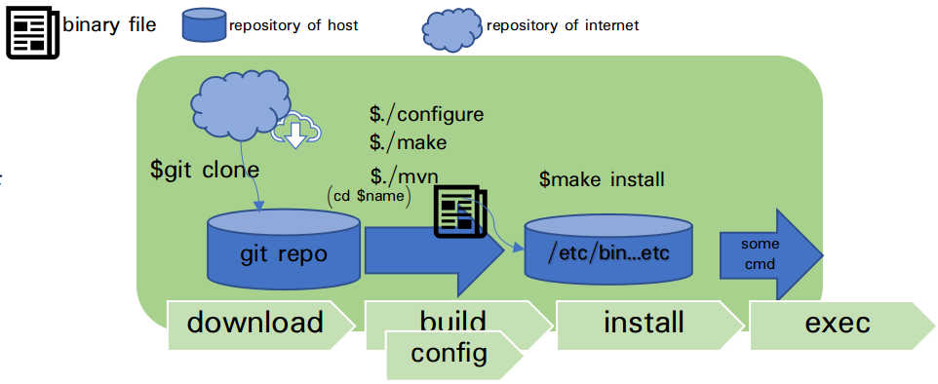
Install major way
All application install is used package-install or source-install.
Installing of sw360 and fossology is used source-install.
package : It is complimently,
source :
Figure1 show you installing from source. (fossology / sw360)
・souce-install is consist of 3 steps.
・step1 is download
・step2 is build and config
・step3 is installing.
・Next page is explain each steps.
package : It is complimently
souce :
プログラムのインストールには、大きく分けて、 パッケージかソースコードからインストールする方法を使う。
ソースコードとは、何かしらの言語で記述された通常のプログラム。バイナリにするためにコンパイル(build)が必要.
パッケージとは、そのプログラムの動作に必要なプログラムやファイルを一つにまとめたもの。プログラムやファイルは、あらかじめコンパイルされたバイナリ形式である。面倒事(依存関係など)は勝手にやってくれる. (下記1~3をすべてやるso this way enable user to exec soon!)
-> aptコマンドの仕組みへ
--- required application
Fossolog required:
・apache -
・postgresql -
sw360 required:
・Lifeway -
・couchdb
・tomcat
figure 1 way of sourceCode's download and install.

Slide 5
STEP1
figure 1 way of sourceCode's download and install.
Download:
This is require to walk application in local.
Step1 is Only download source from remote(internet) to local(your pc) folder. Downloaded folder is default current directory(current directory is where you typed under command).
It is not still to exec. You shold build to exec application!
Same program may be required to unzip. before you build.
fossology: git clone https://github.com/fossology/fossology.git
sw360 : git clone
-> how it wark git clone. Figure 2
You may use curl-cmd to download source.
Curl is cmd get to source using HTTP(passing URL).
* mvnはビルドまで.
configureは設定だけ.
makeは,Makefileに
mvnは.pomファイルにしたがう
* どこにどの拡張子でインストールされるかは,異なる.makefile等にしたがう

Slide 6
Build tool(program) is too many. some build tool move under programing languuage(ex.maven)->make(maven)の仕組みへ.
NOTE: excluding make, some programm is not included 3.インストールは含まずに、4..execへいくことができる(fossology and sw360 use make)
When program use systemd, you may tipe systemctl cmd. -> systemdのしくみへ
install is not included.
language(ex. maven is java tool.) -> maven, make , configureの仕組みへ
[apt install]
apt install
STEP2
figure 1 way of sourceCode's download and install.
figure 2 how it wark make, maven
STEP2. BUILD:
This step make binaryFile(exec file)
sw360 is used build tool called maven!
Fossology is used build tool called MAKE and configuration!
-> how it wark Make, maven: figure 2
->
, make / make install, configure, and some scripts)
NOTE: You should download 前提プログラム(fossology give auto install script. sw360 don't give. pls show under URL or next page).
Compile and make binay files. Binary files is called when user exec program.
But kernel may call binary file auto(ex.systemd, clon).
* mvnはビルドまで.
configureは設定だけ.
makeは,Makefileに
mvnは.pomファイルにしたがう
* どこにどの拡張子でインストールされるかは,異なる.makefile等にしたがう

Slide 7
Build tool(program) is too many. some build tool move under programing languuage(ex.maven)->make(maven)の仕組みへ.
NOTE: excluding make, some programm is not included 3.インストールは含まずに、4..execへいくことができる(fossology and sw360 use make)
When program use systemd, you may tipe systemctl cmd. -> systemdのしくみへ
STEP3
figure 1 way of sourceCode's download and install.
STEP2. BUILD:
This step is
sw360 is used build tool called maven!
Fossology is used build tool called MAKE and configuration!
-> how it wark Make, maven: figure 2
->
, make / make install, configure, and some scripts)
NOTE: You should download 前提プログラム(fossology give auto install script. sw360 don't give. pls show under URL or next page).
Compile and make binay files. Binary files is called when user exec program.
But kernel may call binary file auto(ex.systemd, clon).
* mvnはビルドまで.
configureは設定だけ.
makeは,Makefileに
mvnは.pomファイルにしたがう
* どこにどの拡張子でインストールされるかは,異なる.makefile等にしたがう

Slide 8
Build tool(program) is too many. some build tool move under programing languuage(ex.maven)->make(maven)の仕組みへ.
NOTE: excluding make, some programm is not included 3.インストールは含まずに、4..execへいくことができる(fossology and sw360 use make)
When program use systemd, you may tipe systemctl cmd. -> systemdのしくみへ
STEP4
figure 1 way of sourceCode's download and install.
STEP4. EXEC:
This step is finall step. You type
sw360 is used build tool called maven!
Fossology is used build tool called MAKE and configuration!
-> how it wark Make, maven: figure 2
->
, make / make install, configure, and some scripts)
NOTE: You should download 前提プログラム(fossology give auto install script. sw360 don't give. pls show under URL or next page).
Compile and make binay files. Binary files is called when user exec program.
But kernel may call binary file auto(ex.systemd, clon).
* mvnはビルドまで.
configureは設定だけ.
makeは,Makefileに
mvnは.pomファイルにしたがう
* どこにどの拡張子でインストールされるかは,異なる.makefile等にしたがう

Slide 9
Major maked folder and explain.
Major required-package(sw360).
Maked folder
コンポーネント
etc/init.d/ (deamon)
|-postgresql.service PostgreSql
|-couchdb.service CouchDB
|-fossology.service Fossology
|-apache2. Apache2
etc/
|-fossology
|-fossology.conf
usr/local/
|-etc/
|-couchdb Couchdb
|-fossology/Db.conf Fossology
|-init.d/couchdb Couchdb
|-bin/
|-composer Composer(php tool)
|-couchcb Couchdb
|-thrift Thrift
|-share/couchdb Couchdb
|-include/libfossology~.h Fossology(header)
Package(sw360)
--- All ---
git, java(jdk-1.8.x), php, g++, pkg-config, make
SW360: maven.
option: *thrift
-build-essential
-libboost(-dev,-test-dev,-program-options-dev)
-libevent-dev automake libtool
-flex bison pkg-config libssl-dev
----------------------------------------
Couchdb ()
-g++
-erlang(-base, -dev,-eunit, -nox)
-*libmozjs185-dev
-libicu(-dev, 4-gnutls-dev)
- libtool
Tomcat(7.x,8.x)
-jdk
*Liferay
--- All ---
git, php
*thrift: option
Sw360のversionが3.3.0-M1なら0.93
SW360の最新版なら,1.1.0
*libmozjs185-dev
ubuntu repositoryにない.
*thrift: option
Sw360のversionが3.3.0-M1なら0.93
SW360の最新版なら,1.1.0
*libmozjs185-dev
ubuntu repositoryにない.
Linux Construction Folders
/etc :
/bin :
/sbin:
/var

Slide 10




Setting amd exected files and
Log folders for using sw360/fossology
web server
web application
database
execed file(auto or manual)
port setting file/ proxy setting file
Sw360
Fossology
Apache2/fossology ---
/usr/local/etc/fossology/fossology.conf
Liferay/Tomcat---
$CATALINA_HOME/con/server.xml
Maven:
~/.m2/settings.xml
Tomcat $tomcat/conf/
Git
$git config
Apatch
$Apatch/conf
$CATALINA_HOME/bin/.catalina
start / stop
/etc/init.d/fossology.service (manual:systemd)
IPADDR/8080
IPADDR/5298/utils
ブラウザより設定できる
Liferay
:8080
???
Apatch2
Tomcat
IPADDR/radis
$tomcat/bin/ (manual)
systemd(auto)
CouchDB
PostgreSQL
Systemd(auto:systemd)
systemd(auto:systemd)
log folder
Fossology : /var/log/fossology/ Apache2 : /var/log/apache2/
Postgresql: /var/log/postgresql/ Tomcat : /$CATALINA_HOME/logs/
CouchDB : /usr/local/var/log/couchdb/
Liferay : /home/daitokeigo/liferay-portal-6.2-ce-ga5/logs
CATALINA_HOME は, tomcat-version/のこと.
liferay ga~だと liferayフォルダの中に付属
systemdとついているものは、自動で設定されsystemctl statusで見れる. ついていないと psでしか確認できない

Slide 11

Other Contants
ssh
* versionに注意
* versionに注意
3 インストール
コマンドなら
/usr/local/bin
/bin/
/sbin ....のどれか
デーモンなら
/lib/systemd/system/
... (下記参照)
1. 前提パッケージのインストール
git cloneやapt installを使う. 左を参照してください
2. ダウンロード
・git cloneやapt installを使う.
2. ビルド(実行ファイルの作成)

