Slide 1
SUPPORT Documents of
Fossology and SW360 for users who using its.
During i install fossology and sw360, I feel some things that be written next page. I write memo as contents in this paper.
This is support document.
------------------------------------- contant 1
・ Where are each proxy / port setting files...?
- > mvn, git, apache, tomcat(liferay), coucudb,
・ and major application's binary files(exec files)...?
------------------------------------ contant 1
・ How it work when did I install on linux?
・ Where are execfile installed and What type?
memo: どこに実行ファイルがインストールされて、どの形式なのか.
memo: /etc/init.d/ なら service関連, or $home/bin なら実行ファイル, /usr/local/binならコマンド. 実行形式が異なる.
written by daito keigo

Slide 2
Content 1 P1~P2
Where are each setting file..? (port and proxy, ) ---p1
How its applications start...? And look? ---p1
Where are each log file...? ---p1,2
Where each binary files(exec file)and What type..? ---p2
Contant 2 p3~p6
Major Installing way on Linux. (Step1~Step3) ---p3
Step1. DOWNLOAD ---p4
Step2. BUILD/CONFIG ---p5
What is (Make / configure / maven / make install) ---p6
Step3. INSTALL --- P3
Download
Where are execfile installed and What type?
CONTENT
written by daito keigo

Slide 3
this paper is based on ⇓
sw360 install :
https://qiita.com/K-Hama/items/90a6105a16400ce3e718
fossology:
https://github.com/OpenChain-Project/Japan-WG-General/blob/master/Compliance-Tooling/FOSSology/Installation/install_from_source_debian_jp.md
written by daito keigo

Slide 4


Setting, exected files andlog folders
for fossology, sw360
Web application server
Front end
Database
execed file (auto or manual)
PORT / PROXY
URL (you can see)
Fossology
/usr/local/etc/fossology/
fossology.conf
Apache
/etc/apache2
Liferay/Tomcat
$CATALINA_HOME/con/
server.xml
Maven
~/.m2/settings.xml
/etc/
Git
~/.gitconfig
sw360
Fossology
$CATALINA_HOME/bin/.catalina start / stop
/etc/init.d/fossology.service (manual)
sw360
https://IPADDR:8080
Liferay
--
Fossology
IPADDR/radis
Tomcat
Apatch2
--
/usr/sbin/apachectl(auto)
PostgreSQL
IPADDR/5298/utils
CouchDB
PostgreSQL
/etc/init.d/couchdb(auto)
systemd(auto:systemd)
LOG
Fossology : /var/log/fossology/ Apache2 : /var/log/apache2/
Postgresql: /var/log/postgresql/ Tomcat : /$CATALINA_HOME/logs/
CouchDB : /usr/local/var/log/couchdb/
Liferay : /home/daitokeigo/liferay-portal-6.2-ce-ga5/logs
*1
using system of systemd are
Couchdb, Apache2, PostgreSQL,
Fossology.
Without Fossology, sw360(Liferay = tomcatt), default is manual.
How it work of systemd=>
*2
$CATALINA_HOME:
liferay ga: exist n liferay folder.
*3.
sw360(Liferay = tomcatt)

Slide 5
Major maked folder And Linux File construdtion.
Maked setting/binary files
Linux Construction Folders
etc/
|-fossology.conf Fossology
|-init.d/
|-postgresql.service PostgreSql
|-couchdb.service CouchDB
|-fossology.service Fossology
|-apache2. Apache2
usr/local/
|-etc/
|-couchdb Couchdb
|-init.d/couchdb Couchdb
|-bin/
|-composer Composer(php tool)
|-thrift Thrift
|-sbin/
|-apachectl Apache2
---- sw360=tomcat=liferay ---
~/liferay-portal-{your version}/
|-tomcat-{your version]
|-bin/
|-conf/
/etc : almost all setting-files is here. (There may are under in subfolder or in /usr/etc.)
/bin : basic cmd (system controal)
/usr : program and library for each user.
| /bin : Basic command for each user.
| /usr/local:
| /usr/local/bin/
| /usr/local/etc/
/var : tempolatory files as a log file.
/var/log : Tempolatory logs.
/lib, /usr/local/lib: be placed files
required when user exec some
commands.
/tmp :
/sbin:
(deamon)

Slide 6
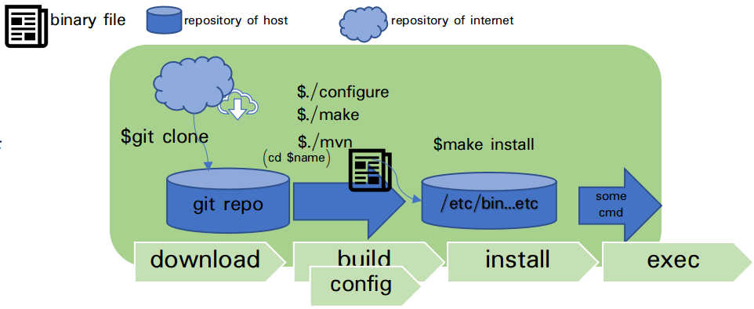
Major Installing way on Linux.
On LINUX, install is used package-install or source-install Installe.
Package install is
package : It is complimently,
source :
Figure1 show you installing from source. (fossology / sw360 / )
souce-install is consist of 3 steps.
・step1 is download
・step2 is build and config
・step3 is installing.
Step2 is used configure、make、
make install commands.
Next page is explain each steps.
figure 1 way of sourceCode's download and install.

Slide 7
DOWNLOAD
1.download(git clone, curl, etc):
This download sourceCode to local (default currentDir) from repository of internet. You should download 前提プロ グラ ム(fossology give auto install script. sw360
don't give. pls show under URL ). Same program may be required to unzip. before
you build
MajorCmd | briefly explaination | is used about
git clone | Download a folder(in some sources).using git. | Liferay ・fossology ・sw360・
curl | Download a sourcefile using HTTP-GET.
apt install | Install Package tools on Ubuntu | couchdb/postgresql/maven/
yum install | install Package tools on CentOS
Notes:
Pa

Slide 8
BUILD/CONFIG
2.build: (maven, make / make install, configure, and some scripts)
Compile and make binay files. Binary files is called when user exec program. But kernel may call binary file auto(ex.systemd, clon). Build tool(program) is too many. some build tool move under programing
languuage(ex.maven)->make(maven)の仕組みへ. NOTE: excluding make, some programm is not included 3.イ ンスト ールは含ま ず
に、4..execへいく こ と ができ る (fossology and sw360 use make)
When program use systemd, you may tipe systemctl cmd. -> systemdのし く みへ
Majorcommand | command briefly explaination | is used about
make | A tool for easily building programs mainly compiled programming language.(ex.C or C++) | Liferay ・fossology ・
configure | A tool for easily building programs mainly compiled programming language.(ex.C or C++) | couchdb/postgresql/maven/
mvn | Package install tools on CentOS
Notes:
Pa

Slide 9


BUILD
・MAKE:
・CONFIGURE:
・MAKE INSTALLL :
git clone

Slide 10
INSTALL
Majorcommand | command briefly explaination | is used about
make install |  | Liferay ・fossology ・
Notes:
Pa

Slide 11
Other Contants HOW THERE WORKED?
DEAMON, SSH
ssh
* versionに注意
* versionに注意
3 インストール
コマンドなら
/usr/local/bin
/bin/
/sbin ....のどれか
デーモンなら
/lib/systemd/system/
... (下記参照)
1. 前提パッケージのインストール
git cloneやapt installを使う. 左を参照してください
2. ダウンロード
・git cloneやapt installを使う.
2. ビルド(実行ファイルの作成)

