Slide 1
SUPPORT Documents of
Fossology and SW360 for users who using its.
During i install fossology and sw360, I feel some things that be written next page. I write memo as contents in this paper.
This is support document.
written by daito keigo

Slide 2
Content 1 P1~P2
Where are each setting file..? (port and proxy, ) ---p1
How its applications start...? And look? ---p1
Where are each log file...? ---p1,2
Where each binary files(exec file)and What type..? ---p2
Contant 2 p3~p6
Major Installing way on Linux. (Step1~Step3) ---p3
Step1. DOWNLOAD ---p4
Step2. BUILD/CONFIG ---p5
What is (Make / configure / maven / make install) ---p6
Step3. INSTALL --- P3
Download
Where are execfile installed and What type?
CONTENT
written by daito keigo

Slide 3
this paper is based on ⇓
sw360 install :
https://qiita.com/K-Hama/items/90a6105a16400ce3e718
fossology:
https://github.com/OpenChain-Project/Japan-WG-General/blob/master/Compliance-Tooling/FOSSology/Installation/install_from_source_debian_jp.md
written by daito keigo

Slide 4


Setting, exected files andlog folders
for fossology, sw360
Web application server
Front end
Database
execed file (auto or manual)
PORT / PROXY
URL (you can see)
Fossology
/usr/local/etc/fossology/
fossology.conf
Apache
/etc/apache2
Liferay/Tomcat
$CATALINA_HOME/con/
server.xml
Maven
~/.m2/settings.xml
/etc/
Git
~/.gitconfig
sw360
Fossology
$CATALINA_HOME/bin/.catalina start / stop
/etc/init.d/fossology.service (manual)
sw360
https://IPADDR:8080
Liferay
--
Fossology
IPADDR/radis
Tomcat
Apatch2
--
/usr/sbin/apachectl(auto)
PostgreSQL
IPADDR/5298/utils
CouchDB
PostgreSQL
/etc/init.d/couchdb(auto)
systemd(auto:systemd)
LOG
Fossology : /var/log/fossology/ Apache2 : /var/log/apache2/
Postgresql: /var/log/postgresql/ Tomcat : /$CATALINA_HOME/logs/
CouchDB : /usr/local/var/log/couchdb/
Liferay : /home/daitokeigo/liferay-portal-6.2-ce-ga5/logs
*1
using system of systemd are
Couchdb, Apache2, PostgreSQL,
Fossology.
Without Fossology, sw360(Liferay = tomcatt), default is manual.
How it work of systemd=>
*2
$CATALINA_HOME:
liferay ga: exist n liferay folder.
*3.
sw360(Liferay = tomcatt)

Slide 5
Major maked folder And Linux File construdtion.
Maked setting/binary files
Linux Construction Folders
etc/
|-fossology.conf Fossology
|-init.d/
|-postgresql.service PostgreSql
|-couchdb.service CouchDB
|-fossology.service Fossology
|-apache2. Apache2
usr/local/
|-etc/
|-couchdb Couchdb
|-init.d/couchdb Couchdb
|-bin/
|-composer Composer(php tool)
|-thrift Thrift
|-sbin/
|-apachectl Apache2
---- sw360=tomcat=liferay ---
~/liferay-portal-{your version}/
|-tomcat-{your version]
|-bin/
|-conf/
/etc : almost all setting-files is here. (There may are under in subfolder or in /usr/etc.)
/bin : basic cmd (system controal)
/usr : program and library for each user.
| /bin : Basic command for each user.
| /usr/local:
| /usr/local/bin/
| /usr/local/etc/
/var : tempolatory files as a log file.
/var/log : Tempolatory logs.
/lib, /usr/local/lib: be placed files
required when user exec some
commands.
/tmp :
/sbin:
(deamon)

Slide 6
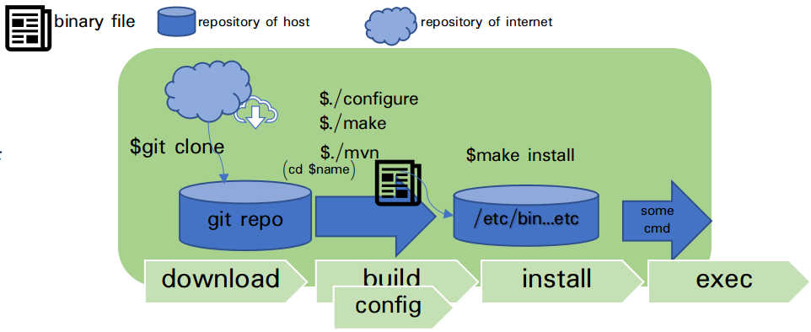
Major Installing way on Linux.
On LINUX, install is used package-install or source-install Installe.
Package install is
package : It is complimently,
source :
Figure1 show you installing from source. (fossology / sw360 / )
souce-install is consist of 3 steps.
・step1 is download
・step2 is build and config
・step3 is installing.
Step2 is used configure、make、
make install commands.
Next page is explain each steps.
figure 1 way of sourceCode's download and install.

Slide 7
DOWNLOAD
1.download:
This download sourceCode to local (default currentDir) from repository of internet. You should download 前提プロ グラ ム(fossology give auto install script. sw360
don't give. pls show under URL ). Same program may be required to unzip. before
you build
MajorCmd | briefly explaination | is used about
git clone | Download a folder(in some sources).using git. | Liferay ・fossology ・sw360
curl / wget | Download a sourcefile using HTTP-GET. | others(downgrenade version)
apt install | Install Package tools on Ubuntu | others (leates version)
yum install | install Package tools on CentOS
Notes:
Pa

Slide 8
BUILD/CONFIG
2.build:
Compile and make binay files. Binary files is called when user exec program. But kernel may call binary file auto(ex.systemd, clon). Build tool(program) is too many. some build tool move under programing
languuage(ex.maven)
NOTE: You use package install don't process this step(step2)~Step3(Install). Then you can go step4.
NOTE: where are compile programs and what is compiled is based on MakeFile, configureScript or pom.xml.
Major Command | command briefly explaination | is used about
make | A tool for easily building programs mainly compiled programming language.(ex.C or C++). It is based on a MakeFile. | Fossology
configure | A script for easily setting enviroments and libraly, and make MakeFile.環境の差異に対応する.It is based on a configure script. | -
mvn | A tool for easily building and installing groprams for Java language. It is based on a pom.xml. | sw360
Notes:
Pa

Slide 9
INSTALL
3.INSTALL:
Install is verry easy. Ths step install compiled programs to local folders. maven is moved under Java projects.
NOTE: where are compile programs and what is compiled is based on MakeFile, configureScript or pom.xml.
Majorcommand | command briefly explaination | is used about
make install | A installing tool Based on install-lavel of MakeFile, for C, C++. | Liferay fossology
maven install | A installing tool Based on pom.xml, for java language. | sw360
Notes:
Pa

Slide 10

SSH on fossology and sw360.
ssh

