Slide 1
PDF vs XML
Nick Carr
ncarr@allette.com.au

Slide 2
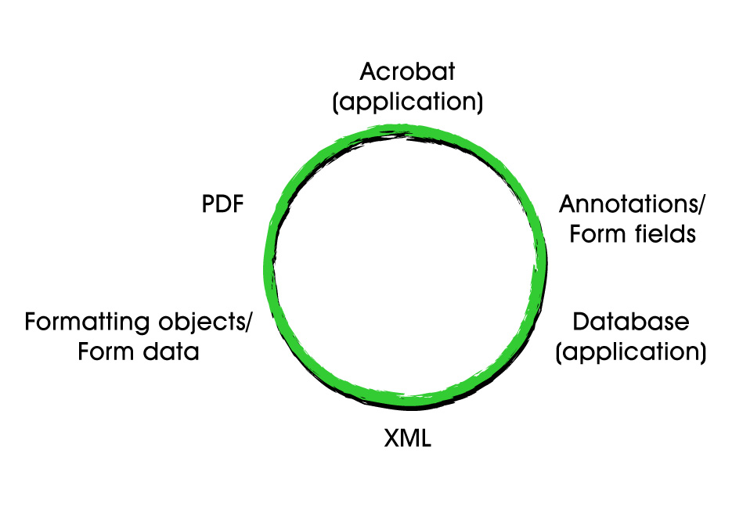
XML/PDF Circle

Slide 3


PDF Annotations vs XML
Document displayed in final format
  Important for proofing
Precision placement of annotations
  Especially line and freehand annotations
Client has built in annotation features
  Native annotation format
  JavaScript API
Large client install base

Slide 4
PDF Annotations vs XML (cont.)
Annotation layer separates comments from document
  Server/database storage
  Uses less bandwidth
  XML format (even if document source is not XML)
  Cleaner (scales better than “track changes”)
Allows parallel reviews
  Faster than serial workflows
  Interaction between reviewers

Slide 5
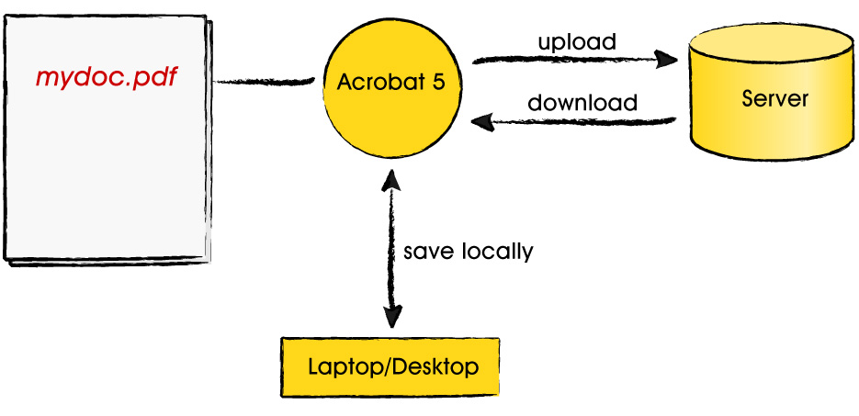
PDF Annotations
Notes:
demo

Slide 6
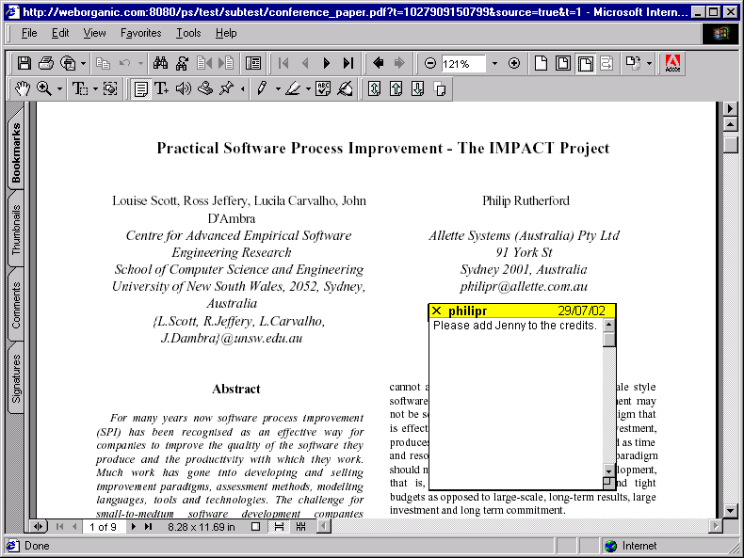
Uploading Annotations
Upload/Download Tools

Slide 7
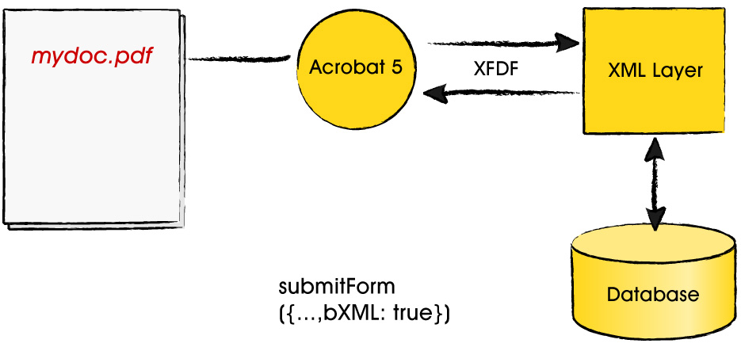
XML/Acrobat Annotations

Slide 8
XFDF format
<text color="#FFFF00" date="D:20020723171008+10'00'" flags="print,nozoom,norotate" page=“2" rect="93.057373,499.161377,111.057373,521.161377" title=“philipr">
<contents>This is an example annotation.</contents>
<popup flags="print,nozoom,norotate" page="0" rect="93.057373,321.161377,293.057373,521.161377">
</popup>
</text>
Notes:
demo

Slide 9
Benefits of XFDF format
Allows development of add-ons
Easy to search
  search across multiple PDFs
Easy to manipulate (DOM or XSL)
  authenticate authors
  email notification of annotations
  produce daily/weekly digest
  threaded discussion
  reply by email
  annotation access levels

Slide 10
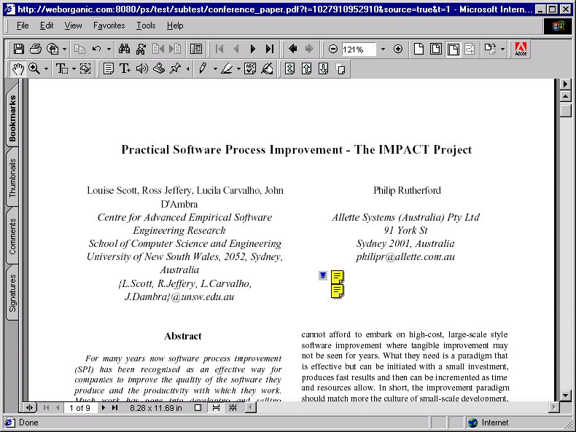
Threaded discussion
Notes:
Instead of having separate annotations clustered around the same point

Slide 11
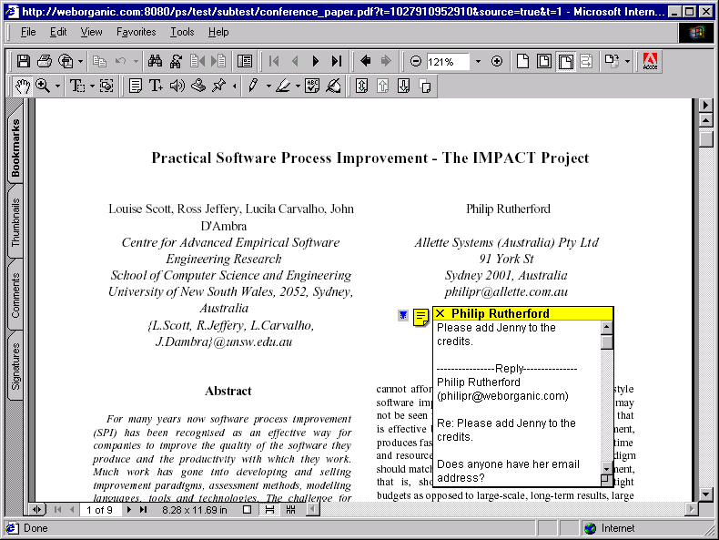
Threaded discussion (cont.)
Notes:
You can have threaded discussion within the same window

Slide 12
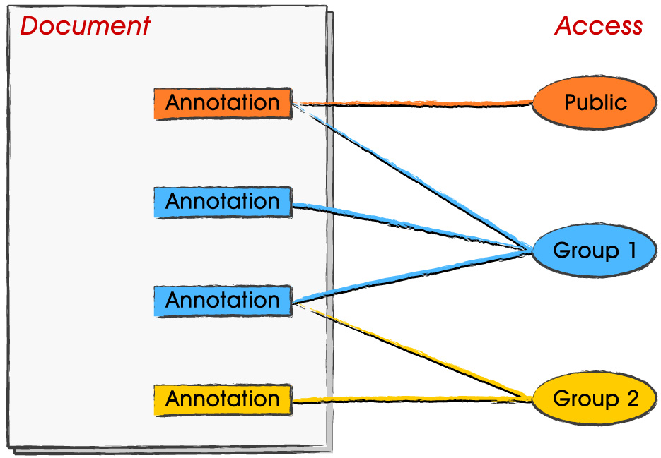
Annotation access levels

