Slide 1

Daivarath B N
AICTE Data Analytics Case-study Report

Slide 2
PROJECT TITLE/Problem Statement
Analysis of Super Store Data-set

Slide 3
AGENDA
The primary goal is to gain valuable insights and make data-driven decisions to optimize the performance of the super store.
To achieve this, there are certain steps to be followed like understanding the dataset, data cleaning and preprocessing, Data Analysis, and followed by Actionable insights.
The main thing is to clean the data to our requirement and get valuable insights so that the company may gain more profit in the future.

Slide 4
PROJECT OVERVIEW
In consideration of the data set. The profit of a company matters a lot. Generally, It used to be measured manually, but because of the revolutions and as the data generation is more of what is very difficult to analyse manually, the data analyst comes into picture, where by making use of certain software and programming language and algorithm, it is easy to track a particular quantitative element. Like considering the data set which has about a dimension of ( 9995, 5), it is hard to analyse manually, so with the help of python the data is analysed and insights are generated.
To improve the insights generated the unwanted data must be discarded, empty data must be filled with NaN. By this the dimension is reduced with reducing the error probability and insights accuracy.

Slide 5
WHO ARE THE END USERS of this project?
Analyzing the data not only makes the company profit, but it also contributes for a much for optimized service and provides an extremely valuable features, such as detecting all kinds of flaws both in the service and the customers, the area where there is room to grow, providing one of a kind services which also helps with easy work compliance.
The user that wants a particular item or category can make use of it providing exact details and in sights too.

Slide 6
YOUR SOLUTION AND ITS VALUE PROPOSITION
Applying machine learning to train and test the sales wrt profit, to get some insights.
By this we can try to predict the future sales and profit.

Slide 7
How did you customize the project and make it your own
Excluding to the case study video I have applied machine learning to do linear regression on a plot of sales vs profit.
Where I have separated the dataset’s 70% to train the model and the rest 30% to test.
By this it analyzed the trend and finally a graph of actual and predicted values.
And thereby calculating the mean squared error, root mean square error, and r-squared(co-efficient of determination).
I have made this my own, and by applying machine learning and conducting linear regression.

Slide 8
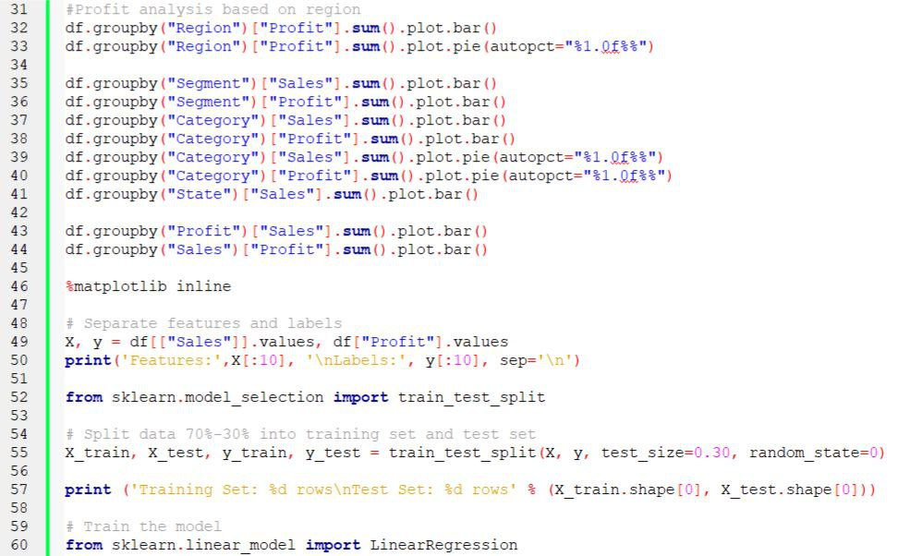
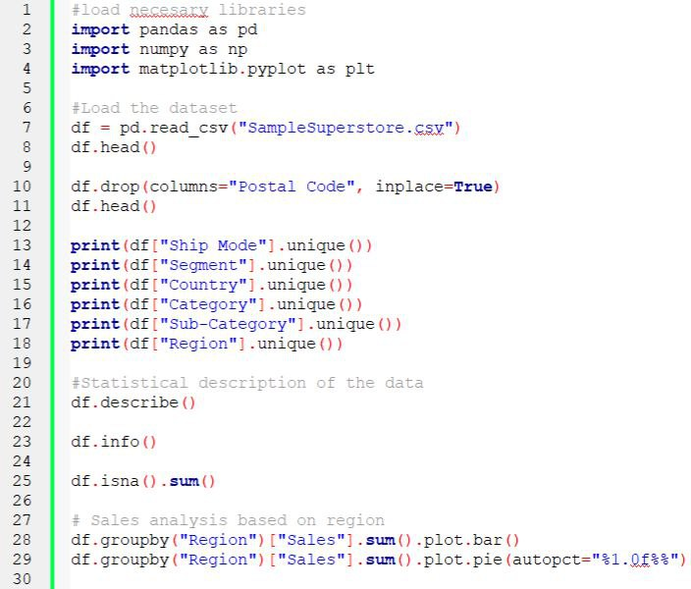
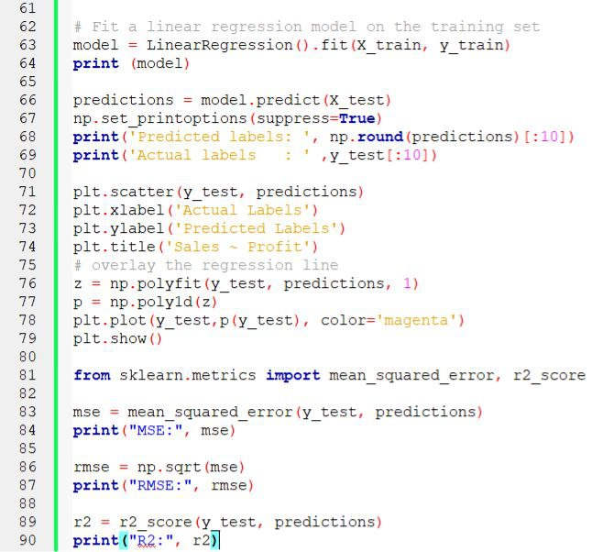
MODELLING
The code is as follows

Slide 9
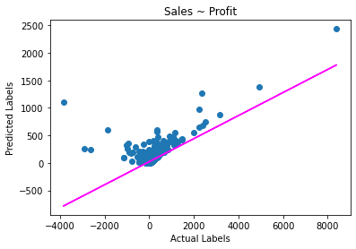
Results
MSE: 51349.12515753704
RMSE: 226.60345354282896
R2: 0.30776582766799
Where
MSE is Mean Square Error.
RMSE is Root Mean Square Error.
R2 is co-efficient of detemination.

Slide 10
links
Project Git-hub link: https://github.com/daivarath-b-n/aicte_ibm_casestudy

