Slide 1
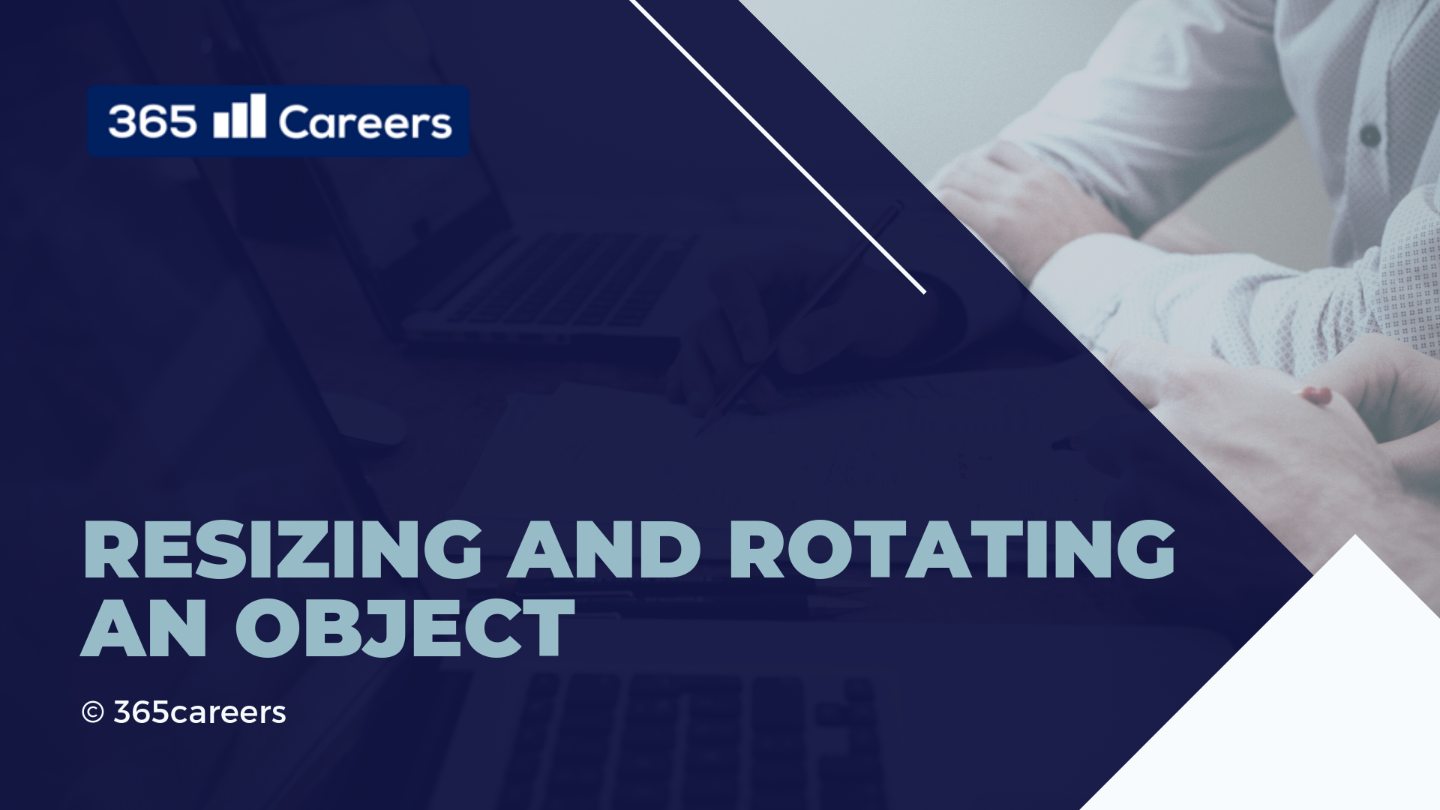

Slide 2

Resizing Objects

Slide 3
Rotating Objects

