Slide 1
PostureAlert - A Webcam-based Posture Corrector
RV College Of Engineering_Code Crusaders
Team Members:
Daivik Mankame
Avishi Singh
Stuthi Mathapati
Aditi Mandviya
PostureAlert transforms any webcam into an AI posture coach that detects bad posture in real time and delivers instant ergonomics corrections before discomfort becomes damage.

Slide 2


Slide 3
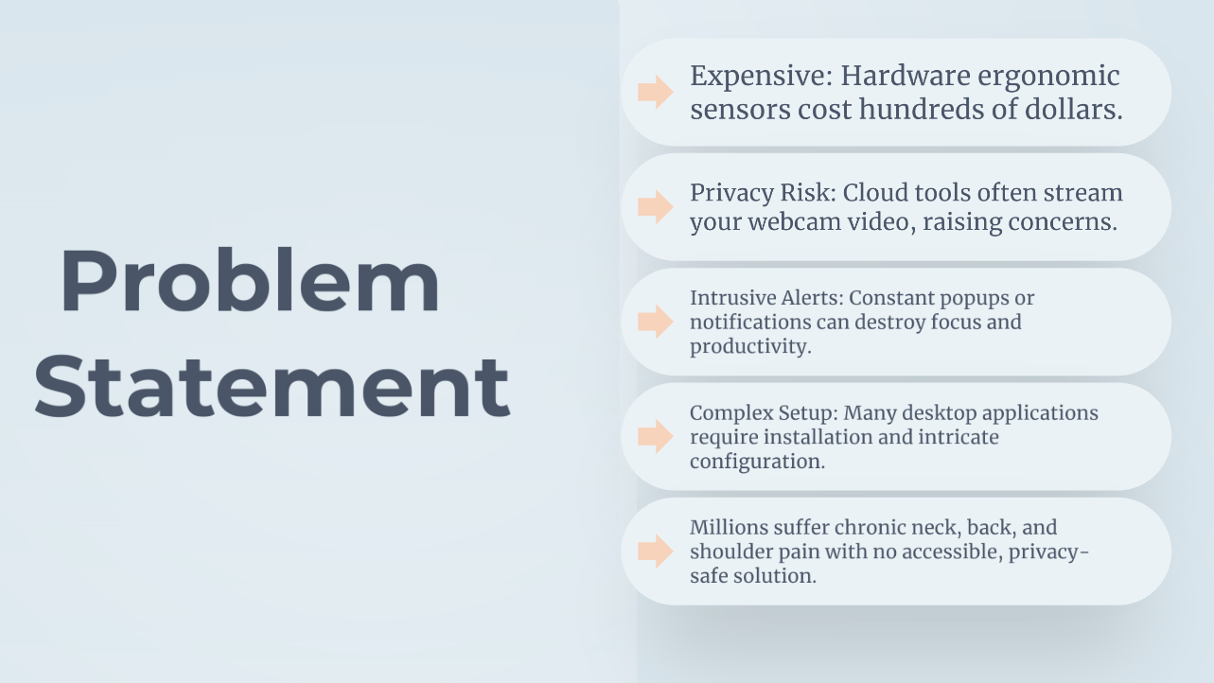

Slide 4
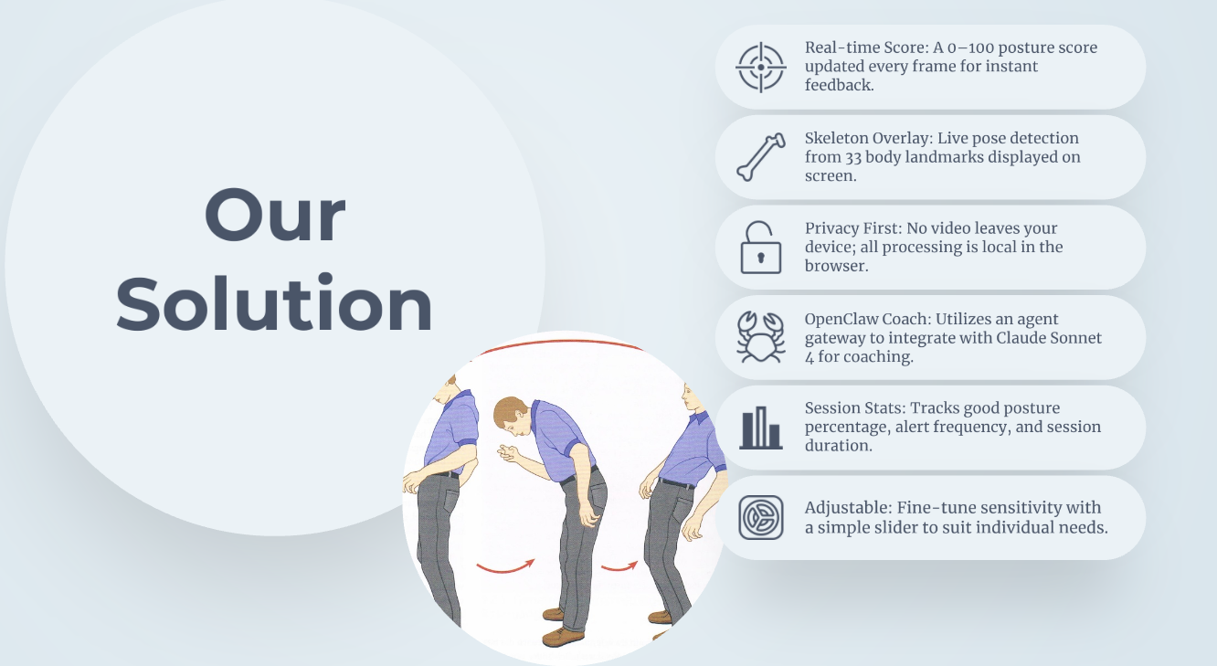

Slide 5
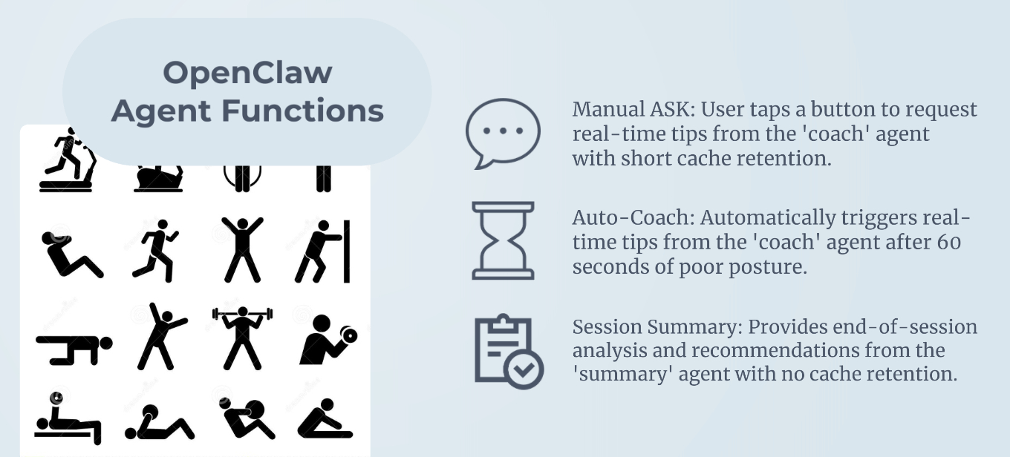

Slide 6


Slide 7
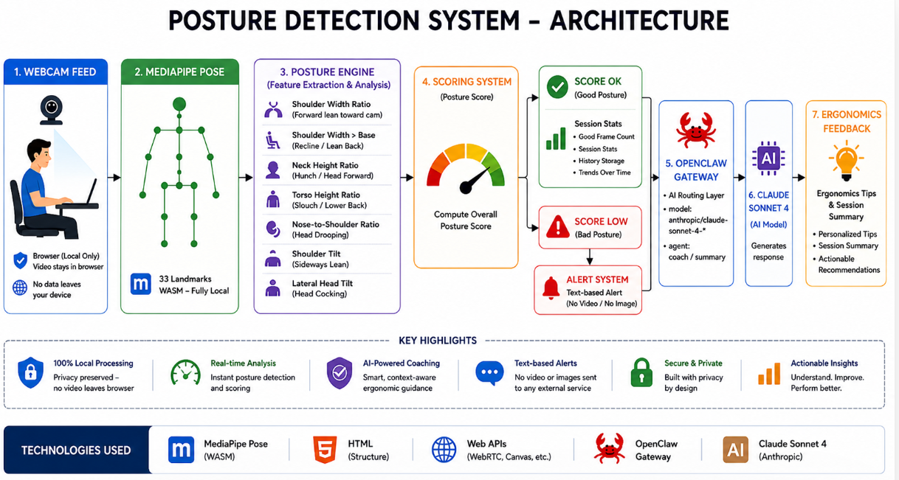

Slide 8
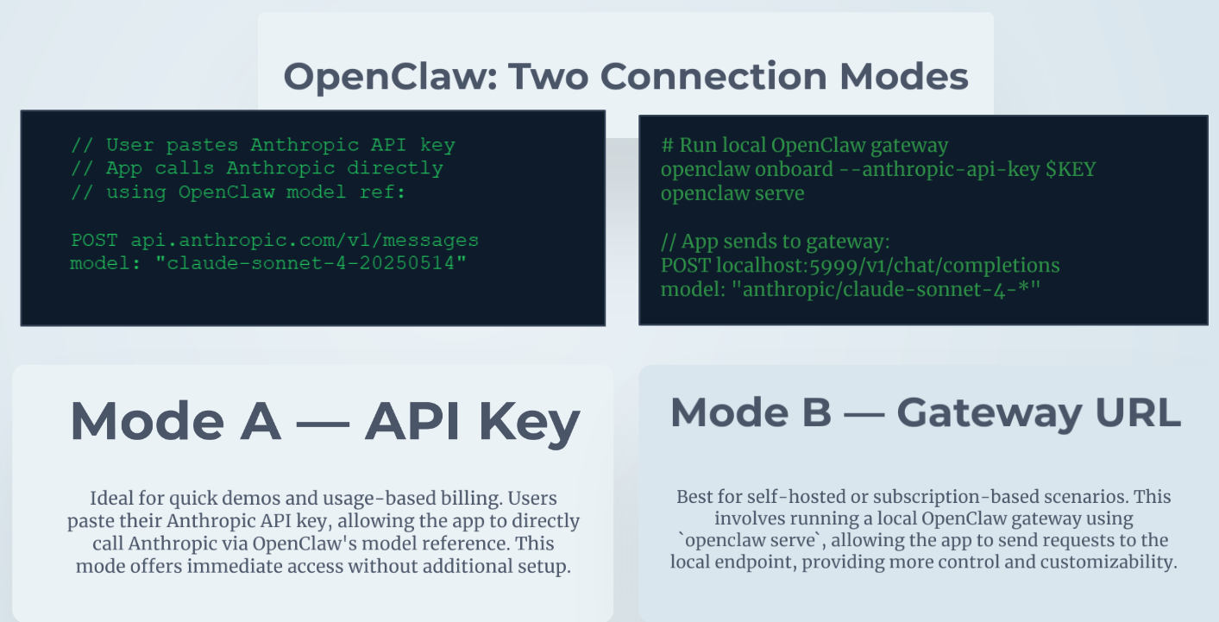

Slide 9


Slide 10


