Slide 1
Hardware Description Languages: Verilog
Verilog
  Structural Models
  (Combinational) Behavioral Models
  Syntax
  Examples

Slide 2
Quick History of HDLs
ISP (circa 1977) - research project at CMU
  Simulation, but no synthesis
Abel (circa 1983) - developed by Data-I/O
  Targeted to programmable logic devices
  Not good for much more than state machines
Verilog (circa 1985) - developed by Gateway (now Cadence)
  Similar to Pascal and C
  Delays is only interaction with simulator
  Fairly efficient and easy to write
  IEEE standard
VHDL (circa 1987) - DoD sponsored standard
  Similar to Ada (emphasis on re-use and maintainability)
  Simulation semantics visible
  Very general but verbose
  IEEE standard

Slide 3
Design Methodology
Structure and Function
(Behavior) of a Design
HDL
Specification
Simulation
Synthesis
Verification: Design
Behave as Required?
Functional: I/O Behavior
Register-Level (Architectural)
Logic-Level (Gates)
Transistor-Level (Electrical)
Timing: Waveform Behavior
Generation: Map
Specification to
Implementation

Slide 4
Verilog/VHDL
The “standard” languages
Very similar
  Many tools provide front-ends to both
  Verilog is “simpler”
    Less syntax, fewer constructs
  VHDL supports large, complex systems
    Better support for modularization
    More grungy details
    “Hello world” is much bigger in VHDL

Slide 5
Verilog
Supports structural and behavioral descriptions
Structural
  Explicit structure of the circuit
  How a module is composed as an interconnection of more primitive modules/components
  E.g., each logic gate instantiated and connected to others
Behavioral
  Program describes input/output behavior of circuit
  Many structural implementations could have same behavior
  E.g., different implementations of one Boolean function

Slide 6
Verilog Introduction
the module describes a component in the circuit
Two ways to describe:
  Structural Verilog
    List of components and how they are connected
    Just like schematics, but using text
    Hard to write, hard to decode
    Useful if you don’t have integrated design tools
  Behavioral Verilog
    Describe what a component does, not how it does it
    Synthesized into a circuit that has this behavior

Slide 7
Structural Model
  Composition of primitive gates to form more complex module
  Note use of wire declaration!
module xor_gate (out, a, b);
input a, b;
output out;
wire abar, bbar, t1, t2;
inverter invA (abar, a);
inverter invB (bbar, b);
and_gate and1 (t1, a, bbar);
and_gate and2 (t2, b, abar);
or_gate or1 (out, t1, t2);
endmodule
By default, identifiers
are wires

Slide 8
Structural Model
Example of full-adder
module full_addr (A, B, Cin, S, Cout);
input A, B, Cin;
output S, Cout;
assign {Cout, S} = A + B + Cin;
endmodule
module adder4 (A, B, Cin, S, Cout);
input [3:0] A, B;
input Cin;
output [3:0] S;
output Cout;
wire C1, C2, C3;
full_addr fa0 (A[0], B[0], Cin, S[0], C1);
full_addr fa1 (A[1], B[1], C1, S[1], C2);
full_addr fa2 (A[2], B[2], C2, S[2], C3);
full_addr fa3 (A[3], B[3], C3, S[3], Cout);
endmodule
Behavior
Structural

Slide 9
Simple Behavioral Model
Combinational logic
  Describe output as a function of inputs
  Note use of assign keyword: continuous assignment
module and_gate (out, in1, in2);
input in1, in2;
output out;
assign out = in1 & in2;
endmodule
Output port of a primitive must
be first in the list of ports
Restriction does not apply to
modules

Slide 10
Verilog Data Types and Values
Bits - value on a wire
  0, 1
  X - don’t care/don’t know
  Z - undriven, tri-state
Vectors of bits
  A[3:0] - vector of 4 bits: A[3], A[2], A[1], A[0]
  Treated as an unsigned integer value
    e.g. , A < 0 ??
  Concatenating bits/vectors into a vector
    e.g., sign extend
    B[7:0] = {A[3], A[3], A[3], A[3], A[3:0]};
    B[7:0] = {4{A[3]}, A[3:0]};
  Style: Use a[7:0] = b[7:0] + c;
  Not: a = b + c; // need to look at declaration

Slide 11
Verilog Numbers
14 - ordinary decimal number
-14 - 2’s complement representation
12’b0000_0100_0110 - binary number with 12 bits (_ is ignored)
12’h046 - hexadecimal number with 12 bits
Verilog values are unsigned
  e.g., C[4:0] = A[3:0] + B[3:0];
  if A = 0110 (6) and B = 1010(-6)
  C = 10000 not 00000
  i.e., B is zero-padded, not sign-extended

Slide 12
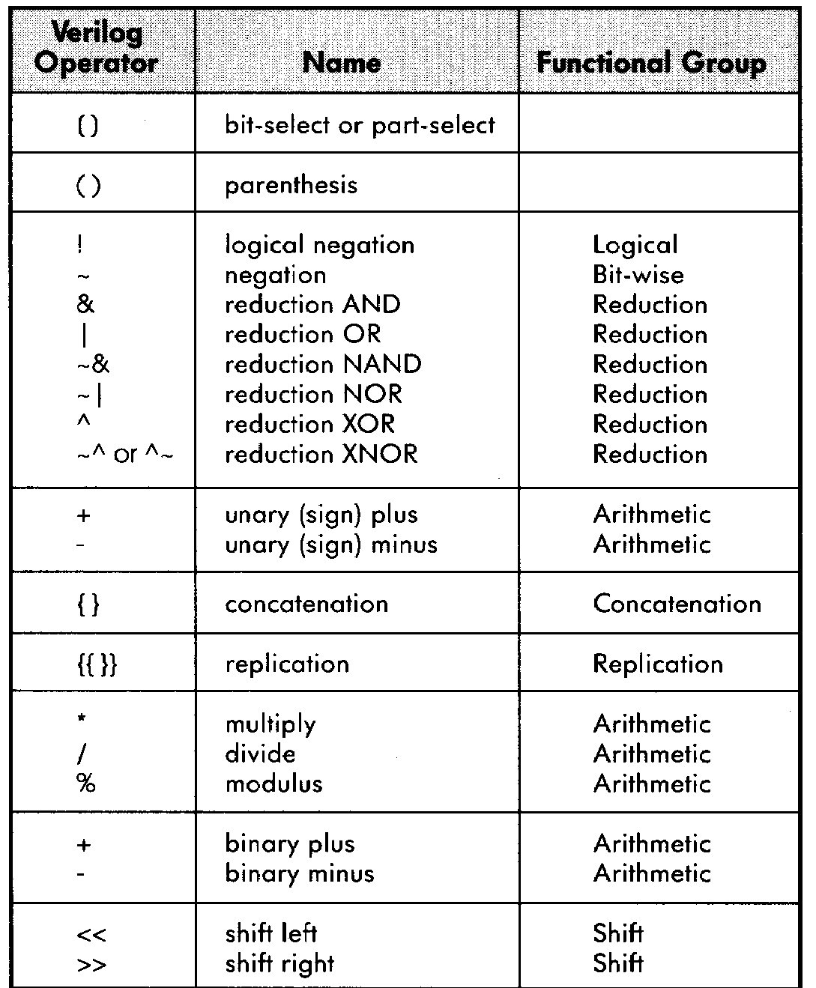
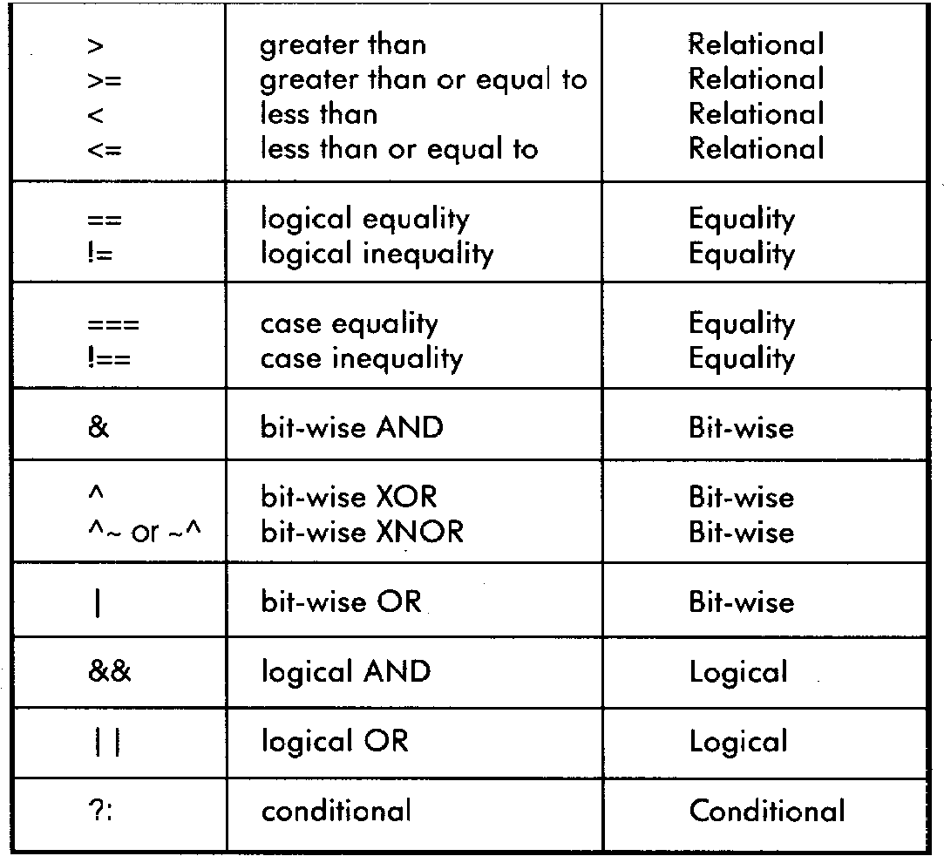
Verilog Operators

Slide 13
Verilog “Variables”
wire
  Variable used simply to connect components together
reg
  Variable that saves a value as part of a behavioral description
  Usually corresponds to a wire in the circuit
  Is NOT necessarily a register in the circuit
The Rule:
  Declare a variable as a reg if it is the target of a concurrent (non-blocking) assignment statement
    Don’t confuse reg assignments with the combinational continuous assign statement!
    Reg should only be used with always blocks (sequential logic, to be presented …)
    Confusing isn’t it?

Slide 14
Verilog Module
Corresponds to a circuit component
  “Parameter list” is the list of external connections, aka “ports”
  Ports are declared “input”, “output” or “inout”
    inout ports used on tri-state buses
  Port declarations imply that the variables are wires
module name
ports
module full_addr (A, B, Cin, S, Cout);
input A, B, Cin;
output S, Cout;
assign {Cout, S} = A + B + Cin;
endmodule
inputs/outputs

Slide 15
Verilog Continuous Assignment
Assignment is continuously evaluated
assign corresponds to a connection or a simple component with the described function
Target is NEVER a reg variable
use of Boolean operators
(~ for bit-wise, ! for logical negation)
assign A = X | (Y & ~Z);
assign B[3:0] = 4'b01XX;
assign C[15:0] = 16'h00ff;
assign #3 {Cout, S[3:0]} = A[3:0] + B[3:0] + Cin;
bits can take on four values
(0, 1, X, Z)
variables can be n-bits wide
(MSB:LSB)
use of arithmetic operator
multiple assignment (concatenation)
delay of performing computation, only used by simulator, not synthesis

Slide 16
Comparator Example
module Compare1 (A, B, Equal, Alarger, Blarger);
input A, B;
output Equal, Alarger, Blarger;
assign Equal = (A & B) | (~A & ~B);
assign Alarger = (A & ~B);
assign Blarger = (~A & B);
endmodule

Slide 17
Comparator Example
// Make a 4-bit comparator from 4 x 1-bit comparators
module Compare4(A4, B4, Equal, Alarger, Blarger);
input [3:0] A4, B4;
output Equal, Alarger, Blarger;
wire e0, e1, e2, e3, Al0, Al1, Al2, Al3, B10, Bl1, Bl2, Bl3;
Compare1 cp0(A4[0], B4[0], e0, Al0, Bl0);
Compare1 cp1(A4[1], B4[1], e1, Al1, Bl1);
Compare1 cp2(A4[2], B4[2], e2, Al2, Bl2);
Compare1 cp3(A4[3], B4[3], e3, Al3, Bl3);
assign Equal = (e0 & e1 & e2 & e3);
assign Alarger = (Al3 | (Al2 & e3) |
(Al1 & e3 & e2) |
(Al0 & e3 & e2 & e1));
assign Blarger = (~Alarger & ~Equal);
endmodule

Slide 18
Announcements
Lecture room change EFFECTIVE 1 FEB 07:
  Beware of what you ask for!
  159 Mulford Hall (near West Gate/Oxford Street)
Card Key Access to 125 Cory
  You can’t get it until 7 February
  For access:
    EECS Keys/Cardkeys, Copy Cards Assistant: Loretta Lutcher
    253 Cory, 642-1527, loret@eecs
    Loretta issues keys and electronic cardkeys for Cory Hall.
    Handles cardkey problems. She can add 125 Cory to your Cal Card.

Slide 19
Simple Behavioral Model: the always block
always block
  Always waiting for a change to a trigger signal
  Then executes the body
module and_gate (out, in1, in2);
input in1, in2;
output out;
reg out;
always @(in1 or in2) begin
out = in1 & in2;
end
endmodule
Not a real register!!
A Verilog register
Needed because of
assignment in always block
Specifies when block is executed
I.e., triggered by which signals

Slide 20
always Block
Procedure that describes the function of a circuit
  Can contain many statements including if, for, while, case
  Statements in the always block are executed sequentially
    (Continuous assignments <= are executed in parallel)
  Entire block is executed at once
  Final result describes the function of the circuit for current set of inputs
    intermediate assignments don’t matter, only the final result
begin/end used to group statements

Slide 21
“Complete” Assignments
If an always block executes, and a variable is not assigned
  Variable keeps its old value (think implicit state!)
  NOT combinational logic ⇒ latch is inserted (implied memory)
  This is usually not what you want: dangerous for the novice!
Any variable assigned in an always block should be assigned for any (and every!) execution of the block

Slide 22
Incomplete Triggers
Leaving out an input trigger usually results in a sequential circuit
Example: Output of this “and” gate depends on the input history
module and_gate (out, in1, in2);
input in1, in2;
output out;
reg out;
always @(in1) begin
out = in1 & in2;
end
endmodule

Slide 23
Verilog if
Same as C if statement
// Simple 4:1 mux
module mux4 (sel, A, B, C, D, Y);
input [1:0] sel; // 2-bit control signal
input A, B, C, D;
output Y;
reg Y; // target of assignment
always @(sel or A or B or C or D)
if (sel == 2’b00) Y = A;
else if (sel == 2’b01) Y = B;
else if (sel == 2’b10) Y = C;
else if (sel == 2’b11) Y = D;
endmodule

Slide 24
Verilog if
Another way
// Simple 4:1 mux
module mux4 (sel, A, B, C, D, Y);
input [1:0] sel; // 2-bit control signal
input A, B, C, D;
output Y;
reg Y; // target of assignment
always @(sel or A or B or C or D)
if (sel[0] == 0)
if (sel[1] == 0) Y = A;
else Y = B;
else
if (sel[1] == 0) Y = C;
else Y = D;
endmodule

Slide 25
Verilog case
Sequential execution of cases
  Only first case that matches is executed (implicit break)
  Default case can be used
// Simple 4-1 mux
module mux4 (sel, A, B, C, D, Y);
input [1:0] sel; // 2-bit control signal
input A, B, C, D;
output Y;
reg Y; // target of assignment
always @(sel or A or B or C or D)
case (sel)
2’b00: Y = A;
2’b01: Y = B;
2’b10: Y = C;
2’b11: Y = D;
endcase
endmodule
Conditions tested in
top to bottom order

Slide 26
Verilog case
Note:
case (case_expression)
case_item1 : case_item_statement1;
case_item2 : case_item_statement2;
case_item3 : case_item_statement3;
case_item4 : case_item_statement4;
default : case_item_statement5;
endcase
… is the same as …
if(case_expression == case_item1)
case_item_statement1;
else if (case_expression == case_item2) case_item_statement2;
else if (case_expression == case_item3)
case_item_statement3;
else if (case_expression == case_item4) case_item_statement4;
else case_item_statement5;

Slide 27
Verilog case
Without the default case, this example would create a latch for Y
Assigning X to a variable means synthesis is free to assign any value
// Simple binary encoder (input is 1-hot)
module encode (A, Y);
input [7:0] A; // 8-bit input vector
output [2:0] Y; // 3-bit encoded output
reg [2:0] Y; // target of assignment
always @(A)
case (A)
8’b00000001: Y = 0;
8’b00000010: Y = 1;
8’b00000100: Y = 2;
8’b00001000: Y = 3;
8’b00010000: Y = 4;
8’b00100000: Y = 5;
8’b01000000: Y = 6;
8’b10000000: Y = 7;
default: Y = 3’bXXX; // Don’t care when input is not 1-hot
endcase
endmodule

Slide 28
Verilog case (cont)
Cases are executed sequentially
  Following implements a priority encoder
// Priority encoder
module encode (A, Y);
input [7:0] A; // 8-bit input vector
output [2:0] Y; // 3-bit encoded output
reg [2:0] Y; // target of assignment
always @(A)
case (1’b1)
A[0]: Y = 0;
A[1]: Y = 1;
A[2]: Y = 2;
A[3]: Y = 3;
A[4]: Y = 4;
A[5]: Y = 5;
A[6]: Y = 6;
A[7]: Y = 7;
default: Y = 3’bXXX;// Don’t care when input is all 0’s
endcase
endmodule

Slide 29
Parallel Case
A priority encoder is more expensive than a simple encoder
  If we know the input is 1-hot, we can tell the synthesis tools
  “parallel-case” pragma says the order of cases does not matter
// simple encoder
module encode (A, Y);
input [7:0] A; // 8-bit input vector
output [2:0] Y; // 3-bit encoded output
reg [2:0] Y; // target of assignment
always @(A)
case (1’b1) // synthesis parallel-case
A[0]: Y = 0;
A[1]: Y = 1;
A[2]: Y = 2;
A[3]: Y = 3;
A[4]: Y = 4;
A[5]: Y = 5;
A[6]: Y = 6;
A[7]: Y = 7;
default: Y = 3’bX; // Don’t care when input is all 0’s
endcase
endmodule

Slide 30
Verilog casex
Like case, but cases can include ‘X’
  X bits not used when evaluating the cases
  In other words, you don’t care about those bits!

Slide 31
casex Example
// Priority encoder
module encode (A, valid, Y);
input [7:0] A; // 8-bit input vector
output [2:0] Y; // 3-bit encoded output
output valid; // Asserted when an input is not all 0’s
reg [2:0] Y; // target of assignment
reg valid;
always @(A) begin
valid = 1;
casex (A)
8’bXXXXXXX1: Y = 0;
8’bXXXXXX10: Y = 1;
8’bXXXXX100: Y = 2;
8’bXXXX1000: Y = 3;
8’bXXX10000: Y = 4;
8’bXX100000: Y = 5;
8’bX1000000: Y = 6;
8’b10000000: Y = 7;
default: begin
valid = 0;
Y = 3’bX; // Don’t care when input is all 0’s
end
endcase
end
endmodule

Slide 32
Verilog for
for is similar to C
for statement is executed at compile time (like macro expansion)
  Result is all that matters, not how result is calculated
  Use in testbenches only!
// simple encoder
module encode (A, Y);
input [7:0] A; // 8-bit input vector
output [2:0] Y; // 3-bit encoded output
reg [2:0] Y; // target of assignment
integer i; // Temporary variables for program only
reg [7:0] test;
always @(A) begin
test = 8b’00000001;
Y = 3’bX;
for (i = 0; i < 8; i = i + 1) begin
if (A == test) Y = i;
test = test << 1;
end
end
endmodule

Slide 33
Another Behavioral Example
Computing Conway’s Game of Life rule
  Cell with no neighbors or 4 neighbors dies; with 2-3 neighbors lives
module life (neighbors, self, out);
input self;
input [7:0] neighbors;
output out;
reg out;
integer count;
integer i;
always @(neighbors or self) begin
count = 0;
for (i = 0; i<8; i = i+1) count = count + neighbors[i];
out = 0;
out = out | (count == 3);
out = out | ((self == 1) & (count == 2));
end
endmodule
integers are temporary compiler variables
always block is executed instantaneously,
if there are no delays only the final result is used

Slide 34
Verilog while/repeat/forever
while (expression) statement
  Execute statement while expression is true
repeat (expression) statement
  Execute statement a fixed number of times
forever statement
  Execute statement forever

Slide 35
full-case and parallel-case
// synthesis parallel_case
  Tells compiler that ordering of cases is not important
  That is, cases do not overlap
    e. g., state machine - can’t be in multiple states
  Gives cheaper implementation
// synthesis full_case
  Tells compiler that cases left out can be treated as don’t cares
  Avoids incomplete specification and resulting latches

