Slide 1

Table of Content
Requirements
Pipeline structure
Folder structure
File structure
Postgres set up
Invalid data exception
Logging
How to

Slide 2
Requirements
Data process is developed and tested in following environment with related software:
Windows 10 (64bits)
PostgresSQL version 13
Anaconda3 (Python 3.8.10)

Slide 3
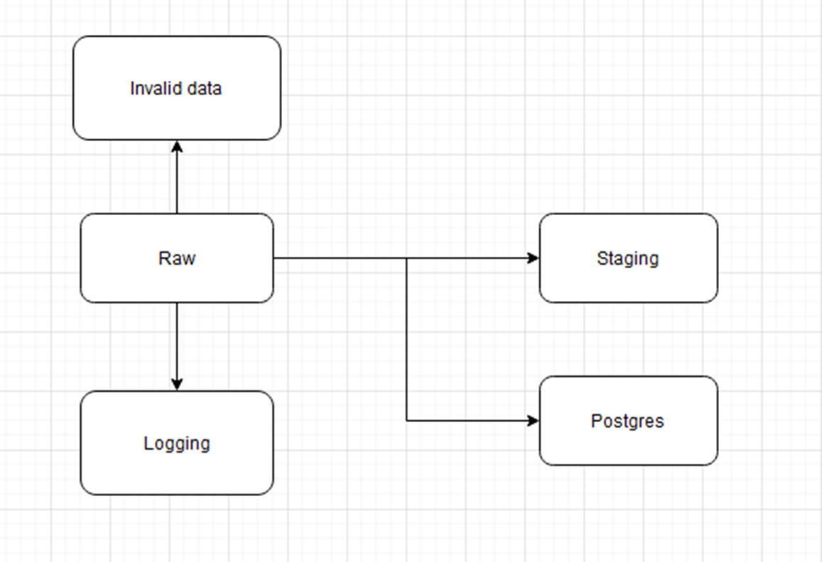
Pipeline structure
All raw files are in raw folder
For every execution process, output can be selected to write into following options - staging folder as csv - staging folder as json - write into postgres
All processes info will be logged into .log file in logging folder
Erroneous data or null that existing in non-nullable column will be rejected and stored into invalid data folder for further checking or reverting to operation team

Slide 4
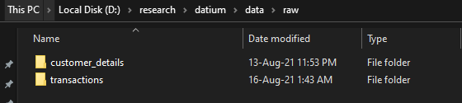
Pipeline structure
There are two raw files provided -test.csv -test.json
Test.csv is identified as transactions and situated in data/raw/transactions/test.csv -output generated by test.csv (“test”)
Test.json is identified as customer details data and situated in data/raw/customer_details/test.json -output generated by test.json (“users”, “jobs_history”, “telephone_numbers”)

Slide 5
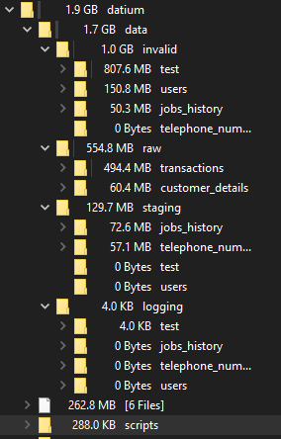
Folder Structure
To fully replicate the environment of development, kindly prepare folder structures in the given format
Please ignore the 262.8MB [6files] above scripts folder

Slide 6
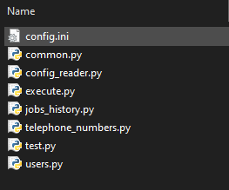
File Structure
Inside scripts folder there should be 8 files
-config.ini which is the main file to control the execution process. This file is also the only that will be configured.
Py files are all the scripts written for execution process. None of the files require any changes for the following execution as the process is fully controlled by parameters in config.ini

Slide 7
File Structure
Common.py is the file for all general functions that can be used across all other python files
Config_reader.py is the file for parsing the config.ini file
Execute.py is the main file for arranging the jobs and launching them. This is also the file to be executed in python command prompt to start the whole process flow.
Jobs_history.py, telephone_numbers.py, test.py, users.py are all the outputs requested to be generated. Transformation is very particular to the requirements of tables so they are managed separately.
Note: No further changes or editing is required to any of the python files.

Slide 8
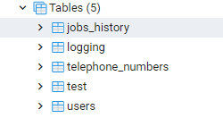
Postgres set up
Postgres is required as it is one of the destination of output. Five tables are required to be created.
Jobs_history
Telephone_numbers
Users
Test
Logging

Slide 9
Postgres set up
Requirement of tables can be obtained from database_structure_design_document.xlsx on the top right of this slide
Requirements can be interpreted as: sheet_name = table name in postgres
Column = column name
Primary_key = primary key indicator for unique id
Data_type = data_type to be selected when creating column
Source = how this column is generated, from which source file. If blank means self generated during transformation
Description = high level description of column details

Slide 10
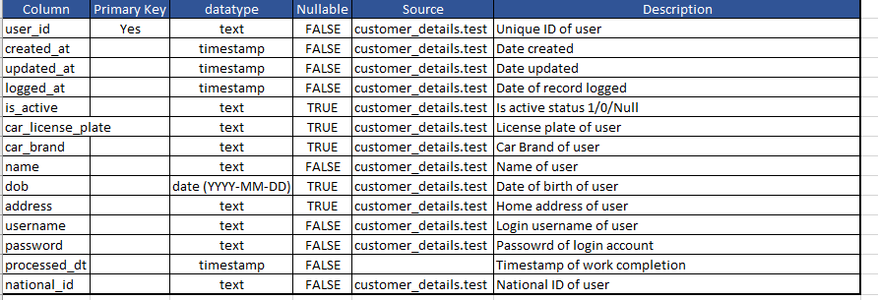
Postgres set up
Example of design specification

Slide 11
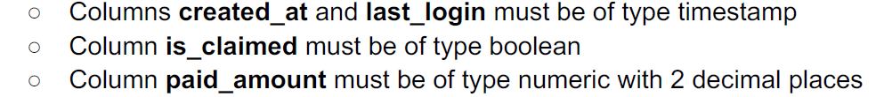
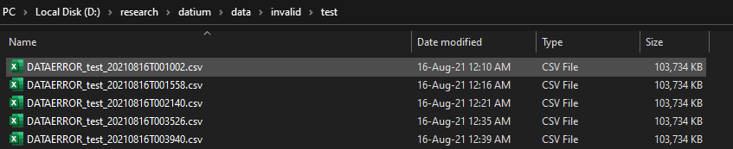
Invalid Data Exception
Due to there are certain requirements provided, for example:
So any row that failed to meet the criteria (null or not the expected type) will be discarded and filtered out into invalid folder. Example of outputs:

Slide 12
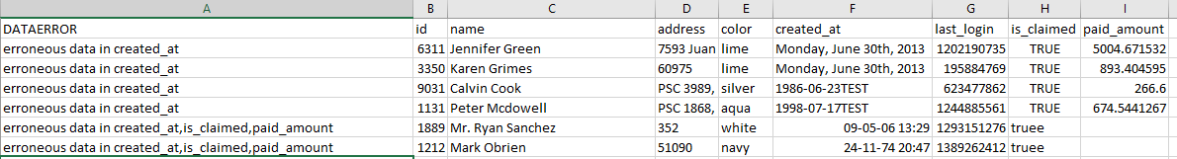
Invalid Data Exception
Explanation of DATAERROR files:
First column DATAERROR indicates which column(s) is having issue. For example - first row indicates erroneous data in created at as the date format is insufficient be parsed into timestamp( there is no time information provided)
Fifth column DATAERROR indicates created_at, is_claimed, and paid_amount are having issue. Created_at is missing seconds element in timestamp is_claimed is not a type can nbe parsed as Boolean
Paid_amount is blank

Slide 13
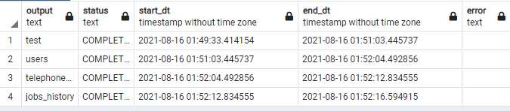
Logging
There are two levels of logging here
Postgres (logging) high level description of process
Detailed logging in logging folder
Example of logging output in Postgres (logging) table. This tables shows the status of the job, the start and completion time, and also error if there is any.

Slide 14
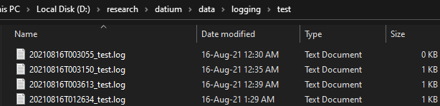
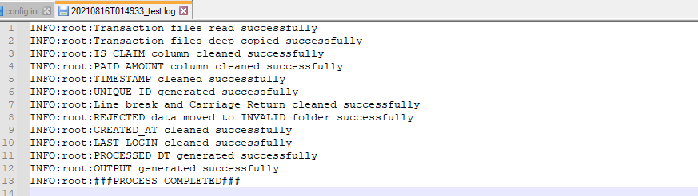
Logging
Detailed logging is also collected in the following path \data\logging\<job_name>\
Inside the file recorded each of the process status for each transformation step. For Example:

Slide 15
How To Get Started
To get started with the execution process, following requirements must first be met.
Postgres is installed and all five tables are created
Folder structure shown is created
Python is installed

Slide 16
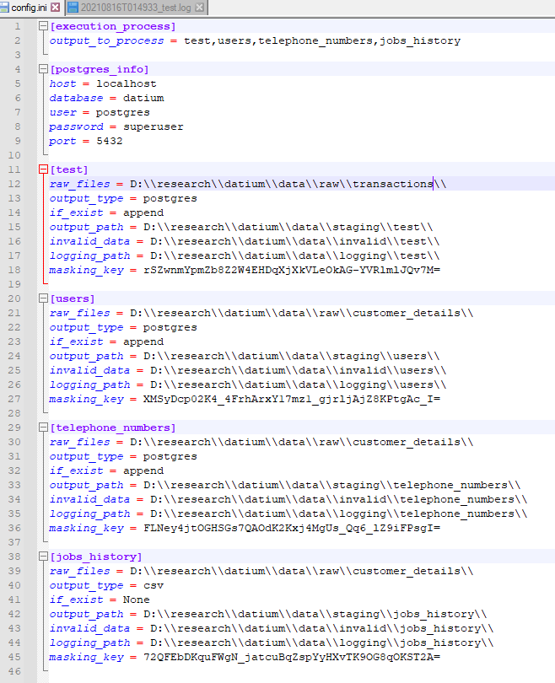
How To Get Started
Configure with config.ini file [execution_ process][output_to_process] is the list of job to run. Currently we have four type of outputs (test, users, telephone_numbers, jobs_history). If only certain jobs are required to run, just remove the unwanted job from the list
[postgres_info] this is parameters to connect to the Postgres server. All parameters are required.
[<job_name>] test, users, telephone_numbers, jobs_history are all having their own configuration.

Slide 17
How To Get Started
[<job_name>] test, users, telephone_numbers, jobs_history are all having their own configuration. 1) raw_files is the path of the raw files location (Please change according to where you have placed your raw files) 2) output_type is the expected output you want. Selection: postgres, csv, json. -if postgres output will be written to Postgres db and table name will be the same as job_name -if csv/json output will be written to staging folder 3) if_exist is the action to be taken for postgres method. Whether the user would like the table to append or to replace the existing data. -append, data will be added to the existing data -replace, old data will be replaced by new data

Slide 18
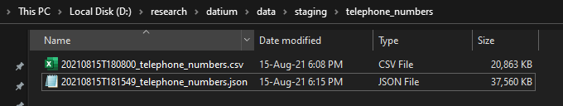
How To Get Started
[<job_name>] test, users, telephone_numbers, jobs_history are all having their own configuration. 4) output_path – if the output_type is json/csv, this is the location path that table output will be written to. File naming format is as following: “%Y%m%dT%H%M%S_<job_name>.<file_extension>”

Slide 19
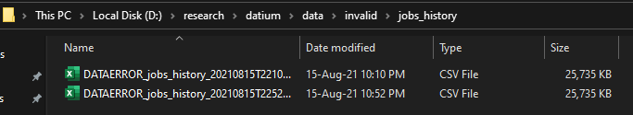
How To Get Started
[<job_name>] test, users, telephone_numbers, jobs_history are all having their own configuration. 4) invalid_path – location path of files to store all the rejected erroneous data.

Slide 20
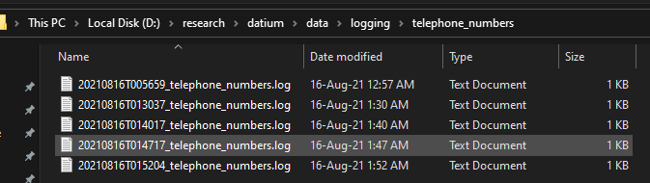
How To Get Started
[<job_name>] test, users, telephone_numbers, jobs_history are all having their own configuration. 5) logging_path – location path of files to store all the logging files

Slide 21
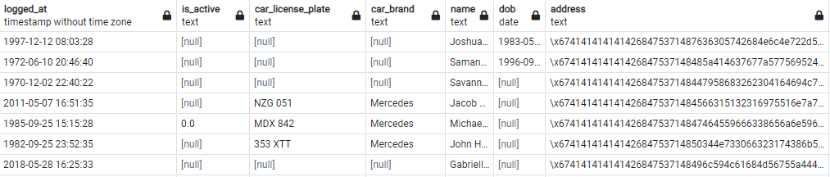
How To Get Started
[<job_name>] test, users, telephone_numbers, jobs_history are all having their own configuration. 6) masking key – Due to data masking is requested on sensitive data. Fernet encryption base64 is used to encrypt the data. Masking key is the token to encrypt and decrypt the sensitive data. Please be informed that 32bytes padding of masking key is required, or masking key that is complex enough.
Example of output in address column after masking

Slide 22
How To Get Started
After configuration on config.ini is completed, script can be executed through command prompt
python <path/execute.py> <path/config.ini> Example:

