Slide 1



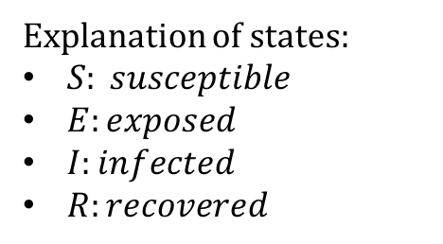


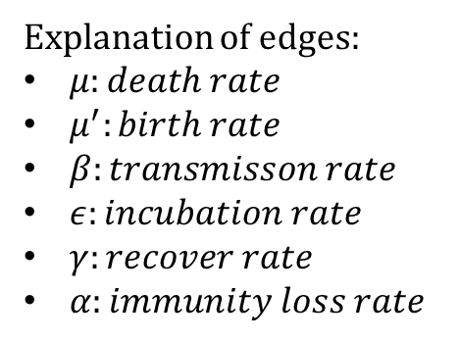




$$μ′$$
$$α$$
S
$$β$$
E
$$ε$$
I
$$γ$$
R
$$μ$$
$$μ$$
$$μ$$
$$μ$$
Explanation of states:
$S: susceptible$
$E:exposed$
$I:infected$
$R:recovered$
Explanation of edges:
$μ:death rate$
$μ^{′}:birth rate$
$β:transmisson rate$
$ε:incubation rate$
$γ:recover rate$
$α:immunity loss rate$

