Slide 1



The role of hippocampal neuron degeneration, dendritic atrophy, and neurogenesis in depression onset and rescue
Joint Master in Neuroscience, 10th Anniversary, University of Strasbourg, 2016
LU Han
Tutor: Julia Gallinaro
Supervisor: Prof. Stefan Rotter

Slide 2


Scientific Background Depression
genes,
stressors...
HEALTHY
DEPRESSION
Lopez-Leon at al., 2008;
Kendler et al., 2003

Slide 3
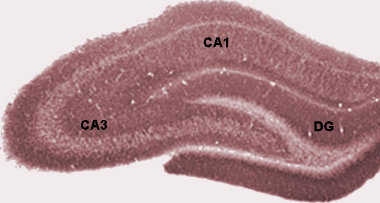
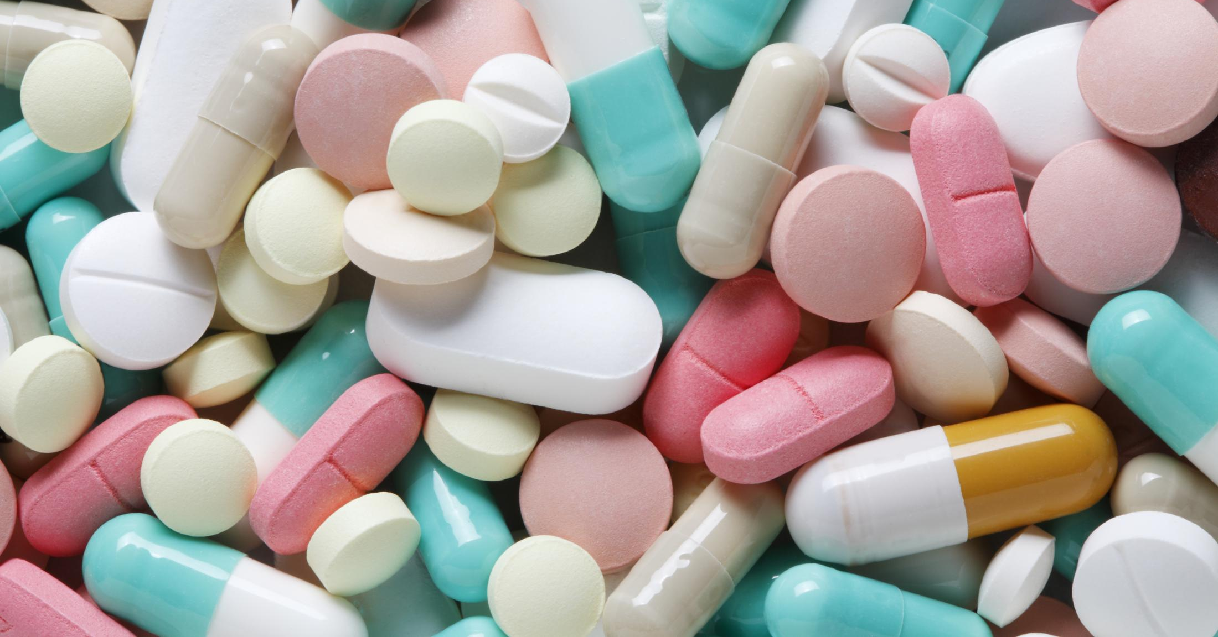
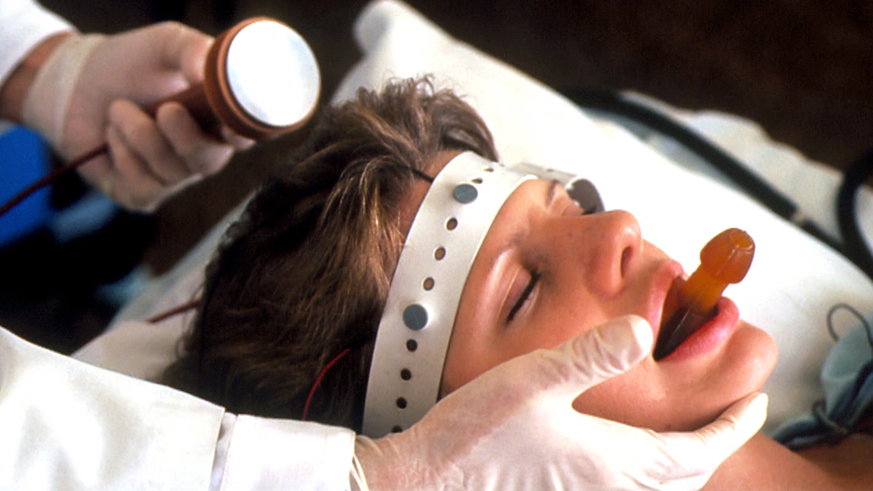
Scientific Background Depression & Neuroplasticity in the hippocampus
stressors
DEPRESSION
neuroplasticity
+/-
treatments
Pittenger and Duman, 2008
Santarelli et al., 2003

Slide 4
Scientific Background Depression & Neuroplasticity in the hippocampus
stressors
hippocampal volume
synaptic change
dendritic morphology
neurogenesis & degeneration
neuroplasticity
+/-
DEPRESSION
treatments

Slide 5
Scientific Background Depression & Neuroplasticity in the hippocampus
stressors
dendritic atrophy in CA3 &
neuron pool reduction
neuroplasticity
neurogenesis in the dentate gyrus
treatments
Santarelli et al., 2000
Vyas et al., 2002
Holderbach et al., 2007

Slide 6
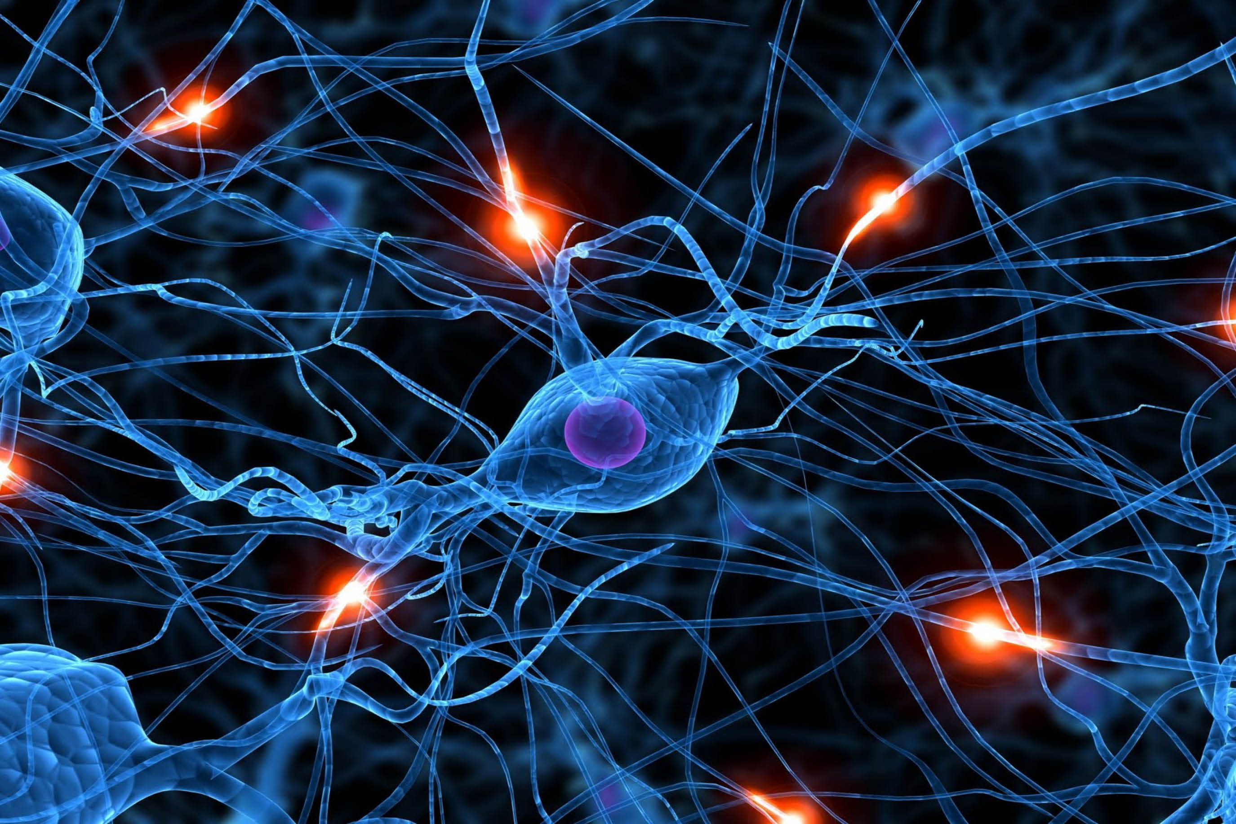
Objectives & Hypotheses computational neuroscience: network dynamics
inputs, size, connection strength...

Slide 7
Objectives & Hypotheses computational neuroscience: network dynamics
pp: perforant path
mf: mossy fiber
rc: recurrent collaterals
(EC)
(DG)
excitatory
inhibitory

Slide 8
Objectives & Hypotheses computational neuroscience: network dynamics
pp: perforant path
mf: mossy fiber
rc: recurrent collaterals
dendritic atrophy & neuron degeneration influence dynamics and plasticity
in CA3
neurogenesis in DG rescues dynamics and plasticity in CA3
(EC)
(DG)
excitatory
inhibitory

Slide 9
Methods
the numeric models
Neuron model
leaky integrate and fire model
Network model
CA3: Brunel model
(balanced recurrent network)
Synapse model
recurrent synapses:
static model
spike-timing-dependent plasticity
(STDP) model
J: synaptic weight
P: firing rate of Poisson generator (PG)
ε: connection probability
N: population size
DG: the dentate gyrus

Slide 10
Methods
the numeric models
Dentate Gyrus
Entorhinal Cortex
|| || | | ||| || ||||
| ||| | |||||
Poisson generator
excitatory neuron
inhibitory neuron
CA3

Slide 11
Methods
the numeric models
Dentate Gyrus
Entorhinal Cortex
|| || | | ||| || ||||
N_gc
(kill 60 neuorns/6s)
| ||| | |||||
J_2
(decrease to 90% per 6s)
Poisson generator
excitatory neuron
inhibitory neuron
CA3

Slide 12
Methods
the numeric models
Dentate Gyrus
Entorhinal Cortex
|| || | | ||| || ||||
N_gc
(100 neuorns/6s)
| ||| | |||||
J_2
(with larger J_2)
Poisson generator
excitatory neuron
inhibitory neuron
CA3

Slide 13
Methods
the simulation timeline

Slide 14
Methods
the simulation timeline

Slide 15
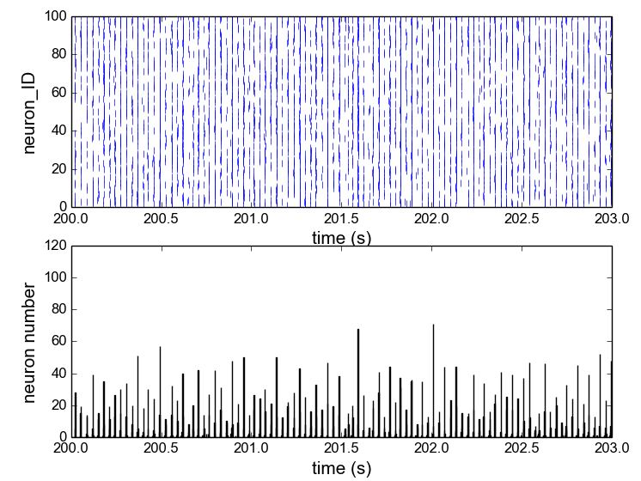
Methods
analysis of CA3 activities and plasticity
raster plot
Activity
Firing rate
Correlation Coefficient (CC)
Peri-Stimulus-Time-Histogram (PSTH)
bin size = 2ms

Slide 16
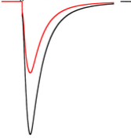
Methods
analysis of CA3 activities and plasticity
raster plot
Activity
Firing rate
Correlation Coefficient (CC)
Plasticity
synaptic weights of excitatory neurons
post-synaptic current
Peri-Stimulus-Time-Histogram (PSTH)
bin size = 2ms

Slide 17
Results
neuron degeneration & dendritic atrophy
influence CA3 dynamics
example: neuron degeneration
100 neurons recorded

Slide 18
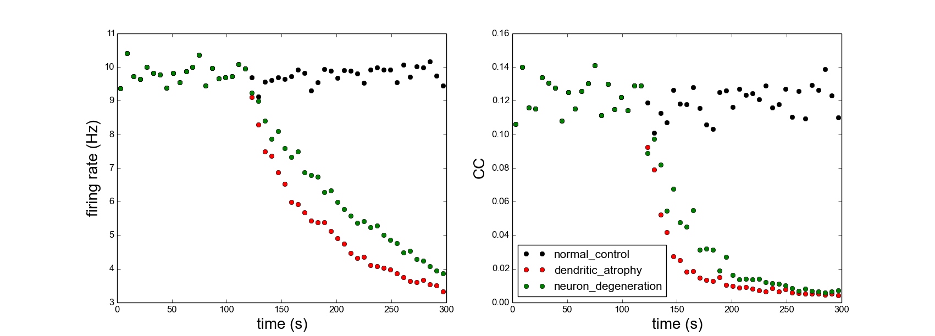
Results
neuron degeneration & dendritic atrophy
influence CA3 dynamics

Slide 19
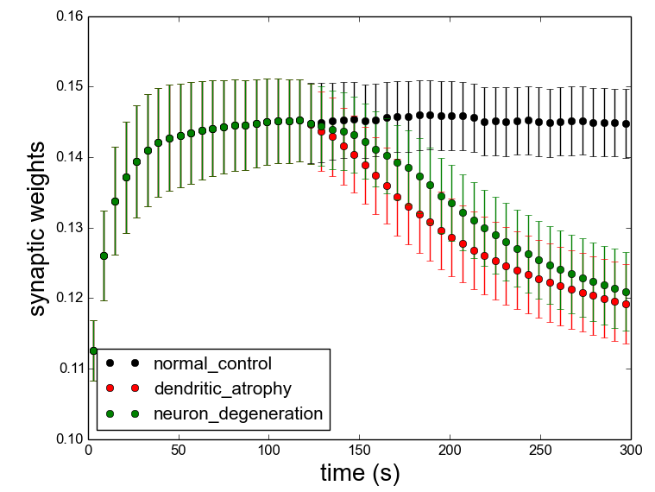
Results
neuron degeneration & dendritic atrophy
influence CA3 plasticity
CA3
recurrent synapses
100 excitatory neurons
STDP synapse model

Slide 20
Results
neurogenesis rescues CA3 dynamics
example: rescued from neuron degeneration
100 neurons recorded

Slide 21
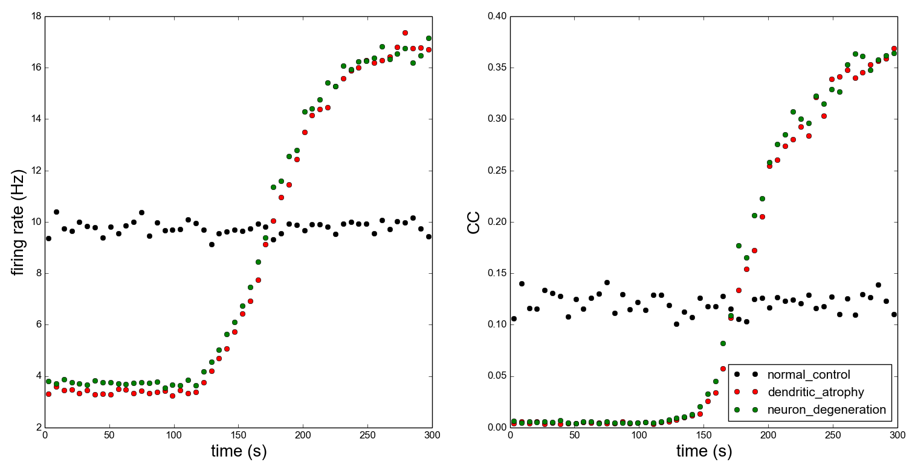
Results
neurogenesis rescues CA3 dynamics

Slide 22
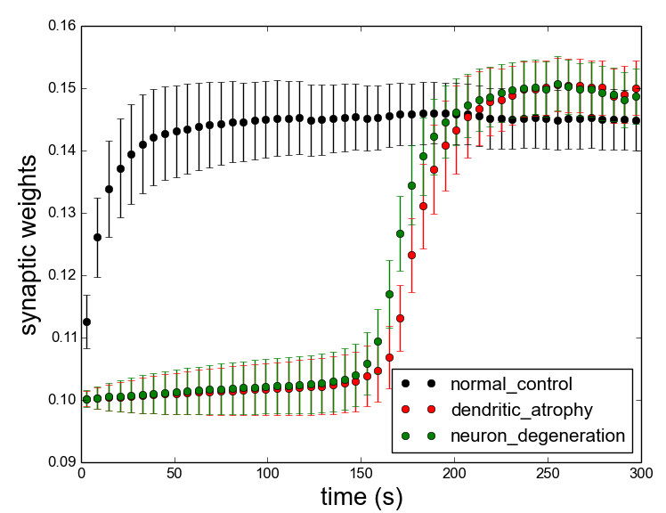
Results
neurogenesis rescues CA3 plasticity
CA3
recurrent synapses
100 excitatory neurons
STDP synapse model

Slide 23
Summary
Our Results
Input strength from DG to CA3 influence CA3 network activities and plasticity.
Empirical Evidence of Depression
Onset: activation abnormality in the hippocampus (Milne et al., 2012)
Rescue: enhancing activation in DG
(Henke, 1989)
(EC)
(DG)
pp: perforant path
mf: mossy fiber
rc: recurrent collaterals

Slide 24
The role of hippocampal neuron degeneration, dendritic atrophy, and neurogenesis in depression onset and rescue
Joint Master in Neuroscience, 10th Anniversary, University of Strasbourg, 2016
Thank you!
LU Han
Tutor: Julia Gallinaro
Supervisor: Prof. Stefan Rotter

