Slide 1



The role of hippocampal neuron degeneration, dendritic atrophy, and neurogenesis in depression onset and rescue
Joint Master in Neuroscience, University of Strasbourg
Master Defense, 16/06/2016
A numeric study
Han LU
Tutor: Julia Gallinaro
Supervisor: Prof. Stefan Rotter

Slide 2
OUTLINE
Scientific Background
Objectives and Hypotheses
Methods
Results

Slide 3

Scientific Background Depression
genes
+
stressors
HEALTHY
DEPRESSION
somatic...
cognitive...
depressed mood
Lopez-Leon at al., 2008;
Kendler et al., 2003

Slide 4
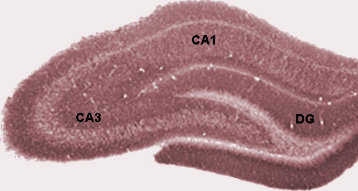
Scientific Background Depression & Neuroplasticity in the hippocampus
Stress
DEPRESSION
neuroplasticity
+/-
antidepressants electroconvulsive therapy
Pittenger and Duman, 2008
Santarelli et al., 2003

Slide 5
Scientific Background Depression & Neuroplasticity in the hippocampus
Stress
hippocampal volume deficit
synaptic change
dendritic morphological change
neurogenesis & degeneration
DEPRESSION
neuroplasticity
+/-
antidepressants electroconvulsive therapy
Pittenger and Duman, 2008
Santarelli et al., 2003

Slide 6
Scientific Background Depression & Neuroplasticity in the hippocampus
Stress
dendritic atrophy in CA3 pyramidal neurons &
neuron population reduction
neuroplasticity
LTD facilitation in CA1 pyramidal neurons
neurogenesis in the dentate gyrus
antidepressants, electroconvulsive therapy
Santarelli et al., 2000
Vyas et al., 2002
Holderbach et al., 2007

Slide 7
Scientific Background Depression & Neuroplasticity in the hippocampus
Stress
dendritic atrophy in CA3 pyramidal neurons &
neuron population reduction
neuroplasticity
LTD facilitation in CA1 pyramidal neurons
neurogenesis in the dentate gyrus
antidepressants, electroconvulsive therapy
Santarelli et al., 2000
Vyas et al., 2002
Holderbach et al., 2007

Slide 8
Objectives & Hypotheses computational neuroscience: dynamics of neural network
pp: perforant path
mf: mossy fiber
rc: recurrent collaterals
(EC)
(DG)
excitatory
inhibitory

Slide 9
Objectives & Hypotheses computational neuroscience: dynamics of neural network
pp: perforant path
mf: mossy fiber
rc: recurrent collaterals
Dendritic atrophy & neuron degeneration influence dynamics and plasticity
in CA3
Neurogenesis in DG rescues dynamics and plasticity in CA3
(EC)
(DG)
excitatory
inhibitory

Slide 10
Methods
the numeric models
Neuron model
leaky integrate and fire model
Network model
CA3: Brunel model
(balanced recurrent network)
Synapse model
recurrent synapses:
static model
spike-timing-dependent plasticity
(STDP) model
J: synaptic weight
P: firing rate of Poisson generator (PG)
ε: connection probability
N: population size

Slide 11
Methods
the numeric models
Neuron model
leaky integrate and fire model
Network model
CA3: Brunel model
(balanced recurrent network)
Synapse model
recurrent synapses:
static model
spike-timing-dependent plasticity
(STDP) model
J: synaptic weight
P: firing rate of Poisson generator (PG)
ε: connection probability
N: population size

Slide 12
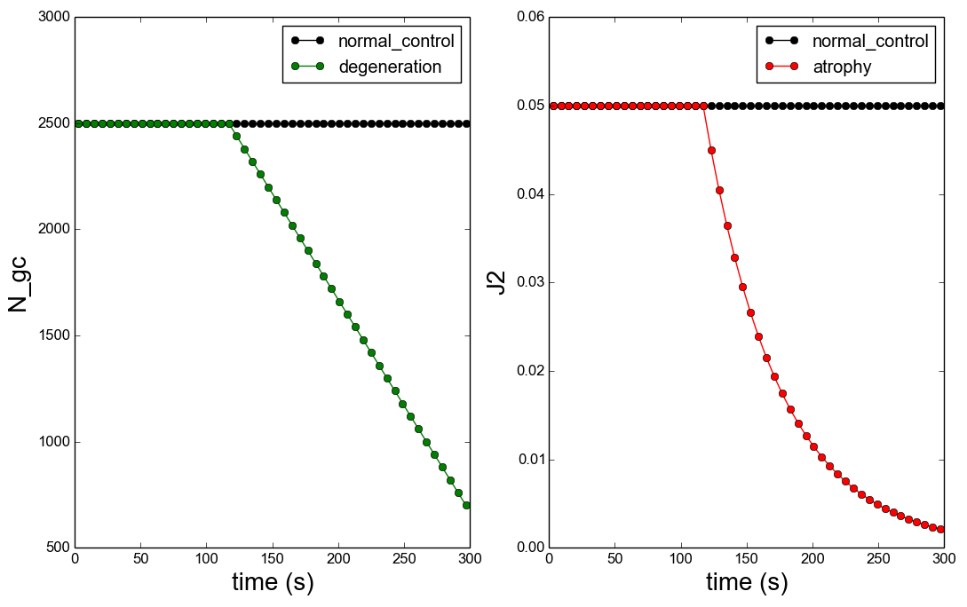
Methods
neuron degeneration & dendritic atrophy (since 120s)
60 neurons degenerate each 6s
reduced to 90% each 6s
N_gc: granule cells in the dentate gyrus J2: synaptic weights from DG to CA3

Slide 13
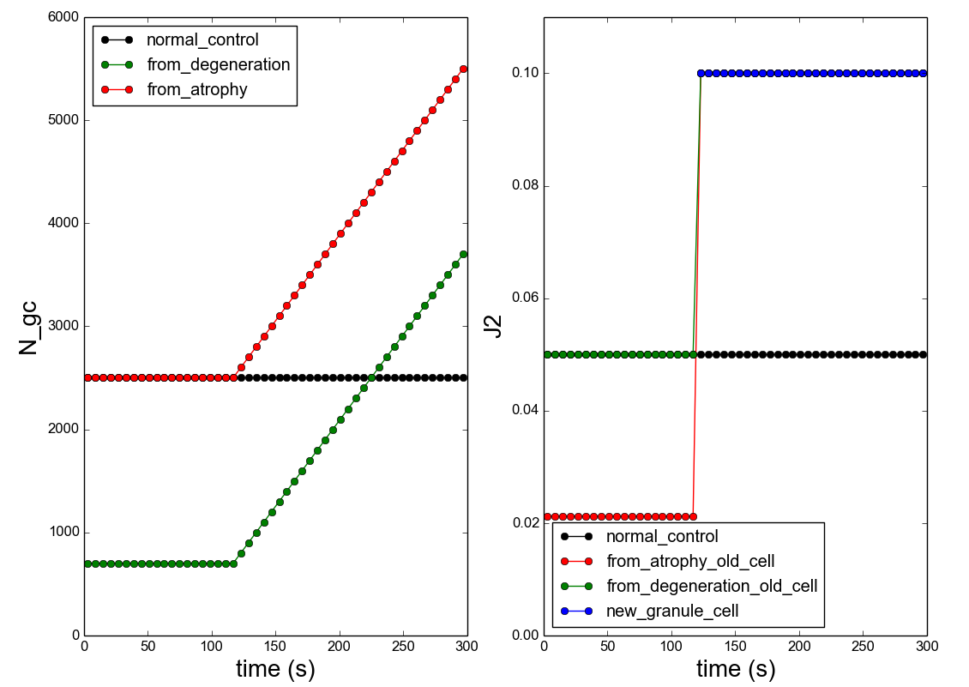
Methods
neurogenesis (since 120s)
synaptic weights of new granule cells: 0.1
generate 100 neurons each 6s
N_gc: granule cells in the dentate gyrus J2: synaptic weights from DG to CA3

Slide 14
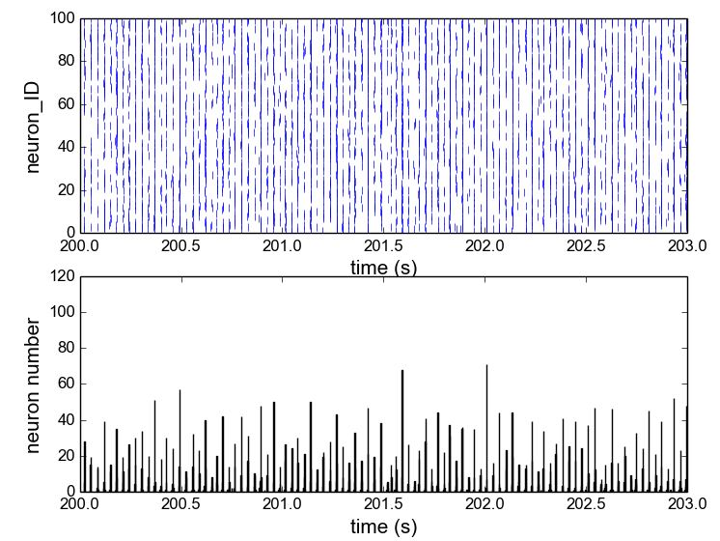
Methods
analysis of CA3 activities and plasticity
raster plot
Activity
Firing rate
Correlation Coefficient (CC)
Peri-Stimulus-Time-Histogram (PSTH)
bin size = 2ms

Slide 15
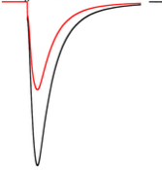
Methods
analysis of CA3 activities and plasticity
raster plot
Activity
Firing rate
Correlation Coefficient (CC)
Plasticity
synaptic weights of excitatory neurons
post-synaptic current
Peri-Stimulus-Time-Histogram (PSTH)
bin size = 2ms

Slide 16
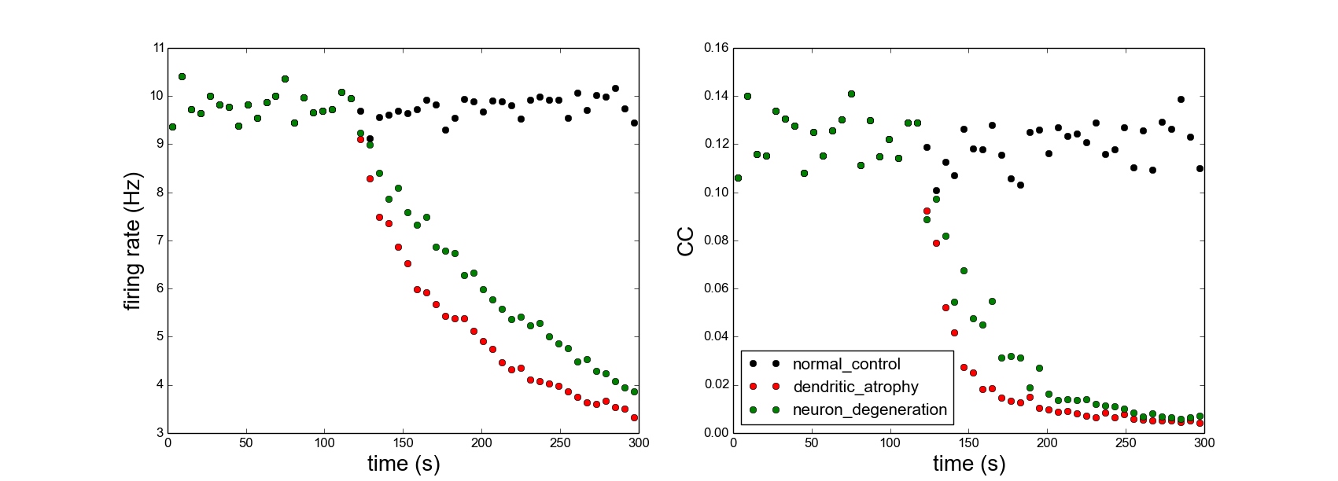
Results
neuron degeneration & dendritic atrophy influence CA3 dynamics

Slide 17
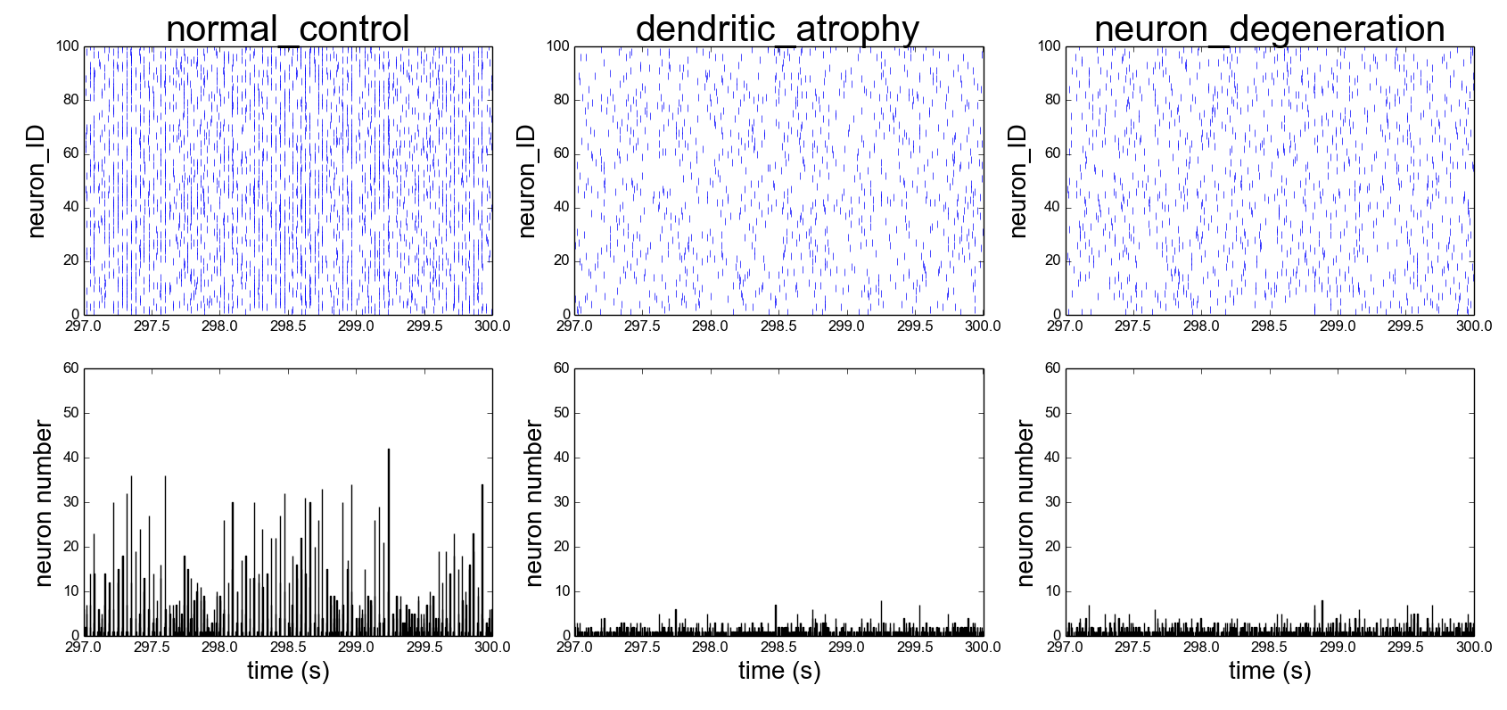
Results
neuron degeneration & dendritic atrophy influence CA3 dynamics
time window: 297s-300s
100 neuron recorded

Slide 18
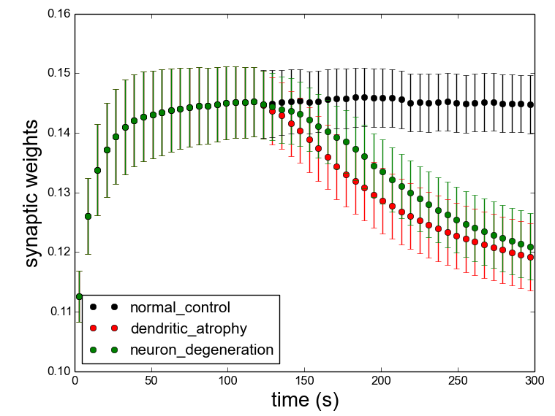
Results
neuron degeneration & dendritic atrophy influence CA3 plasticity
CA3
recurrent synapses
100 excitatory neurons
STDP synapse model

Slide 19
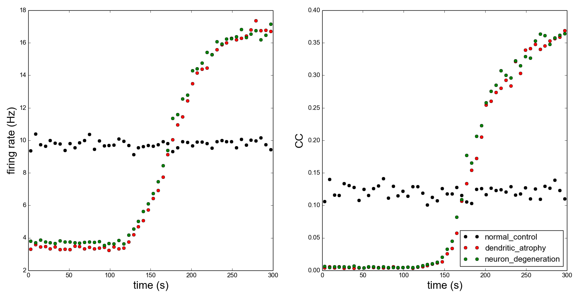
Results
neurogenesis rescues CA3 dynamics

Slide 20
Results
neurogenesis rescues CA3 dynamics
time point: 175s

Slide 21
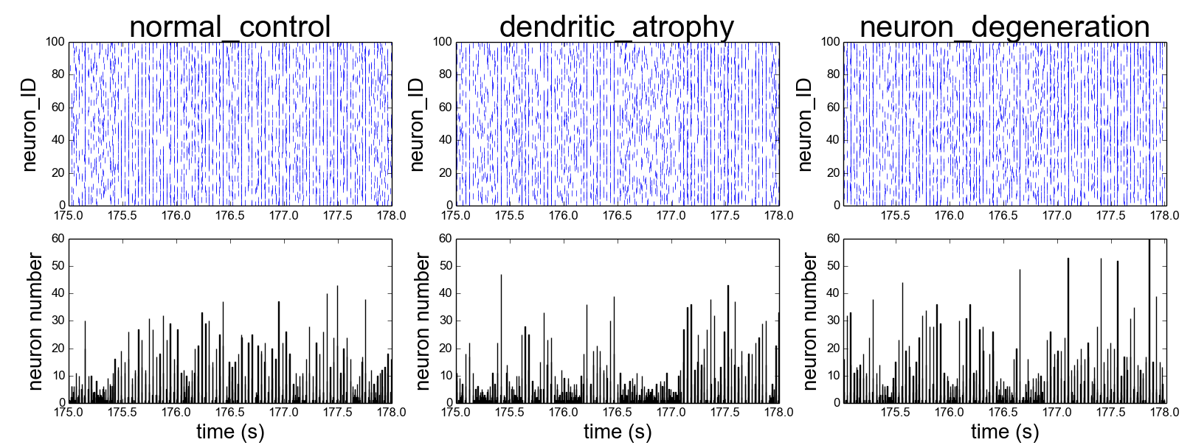
Results
neurogenesis rescues CA3 dynamics
time window: 175s-178s
100 neurons recorded

Slide 22
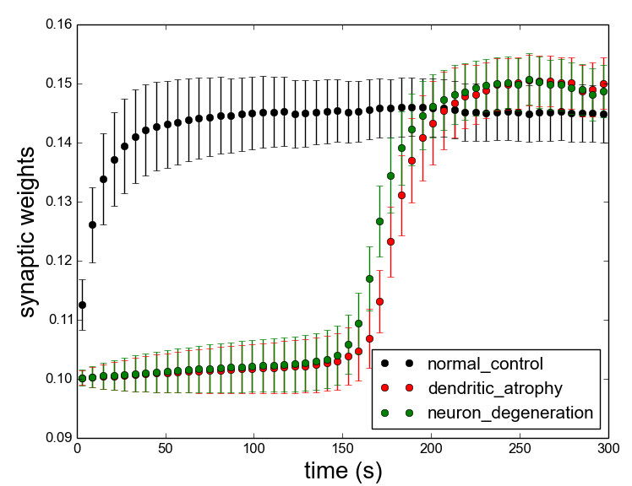
Results
neurogenesis rescues CA3 plasticity
CA3
recurrent synapses
100 excitatory neurons
STDP synapse model

Slide 23
Summary
Our Results
Input strength from DG to CA3 influence CA3 network activities and plasticity.
Empirical Evidence of Depression
Onset: activation abnormality in the hippocampus (Milne et al., 2012) Immature dentate gyrus (Hagihara et al., 2013)
Rescue: enhancing activation in DG
(Henke, 1989)
Simplified Model
(EC)
(DG)
pp: perforant path
mf: mossy fiber
rc: recurrent collaterals

Slide 25
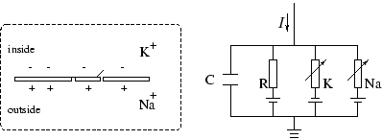
Neuron Model
leaky integrate and fire neuron model
I(t): membrane current
u(t): membrane potential
R: membrane resistance
C: membrane capacitance

Slide 26
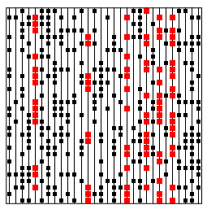
Network Model
random balanced recurrent network
source
N_{ex} = 10000
N_{in} = 2500
ε = 0.1 (connection probability)
J = 0.1
g = 8 (inhibition level)
J_{ex} = J
J_{in} = -g*J
target
excitatory synapse
inhibitory synapse

Slide 27
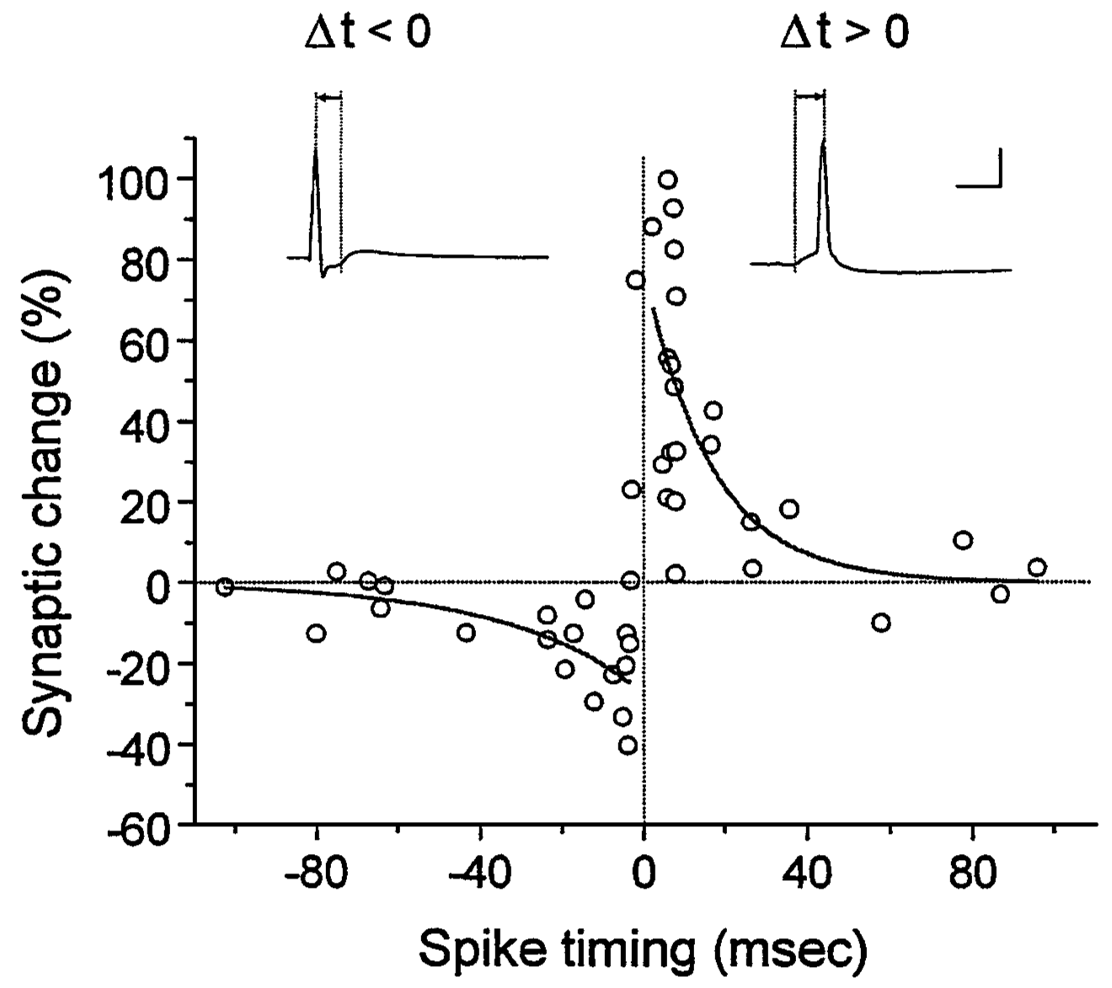
Synapse Model
spike-timing-dependent plasticity model

