Slide 1
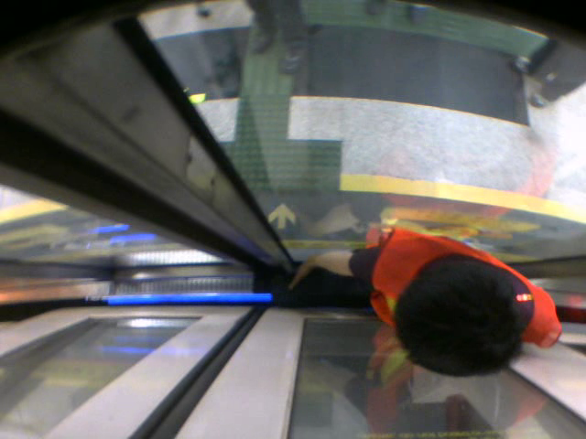
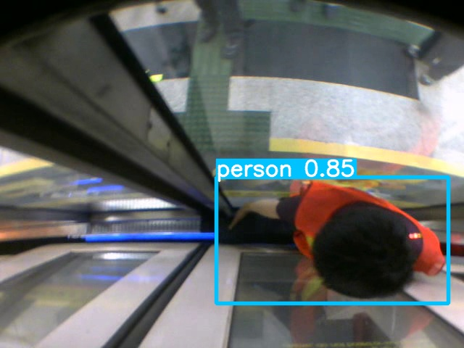
输入
骨干网络
检测头
预测
输出
Focus
0
CONV
1
CoT3
CONV
2
18
CONV
3×C3
CONV
3
17
CoT3
Concat
4
16
UpSample
15
CONV
Concat
14
19
CONV
3×C3
3×C3
CONV
5
13
20
CoT3
Concat
6
12
CONV
UpSample
CONV
7
11
21
SPP
8
CoT3
CONV
Concat
3×C3
CoT3
CONV
9
10
22
23
24

Slide 2
Input
Backbone
Neck
Prediction
Output
Stem Block
0
CONV
1
3×C3
CONV
2
18
CONV
3×C3
CONV
3
17
6×C3
Concat
4
16
UpSample
15
CONV
Concat
14
19
CONV
3×C3
SPP
5
13
20
9×C3
Concat
3×C3
6
12
21
CONV
UpSample
CBAM
CONV
7
11
22
3×Transformer
CONV
8
23
SPPF
CONV
Concat
SPP
3×Transformer
CBAM
CONV
9
10
24
25
26
27
(a) YOLO-Former
CBL
=
CONV
BN
Leaky
ReLU
C3
=
CBL
ResUnit
(b) CBL
Concat
CBL
CBL
SPPF
=
CBL
Maxpool
Maxpool
Maxpool
(c) C3
Maxpool
Concat
CBL
SPPF
=
CBL
Maxpool
Concat
CBL
(d) SPPF
(e) SPP
Maxpool

