Slide 1

Yufei Dai
Electrical Engineering Major

Slide 2
Link to portfolio walk through video (9 min)
For the complete for all programming projects follow this link to github: https://github.com/daiyuf25/Yufei-s-Portfolio

Slide 3
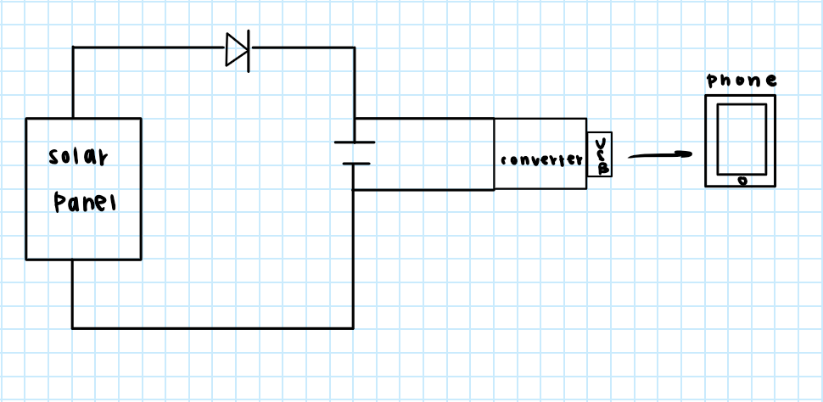
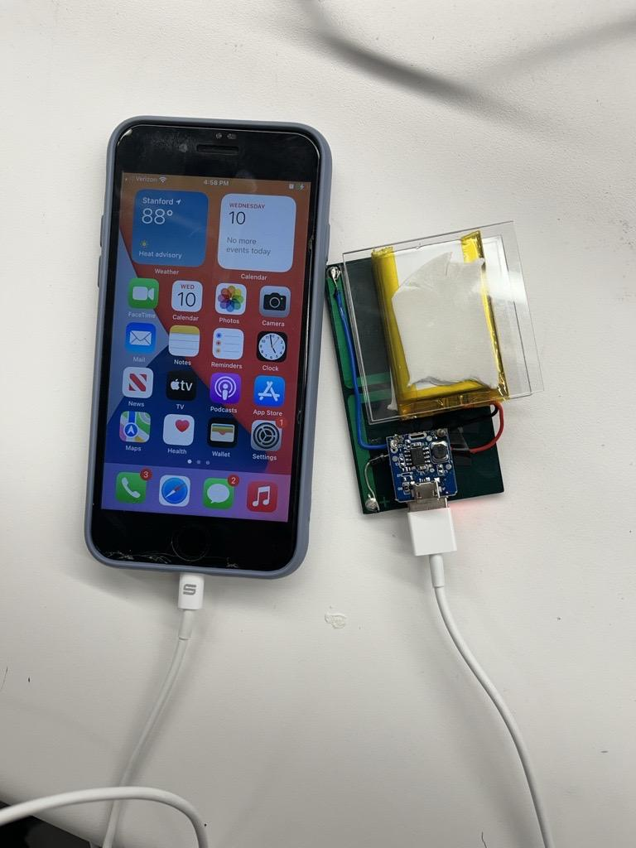
Solar Panel Phone Charger
Schematic:
Picture:
Notes:
The solar panel is used to charge a 3.7V battery. The converter increases the battery voltage to 5V for phone charging. The phone only accepts voltages around 5V. A diode is placed between the solar panel and the battery to prevent current from flowing out of the battery and back into the solar panel when it is dark. This is called reverse current which can damage the solar panel.
On the right is a picture of the device in action.

Slide 4
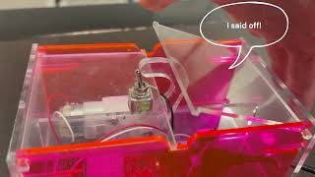
Useless Box
Overview: The useless box is a toy where you flip a switch on the box and a finger in the box flips the switch back. I changed the Arduino code to give my useless box a personality. This video is a demo of the the useless box I made.

Slide 5
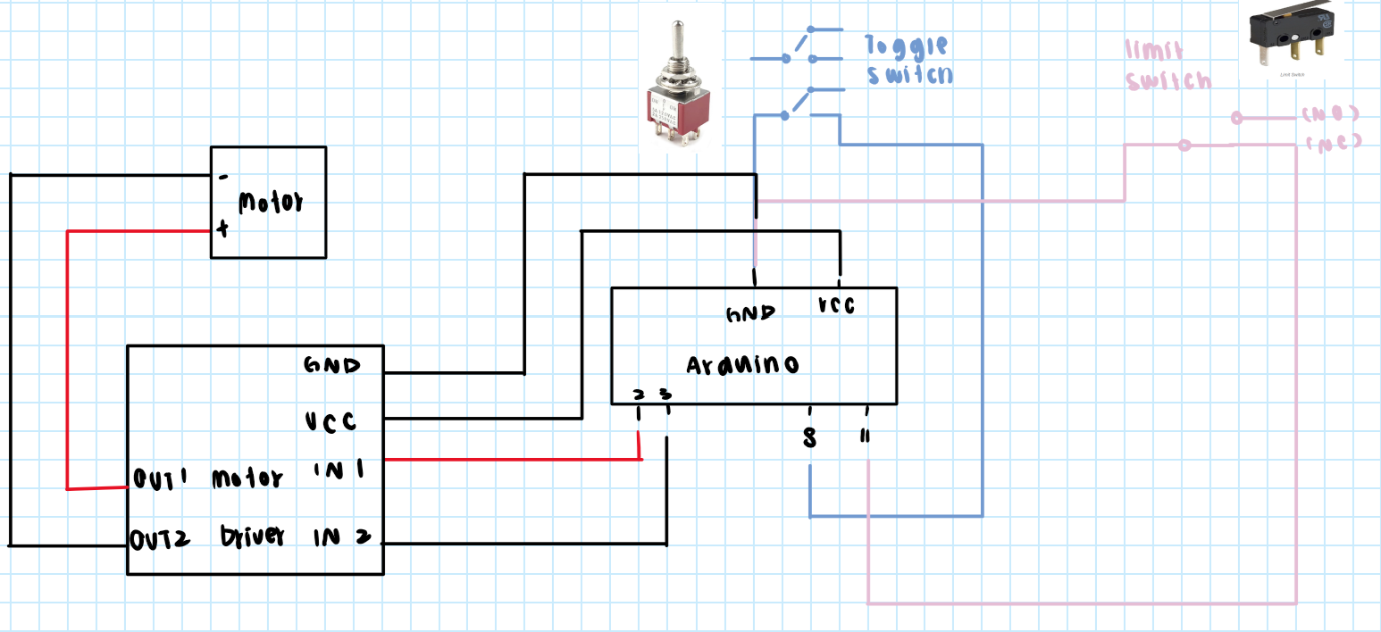
Electrical Schematic
Notes:
High Level Overview
TOGGLE switch and LIMIT switch send signals to the Arduino
The Arduino uses the signals from the switches to determine signals to send out from pins 2 and 3

Slide 6
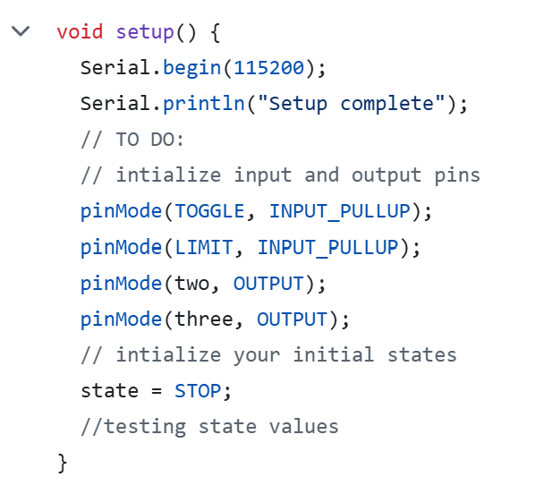
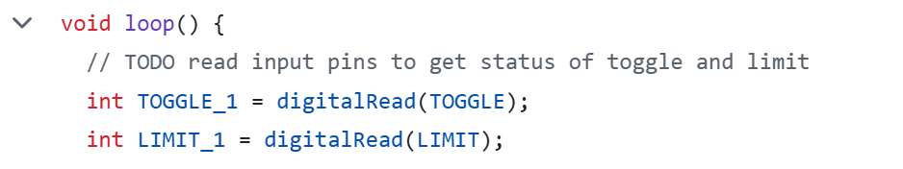
Code Overview
Setting up the Arduino Pins
Loop() Structure
switch (state) {
case STOP:
// code
break;
case FORWARD:
// code
break;
default:
// code
break;
}
Notes:
setup()
Set the Arduino pins as input or output
Sets initial state to STOP
loop()
The code in inside of the loop is a switch case statement
There was intended to be a reverse case. However, the code would not enter the reverse case so the reverse case was combined with the forward case.

Slide 7
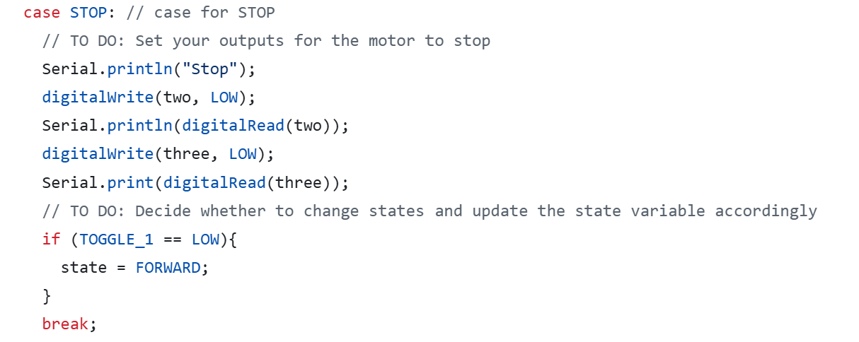
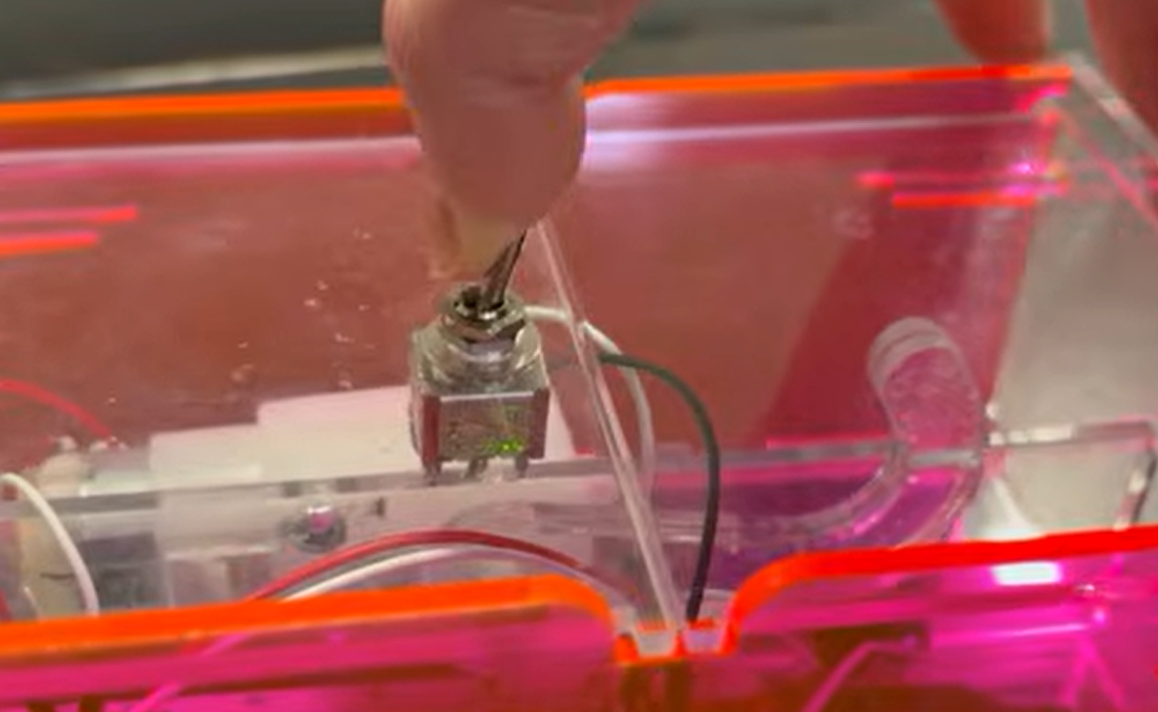
Stop Case
Notes:
STOP Case:
sets both output pins to be LOW
STOP -> FORWARD: If the user flips the switch, TOGGLE pin will read LOW which switches the state to FORWARD

Slide 8
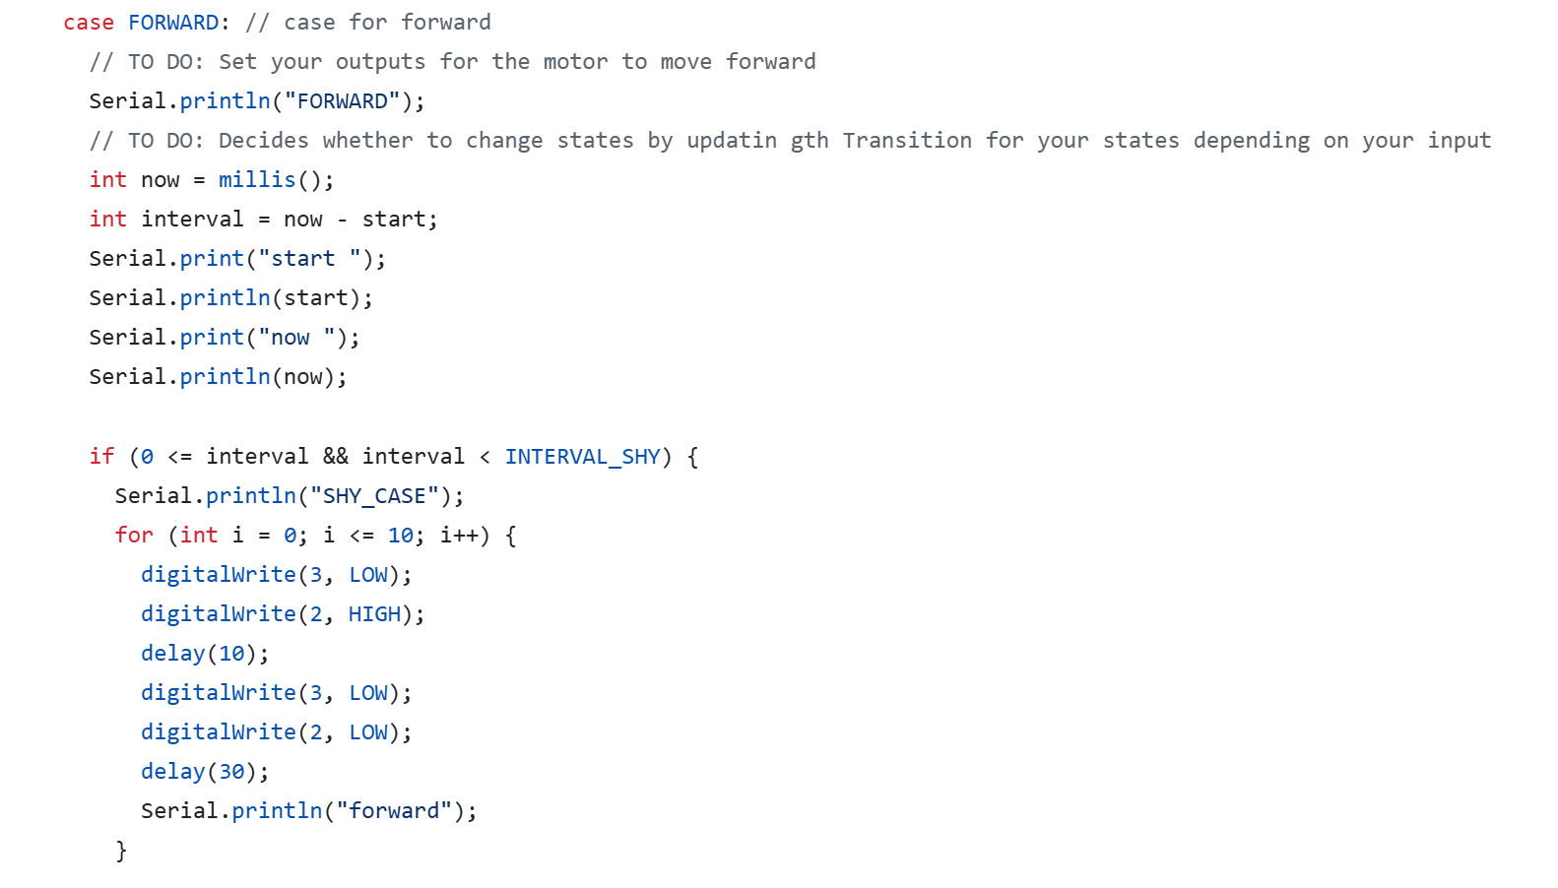
Forward/Reverse Case
Notes:
FORWARD Case:
The signals sent through the output pins depended on how long the program has been running
Let's look at the shy interval.
First the the finger moves counterclockwise at a slow speed.

Slide 9
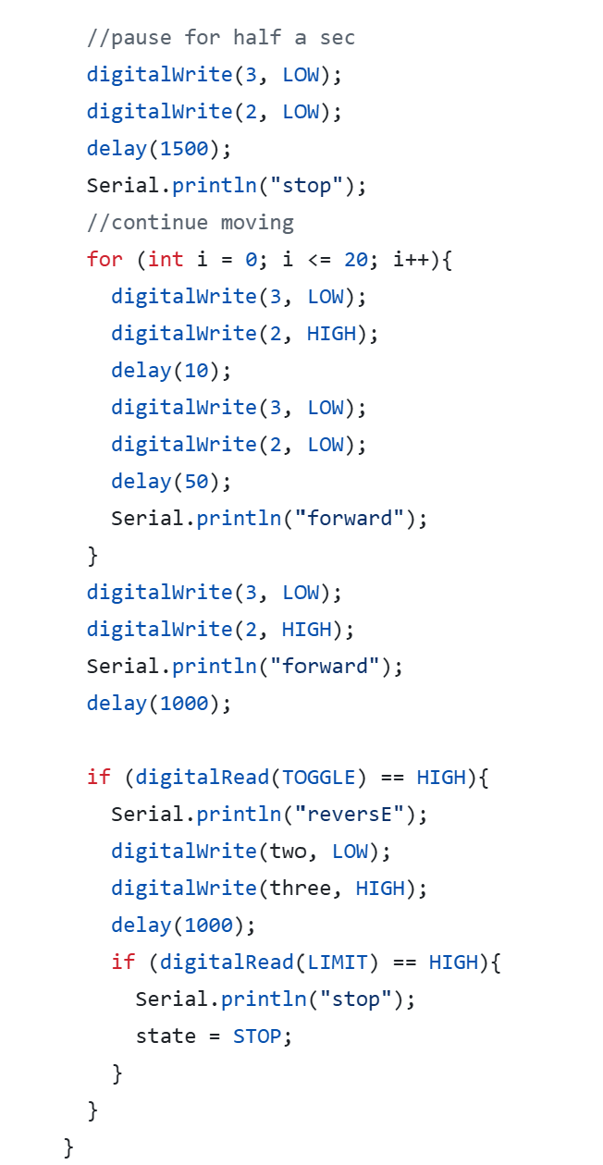
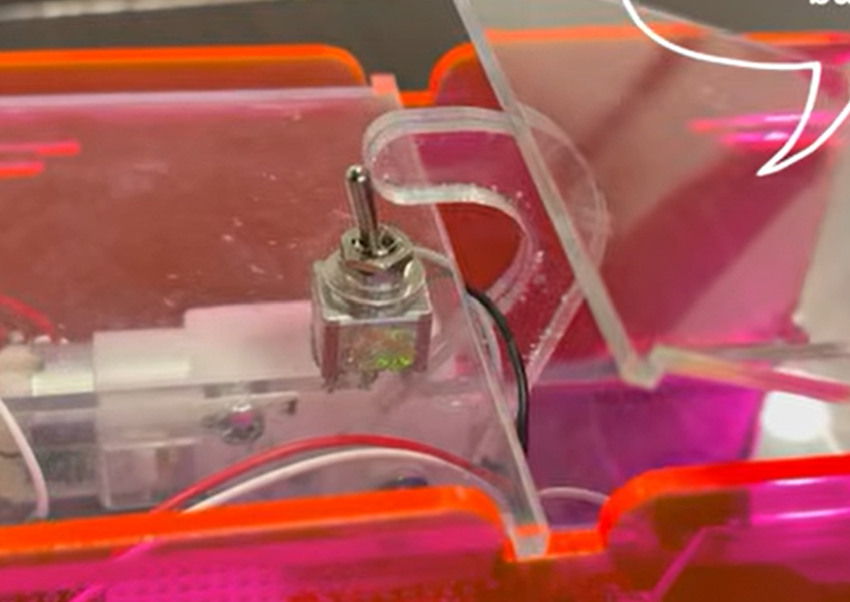
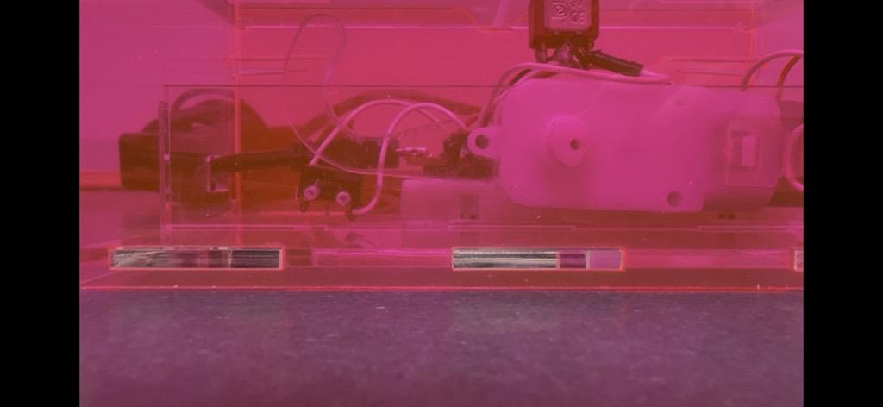
Forward/Reverse Case
Notes:
The finger then pauses before continuing forward as a quicker pace
When the finger flips back the toggle switch, TOGGLE reads HIGH which signals the code to tell the finger to reverse
When the finger hits the limit switch, the LIMIT will read high which will switch the state to STOP

Slide 10
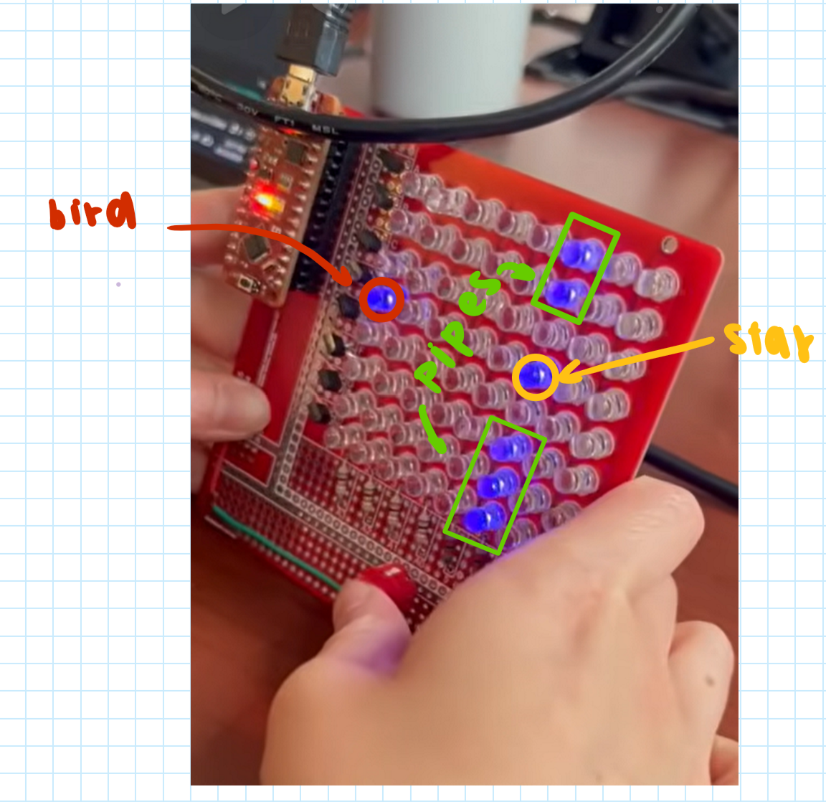
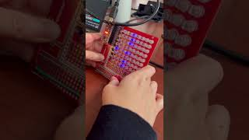
Flappy Bird
Overview: I recreated flappy bird on an 8x8 LED display board. See here for demo!

Slide 11
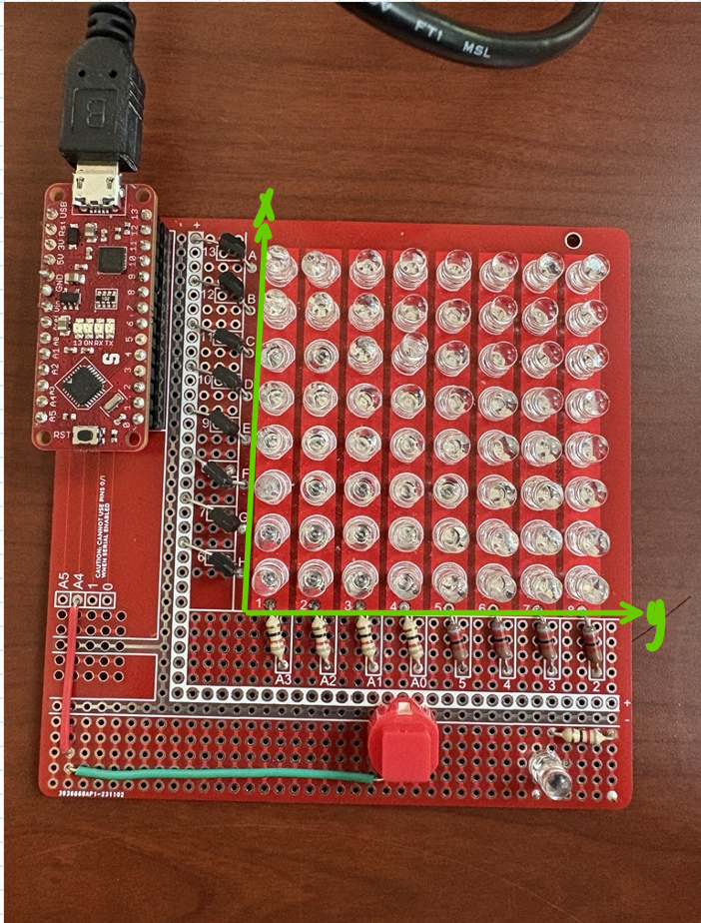
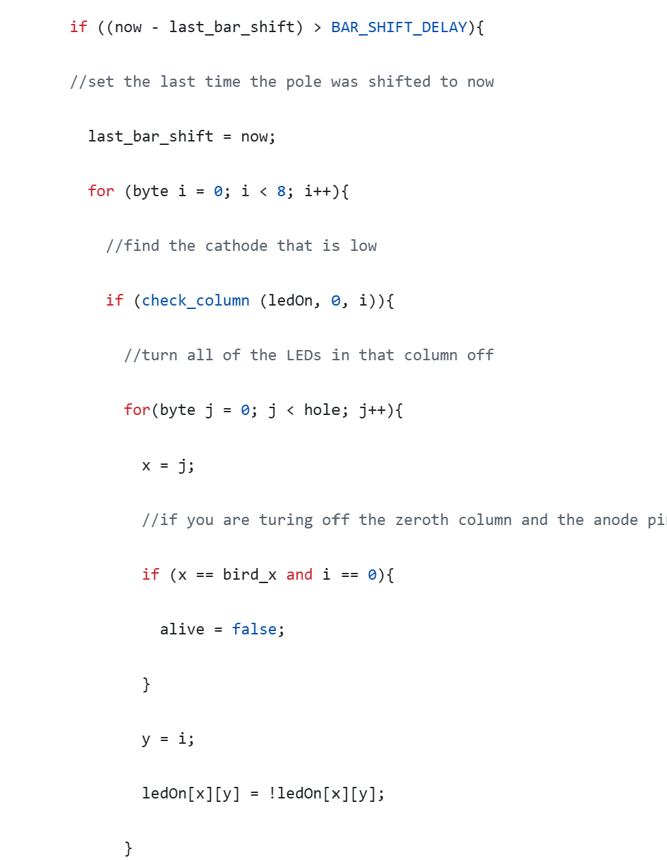
Use of Program Duration
<- Find the column with LED lights on
<- Turn every LED that represents a pipe off. Set alive to false if a the bird happens to collide with the pipe
Notes:
The amount of the time the program is stored in the variable called now.
If the time interval between the last time the pipe was shifted to the left and now is greater than BAR_SHIFT_DELAY, then then the program will shift to the left.
The third if statement checks to see if the bird has collided with the pipe and if so, the program ends the game

Slide 12
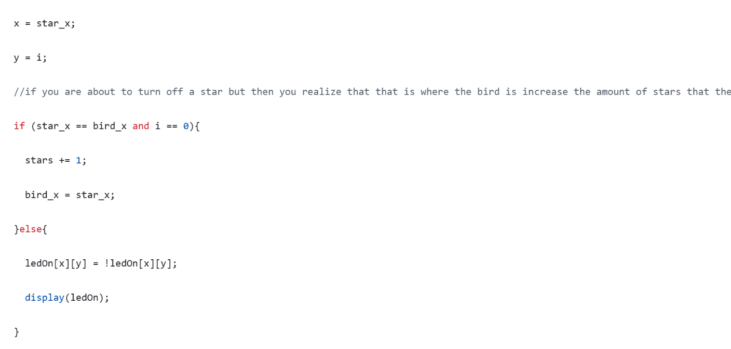
Use of Program Duration
If the bird happens to be at the same location of the star when the program tries to remove the column instead of removing the star, stars(the number of stars the user obtains through out the game) gets increased by 1
Notes:
The program also checks to see if the bird has collided with the star.
This is so that the program knows to increment stars by one and not turn off the light that represents the bird as well as the star

Slide 13
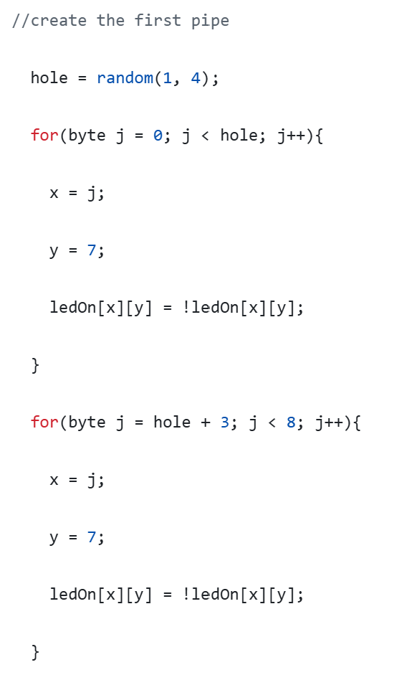
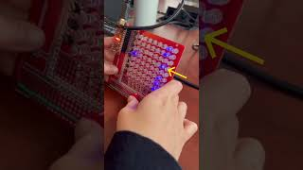
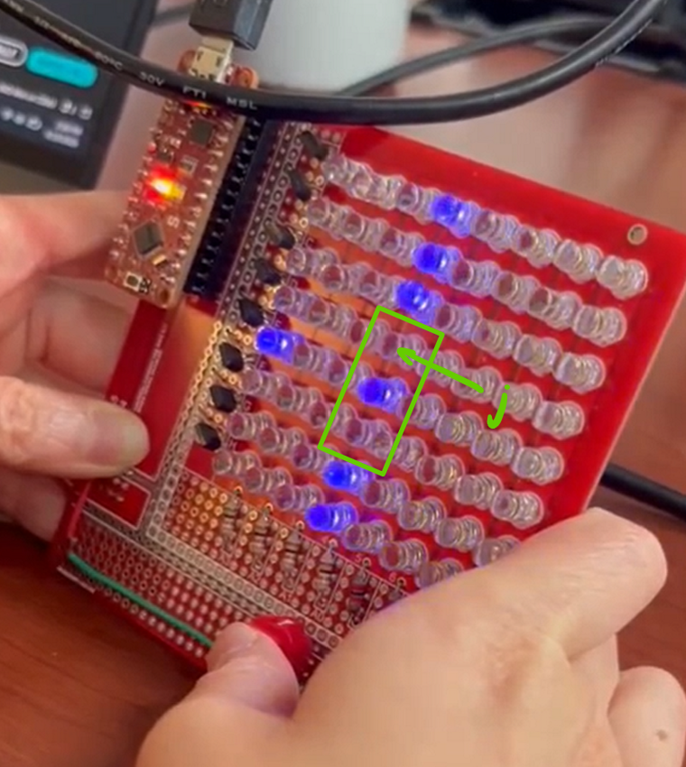
Use of Randomness
Notes:
Each time a new pipe is generated the pipe hole is in a new random location
This is done using the random function to generate the row where the hole begins

Slide 14
Guess the Picture with Python
Overview: This code reveals one small section of a picture per round to a user who tries to guess what is depicted in the picture. The code makes an API call to ChatGPT to verify the user’s answers. This helps account for the variability of user’s responses that may not exactly match the answer given by the coder. The demo on the next page shows a version of the game without the API call because I currently out of tokens which are needed to make the API call.

Slide 15
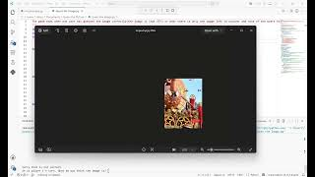
Game Demo

Slide 16
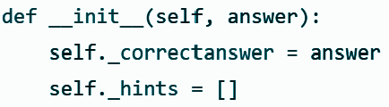
Using the API Call
Code in Guess the Image.py (main program)
Code in TypeImage.py
Create an image object by passing in the answer for the current picture in play
Calling the method get_answer_validation in TypeImage.py
Notes:
The class called TypeImage.py has a constructor which creates an Image object
The code calls methods on the image object to get responses from ChatGPT

Slide 17
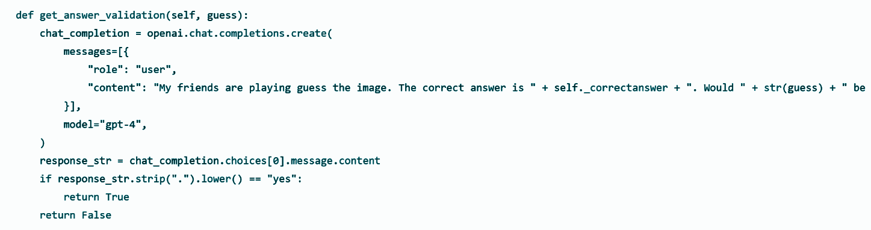
Using the API Call
User guess
Correct answer
Return whether or not the user’s guess is valid

Slide 18
Thank You!

