Slide 1

Lidar Based Point Cloud Denoising with Manhattan World Assumption
Group Members
Liu Tao 2022231023
Dai ZiJia 2022233158
Wu ShaoXun 2019533211
Zhang XinYue 2019233140

Slide 2
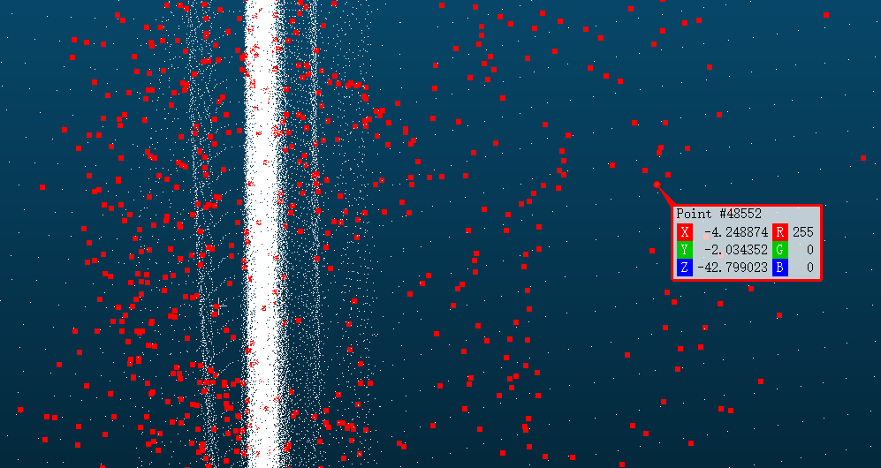
Problem Statement
Point cloud denoising, which is a fundamental and vital research area in computer graphics and computer vision, aims to recover the ground-truth point cloud by removing unwanted noises from a given noisy input.

Slide 3
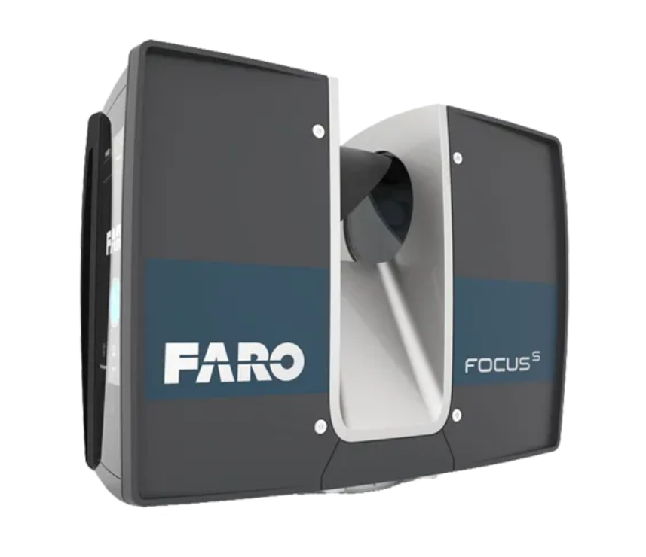
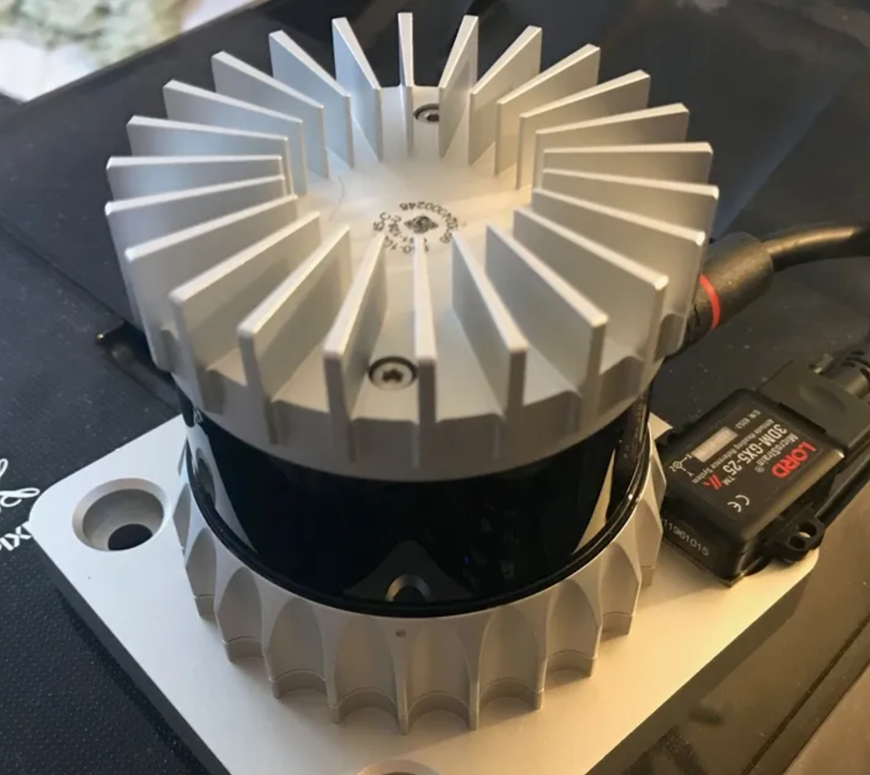
Problem Statement
Input: Noisy point cloud
Output: Cleaned point cloud
Training data: Scans of Lidar
Ground truth: FARO

Slide 4
Main Contributions
·Develop a deep learning-based methods on point cloud denoising;
·Learning the distribution of noise in parameter space;
· Propose a weak-supervised method based on SLAM framework.

Slide 5
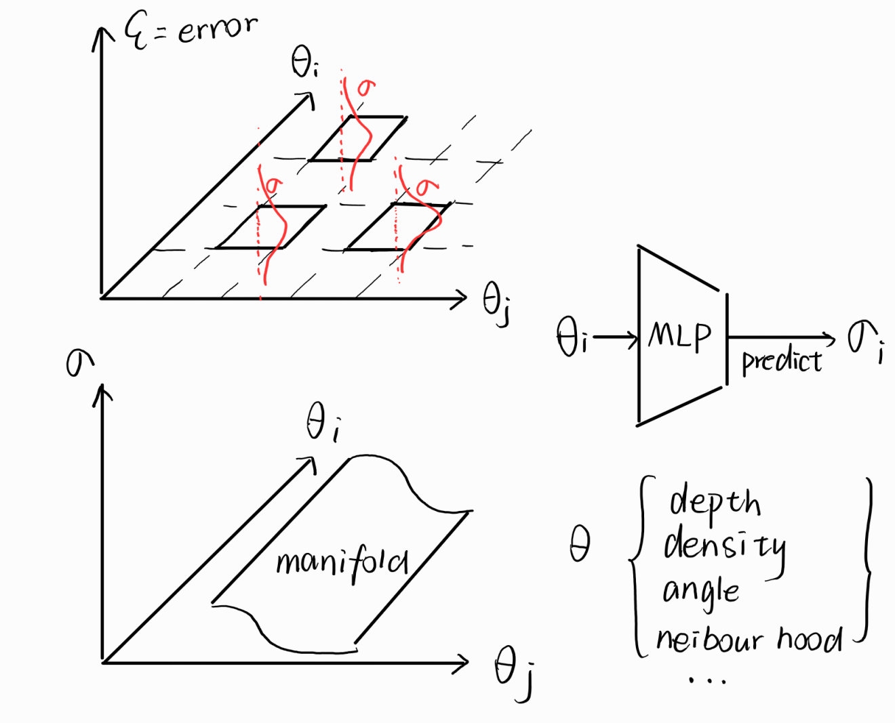





Expected Algorithm
error
MLP
predict
Depth
Density
Angle
Neighbor
manifold

Slide 6
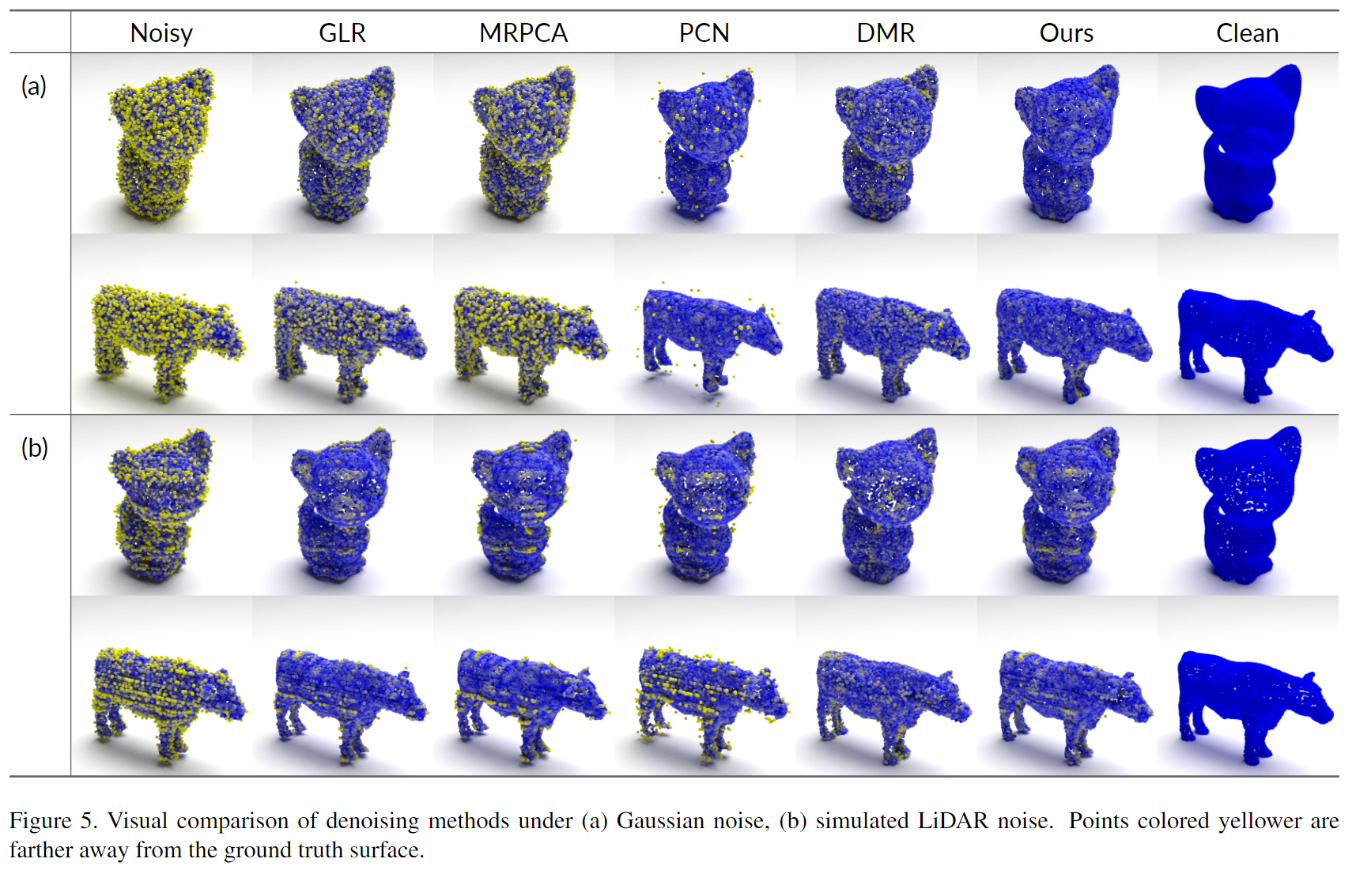
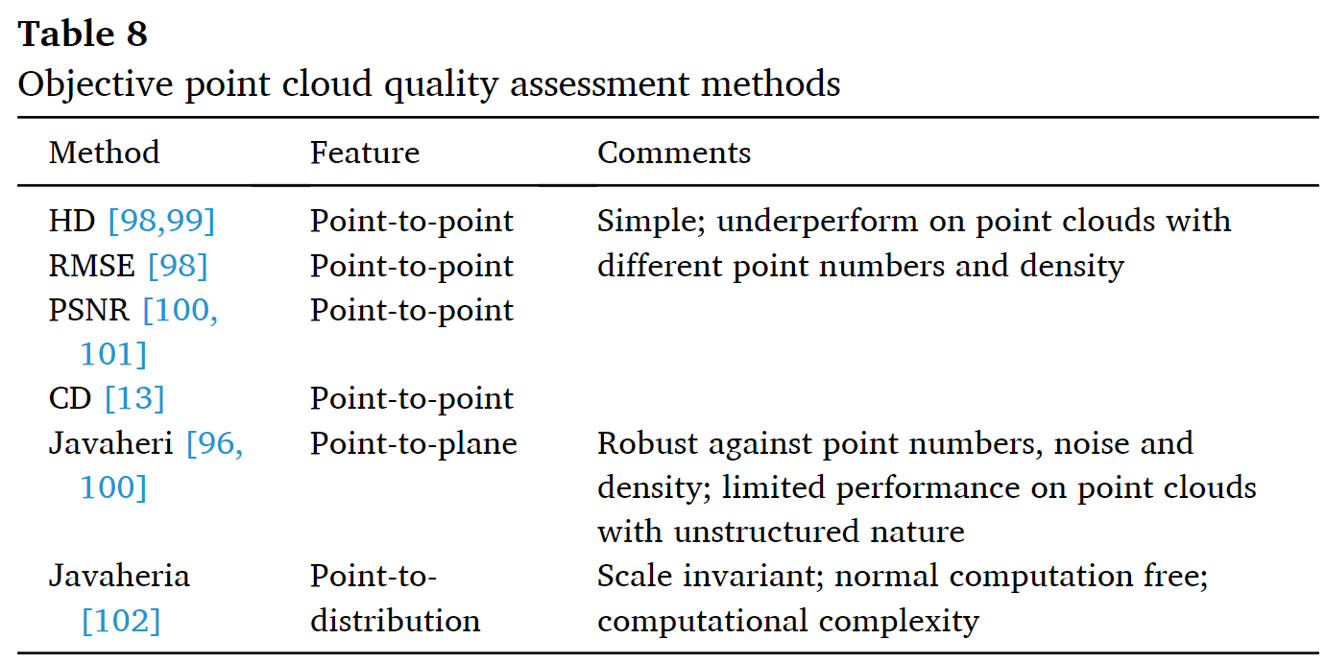
Evaluation Methods
·Visual comparison;
·Use LSQ to evaluate quality;

Slide 7
THANKS

