Slide 1
Point Cloud Object Detection Based on PointNet of Attention Mechanism
刘滔 2022231023
戴子佳 2022233158
何美漫 2022231013

Slide 2
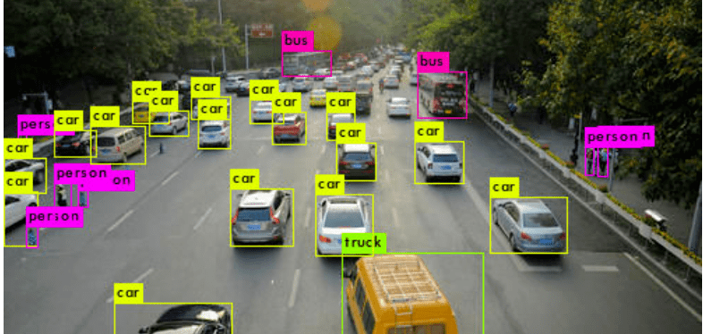
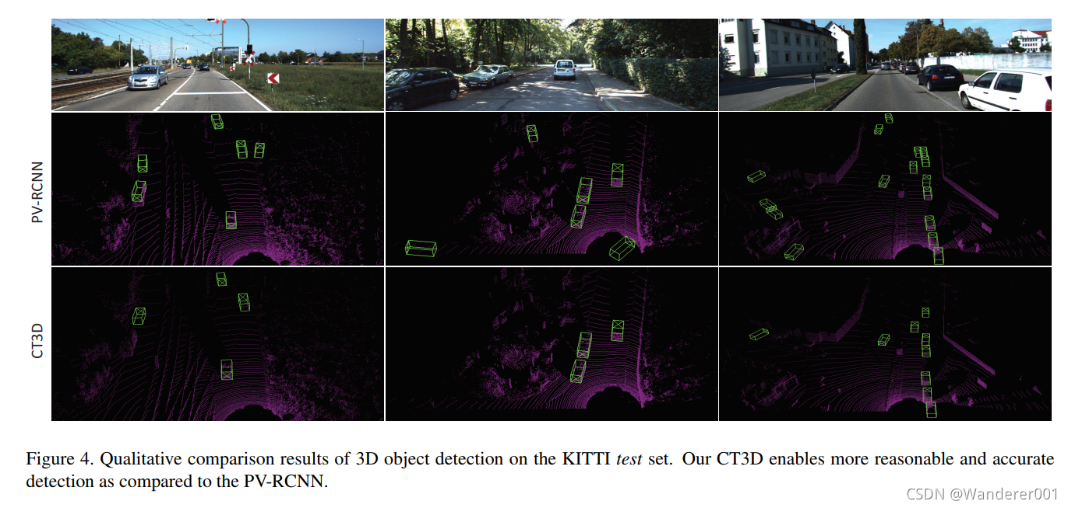
Background
Target detection is the basic perception task of automatic driving
Image-based
Lidar point cloud based

Slide 3
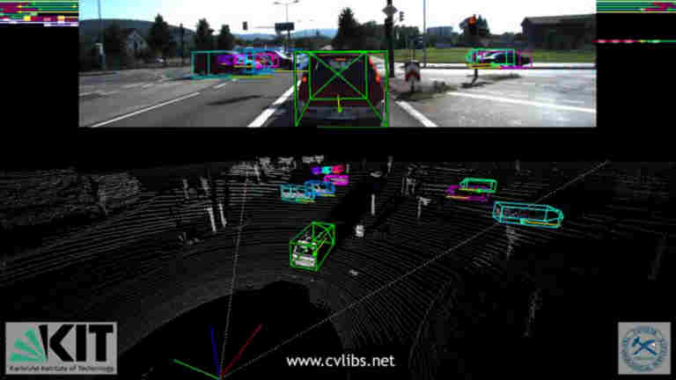
Dataset
1、KITTI:
3D scenes are mainly used to label lidar point clouds.
There are four categories of cars, pedestrians, bicycles and misc.
2、Modelnet40:
CAD model containing about 40 object categories, suitable for classification.

Slide 4
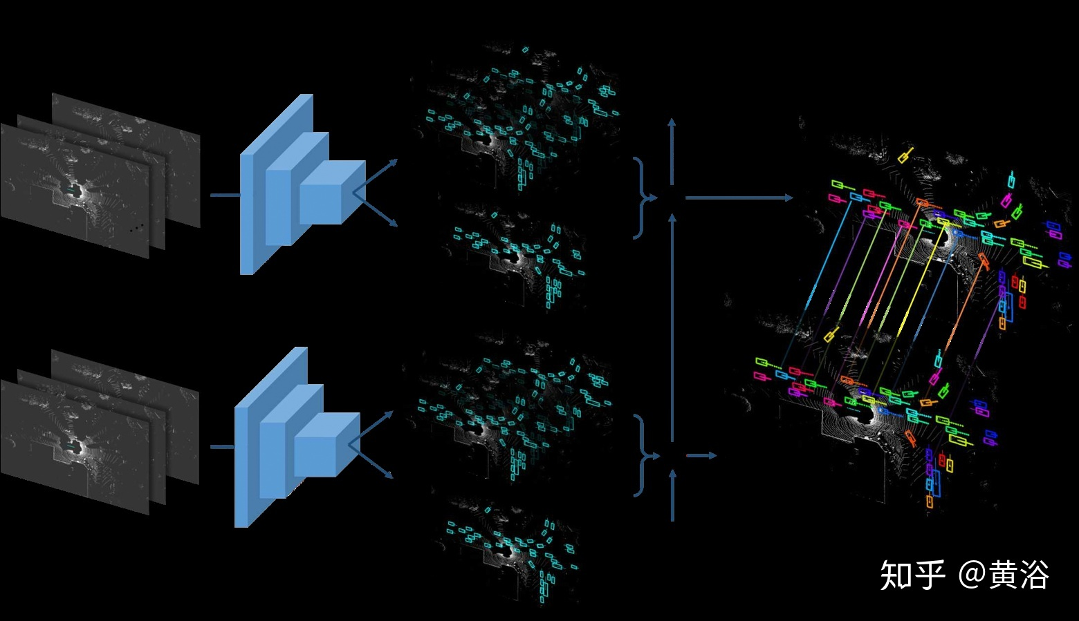
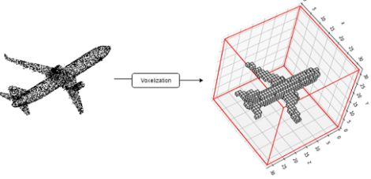
Related work & problem
3D voxelization
2D Aerial View

Slide 5
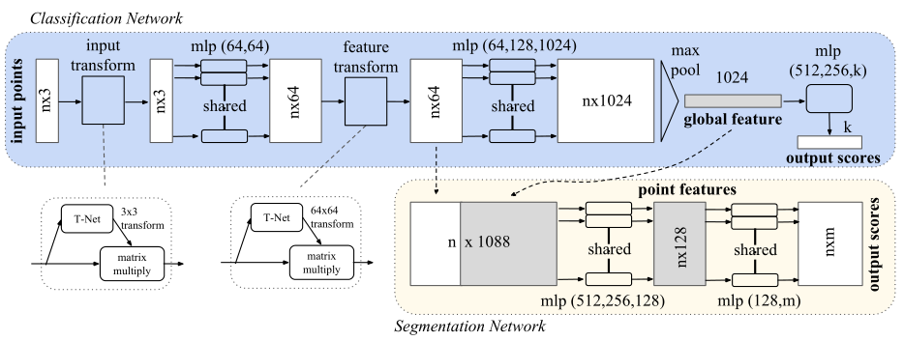
Related work & problem
PointNet structure:

Slide 6
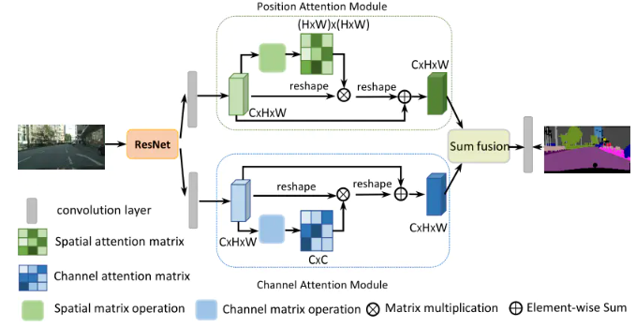
Related work & problem
Dual Attention Network:

Slide 7

Improvement
Each cluster of point clouds NX3
Input point cloud
Dual Attention mechanism
RANSAC ground segmentation
Kdtree-DBSCAN clustering
X
T-Net
NX3
Filter remote categories
MLP
（64，64）
T-Net
Extract the point cloud in the box
X
NX64
MLP
（64，128，1024）
Global feature
Dual Attention mechanism
MLP
（512，256，4）
car
pedestrain
cyclist
misc

Slide 8
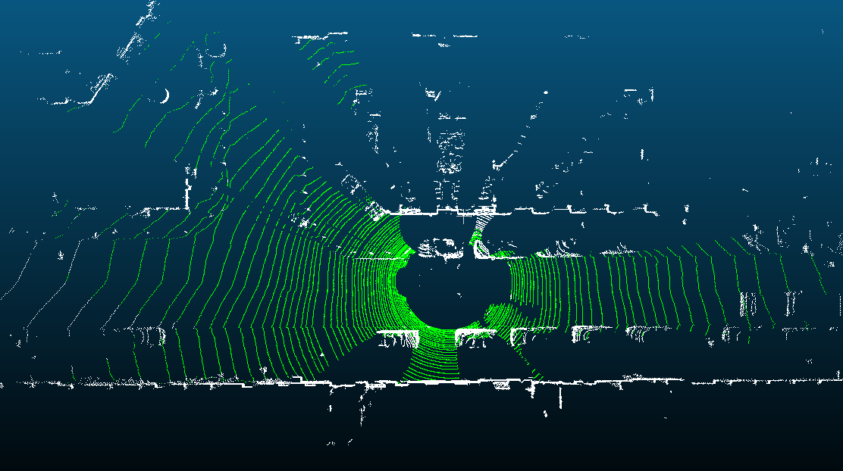
RANSAC ground segmentation
Green is the part of the ground we divide
Notes:
我求出了每个点法向量，过滤掉与z轴夹角小于30度的点云，即墙面，来减少对ransac算法的影响。
绿色即为分割出来的地面，最后返回了地面方程，和地面点的index

Slide 9
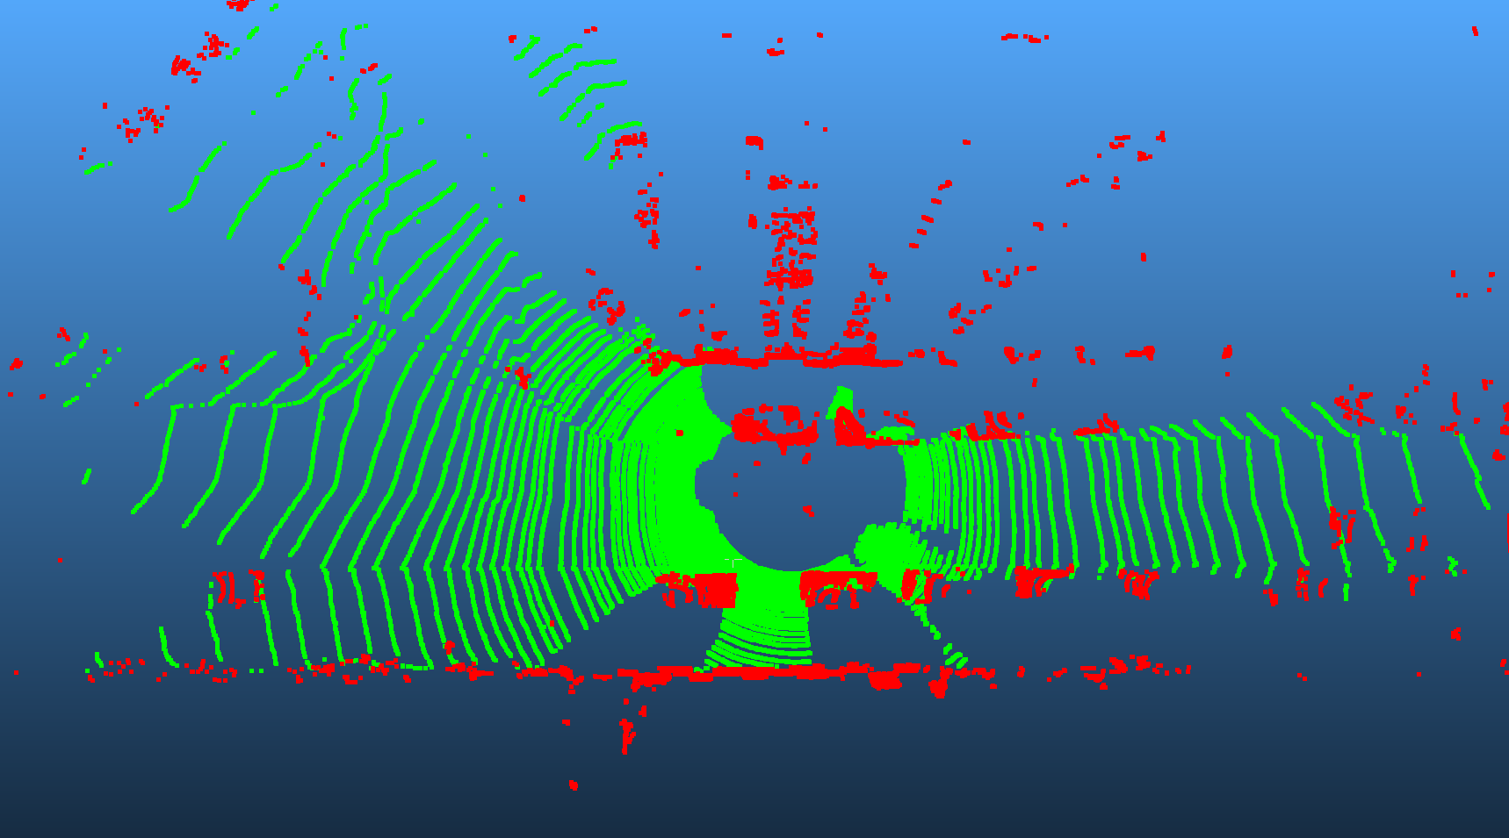
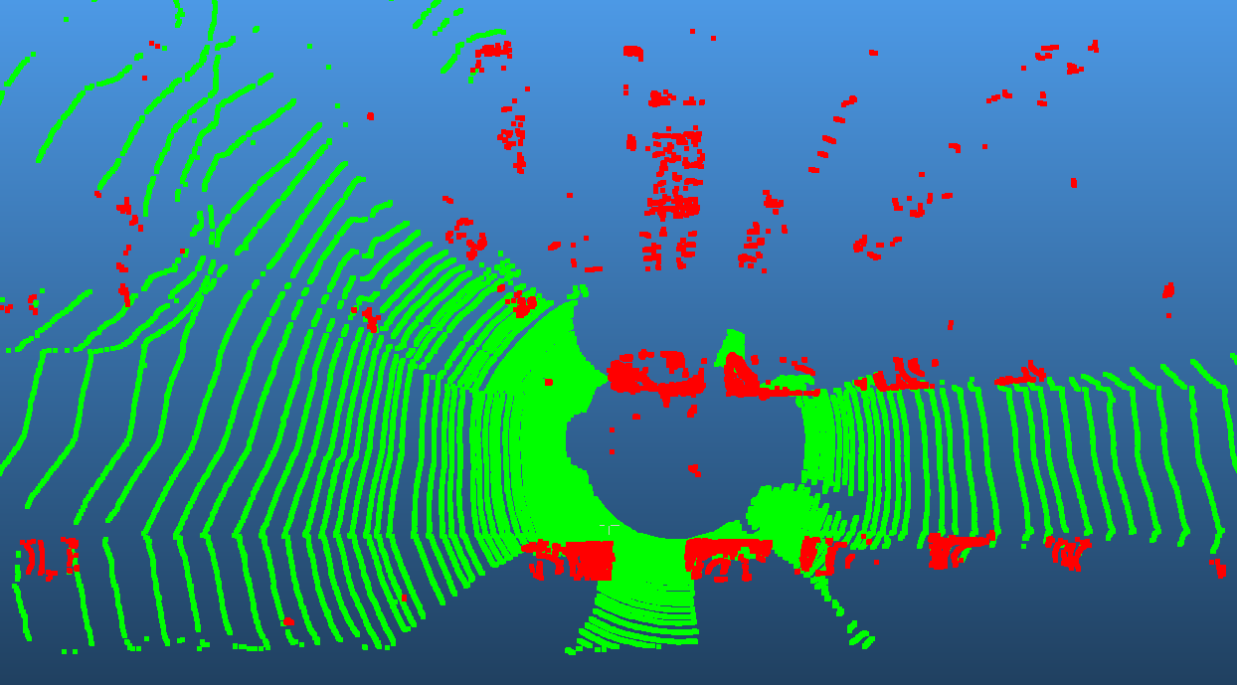
RANSAC ground segmentation
Red is the segmented object walls are removed through vector filtering
Notes:
之后我求出了每个点对地面的距离，过滤掉了与地面相距30cm以内的点，红色的点云是要进行下一步聚类的点云

Slide 10
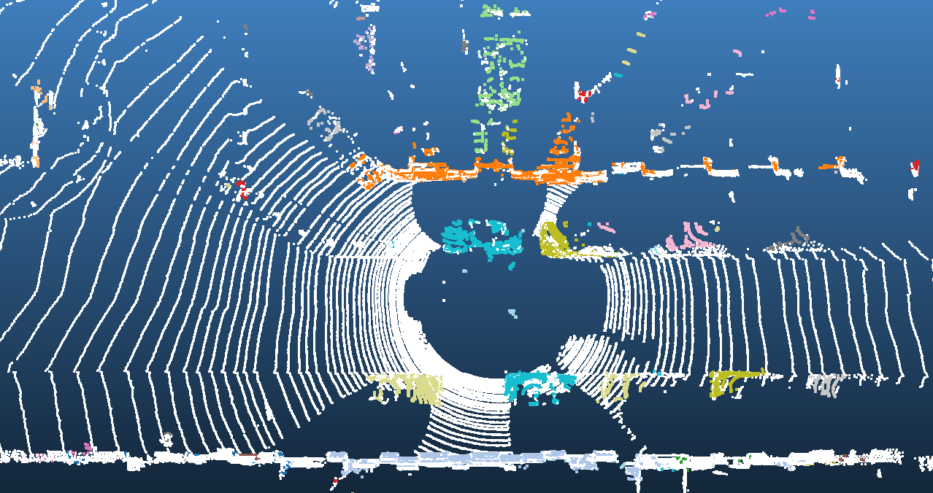
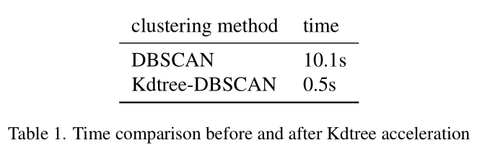
Kdtree-DBSCAN Clustering
Notes:
结合我们的需求和数据集分析，在众多聚类方法中，经过比对，我选择了Kdtree-DBSCAN，因为他是一种根据点云密度聚类的方法，而且不用指定聚类的个数。在此我使用Kdtree来对DBSCAN聚类进行加速，速度的提升非常明显。
每种颜色代表一种聚类。

Slide 11
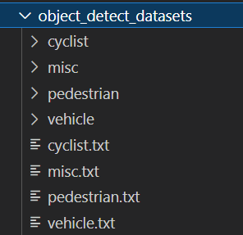

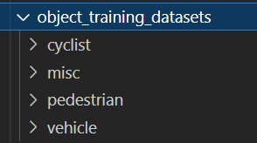
Training data processing
Notes:
下载kitti官方数据集
对于每一帧相互关联的点云，图像，标签，相机矫正数据进行以下操作
地面分割，提取出非地面部分的点云，并对非地面的点云进行DBSCAN聚类
遍历对应标签中的每一行
根据每一行中的3D物体检测框的中心点坐标，过滤调中心坐标距离雷达坐标系中心大于一定距离的分类
提取以检测框最长对角线为半径的范围内的所有点云
根据相机矫正矩阵和2D物体检测框对点云进行滤波，获取到所有处于2D物体检测框中的点云
对检测框中的点云进行非极大值抑制，获取到点数最多的类别
保存非极大值抑制后的点云，并将label的标签作为点云的标签
有的类别少进行了数据增强

Slide 12


Attention mechanism
Channel Attention Mechanism
Point Cloud Number Attention Mechanism
BxNxC
Maxpool
(C)
BxNx1
MLP
BxNxC
BxNxC
BxNxC
Maxpool
(N)
Bx1xC
MLP
I
I
Bx1xC
$$O_{1}$$
BxNxC
Softmax
+
X
Softmax
$$O_{2}$$
+
X
Avgpool
(C)
BxNx1
Bx1xC
BxNxC
Avgpool
(N)
Bx1xC

Slide 13


Attention mechanism
Max
pool
MLP
BxNxC
MLP
I
BxNxC
Max
pool
Bx1xC
$$O_{1}$$
+
X
+
$$O_{2}$$
X
Avg
pool
Avg
pool
BxNxC
Bx1xC
Max
pool
MLP
BxNxC
+
Avg
pool
BxNxC
I
$$O_{2}$$
+
X
Max
pool
MLP
Bx1xC
+
Avg
pool
Bx1xC

Slide 14
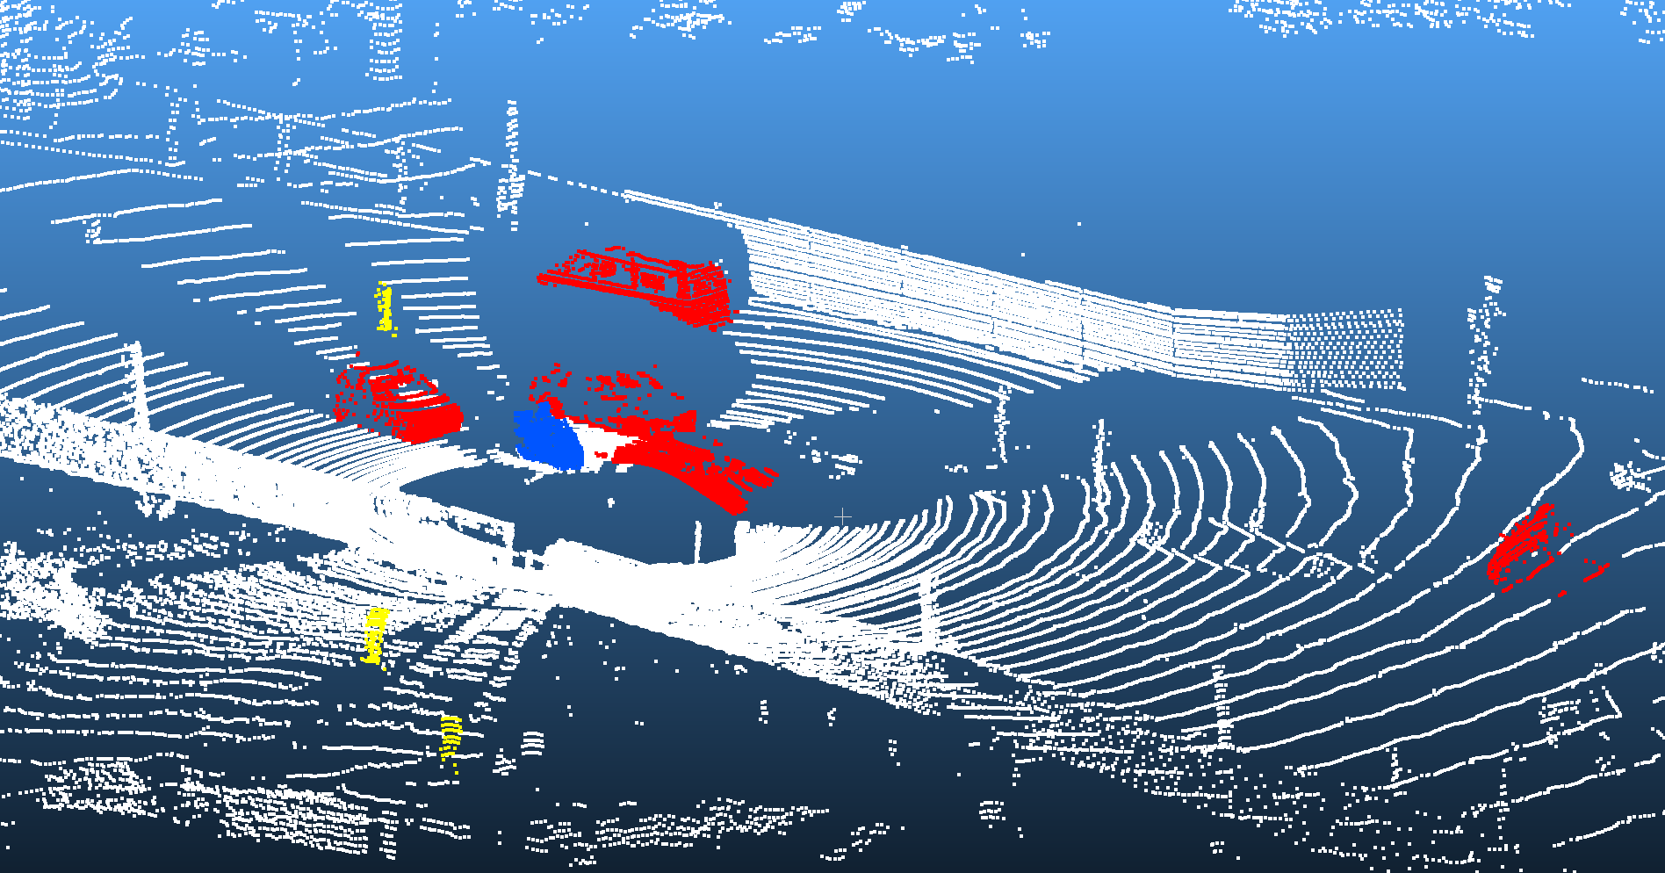
Experiment results

Slide 15
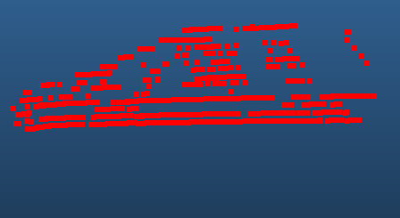
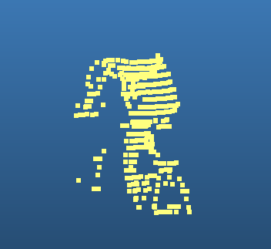


Experiment results
Four types of point cloud visualization
cyclist
pedestrain
vehicle
misc

Slide 16
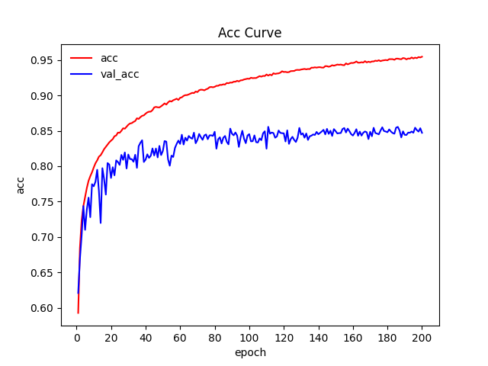
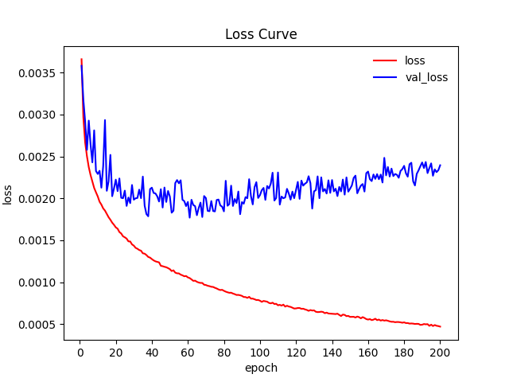
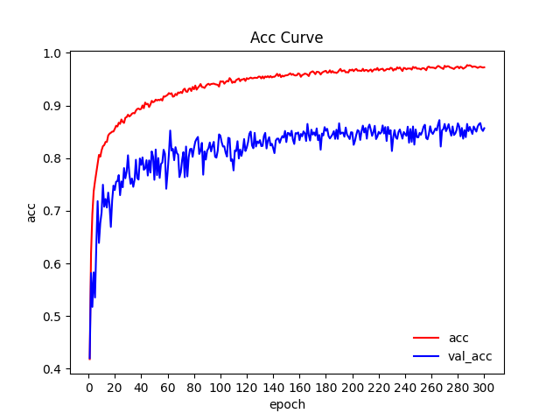
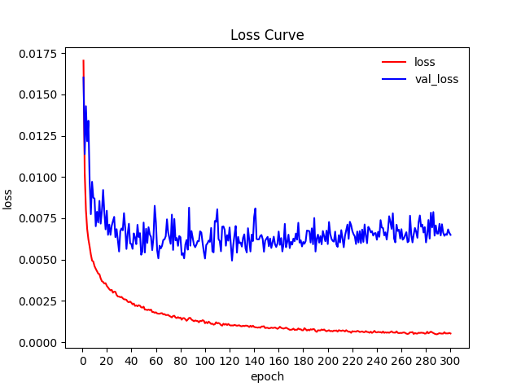
Experiment results
KITTI training set
Modelnet40
training set

Slide 17
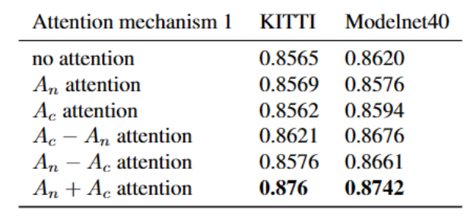
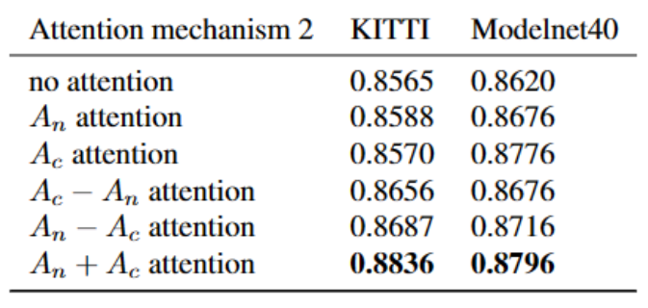
Experiment results
Accuracy of attention after point cloud input
Accuracy of attention added to global features

Slide 18
Conclusion
• The network we designed does not need to convert point cloud data, and can directly use the sparsity and disorder of point cloud data for target detection tasks.
• We use Kdtree to accelerate DBSCAN clustering for non surface points in Lidar data to extract each type of point cloud, which improves the clustering speed by 20 times without data conversion.
• We added channel focus and point cloud focus modules. Finally, it is found that after the two attention mechanisms are applied to the global features in parallel, the important features can be extracted more effectively, and the final accuracy is 2.71% higher than that of the network without attention mechanism.

Slide 19
Thanks!

