Slide 1
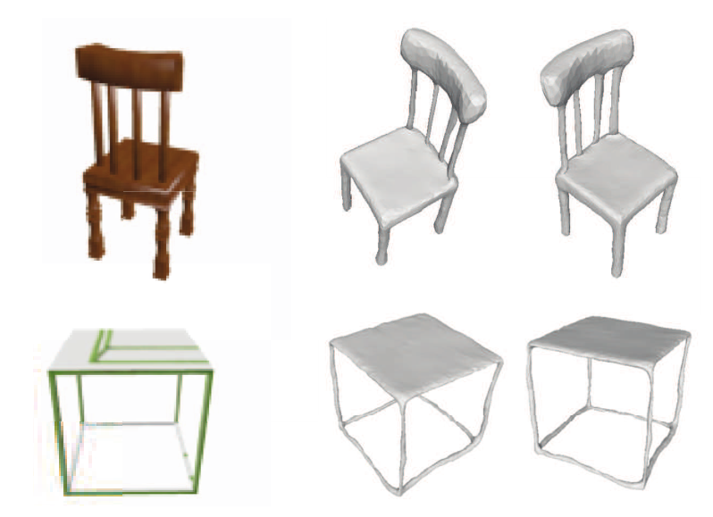
A Skeleton-bridged Deep Learning Approach for Generating Meshes of Complex Topologies from Single RGB Images
Jiapeng Tang ∗1, Xiaoguang Han ∗2, Junyi Pan1, Kui Jia †1, and Xin Tong3
Group members:
Dai Zijia, Liu Tao
CVPR2019

Slide 2
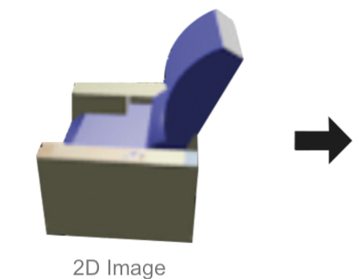
Research Problem
Input: 2D RGB Images
Output: 3D Mesh
From AtlasNet

Slide 3
The Main Contributions
1. An integrated stage-wise learning, taking the respective advantages of point cloud, volume, and mesh
2. Propose a skeleton-bridged approach
3. Conduct intensive ablation studies to investigate the
efficacy of approach，by alternatively removing one of them, to verify the necessity of each stage.

Slide 4
Related Works
Drawbacks
Ideas
Volume-based Generator
Efficiency and
topology-insensitivity
Use it to convert the inferred skeletal point cloud to a solid volume, bridging the gap between the skeleton and the surface mesh
Surface-based Generator
Generated points are placed sparse and scattered, difficult to use CNN
Use AtlasNet to infer the meso-skeleton point, use Pixel2mesh to generate geometric details
Structure Inference
Cuboids are hard for fitting curved shapes, require a large human-labeled dataset
Use meso-skeleton, a point cloud, parametric line and square elements

Slide 5
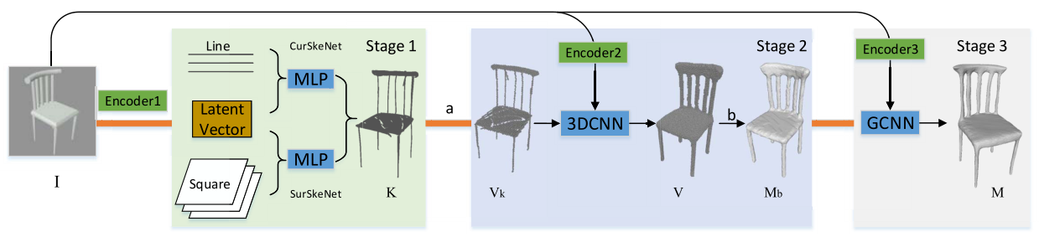
The Proposed Approach—Three Stages
Learning of Meso-Skeleton
From Skeleton to Base Mesh
Mesh Refinement

Slide 6
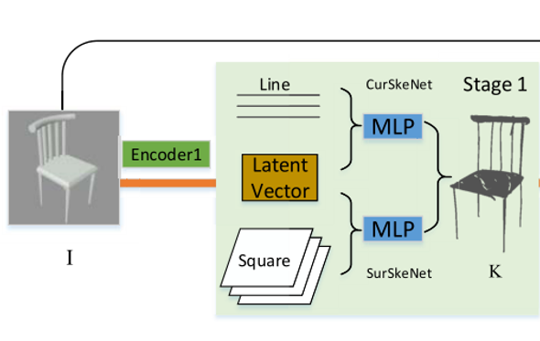
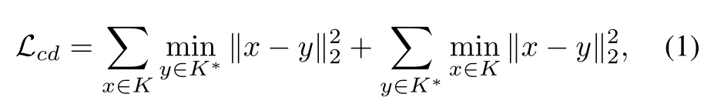
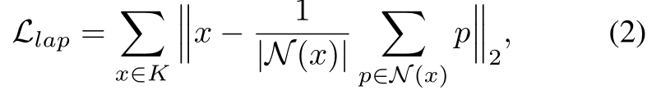
Learning of Meso-Skeleton
The same settings as in AtlasNet
ResNet-8
1 D point set
A RGB image
Novel contribution-Decoder
Chamfer Distance (CD)
regularizer of Laplacian smoothness

Slide 7
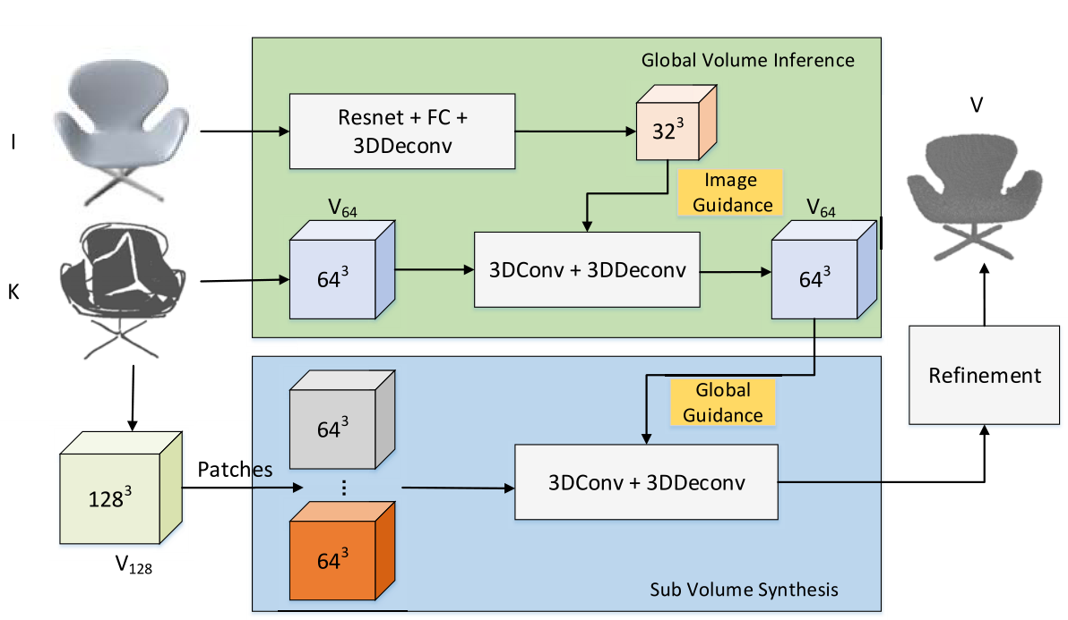
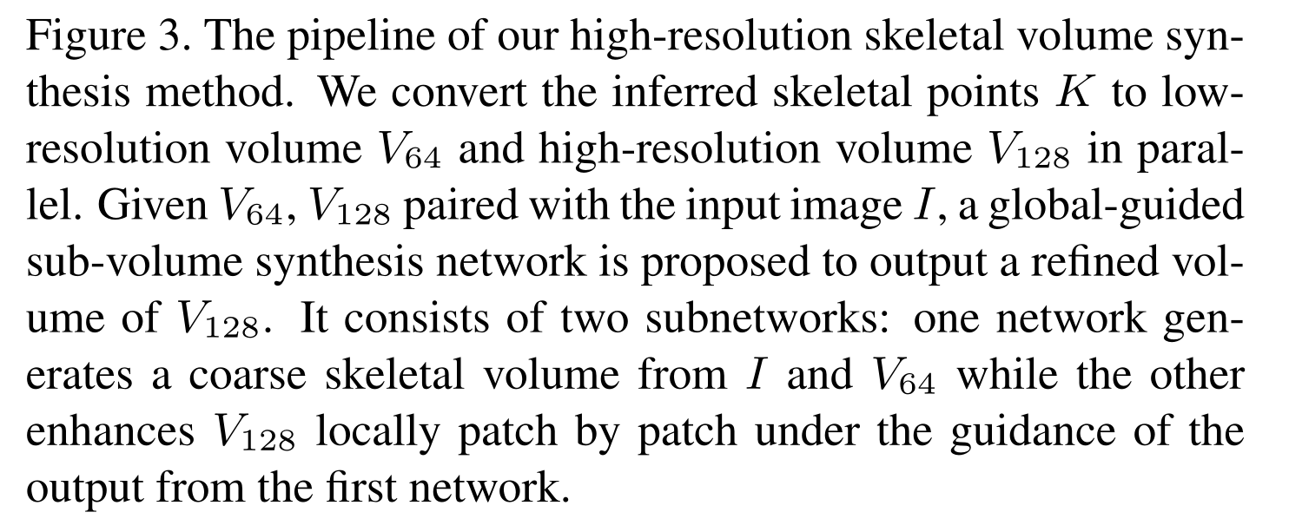
From Skeleton to Base Mesh
Row image I: Correct the possible stage-wise errors
Skeletal points K

Slide 8
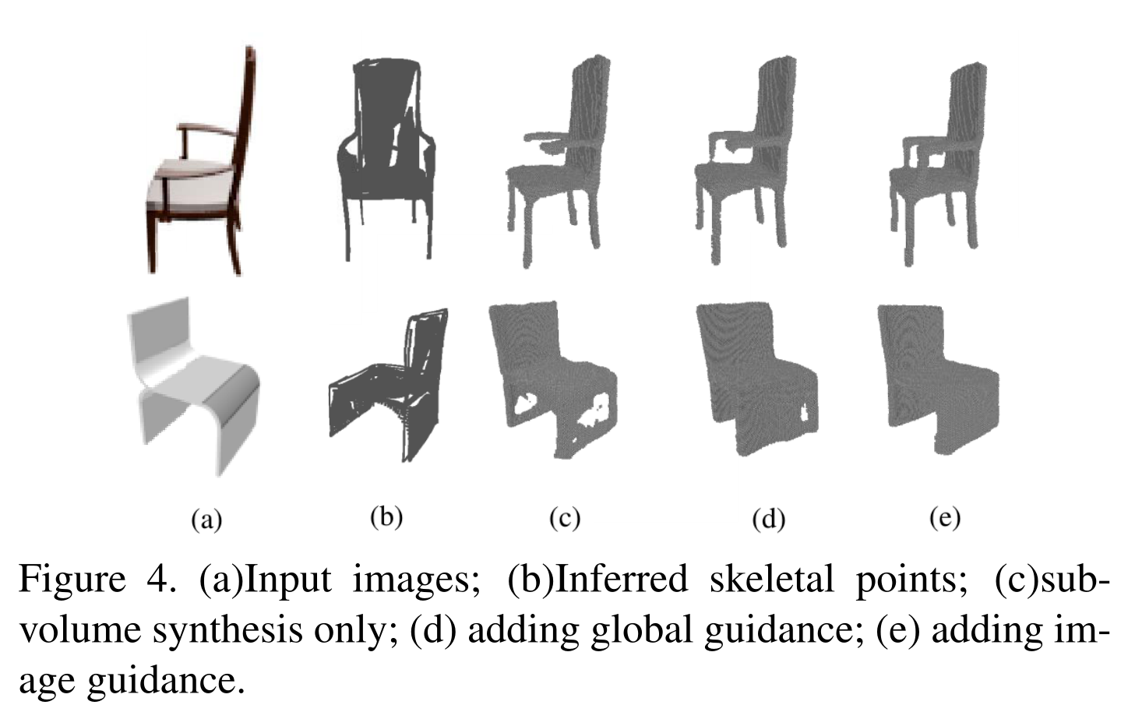
From Skeleton to Base Mesh

Slide 9
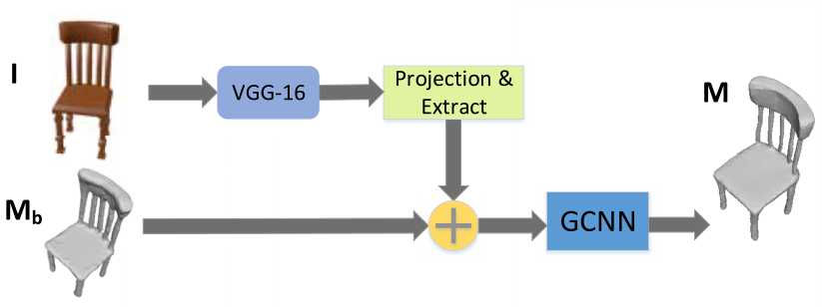
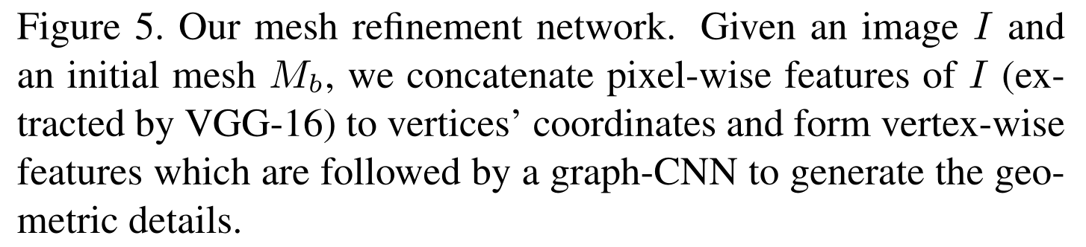
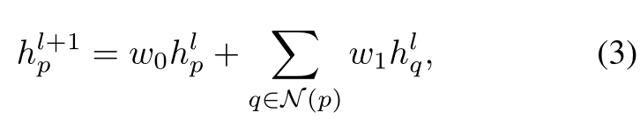
Mesh Refinement
graph-based covolutional layer

Slide 10
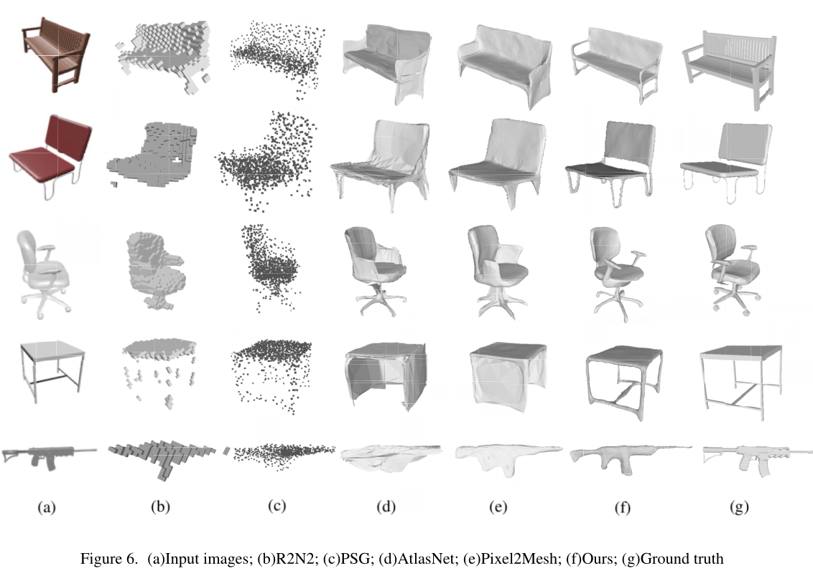
Experiments

Slide 11
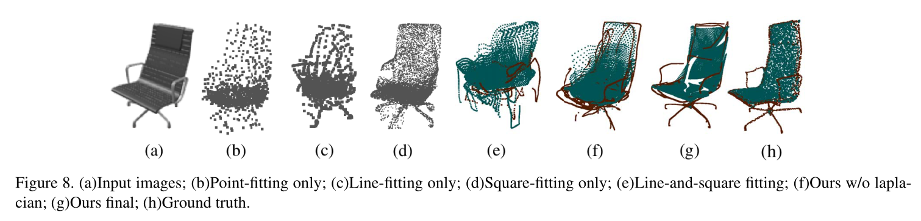
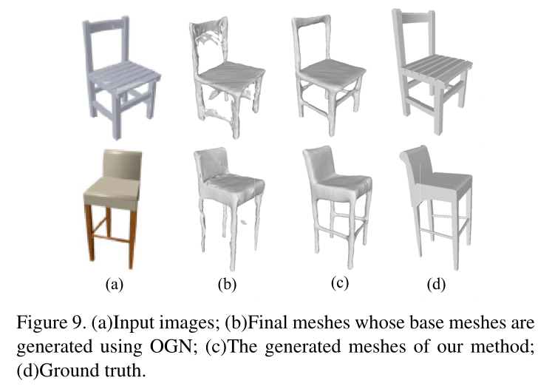
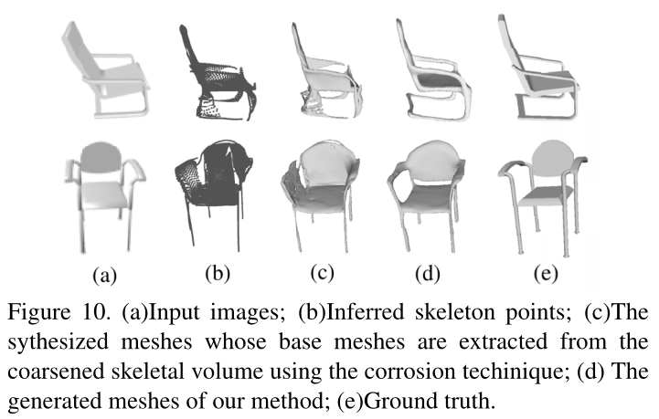
Experiments

Slide 12
Thanks

