Slide 1



Drone Interception via EDMDc-Based Model Predictive Control
D. Johnson, A. Bengal, Y. Atteia, T. Hlayel, S. Maharjan*, and A. Stein
Department of Mechanical & Industrial Engineering Louisiana State University (LSU), Baton Rouge, 70803
*Presenter (smaha12@lsu.edu)
(Sponsoring organization)
Conference Logo
Conference Title
Date | Place
European Safety and Reliability (ESREL) &
Society for Risk Analysis Europe (SRA-E ) conference
June 15-19, 2025 | Stavanger, Norway

Slide 2
Outline
Test 1
Test 2
Information:
Don’t change the font of the header: it stays Font: Georgia 23 – bold
The text in the text boxes is Font: Calibri (Body) 18
Every new section is introduced with an outline slide where the current section is put into “bold” (see next slide and compare it to this slide)

Slide 4
Outline
Test 1
Test 2

Slide 5
Outline
Test 1
Test 2

Slide 9
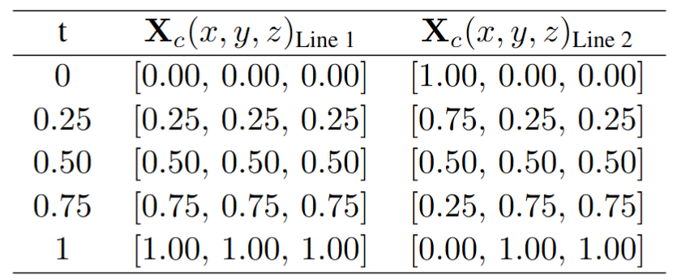
Initial Preparation (Template Header)
Make sure that all the headers are at the same position for each slide
Figures/Tables:
1) Download the .pdf file from overleaf with the figure included
2) Zoom very close to the figure/table
3) Take a screenshot with snipping tool of the figure/table
4) The screenshot should show a very crisp figure/table
Same procedure for equations

Slide 10

Conclusions
Logo of sponsor
(NASA, NSF, etc.)
For detailed discussions:
Adrian Stein: astein@lsu.edu
…
www.ctrlstein.com

