Slide 1
Algorithms for Estimating Trends in Global Temperature Volatility
Arash Khodadadi and Daniel McDonald

Slide 2
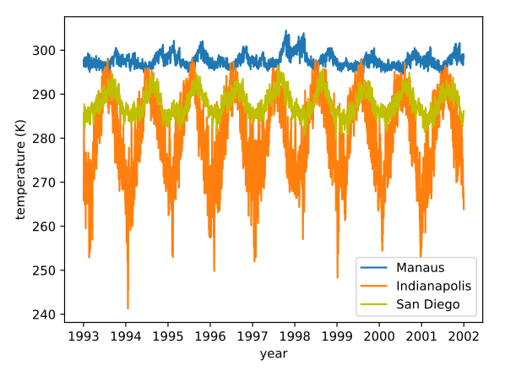
Time-series of the temperature (in Kelvin) of three cities

Slide 3
Modeling trend in variance
We have 52000 of these time-series
They have different trends and periodic components
The periodic component is not necessarily sinusoidal.
We don’t really care about the shape of the trend and the periodic terms. We just want to get rid of them!
These observations suggest a non-parametric approach.

Slide 4
Modeling trend in variance
We need to model the trend in the variance of the time-series
Data is spatio-temporal

Slide 5
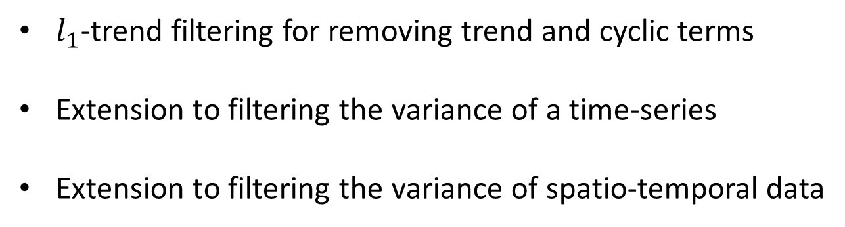
Outline

Slide 6
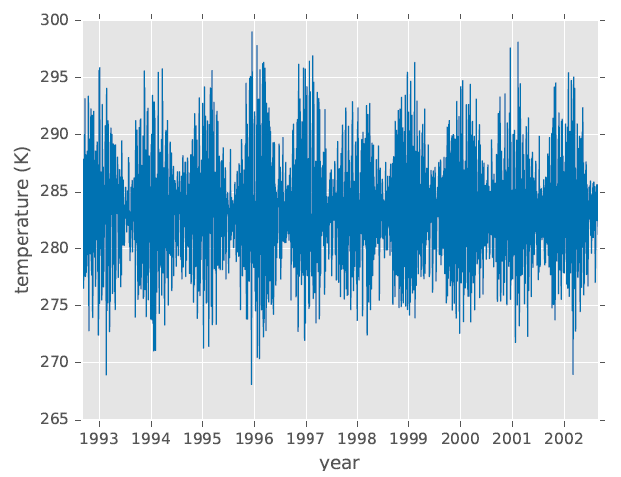
L1 trend filtering of variance
Motivating example

Slide 7



L1 trend filtering of variance
Here, ht is a hidden (unobserved) state.
Penalized MLE estimation of variance leads to the following optimization problem:

Slide 8
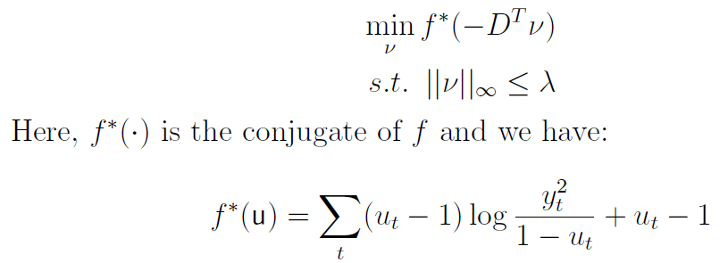
L1 trend filtering of variance
We solve this optimization problem using the primal-dual interior point method.
The dual is:

Slide 9
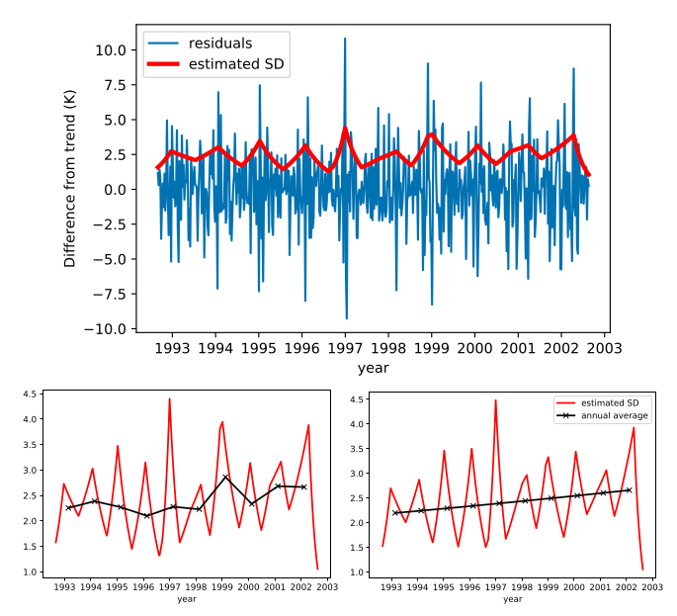
L1 trend filtering of variance

Slide 10
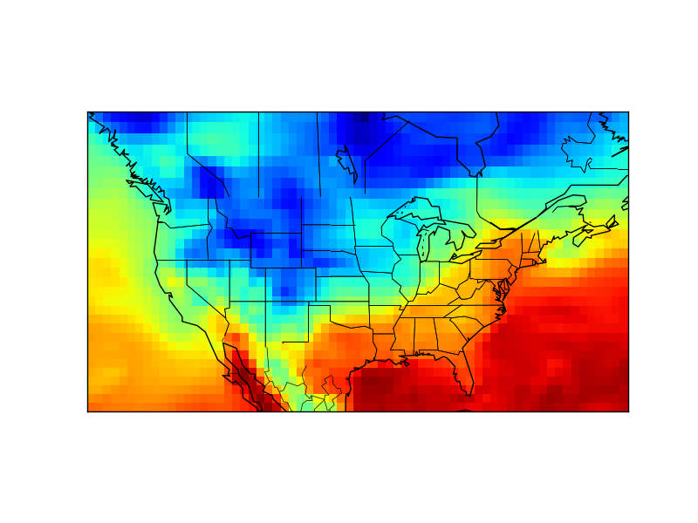
L1 trend filtering on graph
So far we have only considered temporal data.
Spatio-temporal data:
penalize differences in the variance of neighboring points
In particular, for each add a row to such that and another row such that .
This results in spatially piecewise constant variance.
Graph LASSO at each time step

Slide 11
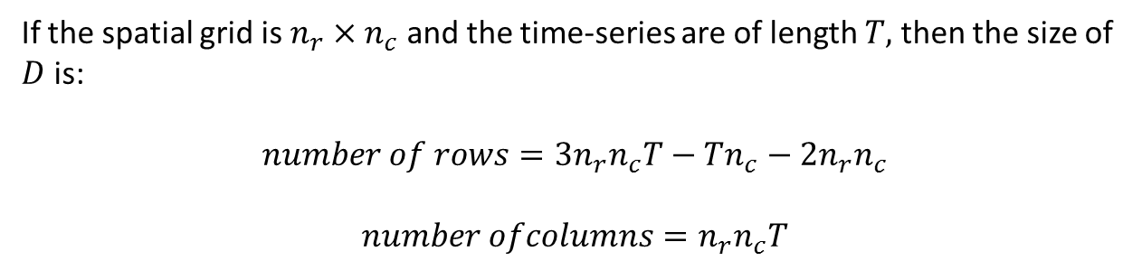
L1 trend filtering on graph
Optimization:
We need to solve the same optimization problem:

Slide 12
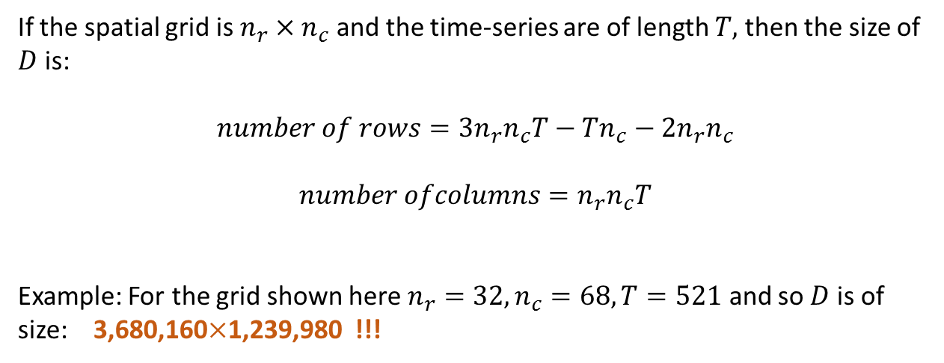
L1 trend filtering on graph
Optimization:

Slide 13
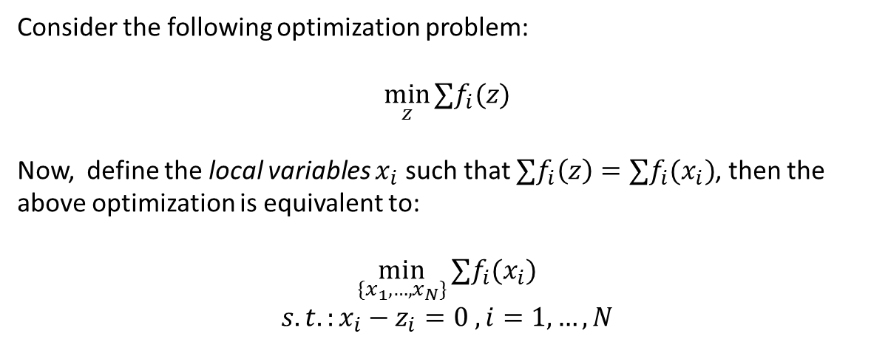
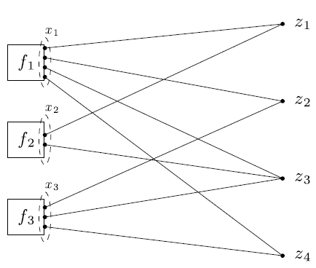
Consensus Alternative Direction Method of Multipliers (ADMM):

Slide 14




Consensus ADMM for L1 trend filtering on graph
ADMM steps:

Slide 15
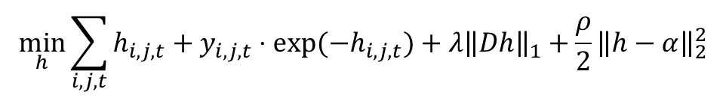
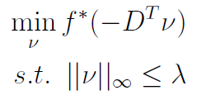

Consensus ADMM for -trend filtering on graph
Each x-update step has the following form:
The dual is:
Where the conjugate function is obtained as follows:
This leads to solving equations in the form Lambert function

Slide 16
