Slide 1
CS 904: Natural Language Processing
Word Sense Disambiguation
L. Venkata Subramaniam
January 24, 2002

Slide 2
Word Sense
Many words have several meanings or senses.
Consider two senses of the word bank
  The rising ground bordering a lake, river or sea …
  An establishment for the custody, loan exchange, or issue of money, for the extension of credit, and for facilitating the transmission or funds
However, the senses are not always so well defined.

Slide 3
Disambiguation
To determine which of the senses of an ambiguous word is invoked in a particular use of the word.
How it is done: A word is assumed to have a finite number of discrete senses. Look at the context of the word’s use to disambiguate.

Slide 4
Methods for Disambiguating
Supervised Disambiguation: disambiguation based on a labeled training set.
Dictionary-based: disambiguation based on lexical resources such as dictionaries and thesauri
Unsupervised Disambiguation: disambiguation based on training on an unlabeled text corpora.

Slide 5
Supervised Disambiguation
Training corpus: Each occurrence of the ambiguous word w is annotated with a semantic label (its contextually appropriate sense s_{k}).
Supervised disambiguation is a classification task. We will look at:
  Bayesian classification (Gale et al. 1992).
  Information-theoretic approach (Brown et al. 1991)

Slide 6
Bayesian Classification
Bayes Decision rule: Decide s’ if P(s’/c) > P(s_{k}/c) for sk  s’.
Bayes decision rule is optimal because it minimizes the probability of error.
Choose the class (or sense) with the highest conditional probability and hence the smallest error rate.

Slide 7
Applying Bayes Decision Rule
Choose a large context window around the ambiguous word.
Combine the evidence from all features to choose the class with highest conditional probability.

Slide 8
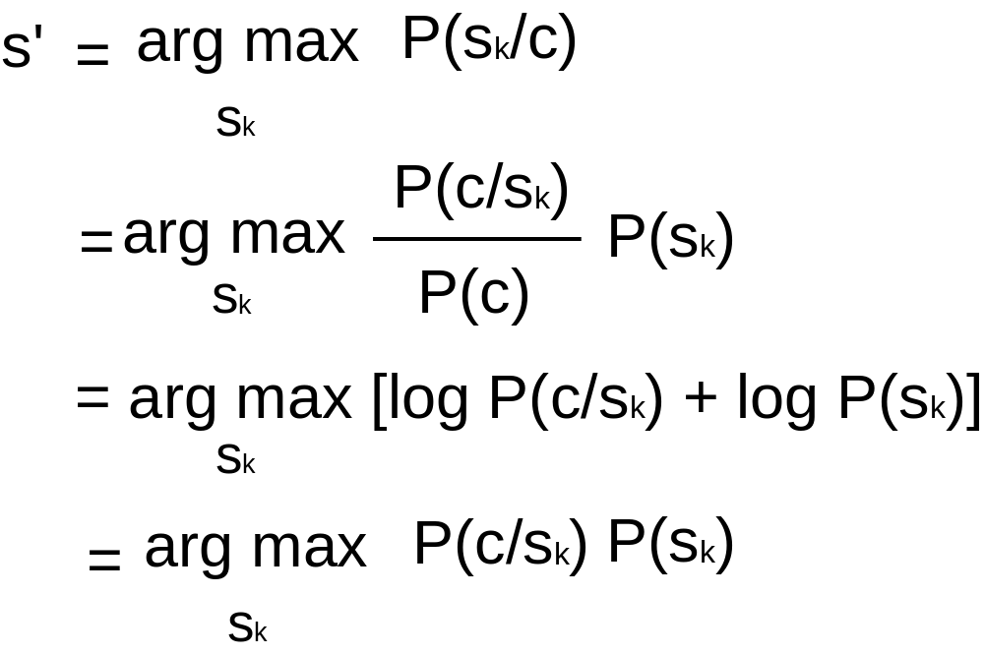
Computing Posterior Probability for Bayes Classification
We want to assign the ambiguous word w to the sense s’, given context c, where:

Slide 9
Naive Bayes (Gale et al. 1992)
Naive Bayes assumption: The attributes (contextual words) used for description are all conditionally independent: P(C|s_{k}) = P({v_{j}/ v_{j} in C}/ s_{k}) = Π _{vj in C} P(v_{j} /s_{k})
Consequences of this assumption:
  Bag of words model: the structure and linear ordering of words within the context is ignored.
  The presence of one word in the bag is independent of another.

Slide 10
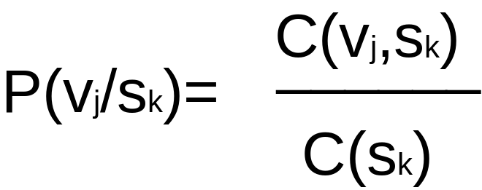
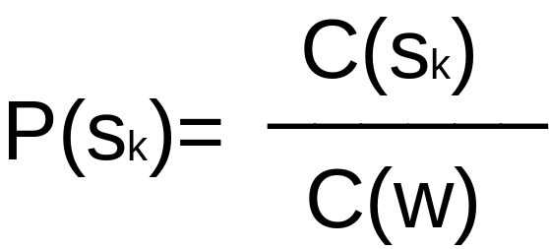
Decision Rule for Naive Bayes
Decide s’ if s’=arg max _{sk} [log P(s_{k})+Σ _{vj in C} log P(v_{j} /s_{k})]
P(v_{j} /s_{k}) and P(s_{k}) are computed via Maximum-Likelihood Estimation, perhaps with appropriate smoothing, from the labeled training corpus:

Slide 11
An Information-Theoretic Approach
Bayes Classifier uses information from all words in the context window by using an independence assumption.
In the information theoretic approach we try to find a single contextual feature that reliably indicates which sense of the ambiguous word is being used.

Slide 12
Example of Classification based on Information-Theoretic Approach
Two senses of a word:
  Prendre une mesure <-> take a measure
  Prendre une decision <-> make a decision
The translations of the ambiguous word {t₁,..,t_{m}} are {take,make}
The possible indicator words are {x₁,…, x_{n}} {mesure, note, exemple, decision, parole}
Find a partition Q={Q₁, Q₂} of {x₁,…,x_{n}} and P={P₁, P₂} of {t₁,…, t_{m}} that maximizes the mutual information:
I(P;Q)=Σ_{x∈X}Σ_{t∈Y}p(x,t) log p(x,t)/(p(x)p(t))

Slide 13
Flip-Flop Algorithm (Brown et al., 1991)
Categorize the informant (contextual word) as to which sense it indicates.
find a random partition P={P₁, p₂} for {t₁,…, t_{m}}
while (improving) do
  find partition Q={Q₁, Q₂} of {x₁,…,x_{n}}
    that maximizes I(P;Q)
  find partition P={P₁, P₂} of {t₁,…, t_{m}}
    that maximizes I(P;Q)
end

Slide 14
Disambiguation using the Information-Theoretic Approach
For the occurrence of the ambiguous word, determine the value x_{i} of the indicator.
If x_{i} is in Q₁, assign the occurrence to sense 1, if x_{i} is in Q₂, assign the occurrence to sense 2.

Slide 15
Dictionary-Based Disambiguation
Sense definitions are extracted from existing sources such as dictionaries and thesauri.
Use distributional properties to improve disambiguation: Ambiguous words are only used with one sense in any given discourse and with any given collocate.

Slide 16
Disambiguation Based on Sense Definitions (Lesk, 1986)
A word’s dictionary definitions are likely to be good indicators of the senses they define.
The algorithm:
  Given a context c for a word w with senses s₁,…,s_{k}.
  Find the bags of words corresponding to each sense s_{k} in the dictionary (s_{k} bags of words).
  Compare with the bag of words formed by combining the context word definitions. Pick the sense which gives maximum overlap with this bag.

Slide 17
Thesaurus-Based Disambiguation (Walker, 1984)
This exploits the semantic categorization provided by a thesaurus like Roget’s.
The semantic categories of the words in a context determine the semantic category of the context as a whole. This category, in turn, determines which word senses are used.

Slide 18
Thesaurus-Based Disambiguation (Walker, 1984)
Each word is assigned one or more subject codes which corresponds to its different meanings. For each subject code, we count the number of words (from the context) having the same subject code. We select the subject code corresponding to the highest count.

Slide 19
Creating New Categories (Yarowsky, 1992)
Add new words to a category if they occur more often than chance. For example Navratilova can be added to the sports category.
The Bayes classifier is used for both adaptation and disambiguation.

Slide 20
Disambituations Based on Translations (Dagan et al. 91 & 94)
Disambiguate words based on translations.
Count the number of times a sense translation occurs in a second language corpus along with translations of the context words. Pick the sense with the highest score.

Slide 21
One Sense per Discourse, One sense per Collocation (Yarowsky 1995)
One sense per discourse:The sense of a target word is highly consistent within any given document.
One sense per collocation: nearby words provide strong and consistent clues to the sense of a target word, conditional on relative distance, order and syntactic relationship.

Slide 22
Unsupervised Disambiguation
Cluster the contexts of an ambiguous word into a number of groups and discriminate between these groups without labeling them.
The probabilistic model is the Bayesian model we used earlier for supervised classification, but the P(v_{j} | s_{k}) are estimated using the EM algorithm.

Slide 23
Testing using Pseudowords
Create artificial ambiguous words (pseudowords), by conflating two or more words. For example occurances of banana and door can be replaced by banana-door.
The disambiguation algorithm can now be tested on this data to disambiguate the pseudoword. For example banana-door into banana and door.

Slide 24
Bounds on Performance
Measure of how well the algorithm performs relative to the difficulty of the task.
Upper Bound: Human performance.
Lower Bound or baseline: Usually the assignment of all contexts to the most frequent sense.

