Slide 1
Social Everywhere

Slide 2
What is social everywhere ?
Public chat
Private room
Profil
Friend

Slide 3
Team n°
Estephe Bouvet :
Guillaume Cassande :
Valentin Pinilla :
Alban Duchene : 50141212
Benjamin Dussouillez : 50141216

Slide 4

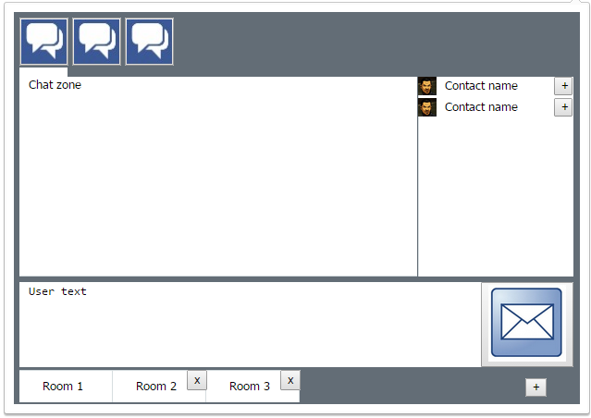
Chat room
Send message
Chat zone
Contact list
Add new friend
Create or delete
private room

Slide 5
Private room
Same to chat room
Add new friend

Slide 6
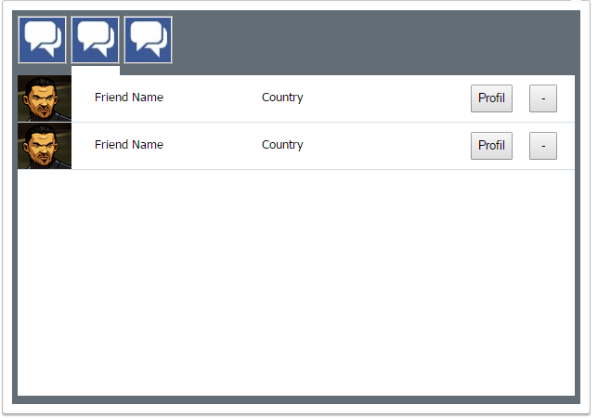
Friend list
Friend list
See their profil
Delete friend

Slide 7
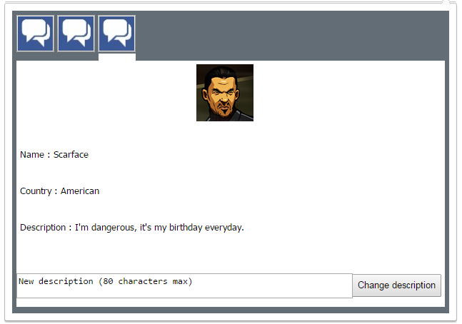
Profil
- Change your own description

Slide 8
Technologies
Server – NodeJs
Database – MongoDb
GUI – HTML / CSS / JS (jQuery)

Slide 9
Demonstration

Slide 10

Thank’s to listening

