Slide 1
THE GEORGE WASHINGTON UNIVERSITY
School of Engineering and Applied Science
Department of Computer Science
CSci 195 Senior Design
Preliminary Design Presentation
Isometric Real-Time Simulation Engine
Dave Kahler

Slide 2
Project Overview
Engine: Provides a real-time simulation program structure for future games
Demo: Modeled around a functioning research laboratory
Goal of Demo: Manage a research lab from initial construction to full operation
¾ Isometric Display

Slide 3
Hardware Specifications
(Game Demo)
Game Boy Advance or Game Boy Advance SP
Project: SciSearch game cartridge
AA (GBA) or rechargeable (GBASP) batteries or AC adaptor

Slide 4
Hardware/Software Specifications (Engine)
Microsoft Visual C++ 6.0
  Game Boy Advance SDK
MS Windows PC capable of running Visual C++ 6.0
Game Boy Advance .ROM Emulator
(for testing)

Slide 5
Program Design
Three main program modules:
  Display
  Interface
  Simulation

Slide 6
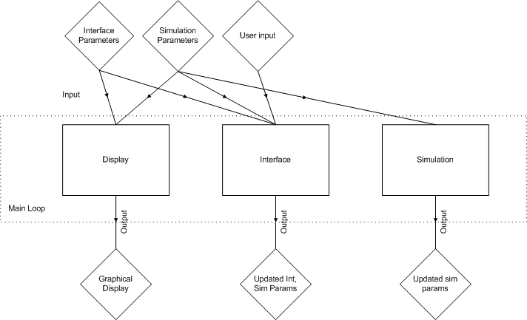
Main Engine Overview

Slide 7
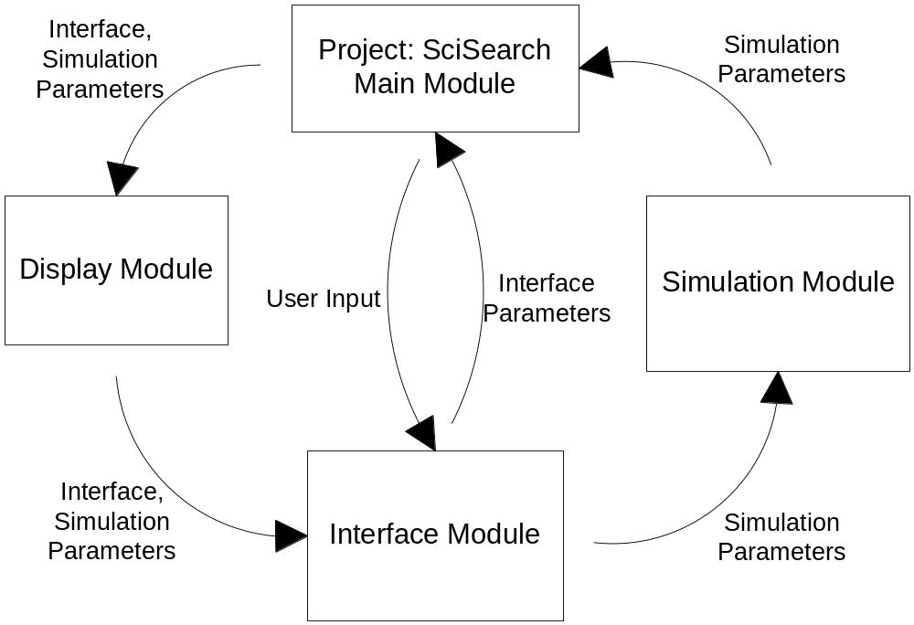
Data Flow

Slide 8
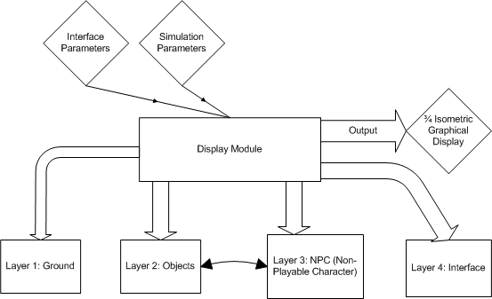
Display Module

Slide 9
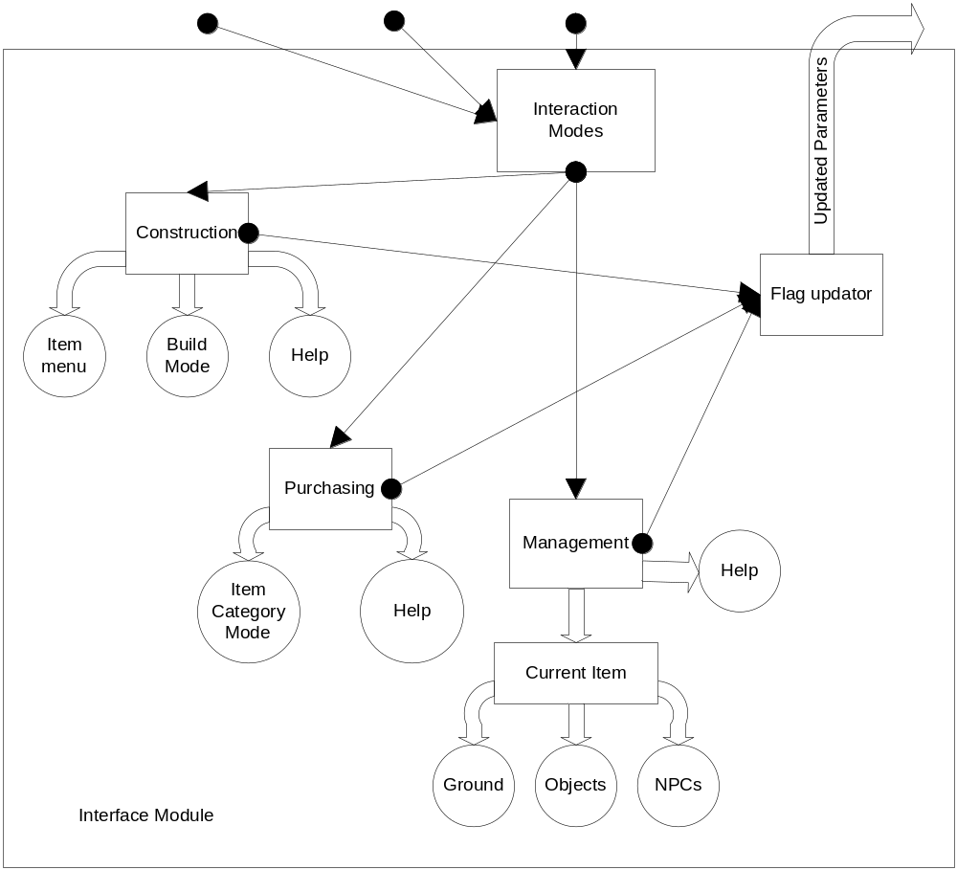
Interface Module
Interface Parameters
Sim Params
User Input

Slide 10
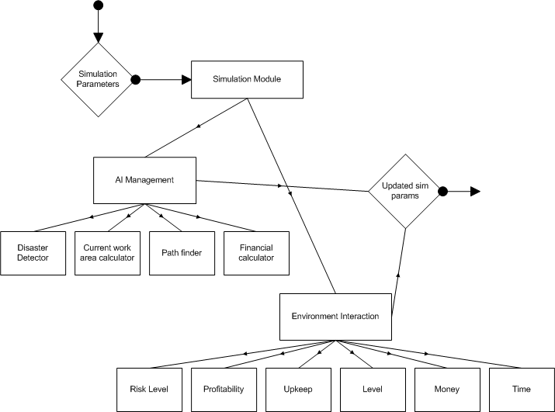
Simulation Module

Slide 11
Simulation Parameters
Risk Level
  Per Cell
  Tentative Calculation:
    Object over cell risk +
    Object x₁+x₂+…+x_{n} risk +
    Floor type risk

Slide 12
Simulation Parameters
Profitability
  Per Object
  Tentative Calculation
    Number of employees assigned factor +
    Object risk factor +
    Object level factor +
    Funding factor

Slide 13
Simulation Parameters
Upkeep
  Per Object
  Tentative Calculation
    Object funding factor +
    Current upkeep +
    Time decay factor

Slide 14
Simulation Parameters
Level
  Per Object
  User-upgradable
    Money
    Technology (Time)

Slide 15
Simulation Parameters
Money
  Game Global
  Gross financial sum available to user
Time
  Game-world time updated on a per-frame basis

Slide 16
AI Management
Disaster Detector
  Triggered on a per-NPC basis
  Tentative trigger calculation
    Cell x Risk +
    AI Risk
      Earnings +
      Education +
      Time at company

Slide 17
AI Management
Current Work Area Calculator
  Time loop
  Cycles through possible NPC work areas
  Raises flag to create new path

Slide 18
AI Management
Path Finder
  Runs when Current Work Area changes
  Heuristic A* search from current node to goal node

Slide 19
AI Management
Financial Calculator
  Calculates NPC’s salary over time
  Subtracts from gross Money total

Slide 20
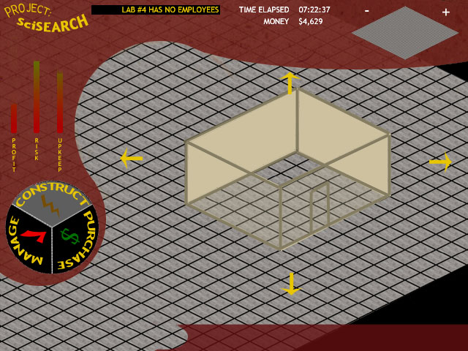
GUI Mockup

Slide 21
Comparative Product Study
Best-selling games sell upwards of 100,000 copies
Advance Wars (50,000 as of 7/2003)
Jurassic Park III – Park Builder (Unavailable)
Sim City 2000 (Not yet released)

Slide 22
Verification Testing
Display Module
  Rendering Test
    Input: Press button to cause scrolling event
    Expected Output: Properly updated and rendered display
  Depth Test
    Input: Place NPC near Objects
    Expected Output: Depth is calculated and rendered correctly

Slide 23
Verification Testing
Interface Module
  Mode Functionality Testing
    Input: Button press for each Interface button
    Expected Output: Interface screen(s) update to correct new screen
  Environment State Testing
    Input: Activation of as many Interface features as possible
    Expected Output: Interface/Simulation Parameters correctly updated

Slide 24
Verification Testing
Simulation Module
  Game State Testing
    Input: Change environment variables (spend money, hire employees, etc.)
    Expected Output: Game behaves as described using new Input
  AI Testing
    Input: New Work Area Location
    Expected Output: Correct path calculated and followed to new Work Area

Slide 25
Project Design Review
Gantt Chart

Slide 26
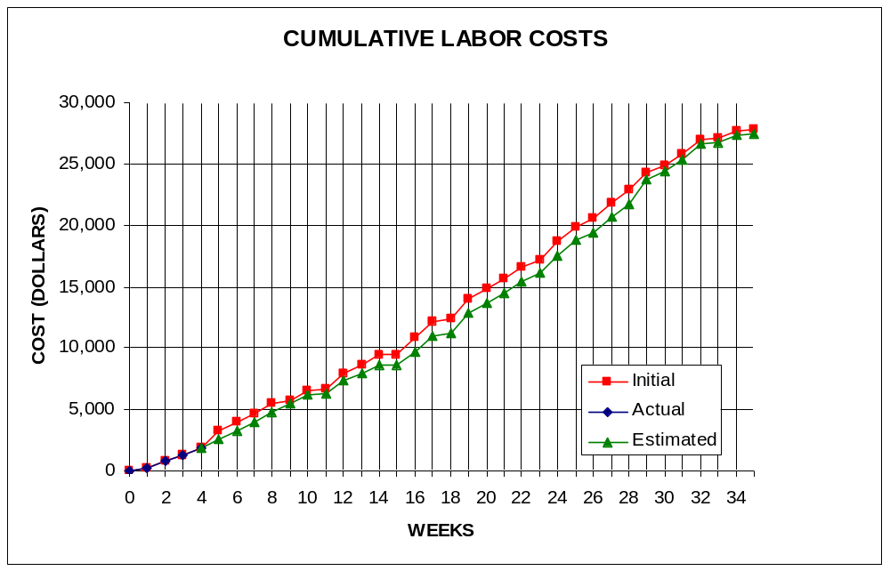
Labor Costs vs. Time

Slide 27
Economic Analysis - Prototype
PERSON | LABOR RATE | INITIAL EST. HRS. | INITIAL EST. COST | CURRENT EST. HRS. | CURRENT EST. COST
COMP. SYSTEMS ANALYST | $45.00 | 150 | $6,750.00 | 143 | $6,435.00
COMP. PROGRAMMER | $40.00 | 204 | $8,160.00 | 204 | $8,160.00
TEST PROGRAMMER | $35.00 | 104 | $3,640.00 | 99 | $3,465.00
TECHNICAL WRITER | $35.00 | 271 | $9,485.00 | 268 | $9,380.00
SUBTOTAL |  | 729 | $28,035.00 | 714 | $27,440.00
ENGINE @ 70% |  | 510 | $19,624.50 | 500 | $19,208.00
GAME @ 30% |  | 219 | $8,410.50 | 214 | $8,232.00
DIRECT OVERHEAD @ 100% |  |  | $28,035.00 |  | $27,440.00
SUBTOTAL |  |  | $56,070.00 |  | $54,880.00
A & G COSTS @ 40% |  |  | $22,428.00 |  | $21,952.00
SUBTOTAL |  |  | $78,498.00 |  | $76,832.00
PROFIT @ 20% |  |  | $15,699.60 |  | $15,366.40
TOTAL COST OF PROTOTYPE |  |  | $94,197.60 |  | $92,198.40

Slide 28
Economic Analysis - Profits
COSTS | RATE | HOURS | INITIAL COST/COPY |  | CURRENT COST/COPY
CONSTRUCTION TIME | $20.00 | 0.25 | $0.50 |  | $0.50
SUBTOTAL DIRECT LABOR |  |  | $0.50 |  | $0.50
INDIRECT OVERHEAD @ 100% |  |  | $0.50 |  | $0.50
SUBTOTAL |  |  | $1.00 |  | $1.00
DOCUMENTATION |  |  | $2.00 |  | $2.00
PACKAGING |  |  | $3.00 |  | $3.00
SUBTOTAL |  |  | $6.00 |  | $6.00
A & G @ 40% |  |  | $2.40 |  | $2.40
SUBTOTAL |  |  | $8.40 |  | $8.40
PROFIT @ 20% |  |  | $1.68 |  | $1.68
SUBTOTAL |  |  | $10.08 |  | $10.08

Slide 29
Economic Analysis – Profits
RECOUP COST OF PROTOTYPE | COSTS | UNITS TO SELL
INITIAL | $94,197.60 | 100000 | $4.71
CURRENT | $92,198.40 | 100000 |  |  | $4.61
RECOUP OVER |  | 20000
MANUFACTURING COSTS |  |  | $14.79 |  | $14.69
WHOLESALE MARKUP @ 20% |  |  | $2.96 |  | $2.94
SUBTOTAL |  |  | $17.75 |  | $17.63
RETAIL MARKUP @ 50% |  |  | $8.87 |  | $8.81
TOTAL RETAIL COST |  |  | $26.62 |  | $26.44
PROFIT (ON FIRST 20,000) |  |  | $33,600.00 |  | $33,600.00
PROFIT (ON THE REST) |  |  | $292,708.08 |  | $289,918.72
TOTAL PROFIT |  |  | $326,308.08 |  | $323,518.72

Slide 30
Status Matrix - Outline
OUTLINE | INT EST LOC | INT EST HOURS | CUR EST LOC | CUR EST HRS | WORK TO-DATE HRS | % WORK COMP | TIME TO COMP HRS
DISPLAY | 2000 | 13 | 2000 | 13 | 13 | 100 | 0
GROUND | 500 | 4 | 500 | 4 | 4 | 100 | 0
OBJECTS | 500 | 3 | 500 | 3 | 3 | 100 | 0
NPC | 500 | 3 | 500 | 3 | 3 | 100 | 0
INTERFACE | 500 | 3 | 500 | 3 | 3 | 100 | 0
INTERFACE | 2500 | 12 | 2500 | 12 | 12 | 100 | 0
CONSTRUCT | 500 | 3 | 500 | 3 | 3 | 100 | 0
PURCHASE | 500 | 3 | 500 | 3 | 3 | 100 | 0
MANAGE | 500 | 4 | 500 | 4 | 4 | 100 | 0
INPUT | 1000 | 2 | 1000 | 2 | 2 | 100 | 0
SIMULATION | 3000 | 8 | 3000 | 8 | 8 | 100 | 0
ENVIRON | 1500 | 4 | 1500 | 4 | 4 | 100 | 0
AI | 1500 | 4 | 1500 | 4 | 4 | 100 | 0
TOTALS | 7500 | 33 | 7500 | 33 | 33 | 100 | 0

Slide 31
Status Matrix - Design
DESIGN | INT EST LOC | INT EST HOURS | CUR EST LOC | CUR EST HRS | WORK TO-DATE HRS | % WORK COMP | TIME TO COMP HRS
DISPLAY | 2000 | 60 | 2000 | 47 | 20 | 43 | 27
GROUND | 500 | 15 | 500 | 12 | 5 | 42 | 7
OBJECTS | 500 | 15 | 500 | 12 | 5 | 42 | 7
NPC | 500 | 15 | 500 | 12 | 3 | 25 | 9
INTERFACE | 500 | 15 | 500 | 11 | 7 | 64 | 4
INTERFACE | 2500 | 60 | 2500 | 31 | 11 | 35 | 20
CONSTRUCT | 500 | 15 | 500 | 7 | 2 | 29 | 5
PURCHASE | 500 | 15 | 500 | 7 | 2 | 29 | 5
MANAGE | 500 | 15 | 500 | 7 | 2 | 29 | 5
INPUT | 1000 | 15 | 1000 | 10 | 5 | 50 | 5
SIMULATION | 3000 | 40 | 3000 | 26 | 15 | 58 | 11
ENVIRON | 1500 | 20 | 1500 | 14 | 7 | 50 | 7
AI | 1500 | 20 | 1500 | 12 | 8 | 67 | 4
TOTALS | 7500 | 160 | 7500 | 104 | 46 | 44 | 58

Slide 32
Status Matrix - Construct
CONSTRUCT | INT EST LOC | INT EST HOURS | CUR EST LOC | CUR EST HRS | WORK TO-DATE HRS | % WORK COMP | TIME TO COMP HRS
DISPLAY | 2000 | 52 | 2000 | 32 | 0 | 0 | 32
GROUND | 500 | 13 | 500 | 8 | 0 | 0 | 8
OBJECTS | 500 | 13 | 500 | 8 | 0 | 0 | 8
NPC | 500 | 13 | 500 | 8 | 0 | 0 | 8
INTERFACE | 500 | 13 | 500 | 8 | 0 | 0 | 8
INTERFACE | 2500 | 128 | 2500 | 51 | 0 | 0 | 51
CONSTRUCT | 500 | 30 | 500 | 12 | 0 | 0 | 12
PURCHASE | 500 | 30 | 500 | 12 | 0 | 0 | 12
MANAGE | 500 | 30 | 500 | 12 | 0 | 0 | 12
INPUT | 1000 | 38 | 1000 | 15 | 0 | 0 | 15
SIMULATION | 3000 | 76 | 3000 | 56 | 0 | 0 | 56
ENVIRON | 1500 | 38 | 1500 | 28 | 0 | 0 | 28
AI | 1500 | 38 | 1500 | 28 | 0 | 0 | 28
TOTALS | 7500 | 256 | 7500 | 139 | 0 | 0 | 139

Slide 33
Status Matrix - Integrate
INTEGRATE | INT EST LOC | INT EST HOURS | CUR EST LOC | CUR EST HRS | WORK TO-DATE HRS | % WORK COMP | TIME TO COMP HRS
DISPLAY | 2000 | 12 | 2000 | 40 | 0 | 0 | 40
GROUND | 500 | 3 | 500 | 10 | 0 | 0 | 10
OBJECTS | 500 | 3 | 500 | 10 | 0 | 0 | 10
NPC | 500 | 3 | 500 | 10 | 0 | 0 | 10
INTERFACE | 500 | 3 | 500 | 10 | 0 | 0 | 10
INTERFACE | 2500 | 13 | 2500 | 40 | 0 | 0 | 40
CONSTRUCT | 500 | 3 | 500 | 10 | 0 | 0 | 10
PURCHASE | 500 | 3 | 500 | 10 | 0 | 0 | 10
MANAGE | 500 | 4 | 500 | 10 | 0 | 0 | 10
INPUT | 1000 | 3 | 1000 | 10 | 0 | 0 | 10
SIMULATION | 3000 | 8 | 3000 | 20 | 0 | 0 | 20
ENVIRON | 1500 | 4 | 1500 | 10 | 0 | 0 | 10
AI | 1500 | 4 | 1500 | 10 | 0 | 0 | 10
TOTALS | 7500 | 33 | 7500 | 100 | 0 | 0 | 100

Slide 34
Status Matrix - Test
TEST | INT EST LOC | INT EST HOURS | CUR EST LOC | CUR EST HRS | WORK TO-DATE HRS | % WORK COMP | TIME TO COMP HRS
DISPLAY | 2000 | 8 | 2000 | 40 | 0 | 0 | 40
GROUND | 500 | 2 | 500 | 10 | 0 | 0 | 10
OBJECTS | 500 | 2 | 500 | 10 | 0 | 0 | 10
NPC | 500 | 2 | 500 | 10 | 0 | 0 | 10
INTERFACE | 500 | 2 | 500 | 10 | 0 | 0 | 10
INTERFACE | 2500 | 13 | 2500 | 37 | 0 | 0 | 37
CONSTRUCT | 500 | 3 | 500 | 10 | 0 | 0 | 10
PURCHASE | 500 | 3 | 500 | 10 | 0 | 0 | 10
MANAGE | 500 | 3 | 500 | 10 | 0 | 0 | 10
INPUT | 1000 | 4 | 1000 | 7 | 0 | 0 | 7
SIMULATION | 3000 | 9 | 3000 | 30 | 0 | 0 | 30
ENVIRON | 1500 | 4 | 1500 | 15 | 0 | 0 | 15
AI | 1500 | 5 | 1500 | 15 | 0 | 0 | 15
TOTALS | 7500 | 30 | 7500 | 107 | 0 | 0 | 107

Slide 35
Status Matrix - Document
DOCUMENT | INT EST LOC | INT EST HOURS | CUR EST LOC | CUR EST HRS | WORK TO-DATE HRS | % WORK COMP | TIME TO COMP HRS
DISPLAY | 2000 | 24 | 2000 | 24 | 0 | 0 | 24
GROUND | 500 | 5 | 500 | 7 | 0 | 0 | 7
OBJECTS | 500 | 5 | 500 | 7 | 0 | 0 | 7
NPC | 500 | 6 | 500 | 8 | 0 | 0 | 8
INTERFACE | 500 | 8 | 500 | 8 | 0 | 0 | 8
INTERFACE | 2500 | 26 | 2500 | 23 | 0 | 0 | 23
CONSTRUCT | 500 | 5 | 500 | 5 | 0 | 0 | 5
PURCHASE | 500 | 5 | 500 | 5 | 0 | 0 | 5
MANAGE | 500 | 5 | 500 | 5 | 0 | 0 | 5
INPUT | 1000 | 11 | 1000 | 8 | 0 | 0 | 8
SIMULATION | 3000 | 22 | 3000 | 20 | 0 | 0 | 20
ENVIRON | 1500 | 11 | 1500 | 10 | 0 | 0 | 10
AI | 1500 | 11 | 1500 | 10 | 0 | 0 | 10
REPORTS |  | 61 |  | 80 | 25 | 31 | 55
PPR |  | 15 |  | 15 | 15 | 100 | 0
PDR |  | 6 |  | 10 | 10 | 100 | 0
CDR |  | 6 |  | 10 | 0 | 0 | 10
FDR |  | 6 |  | 10 | 0 | 0 | 10
PR1 |  | 5 |  | 7 | 0 | 0 | 7
PR2 |  | 5 |  | 6 | 0 | 0 | 6
PR3 |  | 5 |  | 6 | 0 | 0 | 6
PR4 |  | 5 |  | 6 | 0 | 0 | 6
FR |  | 8 |  | 10 | 0 | 0 | 10
TOTALS | 7500 | 133 | 7500 | 147 | 25 | 17 | 122

Slide 36
Status Matrix - Total
TOTAL | INT EST LOC | INT EST HOURS | CUR EST LOC | CUR EST HRS | WORK TO-DATE HRS | % WORK COMP | TIME TO COMP HRS
DISPLAY | 2000 | 169 | 2000 | 196 | 33 | 17 | 163
GROUND | 500 | 42 | 500 | 51 | 9 | 18 | 42
OBJECTS | 500 | 41 | 500 | 50 | 8 | 16 | 42
NPC | 500 | 42 | 500 | 51 | 6 | 12 | 45
INTERFACE | 500 | 44 | 500 | 50 | 10 | 20 | 40
INTERFACE | 2500 | 252 | 2500 | 194 | 23 | 12 | 171
CONSTRUCT | 500 | 59 | 500 | 47 | 5 | 11 | 42
PURCHASE | 500 | 59 | 500 | 47 | 5 | 11 | 42
MANAGE | 500 | 61 | 500 | 48 | 6 | 13 | 42
INPUT | 1000 | 73 | 1000 | 52 | 7 | 13 | 45
SIMULATION | 3000 | 163 | 3000 | 160 | 23 | 14 | 137
ENVIRON | 1500 | 81 | 1500 | 81 | 11 | 14 | 70
AI | 1500 | 82 | 1500 | 79 | 12 | 15 | 67
REPORTS |  | 61 |  | 80 | 25 | 31 | 55
CLASS TIME |  | 84 |  | 84 | 18 | 21 | 66
GRAND TOTAL | 7500 | 729 | 7500 | 714 | 122 | 17 | 537

Slide 37
Conclusions
Development Time:
  70% Engine
  30% Game Demonstration
Prototype Cost: $92,198
Total Hours: 714

