Slide 1
THE GEORGE WASHINGTON UNIVERSITY
School of Engineering and Applied Science
Department of Computer Science
CSci 195 Senior Design
Project Proposal Presentation
Isometric Real-Time Simulation Game
Dave Kahler

Slide 2
Project Overview
¾ Isometric view
Manage a research lab from initial construction to full operation
Modes:
  Construction
  Purchasing
  Maintenance

Slide 3
Hardware Specifications
Game Boy Advance or Game Boy Advance SP
Project: SciSearch game cartridge
AA (GBA) or rechargeable (GBASP) batteries or AC adaptor

Slide 4
Program Design
Three main program modules:
  Display
  Interface
  Simulation

Slide 5
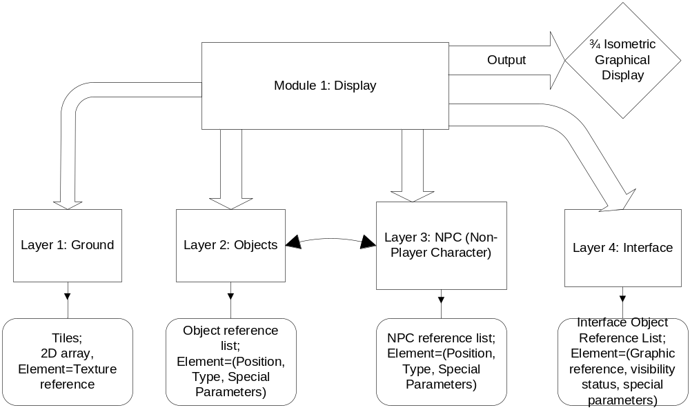
Display Module

Slide 6
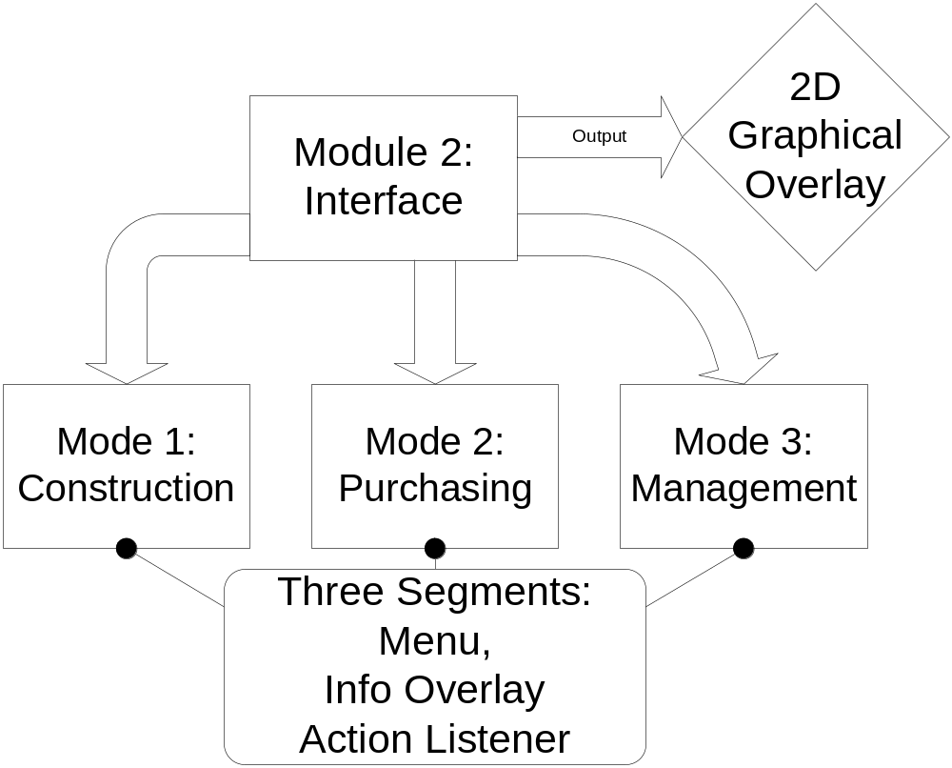
Interface Module

Slide 7
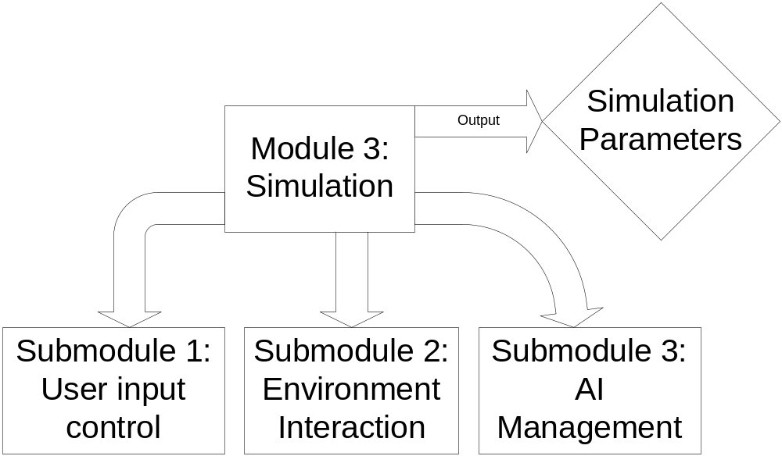
Simulation Module

Slide 8
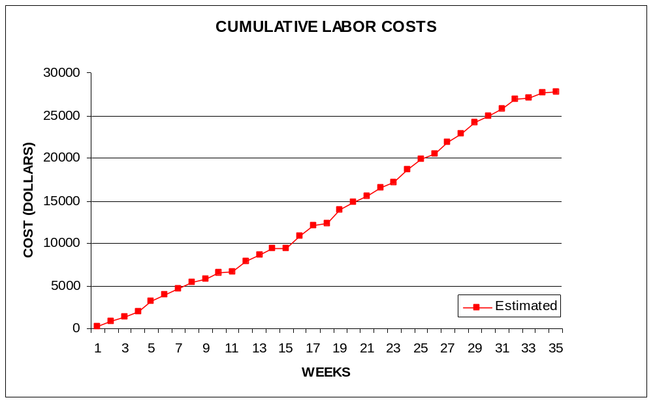
Labor Costs vs. Time

Slide 9
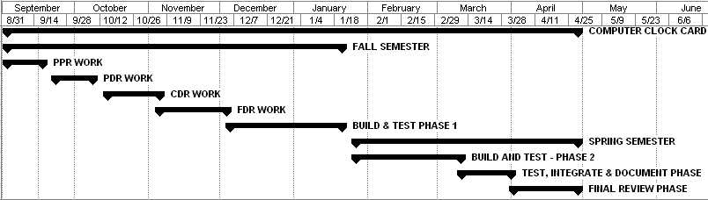
Gantt Chart Timeline

Slide 10
Economic Analysis - Prototype
PERSON | LABOR RATE | INITIAL EST. HRS. | INITIAL EST. COST
COMP. SYSTEMS ANALYST | $45.00 | 195 | $8,775.00
COMP. PROGRAMMER | $40.00 | 181 | $7,240.00
TEST PROGRAMMER | $35.00 | 91 | $3,185.00
TECHNICAL WRITER | $35.00 | 245 | $8,575.00
TOTAL |  | 712 | $27,775.00
DIRECT OVERHEAD @ 100% |  |  | $27,775.00
SUBTOTAL |  |  | $55,550.00
A & G COSTS @ 40% |  |  | $22,220.00
SUBTOTAL |  |  | $77,770.00
PROFIT @ 20% |  |  | $15,554.00
TOTAL COST OF PROTOTYPE |  |  | $93,324.00

Slide 11
Economic Analysis - Profits
COSTS | RATE | HOURS | INIT. COST/COPY | CURR. COST/COPY
CONSTRUCTION TIME | $20.00 | 0.25 | $0.50 | $0.50
SUBTOTAL DIRECT LABOR |  |  | $0.50 | $0.50
INDIRECT OVERHEAD @ 100% |  |  | $0.50 | $0.50
DOCUMENTATION |  |  | $2.00 | $2.00
PACKAGING |  |  | $3.00 | $3.00
A & G @ 40% |  |  | $2.40 | $2.40
PROFIT @ 20% |  |  | $1.68 | $1.68
SUBTOTAL |  |  | $10.08 | $10.08

Slide 12
Economic Analysis – Profits
RECOUP COST OF PROTOTYPE | COSTS | TO SELL
INITIAL | $93,324.00 | 100000 | $4.67
RECOUP OVER |  | 55550
MANUFACTURING COSTS |  |  | $14.75 | $14.75
WHOLESALE MARKUP @ 20% |  |  | $2.95 | $2.95
SUBTOTAL |  |  | $17.70 | $17.70
RETAIL MARKUP @ 50% |  |  | $8.85 | $8.85
TOTAL RETAIL COST |  |  | $26.54 | $26.54
PROFIT (ON FIRST 100,000) |  |  | $168,000.00 | $168,000.00

Slide 13
Comparative Product Study
Advance Wars
Jurassic Park III – Park Builder
Sim City 2000

Slide 14
Status Matrix - Outline
 | INITIAL ESTIMATED HOURS | WORK TO-DATE HOURS | % WORK COMP | TIME TO COMP HOURS
MODULE 1 | 13 | 11 | 85 | 2
MODULE 2 | 10 | 7 | 70 | 3
MODULE 3 | 10 | 8 | 80 | 2

Slide 15
Status Matrix - Design
 | INITIAL ESTIMATED HOURS | WORK TO-DATE HRS | % WORK COMP | TIME TO COMP HRS
MODULE 1 | 60 | 0 | 0 | 60
MODULE 2 | 45 | 0 | 0 | 45
MODULE 3 | 55 | 0 | 0 | 55

Slide 16
Status Matrix - Construct
 | INITIAL EST LOC | INT EST HOURS | WORK TO-DATE HRS | % WORK COMP | TIME TO COMP HRS
MODULE 1 | 2000 | 52 | 0 | 0 | 52
MODULE 2 | 1500 | 90 | 0 | 0 | 90
MODULE 3 | 4000 | 114 | 0 | 0 | 114

Slide 17
Status Matrix - Integrate
 | INITIAL ESTIMATED HOURS | WORK TO-DATE HRS | % WORK COMP | TIME TO COMP HRS
MODULE 1 | 12 | 0 | 0 | 12
MODULE 2 | 10 | 0 | 0 | 10
MODULE 3 | 11 | 0 | 0 | 11

Slide 18
Status Matrix - Test
 | INITIAL ESTIMATED HOURS | WORK TO-DATE HRS | % WORK COMP | TIME TO COMP HRS
MODULE 1 | 8 | 0 | 0 | 8
MODULE 2 | 9 | 0 | 0 | 9
MODULE 3 | 13 | 0 | 0 | 13

Slide 19
Status Matrix - Document
 | INITIAL ESTIMATED HOURS | WORK TO-DATE HRS | % WORK COMP | TIME TO COMP HRS
MODULE 1 | 24 | 0 | 0 | 24
MODULE 2 | 15 | 0 | 0 | 15
MODULE 3 | 33 | 0 | 0 | 33
REPORTS | 50 | 15 | 30 | 35

Slide 20
Status Matrix - Total
 | INIT EST LOC | INIT EST HOURS | WORK TO-DATE HRS | % WORK COMP | TIME TO COMP HRS
MODULE 1 | 2000 | 169 | 11 | 7 | 158
MODULE 2 | 1500 | 179 | 7 | 4 | 172
MODULE 3 | 4000 | 236 | 8 | 3 | 228
CLASS TIME |  | 78 | 6 | 8 | 72
GRAND TOTAL | 7500 | 712 | 47 | 7 | 665

