Slide 1
THE GEORGE WASHINGTON UNIVERSITY
School of Engineering and Applied Science
Department of Computer Science
First Progress Presentation
for
Project: SciSearch
by
Dave Kahler
CSCI195-11
January 21, 2004

Slide 2
Project Overview
Engine: Provides a real-time simulation program structure for future games
Demo: Modeled around a functioning research laboratory

Slide 3
Hardware Specifications
(Game Demo)
Game Boy Advance or Game Boy Advance SP
Project: SciSearch game cartridge
AA (GBA) or rechargeable (GBASP) batteries or AC adaptor

Slide 4
Hardware/Software Specifications (Engine)
Microsoft Visual C++ 6.0
  Game Boy Advance SDK
MS Windows PC capable of running Visual C++ 6.0
Game Boy Advance .ROM Emulator
(for testing)

Slide 5
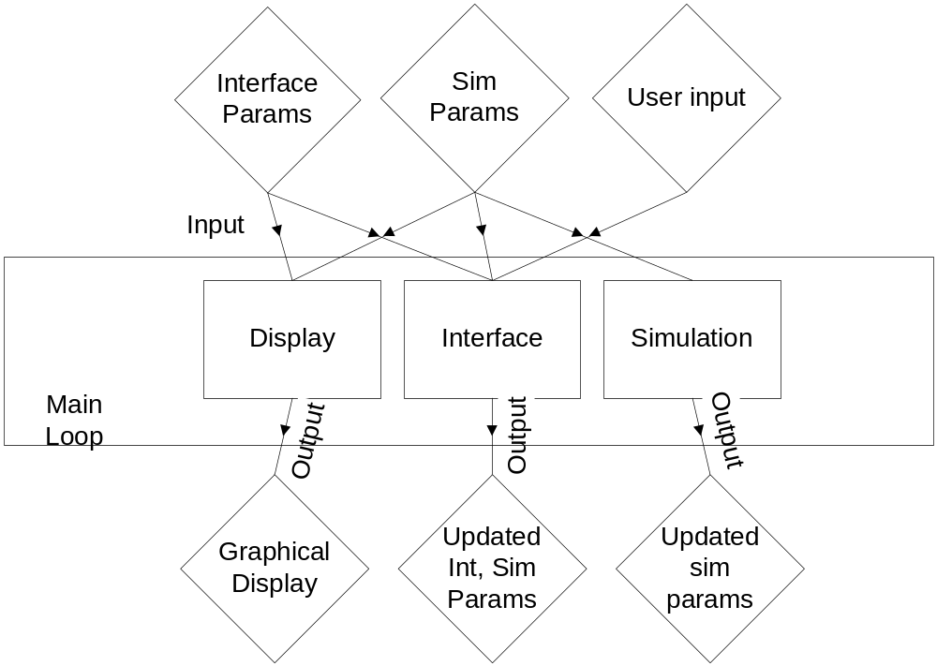
Main Engine Overview

Slide 6
Module List
Module Name | Module Function | Called By | Calls
Display | Graphical Output | Main Loop | Ground,Object,NPC,Interface
Ground | Draw Ground | Display | None
Object | Draw Objects | Display | None
NPC | Draw NPCs | Display | None
Interface | Draw Interface | Display | None
Interface | Handle Interface Updates | Main Loop | Menus,Modes,Help,Input
Menus | Handle Menu Structure | Input | None
Modes | Handle Modes | Input | None
Help | Handle Help System | Input | None
Input | Handle User Input | Interface | Menus,Modes,Help
Simulation | Handle sim events | Main Loop | Environ, AI
Environ | Handle Environ Cues | Simulation | None
AI | Handle AI responses | Simulation | None

Slide 7
Module List
Module Name | LOC Current | LOC left | Hrs current | Hrs left | % complete | Cost
Display | 1,200 | 200 | 80 | 10 | 89% | $6,000
Ground | 500 | 0 | 30 | 0 | 100% | $1,500
Objects | 400 | 0 | 25 | 0 | 100% | $1,500
NPCs | 100 | 100 | 10 | 5 | 67% | $1,500
Interface | 200 | 100 | 15 | 5 | 75% | $1,500
Interface | 700 | 900 | 25 | 30 | 45% | $6,000
Menus | 200 | 300 | 10 | 10 | 50% | $1,500
Modes | 200 | 200 | 5 | 10 | 33% | $1,500
Help | 100 | 200 | 2 | 5 | 29% | $1,500
Input | 200 | 200 | 8 | 5 | 62% | $1,500
Simulation | 0 | 2,000 | 0 | 60 | 0% | $8,000
Environ | 0 | 1,000 | 0 | 30 | 0% | $4,000
AI | 0 | 1,000 | 0 | 30 | 0% | $4,000
TOTAL | 1,900 | 3,100 | 105 | 100 | 51% | $20,000

Slide 8
Verification Testing
Display Module
Action | Expected Result
Scroll in all directions | Graphical layers render in correct order; Objects selected/displayed as stored in system; Scrolling stops at end of map
Place NPCs above/below objects | NPCs and Objects render in correct depth order
Test response time in emulator | Response time should be < 1/10 second

Slide 9
Verification Testing
Interface Module
Action | Expected Result
Select and deselect all interface components on at a time | Selection/deselection causes proper change in interface state
Place object in scene | Object adds correctly to simulation and displays
Place NPC in scene | NPC adds correctly to simulation and displays
Invoke help menu for each state | Proper help text is displayed

Slide 10
Verification Testing
Simulation Module
Action | Expected Result
Compare time to real-world clock | Time is synced to within 30 seconds an hour
Check new NPC paths | NPC paths should be close to optimal and correct
Check various simulation calculators | Calculators (e.g. Risk) should be at plausible values within the specified range
Place an overload of objects/NPCs in simulation | System should revert to software rendering and slow down, but not crash

Slide 11
Progress Review
Gantt Chart

Slide 12
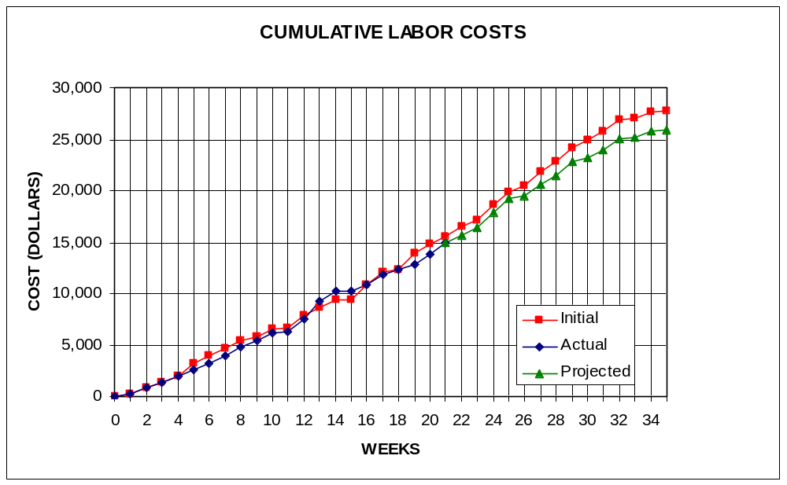
Labor Costs vs. Time

Slide 13
Economic Analysis - Prototype
PERSON | LABOR RATE | INITIAL EST. HRS. | INITIAL EST. COST | CURRENT EST. HRS. | CURRENT EST. COST
COMP. SYSTEMS ANALYST | $45.00 | 150 | $6,750 | 131 | $5,895
COMP. PROGRAMMER | $40.00 | 204 | $8,160 | 203 | $8,120
TEST PROGRAMMER | $35.00 | 104 | $3,640 | 91 | $3,185
TECHNICAL WRITER | $35.00 | 271 | $9,485 | 250 | $8,750
SUBTOTAL |  | 729 | $28,035 | 675 | $25,950
ENGINE @ 70% |  | 510 | $19,625 | 473 | $18,165
GAME @ 30% |  | 219 | $8,411 | 203 | $7,785
TOTAL |  | 729 | $28,035 | 675 | $25,950
DIRECT OVERHEAD @ 100% |  |  | $28,035 |  | $25,950
SUBTOTAL |  |  | $56,070 |  | $51,900
A & G COSTS @ 40% |  |  | $22,428 |  | $20,760
SUBTOTAL |  |  | $78,498 |  | $72,660
PROFIT @ 20% |  |  | $15,700 |  | $14,532
TOTAL COST OF PROTOTYPE |  |  | $94,198 |  | $87,192

Slide 14
Economic Analysis - Profits
COSTS | RATE | HOURS | INITIAL COST/COPY |  | CURRENT COST/COPY
CONSTRUCTION TIME | $20.00 | 0.25 | $0.50 |  | $0.50
SUBTOTAL DIRECT LABOR |  |  | $0.50 |  | $0.50
INDIRECT OVERHEAD @ 100% |  |  | $0.50 |  | $0.50
SUBTOTAL |  |  | $1.00 |  | $1.00
DOCUMENTATION |  |  | $2.00 |  | $2.00
PACKAGING |  |  | $3.00 |  | $3.00
SUBTOTAL |  |  | $6.00 |  | $6.00
A & G @ 40% |  |  | $2.40 |  | $2.40
SUBTOTAL |  |  | $8.40 |  | $8.40
PROFIT @ 20% |  |  | $1.68 |  | $1.68
SUBTOTAL |  |  | $10.08 |  | $10.08

Slide 15
Economic Analysis – Profits
RECOUP COST OF PROTOTYPE | COSTS | UNITS TO SELL
INITIAL | $94,198 | 100,000 | $4.71
CURRENT | $87,192 | 100,000 |  |  | $4.36
RECOUP OVER |  | 20,000
MANUFACTURING COSTS |  |  | $14.79 |  | $14.44
WHOLESALE MARKUP @ 20% |  |  | $2.96 |  | $2.89
SUBTOTAL |  |  | $17.75 |  | $17.33
RETAIL MARKUP @ 50% |  |  | $8.87 |  | $8.66
TOTAL RETAIL COST |  |  | $26.62 |  | $25.99
PROFIT (ON FIRST 20,000) |  |  | $33,600 |  | $33,600
PROFIT (ON THE REST) |  |  | $292,708 |  | $282,934
TOTAL PROFIT |  |  | $326,308 |  | $316,534

Slide 16
Status Matrix - Outline
OUTLINE | INT EST HOURS | CUR EST HRS | WORK TO-DATE HRS | % WORK COMP | TIME TO COMP HRS
DISPLAY | 13 | 13 | 13 | 100 | 0
GROUND | 4 | 4 | 4 | 100 | 0
OBJECTS | 3 | 3 | 3 | 100 | 0
NPC | 3 | 3 | 3 | 100 | 0
INTERFACE | 3 | 3 | 3 | 100 | 0
INTERFACE | 12 | 12 | 12 | 100 | 0
MENUS | 3 | 3 | 3 | 100 | 0
MODES | 3 | 3 | 3 | 100 | 0
HELP | 4 | 4 | 4 | 100 | 0
INPUT | 2 | 2 | 2 | 100 | 0
SIMULATION | 8 | 8 | 8 | 100 | 0
ENVIRON | 4 | 4 | 4 | 100 | 0
AI | 4 | 4 | 4 | 100 | 0
TOTALS | 33 | 33 | 33 | 100 | 0

Slide 17
Status Matrix - Design
DESIGN | INT EST HOURS | CUR EST HRS | WORK TO-DATE HRS | % WORK COMP | TIME TO COMP HRS
DISPLAY | 63 | 47 | 47 | 100 | 0
GROUND | 16 | 12 | 12 | 100 | 0
OBJECTS | 15 | 12 | 12 | 100 | 0
NPC | 17 | 12 | 12 | 100 | 0
INTERFACE | 15 | 11 | 11 | 100 | 0
INTERFACE | 62 | 31 | 31 | 100 | 0
MENUS | 15 | 7 | 7 | 100 | 0
MODES | 16 | 7 | 7 | 100 | 0
HELP | 15 | 7 | 7 | 100 | 0
INPUT | 16 | 10 | 10 | 100 | 0
SIMULATION | 40 | 26 | 26 | 100 | 0
ENVIRON | 20 | 14 | 14 | 100 | 0
AI | 20 | 12 | 12 | 100 | 0
TOTALS | 165 | 104 | 104 | 100 | 0

Slide 18
Status Matrix - Construct
CONSTRUCT | INT EST HOURS | CUR EST HRS | WORK TO-DATE HRS | % WORK COMP | TIME TO COMP HRS
DISPLAY | 56 | 51 | 47 | 92 | 4
GROUND | 15 | 25 | 25 | 100 | 0
OBJECTS | 13 | 8 | 8 | 100 | 0
NPC | 15 | 6 | 5 | 83 | 1
INTERFACE | 13 | 12 | 9 | 75 | 3
INTERFACE | 132 | 48 | 22 | 46 | 26
MENUS | 30 | 12 | 6 | 50 | 6
MODES | 32 | 12 | 7 | 58 | 5
HELP | 30 | 12 | 3 | 25 | 9
INPUT | 40 | 12 | 6 | 50 | 6
SIMULATION | 82 | 60 | 0 | 0 | 60
ENVIRON | 40 | 30 | 0 | 0 | 30
AI | 42 | 30 | 0 | 0 | 30
TOTALS | 270 | 159 | 69 | 43 | 90

Slide 19
Status Matrix - Integrate
INTEGRATE | INT EST HOURS | CUR EST HRS | WORK TO-DATE HRS | % WORK COMP | TIME TO COMP HRS
DISPLAY | 17 | 51 | 23 | 45 | 28
GROUND | 5 | 11 | 5 | 45 | 6
OBJECTS | 4 | 12 | 5 | 42 | 7
NPC | 3 | 13 | 5 | 38 | 8
INTERFACE | 5 | 15 | 8 | 53 | 7
INTERFACE | 16 | 48 | 20 | 42 | 28
MENUS | 4 | 11 | 5 | 45 | 6
MODES | 4 | 12 | 5 | 42 | 7
HELP | 5 | 10 | 4 | 40 | 6
INPUT | 3 | 15 | 6 | 40 | 9
SIMULATION | 10 | 40 | 0 | 0 | 40
ENVIRON | 5 | 20 | 0 | 0 | 20
AI | 5 | 20 | 0 | 0 | 20
TOTALS | 43 | 139 | 43 | 31 | 96

Slide 20
Status Matrix - Test
TEST | INT EST HOURS | CUR EST HRS | WORK TO-DATE HRS | % WORK COMP | TIME TO COMP HRS
DISPLAY | 15 | 40 | 25 | 63 | 15
GROUND | 3 | 11 | 8 | 73 | 3
OBJECTS | 4 | 8 | 6 | 75 | 2
NPC | 3 | 8 | 5 | 63 | 3
INTERFACE | 5 | 13 | 6 | 46 | 7
INTERFACE | 17 | 45 | 23 | 51 | 22
MENUS | 5 | 11 | 5 | 45 | 6
MODES | 4 | 11 | 6 | 55 | 5
HELP | 3 | 11 | 6 | 55 | 5
INPUT | 5 | 12 | 6 | 50 | 6
SIMULATION | 11 | 51 | 0 | 0 | 51
ENVIRON | 6 | 25 | 0 | 0 | 25
AI | 5 | 26 | 0 | 0 | 26
TOTALS | 43 | 136 | 48 | 35 | 88

Slide 21
Status Matrix - Document
DOCUMENT | INT EST HOURS | CUR EST HRS | WORK TO-DATE HRS | % WORK COMP | TIME TO COMP HRS
DISPLAY | 28 | 34 | 27 | 79 | 7
GROUND | 7 | 8 | 7 | 88 | 1
OBJECTS | 7 | 8 | 7 | 88 | 1
NPC | 7 | 9 | 6 | 67 | 3
INTERFACE | 7 | 9 | 7 | 78 | 2
INTERFACE | 36 | 40 | 26 | 65 | 14
MENUS | 8 | 10 | 6 | 60 | 4
MODES | 6 | 10 | 7 | 70 | 3
HELP | 9 | 10 | 6 | 60 | 4
INPUT | 13 | 10 | 7 | 70 | 3
SIMULATION | 27 | 30 | 17 | 57 | 13
ENVIRON | 14 | 15 | 9 | 60 | 6
AI | 13 | 15 | 8 | 53 | 7
TOTALS | 91 | 104 | 70 | 67 | 34

Slide 22
Status Matrix - Total
TOTAL | INT EST HOURS | CUR EST HRS | WORK TO-DATE HRS | % WORK COMP | TIME TO COMP HRS
DISPLAY | 192 | 236 | 182 | 77 | 54
GROUND | 50 | 71 | 61 | 86 | 10
OBJECTS | 46 | 51 | 41 | 80 | 10
NPC | 48 | 51 | 36 | 71 | 15
INTERFACE | 48 | 63 | 44 | 70 | 19
INTERFACE | 275 | 224 | 134 | 60 | 90
MENUS | 65 | 54 | 32 | 59 | 22
MODES | 65 | 55 | 35 | 64 | 20
HELP | 66 | 54 | 30 | 56 | 24
INPUT | 79 | 61 | 37 | 61 | 24
SIMULATION | 178 | 215 | 51 | 24 | 164
ENVIRON | 89 | 108 | 27 | 25 | 81
AI | 89 | 107 | 24 | 22 | 83
CLASS TIME | 84 | 84 | 45 | 54 | 39
GRAND TOTAL | 729 | 675 | 412 | 61 | 347

Slide 23
Project: SciSearch
Demonstration

