Slide 1
THE GEORGE WASHINGTON UNIVERSITY
School of Engineering and Applied Science
Department of Computer Science
Third Progress Presentation
for
Project: SciSearch
by
Dave Kahler
CSCI196-11
March 3, 2004

Slide 2
Project Overview
Provides a real-time simulation program structure with an isometric rendering output for use in games developed for the Game Boy Advance platform.

Slide 3
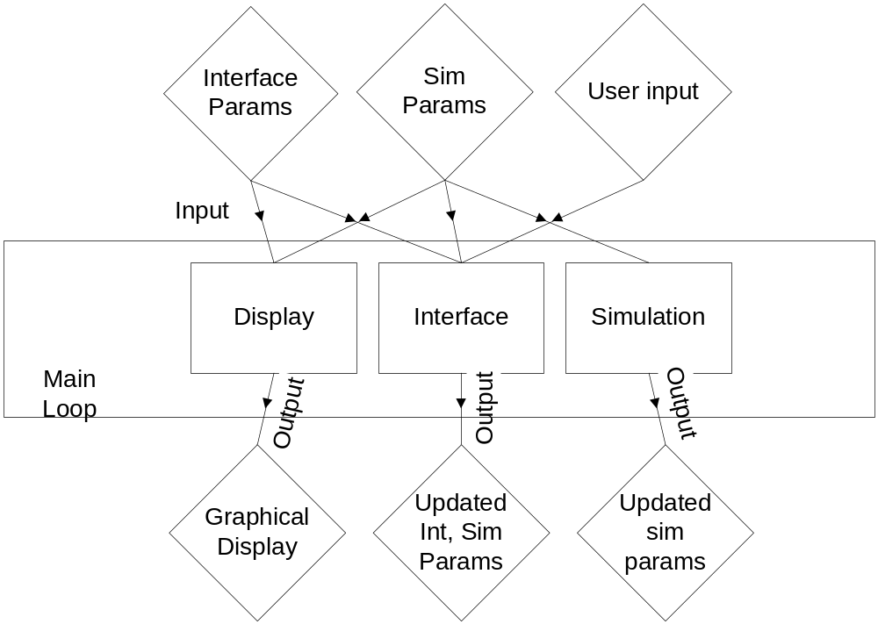
Main Engine Overview

Slide 4
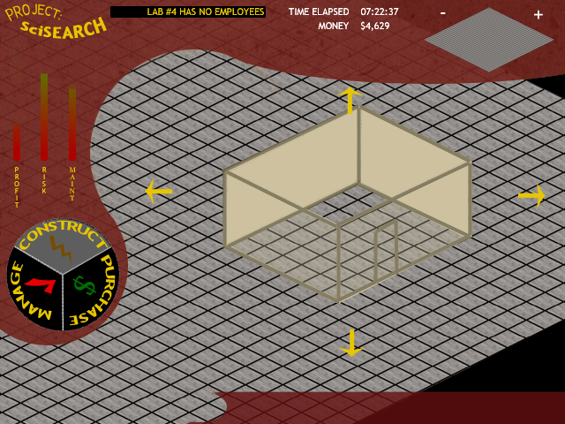
Conceptual GUI

Slide 5
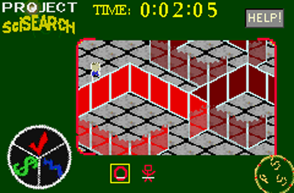
Functional GUI

Slide 6
Module List
Module Name | Module Function | Called By | Calls
Display | Graphical Output | Main Loop | Ground,Object,NPC,Interface
Ground | Draw Ground | Display | None
Object | Draw Objects | Display | None
NPC | Draw NPCs | Display | None
Interface | Draw Interface | Display | None
Interface | Handle Interface Updates | Main Loop | Menus,Modes,Help,Input
Menus | Handle Menu Structure | Input | None
Modes | Handle Modes | Input | None
Help | Handle Help System | Input | None
Input | Handle User Input | Interface | Menus,Modes,Help
Simulation | Handle sim events | Main Loop | Environ, AI
Environ | Handle Environ Cues | Simulation | None
AI | Handle AI responses | Simulation | None

Slide 7
Module List
Module Name | LOC Current | LOC left | Hrs current | Hrs left | % complete | Cost
Display | 2,000 | 0 | 47 | 0 | 100% | $6,000
Ground | 500 | 0 | 25 | 0 | 100% | $1,500
Objects | 700 | 0 | 8 | 0 | 100% | $1,500
NPCs | 300 | 0 | 5 | 0 | 100% | $1,500
Interface | 500 | 0 | 9 | 0 | 100% | $1,500
Interface | 2,000 | 0 | 32 | 0 | 100% | $6,300
Menus | 600 | 0 | 9 | 0 | 100% | $1,500
Modes | 600 | 0 | 8 | 0 | 100% | $1,500
Help | 200 | 0 | 5 | 0 | 100% | $1,500
Input | 600 | 0 | 10 | 0 | 100% | $1,800
Simulation | 500 | 1,000 | 18 | 26 | 41% | $7,700
Environ | 200 | 500 | 10 | 8 | 56% | $3,700
AI | 300 | 500 | 8 | 18 | 31% | $4,000
TOTAL | 4,500 | 1,000 | 97 | 26 | 79% | $20,000

Slide 8
Verification Testing - Display
Test | Input/Action | Expected Output | Results/Comments
Depth sorting | Place new NPCs near (above/below) object walls | New NPCs depth rendering consistent with real-world | Passed.
Scroll updating | Press scroll buttons | Display scrolls in appropriate direction and renders | Passed.
Response time | Measure framerate in emulator | Framerate >= 10fps | Passed.
Screen clearing | Enter and exit help mode | Help graphics clear from background | Passed.
Sprite display | Sprite list for one frame in emulator | Matching sprite display on screen | Passed.

Slide 9
Verification Testing - Interface
Test | Input/Action | Expected Output | Results/Comments
L/R buttons 1 | Press L/R in main mode | Scrolling select through mode types | Passed.
L/R buttons 2 | Press L/R in sim mode | Scrolling through visible object selection | Passed.
B button | Press B button in any mode | Mode is exited if applicable | Passed.
A button 1 | Press A button in main mode | Selected mode is activated | Passed.
A button 2 | Press A button in obj creation mode | Selector appears/obj is created | Passed.
A button 3 | Press A button in obj deletion mode | Selected obj is deleted | Passed.
A button 4 | Press A button in npc creation mode | NPC is created at selected spot | Passed.
A button 5 | Press A button in npc deletion mode | Selected NPC is deleted. | Passed.

Slide 10
Verification Testing - Simulation
Test | Input/Action | Expected Output | Results/Comments
Env. Risk | Inspect Risk for NPCs | Equal to Risk eq. | Pending.
Env. Profit | Inspect Profit for obj | Equal to Profit eq. | Passed.
Env. Maintenance | Inspect Maint. for obj | Equal to Maint. eq. | Passed.
Env. Level | Inspect Level for obj | Equal to Level eq. | Passed.
Env. Money | Inspect Money for sim | Equal to Money eq. | Passed.
Env. Time | Compare to real-world | Accurate to within 5sec/hr | Passed.
AI Disaster | Compare NPC disaster detector | Equal to DD eq. | Pending.
AI Current Work Area | Inspect WA Cycle | NPC follows timed cycle | Pending.
AI Path Finder | Inspect new path | Path conforms to BFS algorithm | Pending.
AI Money | Inspect AI salary | Salary subtracts from global money | Pending.
Sprite overload | Insert overload of Obj/NPC | System reverts to software rendering | Pending.

Slide 11
Progress Review
Gantt Chart

Slide 12
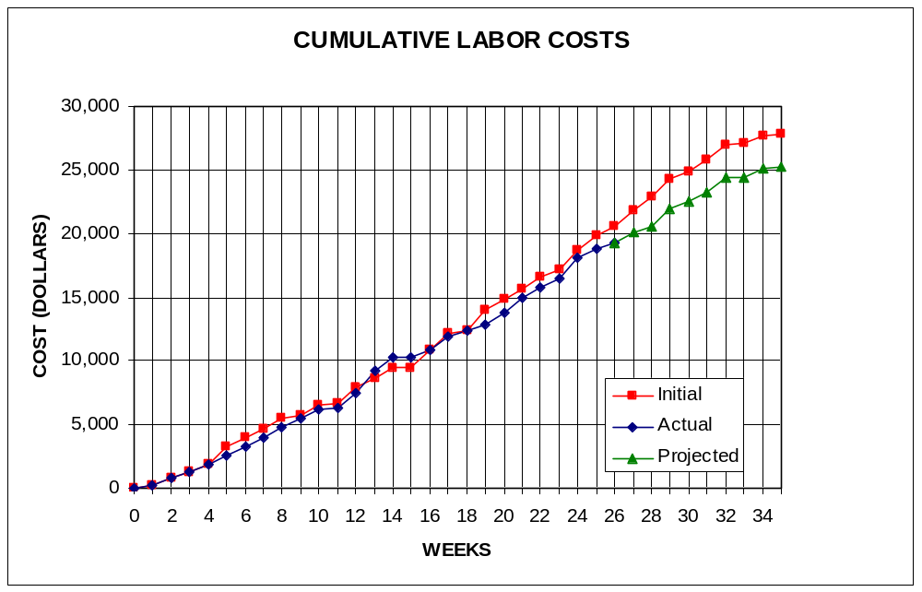
Labor Costs vs. Time

Slide 13
Economic Analysis - Prototype
PERSON | LABOR RATE | INITIAL EST. HRS. | INITIAL EST. COST | CURRENT EST. HRS. | CURRENT EST. COST
COMP. SYSTEMS ANALYST | $45.00 | 150 | $6,750 | 125 | $5,625
COMP. PROGRAMMER | $40.00 | 204 | $8,160 | 226 | $9,040
TEST PROGRAMMER | $35.00 | 104 | $3,640 | 78 | $2,730
TECHNICAL WRITER | $35.00 | 271 | $9,485 | 223 | $7,805
SUBTOTAL |  | 729 | $28,035 | 652 | $25,200
ENGINE @ 70% |  | 510 | $19,625 | 456 | $17,640
GAME @ 30% |  | 219 | $8,411 | 196 | $7,560
TOTAL |  | 729 | $28,035 | 652 | $25,200
DIRECT OVERHEAD @ 100% |  |  | $28,035 |  | $25,200
SUBTOTAL |  |  | $56,070 |  | $50,400
A & G COSTS @ 40% |  |  | $22,428 |  | $20,160
SUBTOTAL |  |  | $78,498 |  | $70,560
PROFIT @ 20% |  |  | $15,700 |  | $14,112
TOTAL COST OF PROTOTYPE |  |  | $94,198 |  | $84,672

Slide 14
Economic Analysis - Profits
COSTS | RATE | HOURS | INITIAL COST/COPY |  | CURRENT COST/COPY
CONSTRUCTION TIME | $20.00 | 0.25 | $0.50 |  | $0.50
SUBTOTAL DIRECT LABOR |  |  | $0.50 |  | $0.50
INDIRECT OVERHEAD @ 100% |  |  | $0.50 |  | $0.50
SUBTOTAL |  |  | $1.00 |  | $1.00
DOCUMENTATION |  |  | $2.00 |  | $2.00
PACKAGING |  |  | $3.00 |  | $3.00
SUBTOTAL |  |  | $6.00 |  | $6.00
A & G @ 40% |  |  | $2.40 |  | $2.40
SUBTOTAL |  |  | $8.40 |  | $8.40
PROFIT @ 20% |  |  | $1.68 |  | $1.68
SUBTOTAL |  |  | $10.08 |  | $10.08

Slide 15
Economic Analysis – Profits
RECOUP COST OF PROTOTYPE | COSTS | UNITS TO SELL
INITIAL | $94,198 | 100,000 | $4.71
CURRENT | $84,672 | 100,000 |  |  | $4.23
RECOUP OVER |  | 20,000
MANUFACTURING COSTS |  |  | $14.79 |  | $14.31
WHOLESALE MARKUP @ 20% |  |  | $2.96 |  | $2.86
SUBTOTAL |  |  | $17.75 |  | $17.18
RETAIL MARKUP @ 50% |  |  | $8.87 |  | $8.59
TOTAL RETAIL COST |  |  | $26.62 |  | $25.76
PROFIT (ON FIRST 20,000) |  |  | $33,600 |  | $33,600
PROFIT (ON THE REST) |  |  | $292,708 |  | $279,418
TOTAL PROFIT |  |  | $326,308 |  | $313,018

Slide 16
Status Matrix - Outline
OUTLINE | INT EST HOURS | CUR EST HRS | WORK TO-DATE HRS | % WORK COMP | TIME TO COMP HRS
DISPLAY | 13 | 13 | 13 | 100 | 0
GROUND | 4 | 4 | 4 | 100 | 0
OBJECTS | 3 | 3 | 3 | 100 | 0
NPC | 3 | 3 | 3 | 100 | 0
INTERFACE | 3 | 3 | 3 | 100 | 0
INTERFACE | 12 | 12 | 12 | 100 | 0
MENUS | 3 | 3 | 3 | 100 | 0
MODES | 3 | 3 | 3 | 100 | 0
HELP | 4 | 4 | 4 | 100 | 0
INPUT | 2 | 2 | 2 | 100 | 0
SIMULATION | 8 | 8 | 8 | 100 | 0
ENVIRON | 4 | 4 | 4 | 100 | 0
AI | 4 | 4 | 4 | 100 | 0
TOTALS | 33 | 33 | 33 | 100 | 0

Slide 17
Status Matrix - Design
DESIGN | INT EST HOURS | CUR EST HRS | WORK TO-DATE HRS | % WORK COMP | TIME TO COMP HRS
DISPLAY | 63 | 47 | 47 | 100 | 0
GROUND | 16 | 12 | 12 | 100 | 0
OBJECTS | 15 | 12 | 12 | 100 | 0
NPC | 17 | 12 | 12 | 100 | 0
INTERFACE | 15 | 11 | 11 | 100 | 0
INTERFACE | 62 | 31 | 31 | 100 | 0
MENUS | 15 | 7 | 7 | 100 | 0
MODES | 16 | 7 | 7 | 100 | 0
HELP | 15 | 7 | 7 | 100 | 0
INPUT | 16 | 10 | 10 | 100 | 0
SIMULATION | 40 | 26 | 26 | 100 | 0
ENVIRON | 20 | 14 | 14 | 100 | 0
AI | 20 | 12 | 12 | 100 | 0
TOTALS | 165 | 104 | 104 | 100 | 0

Slide 18
Status Matrix - Construct
CONSTRUCT | INT EST HOURS | CUR EST HRS | WORK TO-DATE HRS | % WORK COMP | TIME TO COMP HRS
DISPLAY | 56 | 47 | 47 | 100 | 0
GROUND | 15 | 25 | 25 | 100 | 0
OBJECTS | 13 | 8 | 8 | 100 | 0
NPC | 15 | 5 | 5 | 100 | 0
INTERFACE | 13 | 9 | 9 | 100 | 0
INTERFACE | 132 | 32 | 32 | 100 | 0
MENUS | 30 | 9 | 9 | 100 | 0
MODES | 32 | 8 | 8 | 100 | 0
HELP | 30 | 5 | 5 | 100 | 0
INPUT | 40 | 10 | 10 | 100 | 0
SIMULATION | 82 | 44 | 18 | 41 | 26
ENVIRON | 40 | 18 | 10 | 56 | 8
AI | 42 | 26 | 8 | 31 | 18
TOTALS | 270 | 123 | 97 | 79 | 26

Slide 19
Status Matrix - Integrate
INTEGRATE | INT EST HOURS | CUR EST HRS | WORK TO-DATE HRS | % WORK COMP | TIME TO COMP HRS
DISPLAY | 17 | 28 | 27 | 96 | 1
GROUND | 5 | 4 | 4 | 100 | 0
OBJECTS | 4 | 8 | 8 | 100 | 0
NPC | 3 | 4 | 3 | 75 | 1
INTERFACE | 5 | 12 | 12 | 100 | 0
INTERFACE | 16 | 31 | 28 | 90 | 3
MENUS | 4 | 7 | 7 | 100 | 0
MODES | 4 | 8 | 7 | 88 | 1
HELP | 5 | 4 | 4 | 100 | 0
INPUT | 3 | 12 | 10 | 83 | 2
SIMULATION | 10 | 26 | 7 | 27 | 19
ENVIRON | 5 | 12 | 4 | 33 | 8
AI | 5 | 14 | 3 | 21 | 11
TOTALS | 43 | 85 | 62 | 73 | 23

Slide 20
Status Matrix - Test
TEST | INT EST HOURS | CUR EST HRS | WORK TO-DATE HRS | % WORK COMP | TIME TO COMP HRS
DISPLAY | 15 | 40 | 35 | 88 | 5
GROUND | 3 | 11 | 11 | 100 | 0
OBJECTS | 4 | 8 | 6 | 75 | 2
NPC | 3 | 8 | 6 | 75 | 2
INTERFACE | 5 | 13 | 12 | 92 | 1
INTERFACE | 17 | 39 | 32 | 82 | 7
MENUS | 5 | 10 | 8 | 80 | 2
MODES | 4 | 11 | 9 | 82 | 2
HELP | 3 | 6 | 5 | 83 | 1
INPUT | 5 | 12 | 10 | 83 | 2
SIMULATION | 11 | 28 | 9 | 32 | 19
ENVIRON | 6 | 13 | 5 | 38 | 8
AI | 5 | 15 | 4 | 27 | 11
TOTALS | 43 | 107 | 76 | 71 | 31

Slide 21
Status Matrix - Document
DOCUMENT | INT EST HOURS | CUR EST HRS | WORK TO-DATE HRS | % WORK COMP | TIME TO COMP HRS
DISPLAY | 28 | 39 | 38 | 97 | 1
GROUND | 7 | 10 | 10 | 100 | 0
OBJECTS | 7 | 8 | 8 | 100 | 0
NPC | 7 | 9 | 9 | 100 | 0
INTERFACE | 7 | 12 | 11 | 92 | 1
INTERFACE | 36 | 44 | 35 | 80 | 9
MENUS | 8 | 10 | 9 | 90 | 1
MODES | 6 | 12 | 10 | 83 | 2
HELP | 9 | 10 | 6 | 60 | 4
INPUT | 13 | 12 | 10 | 83 | 2
SIMULATION | 27 | 33 | 17 | 52 | 16
ENVIRON | 14 | 15 | 9 | 60 | 6
AI | 13 | 18 | 8 | 44 | 10
TOTALS | 91 | 116 | 90 | 78 | 26

Slide 22
Status Matrix - Total
TOTAL | INT EST HOURS | CUR EST HRS | WORK TO-DATE HRS | % WORK COMP | TIME TO COMP HRS
DISPLAY | 192 | 214 | 207 | 97 | 7
GROUND | 50 | 66 | 66 | 100 | 0
OBJECTS | 46 | 47 | 45 | 96 | 2
NPC | 48 | 41 | 38 | 93 | 3
INTERFACE | 48 | 60 | 58 | 97 | 2
INTERFACE | 275 | 189 | 170 | 90 | 19
MENUS | 65 | 46 | 43 | 93 | 3
MODES | 65 | 49 | 44 | 90 | 5
HELP | 66 | 36 | 31 | 86 | 5
INPUT | 79 | 58 | 52 | 90 | 6
SIMULATION | 178 | 165 | 85 | 52 | 80
ENVIRON | 89 | 76 | 46 | 61 | 30
AI | 89 | 89 | 39 | 44 | 50
CLASS TIME | 84 | 84 | 63 | 75 | 21
GRAND TOTAL | 729 | 652 | 525 | 81 | 127

Slide 23
Project: SciSearch
Demonstration

